Slide 1




Data Science Student Championship 2024
SHUBHAM AGGARWAL
3rd Year Mechanical Student

Slide 2
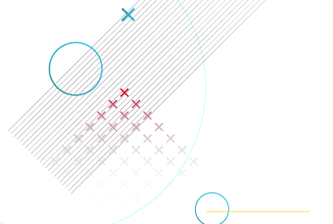
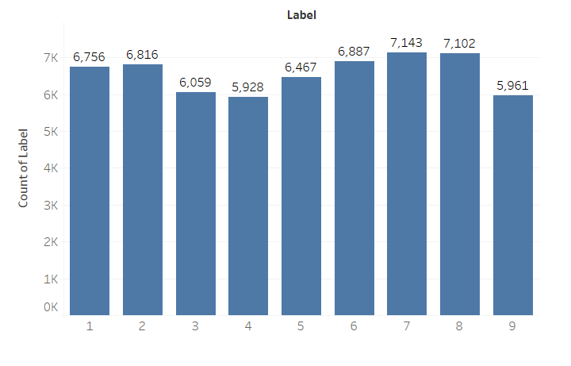
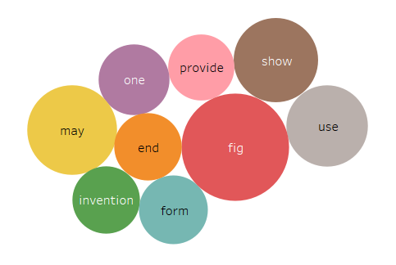
Data Understanding
Training Data : 59119 Labels
Test Data : 25337 Labels
There are 9 different classes
There is no big imbalance in the classes of the training dataset
Average Sentence length is 250 words
Most frequent words in the dataset are fig, show, provide, use, etc
Notes:
Learnings & how their approach can be applied to different use cases

Slide 3

Data Preparation
Normalization
Text Cleaning
Lowercasing
Handling Accents
Whitespace Removal
Stemming
Lemmatization
Removing Stopwords
Removing Numbers
Removing Puntuations
Removing Frequent Words
Tokenization
TensorFlow Vectorizer
Notes:
Learnings & how their approach can be applied to different use cases

Slide 4


Model Building & Evaluation
Machine Learning Models
Couple of models such as Naïve bayes, Support vector machine (SVM), XGBoost classifier were used initially, but none of them were able to cross an Accuracy of around 0.53
Therefore Deep Learning models were used to study this complex data
The Best model worked for me was a combination of CNN and RNN model
Both CNN and RNN model has their own strengths; > CNN captures local patterns using 1D convolutions > RNN(LSTM) excels at capturing long-range temporal dependencies across the entire sequence.
Various hyperparameters were tuned and the following gave the best results Max Vocabulary size =9000 LSTM units (M) = 100 Dimensionality (D)= 400 Learning rate =0.001 Batch size =128 Epochs = 2
35% of the training dataset is used as validation set
Training set accuracy: 63.18% Validation set accuracy:57.72%
Naïve Bayes
Support Vector Machine
XGBoost Classifier
Deep Learning Models
CNN (56.74%)
RNN-LSTM (56.85%)
Notes:
Learnings & how their approach can be applied to different use cases

Slide 5
Model Building & Evaluation
CNN Layers
LSTM Layers
x = Embedding(V + 1, D)(i)
x = Conv1D(128, 3, activation='relu')(x)
x = GlobalMaxPooling1D()(x)
x = Embedding(V + 1, D)(i)
x = LSTM(M, return_sequences=True)(x)
x = GlobalMaxPooling1D()(x)
Concatenate
x = Dense(9, activation='softmax')
Notes:
Learnings & how their approach can be applied to different use cases

Slide 6
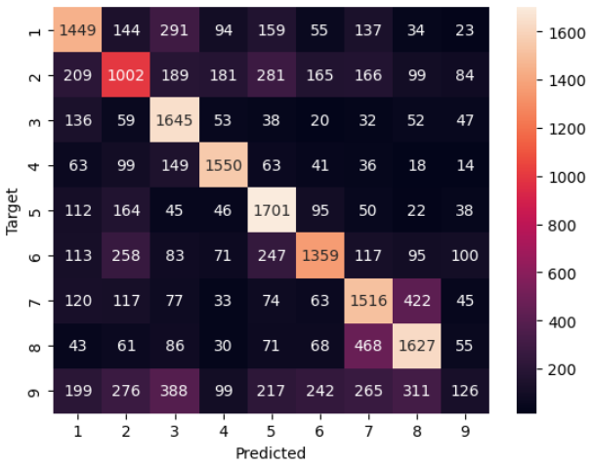
Results and Recommendations
Deep Learning Models
CNN (56.74%)
RNN-LSTM (56.85%)
Combined (57.72%)
The results demonstrated that the ensemble model significantly outperformed individual CNN and RNN models, signifying the benefit of combining their capabilities.
CNN Accuracy => 56.74% LSTM Accuracy => 56.85% Combined => 57.72%
Using the confusion matrix following insights are made: > Model has a good accuracy in predicting labels 1 to 6 > Model has trouble in predicting label 9 (General tagging of new or cross-sectional technology) > Model often confuses with prediction of label 7(Physics) and 8(Electricity)
Notes:
Learnings & how their approach can be applied to different use cases

Slide 7
Recommendations
Based on the results my recommendation of deployment is :
Integration of model with existing patent search system
Since the model has good accuracy in predicting labels 1 to 6, we can utilize that strength and improve the existing system.
Furthermore with more dataset model can be trained to accurately differentiate label 7 and 8 , which will make the model more robust.
Note that to ensure the model's continued effectiveness, it needs to be regularly update it with new patent data, allowing it to adapt to evolving trends and technologies.
Notes:
Learnings & how their approach can be applied to different use cases

Slide 8
Recommendations
This model can offer significant benefits for various stakeholders in the patent ecosystem, leading to improved efficiency, cost savings, and better decision-making
Increased Accuracy: With the improved accuracy of classification process, users can save their valuable time and reduce the risk of missing important patents
Innovation Opportunities: It will help to analyze classified patents and discover gaps in existing technologies to identify potential areas for new inventions
Faster Search: With reduced time spent searching for relevant patents, research and development process can be accelerated
Notes:
Learnings & how their approach can be applied to different use cases

Slide 9
Thank You
Notes:
Learnings & how their approach can be applied to different use cases

