Slide 1
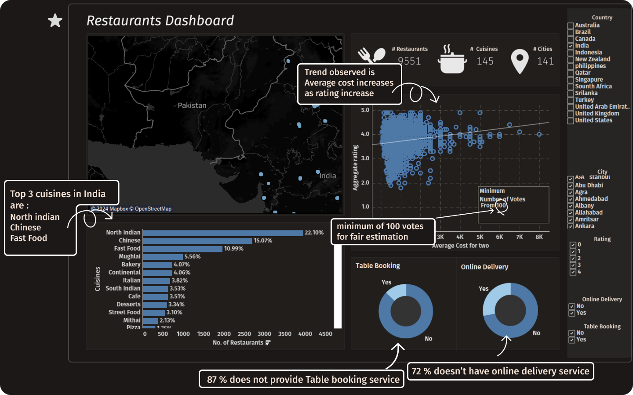

Slide 2
Data Vizzez 2.0
Go-To-Market (GTM) Strategy
Problem
Statement
Distribution channels and Differentiators
Marketing and SWOT Analysis
Predictive Model
What are the current trends of cuisine in India?
What specific market gap does our proposed restaurant address?
Our Solution?
What are the key components of our Go-To-Market (GTM) strategy, including pricing, and distribution?
How does our restaurant differentiate itself from competitors offering similar cuisines?
What are the SWOT Analysis for our restaurant concept in comparison to competitors
How can we enhance brand visibility and expand audience reach?
What are the plans for expansion beyond the initial launch?
How can we utilize a machine learning model trained on given dataset to generate insights into the potential success of restaurants?
01
02
03
04
Overview

Slide 3
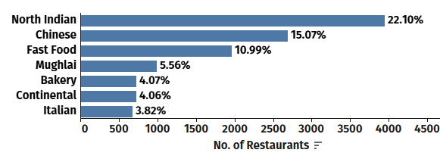
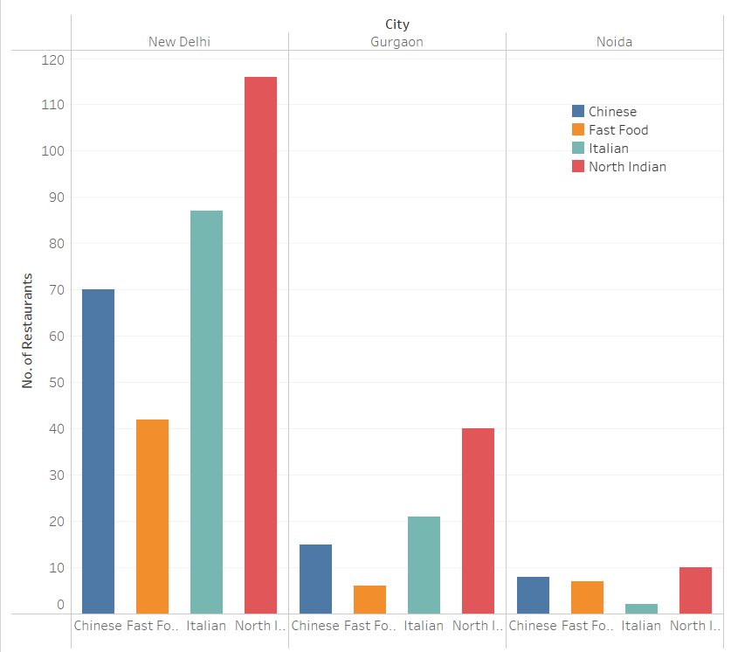
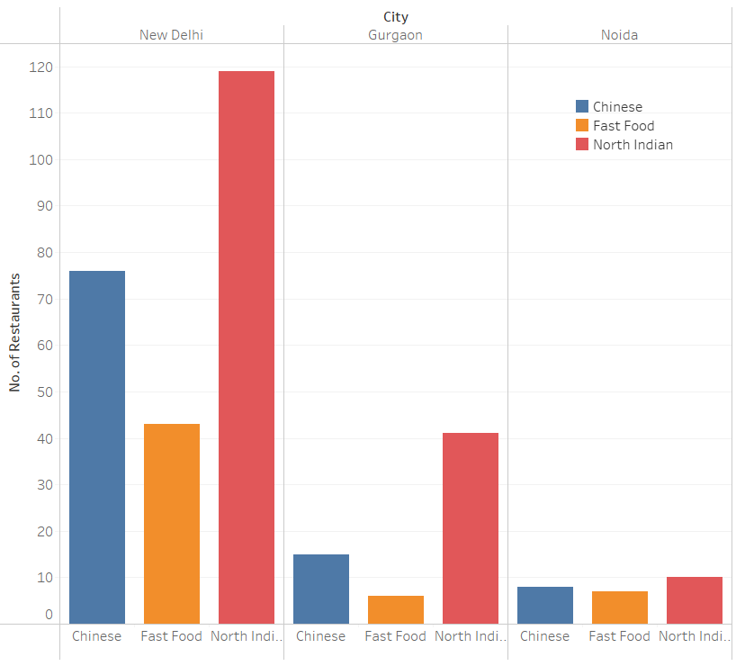
01
What are the current trends of cuisine in India?
North Indian, Chinese, fast food, Mughlai, bakery, continental, and Italian cuisines are among the top 7 in India, based on the number of restaurants
What specific market gap does our proposed restaurant address?
While there is a saturation of well-established north Indian restaurants, the demand for quality fast food appears to be less pronounced
Notible, highly rated Chinese and Italian dining options are absent, indicating a significant market gap for these quality cuisines
01
Problem Statement

Slide 4
Our Solution
01
Median Votes
In Noida, despite customers preferring Italian and Chinese restaurants, there are fewer establishments available.
Conversely, in New Delhi, where there is a good number of Italian and Chinese restaurants, there remains a strong demand for these cuisines.
Good quality Thai cuisine is also well-received in Indian cities. Moreover, Thai cuisine shares common ingredients and cooking techniques with Chinese cuisine, allowing restaurants to manage resources and kitchen capabilities
 | New Delhi | Gurgaon | Noida | Others
Chinese | 381 | 259 | 356 | 345
Italian | 496 | 242 | 429 | 411
Thai | 281.5 | 208 | 275 | 302
Assuming median have a direct relationship with the customer response to the restaurant.
01
Considering the demand and availability of good restaurants, we have decided to establish a
multi-cuisine restaurant offering:
Chinese, Italian, and Thai cuisine.
Solution

Slide 5
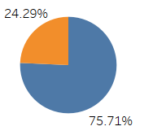
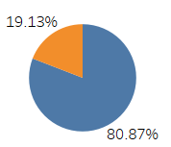
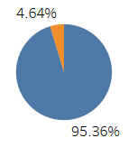
02
What are the key components of our Go-To-Market (GTM) strategy
Yes
No
For our restaurant, we will be serving top Chinese cuisines such as Manchurian, Hakka noodles, dim sum, chilli chicken, and Schezwan fried rice.
Additionally, our Italian cuisine offerings will include pizza Margherita, pasta carbonara, lasagna, and tiramisu, which are popular favorites in India.
For Thai cuisine, we will be serving food items that resemble Chinese menu items, such as Thai green curry, pad Thai noodles, tom yum soup, and mango sticky rice.
In the current market, there is a relatively low number of restaurants providing online delivery for these cuisines
Our multi-cuisine restaurant can capitalize on this underutilized space to reach a broader audience seeking diverse culinary options
Chinese
Italian
Has Online Delivery
By considering the median cost of competitors, along with affordability and profitability factors, we have decided to set the average cost for two at our restaurant to be ₹1400.
Thai
01

Slide 6
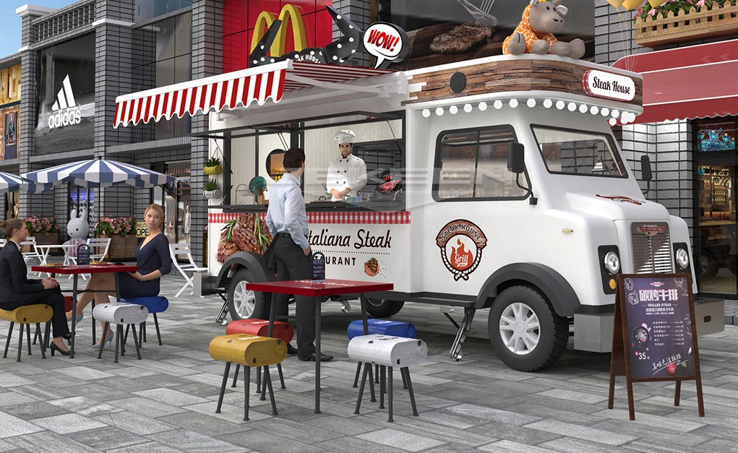
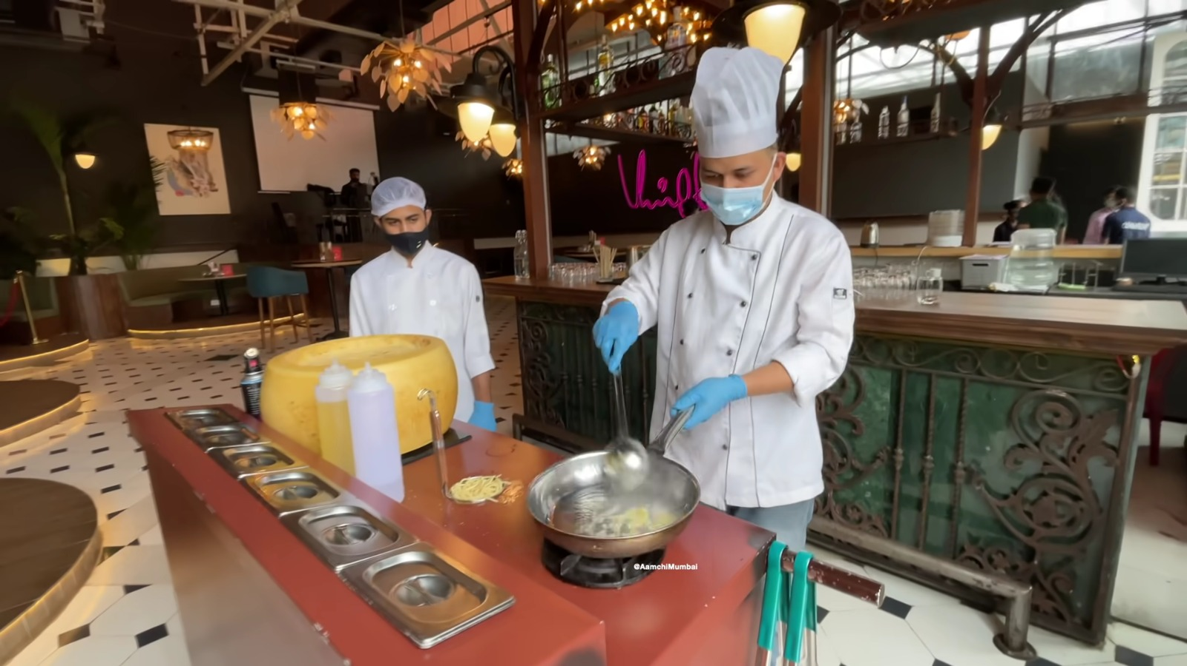
03
How does our restaurant differentiate itself from competitors offering similar cuisines?
02
01
Italo-Chinese Fusion Menu: Unique fusion of Chinese and Italian cuisines, featuring innovative dishes like Chinese-style noodles with Italian sauces and fusion dumplings.
Regional Flavored Menus: Tailored menus highlighting regional specialties such as "India Flavored Menu" offering dishes from various Indian regions.
Best of Three Cuisines Under One Roof: Providing top-quality Chinese, Italian, and Thai dishes in a single establishment, ensuring diverse options for all tastes.
Food Truck Pop-ups at Popular Events: Participating in food truck pop-ups at events to showcase signature dishes and reach a broader audience outside the restaurant setting.
Live Kitchen Experience: Enjoy an interactive dining experience where our skilled chefs prepare selected dishes right in front of customers, allowing customers to witness the culinary artistry and freshness of our ingredients firsthand.
01
Differentiators

Slide 7
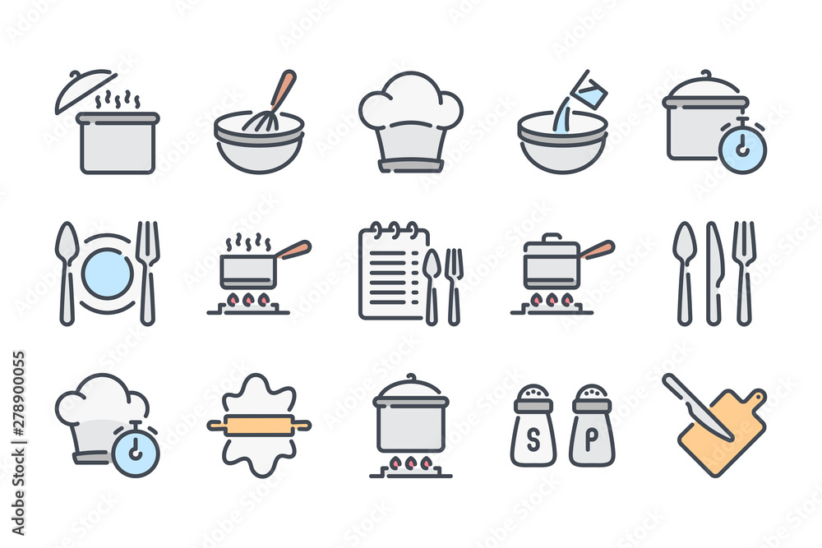
SWOT Analysis of Our Multi-Cuisine
03
Problem Statement
Strengths
Weaknesses
Diverse menu offering Chinese, Italian, and Thai cuisines, catering to varied tastes and preferences.
Unique fusion dishes combining flavors from different culinary traditions.
High-quality ingredients sourced for authentic and flavorful dishes.
Strategic location in key urban areas (Delhi, Gurugram, Noida) with high foot traffic.
Initial brand awareness and market penetration in the competitive restaurant landscape.
Operational challenges in managing multiple cuisines and ensuring consistent quality across diverse menu items.
Limited customer loyalty and repeat business in the early stages of establishment.
Opportunities
Threats
Leveraging the growing demand for diverse and authentic cuisines in metropolitan cities.
Expanding online delivery services to reach a broader customer base.
Introducing unique dining experiences or themed events to attract and retain customers.
Intense competition from established restaurants offering similar cuisines.
Fluctuating food costs and supply chain disruptions affecting ingredient availability.
01
SWOT Analysis

Slide 8
03
Expansion and future scope
03
01
Digital Marketing and Online Presence: Use digital strategies to boost brand awareness. Engage on platforms like Instagram, Facebook, and Twitter with compelling content and exclusive offers.
Content Marketing and Blogging: Create engaging posts, articles, and videos about food and culinary tips. Drive organic traffic, improve SEO, and establish industry leadership.
Customer Loyalty Programs: Implement programs to increase retention. Offer discounts, coupons, and personalized promotions to reward and retain loyal customers. Strengthen relationships for long-term loyalty.
Considering the availability and demand for cuisine in specific cities, our primary focus will be on Noida, followed by New Delhi and Gurugram.
Our decision has been validated by insights from our machine learning model, confirming the optimal market prioritization based on data analysis."
01
Marketing

Slide 9
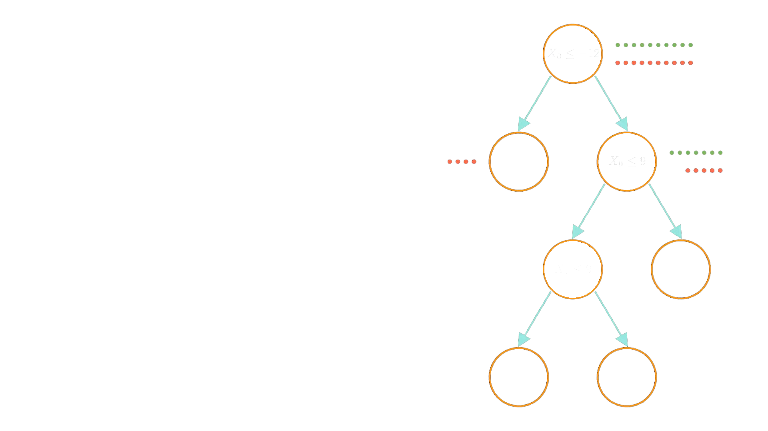
Prediction Model
XGBoost Model for Restaurant Success Prediction
XGBoost Model: We've employed a powerful XGBoost decision tree model to analyze restaurant data and predict the success of our restaurant
Data-Driven Insights: This model considers factors like location, cuisine type, rating, votes, and competition to predict success.
High Success Probability: Based on this analysis, our model predicts an 83.5% chance of success for our new restaurant.
This valuable insight helps us to make informed decisions regarding location, target market, and overall strategy.
01
Prediction Model
Model:
https://colab.research.google.com/drive/1wMd58axfr0raipTUa9e1pbfynSLR7uIG?usp=sharing

