Slide 1






01
PROBLEM CONTEXT
When an inverter fails or underperforms:
Energy Loss
Reduced PR
High Maint. Cost
Revenue Impact
OUR SOLUTION
AI-Driven
Predicts inverter failure or degradation risk 7–10 days in advance
Solar Inverter
Failure Prediction
ML models trained on inverter telemetry (power, temperature, voltage)
Natural language explanations via Generative AI (RAG-powered)
Empowers operators to act proactively — before energy loss occurs
& Intelligence Platform
HOW IT WORKS
Introduction
Predicting inverter risk
7–10 days before impact.
›
›
›
Telemetry
Data
ML Risk
Prediction
GenAI
Explanation
Operator
Action
Goal: Transform solar plant monitoring from reactive troubleshooting to proactive, intelligent maintenance.

Slide 2



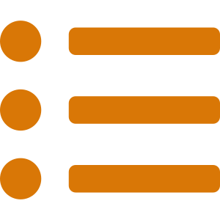



Our Proposed Approach
04
END-TO-END
Telemetry
Data
›
Feature
Engineering
›
LightGBM
Prediction
›
Factor
Explanation
›
FastAPI
Serving
›
Streamlit
Dashboard
Telemetry Processing
Feature Engineering
LightGBM Risk Prediction
SHAP Factor Explanation
Raw power, temperature, voltage & behavioral data preprocessed into clean inverter-level structured inputs.
Power stats, temperature trends, daily variation patterns and performance deviation indicators engineered from raw data.
Classifies each inverter as high-risk or low-risk. Fast, accurate, and optimized for structured tabular plant data.
Returns top contributing factors per inverter: power variation, temperature signals, and operating trend anomalies.
↳ Focuses model on meaningful operational signals, not raw noise.
↳ Exposes subtle pre-failure behavioral shifts before visible breakdown.
↳ Practical prediction engine — accurate and lightweight for deployment.
↳ Trustworthy and actionable — not a black-box model.
FastAPI Backend
Streamlit Dashboard
RAG Assistance Layer
REST endpoints: /health · /predict · /qa — with Pydantic validation, clean error handling and modular structure.
12 inverter cards with green/red risk indicators, detailed drill-down views and an integrated chatbot panel.
Retrieval-based QA chat layer for operators to query inverter condition and understand system outputs naturally.
↳ Scalable, easy to integrate, and ready for frontend connection.
↳ Converts model output into a usable plant-operator interface.
↳ Makes technical outputs accessible for non-technical plant staff.
Our approach does not stop at prediction — it delivers prediction, explanation, deployment, and usability in one complete system.

Slide 3




Why Choose Our Solution?
05
AI-POWERED
THE
ADVANTAGE
01
02
03
7–10 day window
No black boxes
RAG-powered
Predictive vs Reactive
Explainable AI Insights
GenAI Operations Assistant
7–10 Day Prediction Window
Not reactive — proactive
Forecasts shutdown or performance degradation 7–10 days ahead — enabling proactive intervention before energy loss.
LightGBM risk scores paired with SHAP factor analysis reveal exactly why each inverter is flagged as high-risk.
RAG-powered chatbot translates technical telemetry into plain-language root causes and maintenance recommendations.
Explainable AI (SHAP)
Operators trust decisions
04
05
06
RAG-Powered Chatbot
Plain-language guidance
REST-ready
12 inverter cards
↑ Energy yield
Production FastAPI Stack
Scalable Architecture
Deep Data Intelligence
Reduced Downtime & Higher Yield
Deploy-ready architecture
FastAPI backend with Pydantic validation, containerization-ready ML services and clean REST endpoint structure.
Merges telemetry signals, engineered KPIs, and anomaly patterns to surface insights invisible to traditional monitoring.
Early failure detection boosts plant uptime and performance ratio — turning operational intelligence into revenue.
12 Inverter Dashboard
Operator-friendly UI
Our solution transforms solar plant monitoring from reactive troubleshooting to proactive, AI-driven operational intelligence.

Slide 4
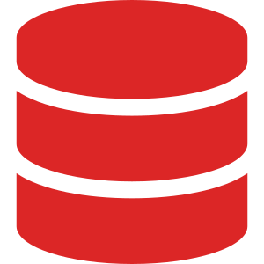





Limitations of Our Solution
06
KNOWN CONSTRAINTS
Understanding where the system has boundaries helps set the right expectations for deployment and use.
Data Quality Dependency
01
Generalization Has Limits
02
Risk Indication, Not Fault Confirmation
03
Noisy, incomplete, or inconsistent telemetry directly reduces prediction reliability and risk estimation accuracy.
Trained on available inverter behavior. Different plant configurations or climates may require retraining or recalibration.
High-risk output signals early warning behavior — it does not guarantee an immediate confirmed physical failure.
⚠ Poor-quality input weakens risk estimation.
⚠ May underperform on unseen plant conditions without adaptation.
⚠ Use as decision-support, not a replacement for inspection.
Explainability Bounded by Features
04
Prototype-Oriented Build
05
Chatbot Context Dependency
06
Predictions are explained using engineered features. Variables absent from telemetry cannot be reflected in explanations.
Production deployment still requires large-scale testing, live pipelines, security hardening, and continuous retraining.
Assistance quality depends on backend responses and retrieved context accuracy. Not suitable as a sole decision source.
⚠ The model explains only what it has learned from available data.
⚠ Demonstrates feasibility — not yet full industrial deployment readiness.
⚠ Supports interpretation — not a primary source for critical decisions.
Our solution is powerful as an early risk intelligence system, but its effectiveness depends on reliable data, plant-specific adaptation, and real-world deployment refinement.

