Slide 1
DEPARTMENT OF COMPUTER SCIENCE AND ENGINEERING,
DELHI TECHNOLOGICAL UNIVERSITY
Coordinator:-
Dr. Anil Singh Parihar

Slide 2
ABOUT ME
Ayush Chopra
3rd Computer Engineering, DTU
Experience:-
Assistant Instructor ML, Coding Blocks
Visiting Researcher, Computer Vision, CVML-IIIT-D
Technical Consultant, Cyclops USA
More:- www.ayushchopra.me

Slide 3
CLASS CODE SOURCE
github.com/ayushchopra96/MLCOE

Slide 4
INTRODUCTION TO MACHINE INTELLIGENCE

Slide 5
CONTENTS OF THE COURSE
Bucket 1:-
Introduction to Machine Learning Concepts
Hands on with Python
Statistical Computation
Bucket 2:-
Intro to Supervised Learning
K-Nearest Neighbors
K-Means Clustering

Slide 6
CONTENTS OF THE COURSE(2)
Bucket 3
Concept of Feature Vector Spaces
Principal Component Analysis
Bucket 4
Concepts of Ensemble Methods
Decision Trees
Random Forests

Slide 7
CONTENTS OF THE COURSE(3)
Bucket 5
Regression vs Classification
Linear Regression
Logistic Regression
Linear vs Non-Linear Decision Boundary

Slide 8
CONTENTS OF THE COURSE(6)
Bucket 6
Introduction to Deep Learning
Intuition for Neural Networks
Logistic Regression as Neural Net
Manifolds
Backpropogation

Slide 9
CONTENTS OF THE COURSE(7)
Bucket 7
Multi-Layer Perceptrons
Building Neural Networks in Python
Convolutions
Convolutional Neural Networks

Slide 10
CONTENTS OF THE COURSE(8)
Bucket 8
Overfitting
Mitigation Strategies for Overfitting
Additional :- Other Topics to be covered

Slide 11
MACHINE INTELLIGENCE

Slide 12
WHAT IS IT
Machine learning is a subfield of artificial intelligence (AI) concerned with algorithms that allow computers to learn. What this means, in most cases, is that an algorithm is given a set of data and infers information about the properties of the data—and that information allows it to make predictions about other data that it might see in the future

Slide 13
WHY THE HYPE
Every minute up to 300 hours of video are uploaded to YouTube.
Average of 31.25 million messages and view 2.77 million videos every minute on Facebook.
More data has been created in the past two years than in the entire previous history of the human race.
At the moment less than 0.5% of all data is ever analyzed and used, just imagine the potential here.

Slide 14
THE INDUSTRY IS USING IT..
Google Page Ranking.
Netflix Suggestions.
Tinder, for you to “chill”
Tesla Self Driving Cars.

Slide 15
THE POTENTIAL:
FEW INTERESTING APPLICATIONS

Slide 16

Demystifying Prisma: Neural Art

Slide 17
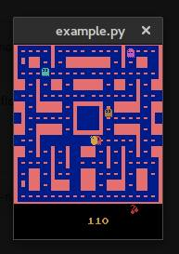
Pacman Champ: The Gamer

Slide 18
The Mathematical Mozart

Slide 19
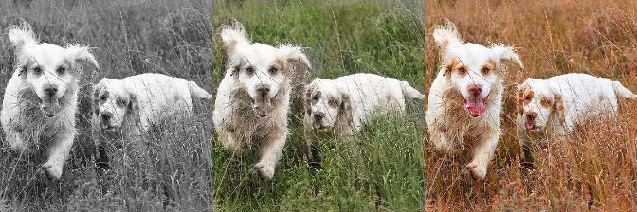

Colorizing the World:

Slide 20
DEVELOPER CHECKLIST
PROGRAMMING INTERFACE AND IDE
Python 2.7, Jupyter-Notebooks, iPython
SCIENTIFIC COMPUTATION
Pandas, Numpy, Scipy
DATA PROCESSING AND VISUALISATION
OpenCV, Matplotlib

Slide 21
DEVELOPER CHECKLIST
MACHINE LEARNING IMPLEMENTATION
ScikitLearn
DEEP LEARNING IMPLEMENTATION
Keras, TensorFlow
AND .............

Slide 22
PATIENCE
and
OPTIMISM !!!

Slide 23
MATHEMATICAL BACKGROUND RESOURCES
Linear Algebra
MIT OCW :- Prof. Gilbert Strang
Probability and Statistics Background
Introduction to Statistical Learning
Elements of Statistical Learning

Slide 24
INTRODUCTION TO PYTHON
and
SCIENTIFIC COMPUTATION

