Slide 1
Stock Analysis
David Guerro
Shubham Jaiswal

Slide 2
Introduction
This Project has three part
1. Extracting Data from the Yahoo Stocks
2. Running the Linear Regression algorithm on the stocks
3. End Result

Slide 3
. Extracting Data from the Yahoo Stocks
1. Creating the Data Generator
 | Date | Open | High | Low | Close
0 | 1970-01-02 | 0.30627 | 0.30627 | 0.30627 | 0.30627
1 | 1970-01-05 | 0.30627 | 0.31768 | 0.30627 | 0.31385
2 | 1970-01-06 | 0.31385 | 0.31385 | 0.30996 | 0.30996
3 | 1970-01-07 | 0.31385 | 0.31385 | 0.31385 | 0.31385
4 | 1970-01-08 | 0.31385 | 0.31768 | 0.31385 | 0.31385

Slide 4
Running the Linear Regression algorithm on the stocks
Trading algorithms are an efficient method of automating transactions and computing technical analysis of financial stock data within a time series. The purpose of Trading Wiz is to implement a Machine Learning (ML) trading algorithm that trains and tests a probabilistic mathematical model using historical stock data for a one year period (253 trading days).

Slide 5
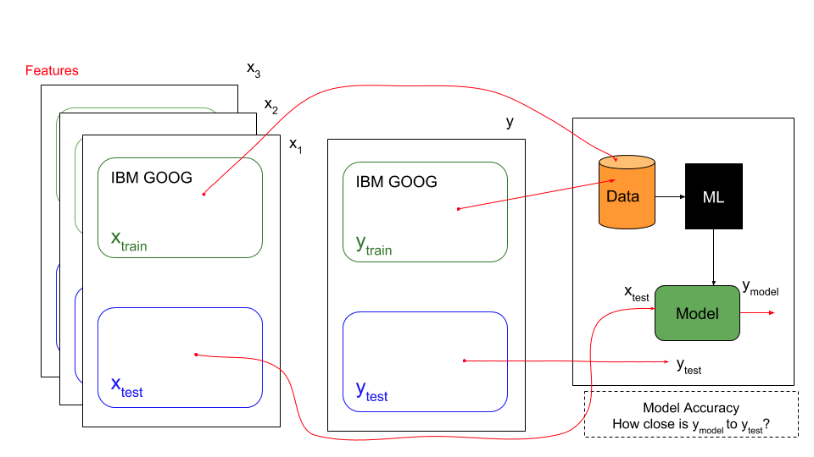

Slide 6
The overall application takes a set of historical stock data xtrain and ytrain ,runs it through a Linear Regression ML algorithm, this will generate a model. Variable xtrain is a multi-dimensional representation of different features of certain ticker symbols (AAPL, GOOG, AMZN). These features can be price change, momentum, or bollinger bands EXPLAIN THESE BELOW. ytrain is a set of stock price data for a given point of time.
The accuracy of the model can be tested by inputting a set of xtest data that produces a ymodel. The closer this ymodel is to ytest the more accurate the model is. The data being used is based on linear time. The older data is utilized to train and generate a model, the more recent data is used to test the model.

