Slide 1
Smart-Pdf the ultimate free pdf editor
Harika | Pretty | Shubham | Sai Nikhila | Venkat

Slide 2

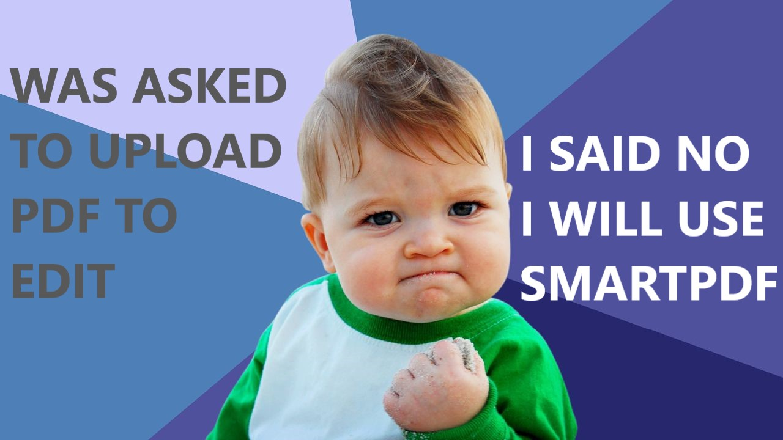
Pdf tools?
Costly (or) limited functionality
Compromise on security

Slide 3
Features
Merge multiple pdf/doc with all/selected page to one pdf-file
Convert all/selected page from pdf/doc to pdf file
Add watermark to a pdf/doc file and store it as pdf-file
Insert all/selected pages from doc/pdf into pdf file

