Slide 1
Chapter 4: Threads

Slide 2
Chapter 4: Threads
Overview
Multicore Programming
Multithreading Models
Thread Libraries
Implicit Threading
Threading Issues
Operating System Examples

Slide 3
Objectives
To introduce the notion of a thread—a fundamental unit of CPU utilization that forms the basis of multithreaded computer systems
To discuss the APIs for the Pthreads, Windows, and Java thread libraries
To explore several strategies that provide implicit threading
To examine issues related to multithreaded programming
To cover operating system support for threads in Windows and Linux

Slide 4
Motivation
Most modern applications are multithreaded
Threads run within application
Multiple tasks with the application can be implemented by separate threads
  Update display
  Fetch data
  Spell checking
  Answer a network request
Process creation is heavy-weight while thread creation is light-weight
Can simplify code, increase efficiency
Kernels are generally multithreaded

Slide 5

Multithreaded Server Architecture

Slide 6
Benefits
Responsiveness – may allow continued execution if part of process is blocked, especially important for user interfaces
Resource Sharing – threads share resources of process, easier than shared memory or message passing
Economy – cheaper than process creation, thread switching lower overhead than context switching
Scalability – process can take advantage of multiprocessor architectures

Slide 7
Multicore Programming
Multicore or multiprocessor systems putting pressure on programmers, challenges include:
  Dividing activities
  Balance
  Data splitting
  Data dependency
  Testing and debugging
Parallelism implies a system can perform more than one task simultaneously
Concurrency supports more than one task making progress
  Single processor / core, scheduler providing concurrency

Slide 8
Multicore Programming (Cont.)
Types of parallelism
  Data parallelism – distributes subsets of the same data across multiple cores, same operation on each
  Task parallelism – distributing threads across cores, each thread performing unique operation
As # of threads grows, so does architectural support for threading
  CPUs have cores as well as hardware threads
  Consider Oracle SPARC T4 with 8 cores, and 8 hardware threads per core

Slide 9


Concurrency vs. Parallelism
Concurrent execution on single-core system:
Parallelism on a multi-core system:

Slide 10

Single and Multithreaded Processes

Slide 11
User Threads and Kernel Threads
User threads - management done by user-level threads library
Three primary thread libraries:
  POSIX Pthreads
  Windows threads
  Java threads
Kernel threads - Supported by the Kernel
Examples – virtually all general purpose operating systems, including:
  Windows
  Solaris
  Linux
  Tru64 UNIX
  Mac OS X

Slide 12
Thread Libraries
Thread library provides programmer with API for creating and managing threads
Two primary ways of implementing
  Library entirely in user space
  Kernel-level library supported by the OS

Slide 13
Pthreads
May be provided either as user-level or kernel-level
A POSIX standard (IEEE 1003.1c) API for thread creation and synchronization
Specification, not implementation
API specifies behavior of the thread library, implementation is up to development of the library
Common in UNIX operating systems (Solaris, Linux, Mac OS X)

Slide 14

Pthreads Example

Slide 15
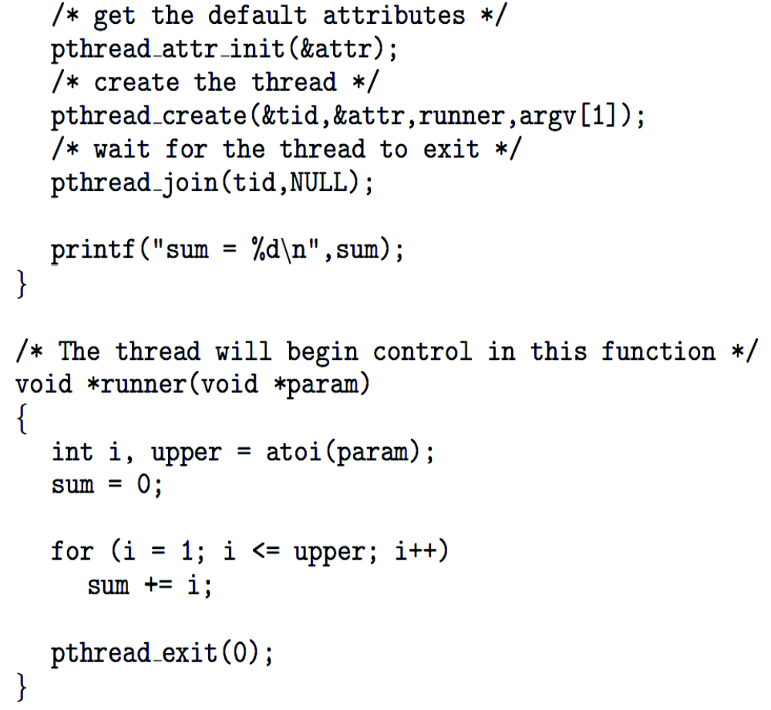
Pthreads Example (Cont.)

Slide 16
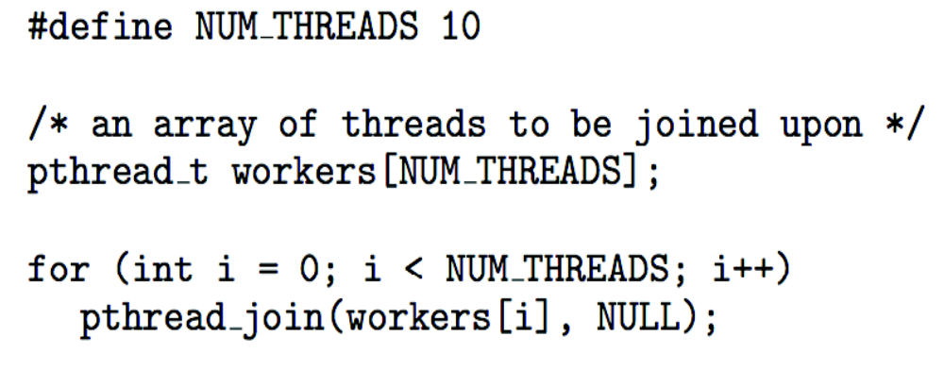
Pthreads Code for Joining 10 Threads

Slide 17
Semantics of fork() and exec()
Does fork()duplicate only the calling thread or all threads?
  Some UNIXes have two versions of fork
exec() usually works as normal – replace the running process including all threads

Slide 18
Signal Handling
Signals are used in UNIX systems to notify a process that a particular event has occurred.
A signal handler is used to process signals
  Signal is generated by particular event
  Signal is delivered to a process
  Signal is handled by one of two signal handlers:
    default
    user-defined
Every signal has default handler that kernel runs when handling signal
  User-defined signal handler can override default
  For single-threaded, signal delivered to process

Slide 19
Signal Handling (Cont.)
Where should a signal be delivered for multi-threaded?
  Deliver the signal to the thread to which the signal applies
  Deliver the signal to every thread in the process
  Deliver the signal to certain threads in the process
  Assign a specific thread to receive all signals for the process

Slide 20

Thread Cancellation
Terminating a thread before it has finished
Thread to be canceled is target thread
Two general approaches:
  Asynchronous cancellation terminates the target thread immediately
  Deferred cancellation allows the target thread to periodically check if it should be cancelled
Pthread code to create and cancel a thread:

Slide 21

Thread Cancellation (Cont.)
Invoking thread cancellation requests cancellation, but actual cancellation depends on thread state
If thread has cancellation disabled, cancellation remains pending until thread enables it
Default type is deferred
  Cancellation only occurs when thread reaches cancellation point
    I.e. pthread_testcancel()
    Then cleanup handler is invoked
On Linux systems, thread cancellation is handled through signals

Slide 22
Thread-Local Storage
Thread-local storage (TLS) allows each thread to have its own copy of data
Useful when you do not have control over the thread creation process (i.e., when using a thread pool)
Different from local variables
  Local variables visible only during single function invocation
  TLS visible across function invocations
Similar to static data
  TLS is unique to each thread

Slide 23

Linux Threads
Linux refers to them as tasks rather than threads
Thread creation is done through clone() system call
clone() allows a child task to share the address space of the parent task (process)
  Flags control behavior
struct task_struct points to process data structures (shared or unique)

Slide 24
End of Chapter 4

