Slide 1
Major Project Report on Grocery Store using Django
Project by: Under Guidance of:
Shubham Gupta (18419MCA042) Prof. P.k Mishra

Slide 2
Grocery Store using Django
Introduction And Objective
Problem Description
Technology Used
Functionality
Snapshot
Conclusion
Future Work

Slide 3
Introduction And Objective
The main aims and objectives are:-
To have an efficient grocery ordering system.
To display the available products and their price to the customer.
To design a dynamic, responsive and useful website for users.
To provide feedback facility to the customer.

Slide 4
Problem Description
It is a Grocery Web based E-Com. project which aims at developing a website to ease the process of buying grocery (for customers) and for shopkeepers to manage their business. The website provide the facility of customer login/signup.
The website makes it easier for the customer to view products available in the grocery store.
The customer can add/remove products from the cart. The customer can place his/her order online from anywhere without having to visit the store. The customer can view his/her profile and can update his/her details.
The customer can contact the grocery store for any queries and feedbacks directly from the website.
Overall this website is developed to help store owner to manage their business online and customers to buy products online from anywhere.

Slide 5
Technology Used
Django Framework
Python
HTML
CSS
Bootstrap
JavaScript
Pay Pal Payment Gateway Integration

Slide 6
Functionality
Designing of the Login/Register Page.
Designing of all other essential web pages to perform the desired functionalities properly.
Creation of Portal for Customers as well as the Database Administrator.
Added necessary options to the Portals.
The User can see the products available on the website but cannot buy it without logging in to the website.
No two Categories/Products can have same name.
On Successful Delivery of Order/ Cancellation of Order, all its entries will be deleted from the tables for efficient use of space.

Slide 7
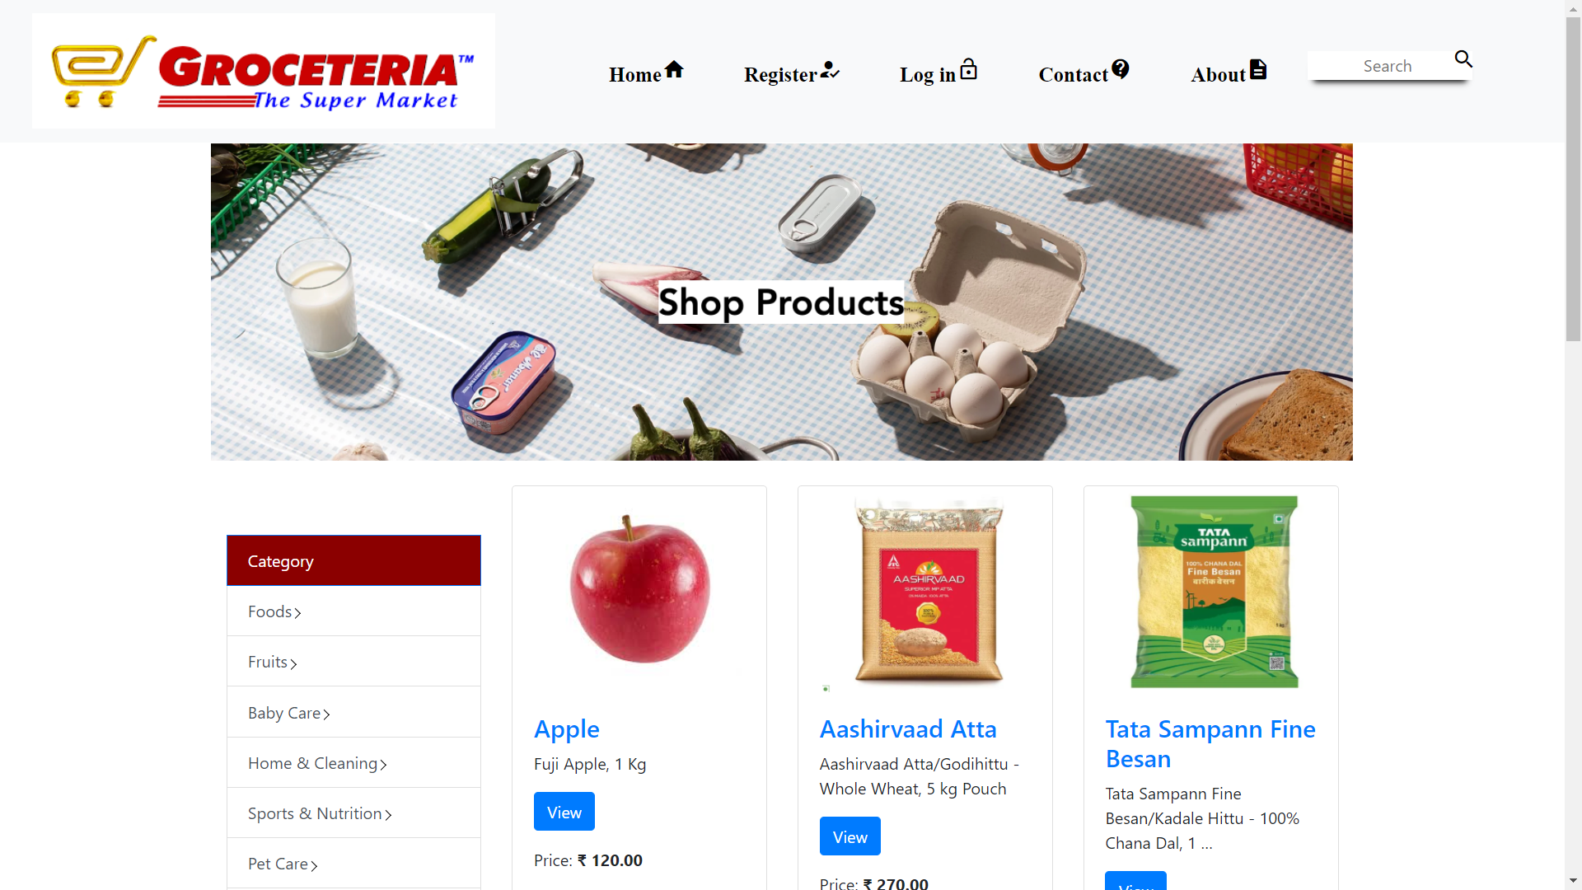
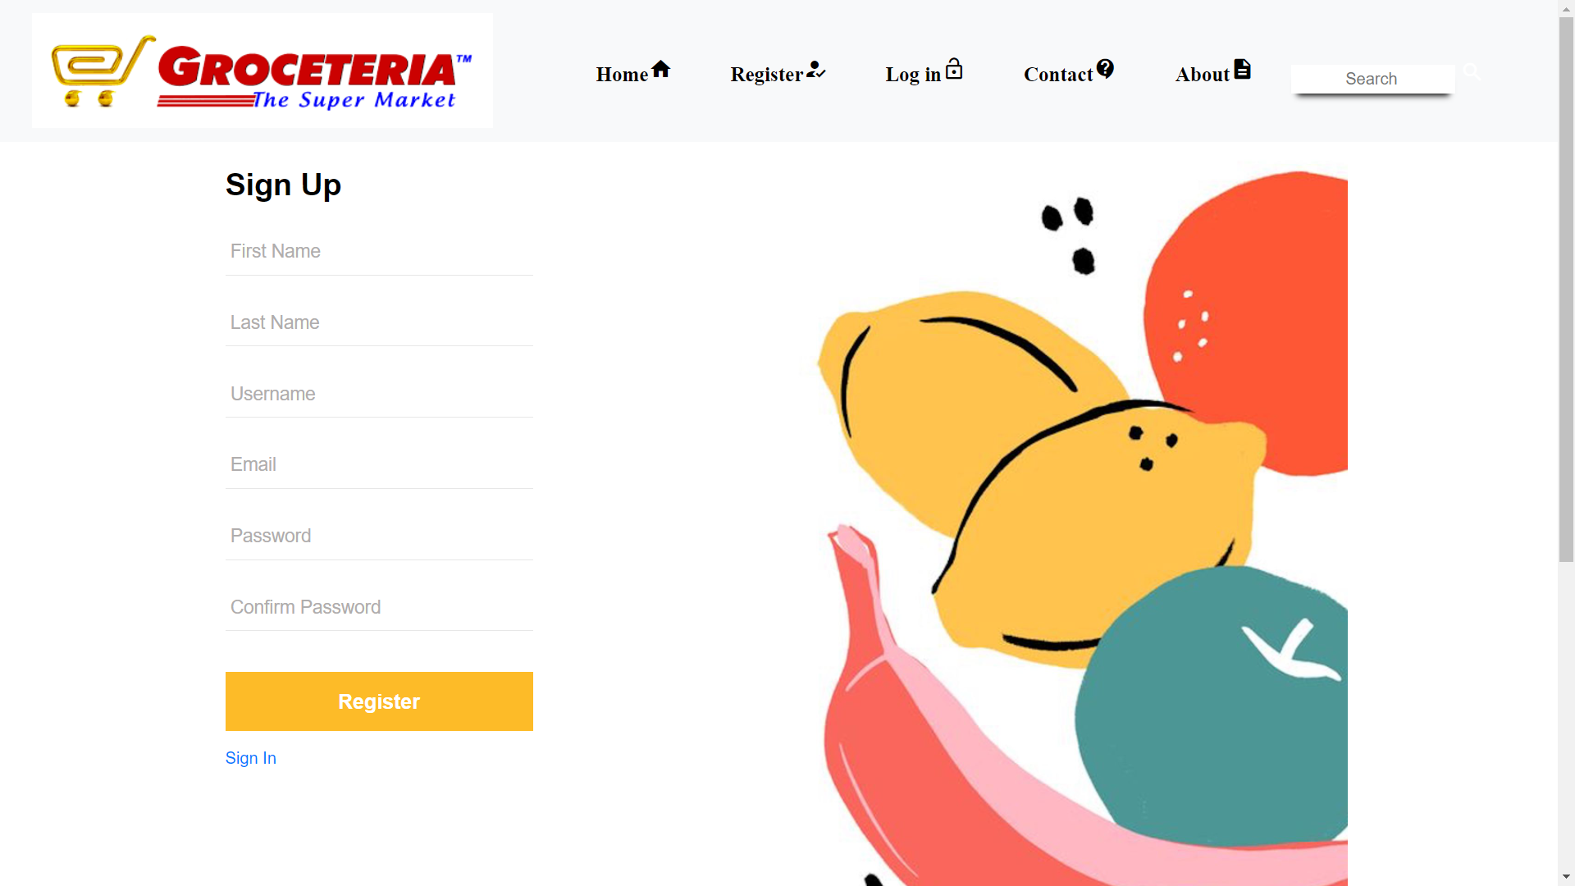
Some Snapshot

Slide 8
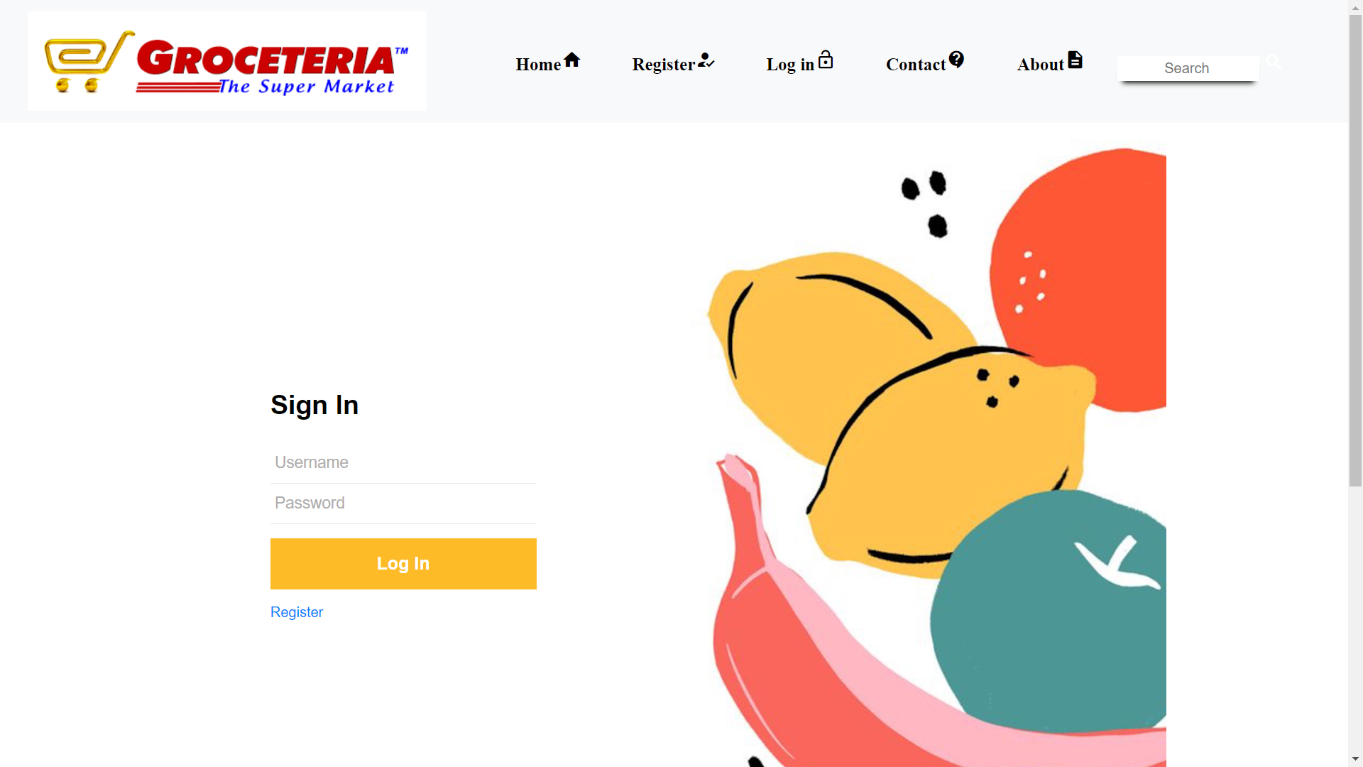
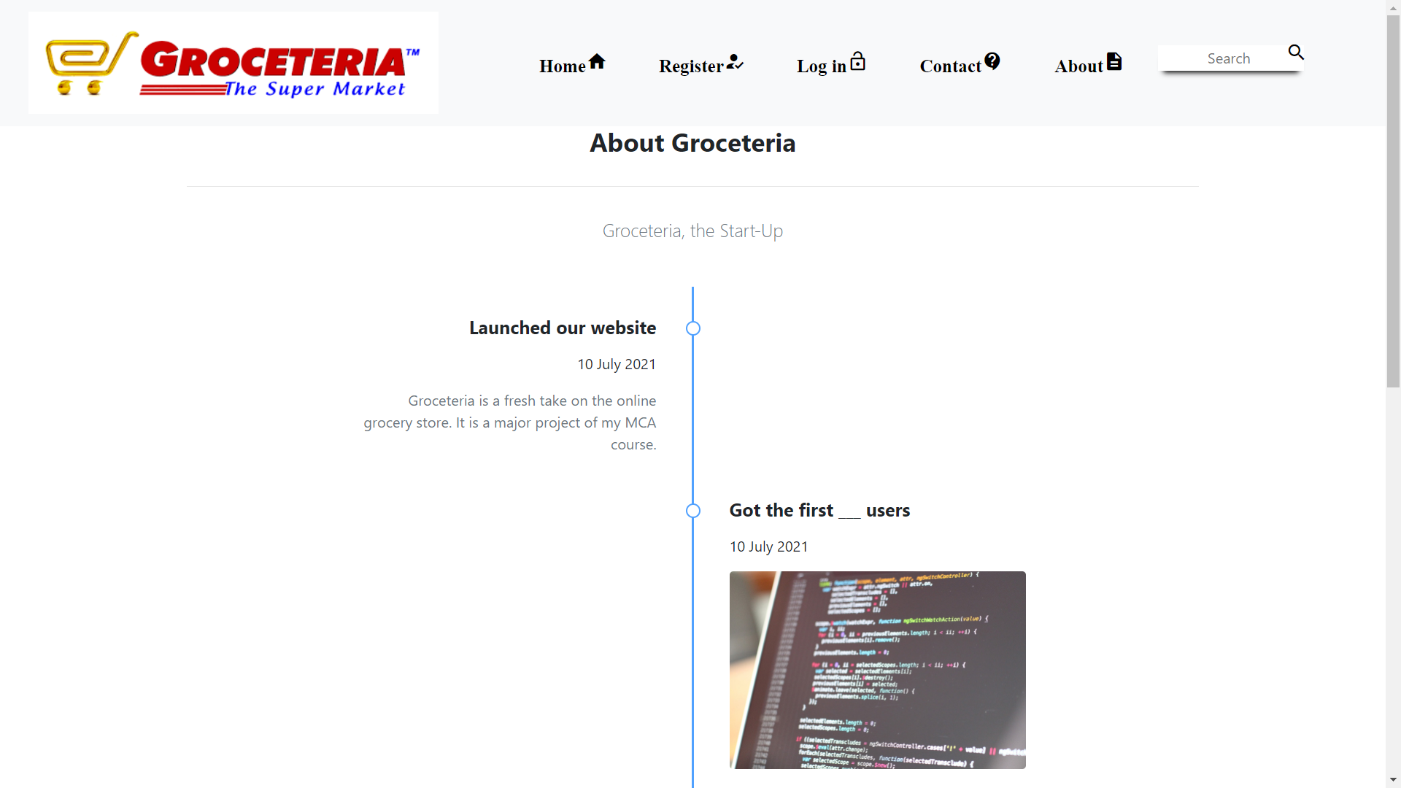

Slide 9
Conclusion
This project is an online market to be used by any normal grocery seller for selling their products.
This website is developed to help store owner to manage their business online and customers to buy products online from anywhere.
The Database is maintained completely by the Administrator.
The website makes it easier for the customer to view products available in the grocery store.

Slide 10
Future Work
Use of Mobile OTP at the time of Login/Registration can be done for further security of User Data and to tackle invalid details like Mobile No.
The Order Status section can be introduced to further simplify the whole process for Customers as well as Database Administrator.
Improvements in visualization and compatibility can be further done.

Slide 11
THANK YOU

