Slide 1
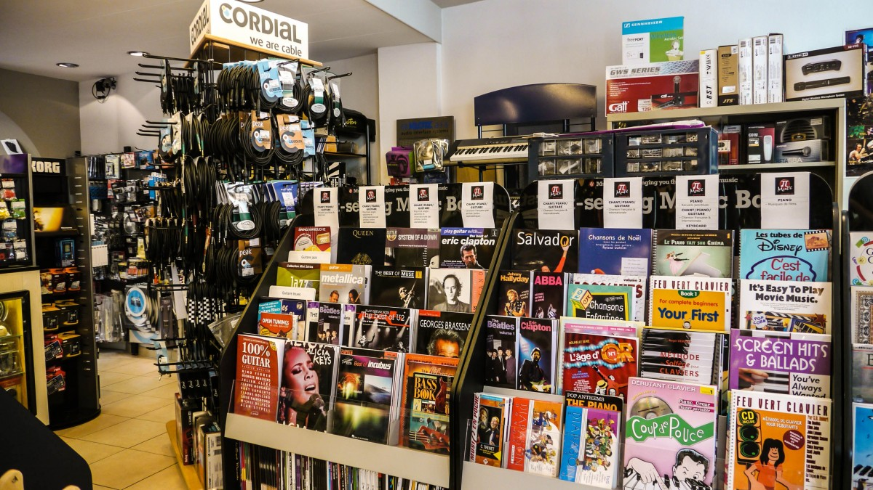
Chinook Music Store
Shubham

Slide 2

About Chinook
As a top brand in the physical music record sector Chinook delivers entertainment across the world. Chinook delivers a full range of music styles to its audience thanks to its international service points.

Slide 3



Problem Statement
To analyze music record sales data to gain insights and make recommendations for the company's strategy in the physical music market.

Slide 4
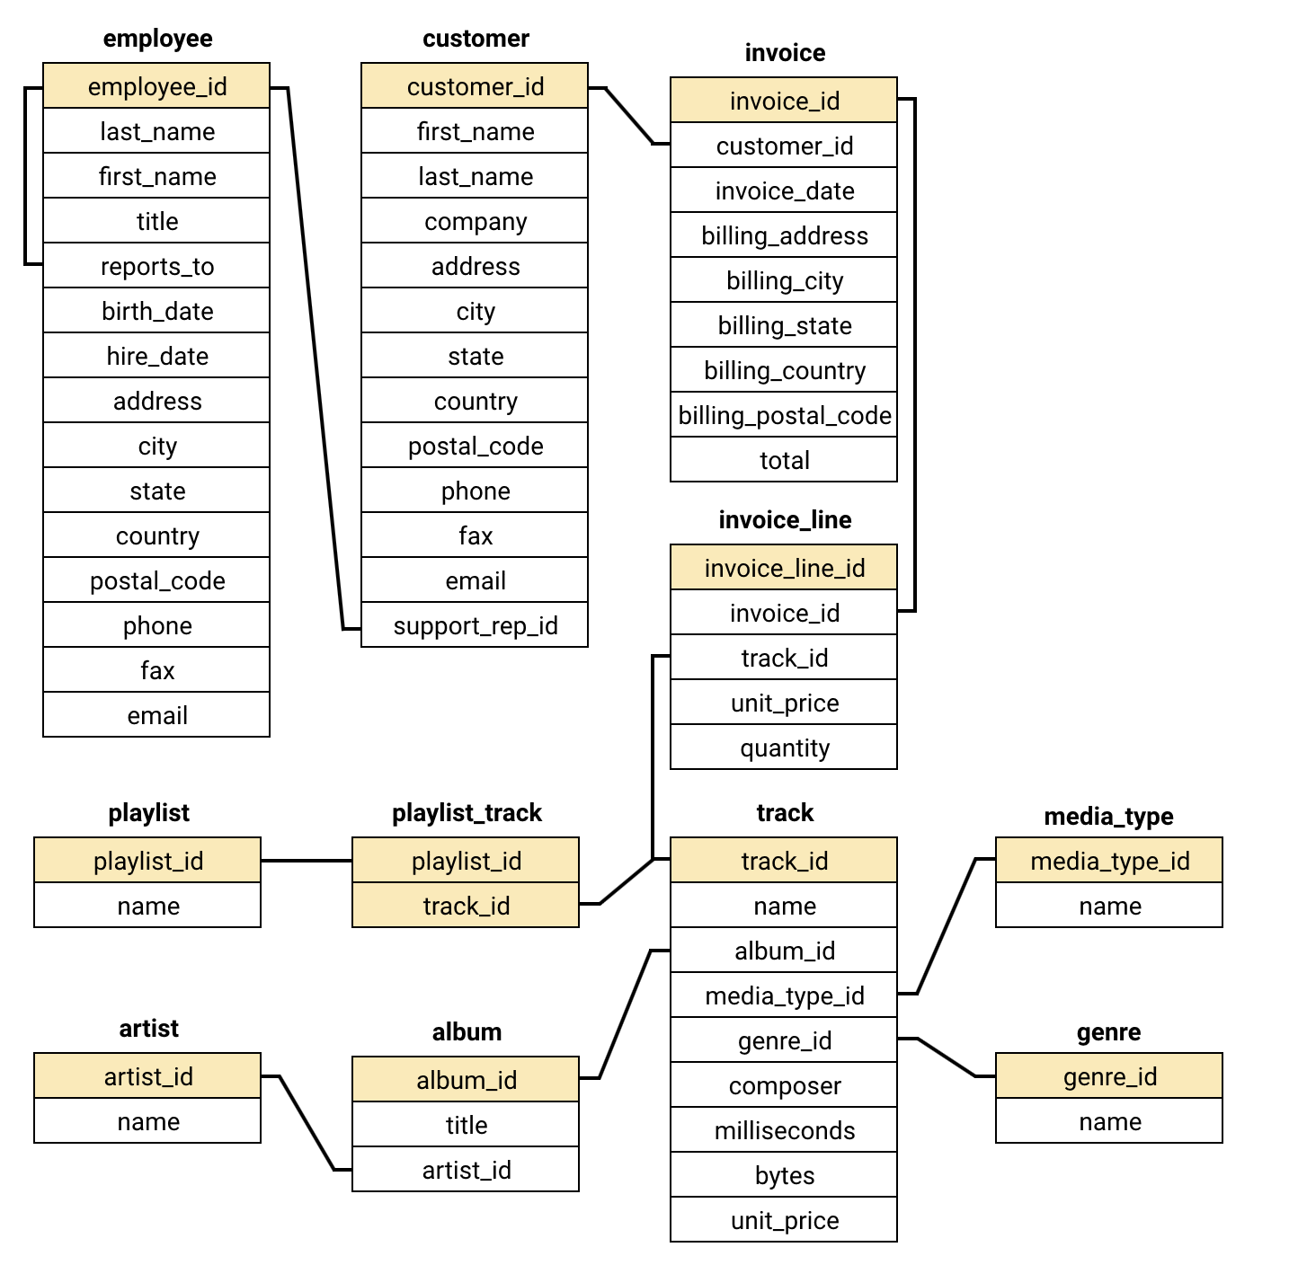
Data Overview
The data provided consists of 11 tables containing information regarding the past performance of Chinook music store
With 251 albums, 130 artists, 25 genres and 59 customers across 24 countries the data is quite vast
The invoice table contains all the data of transactions by a customer
Customer table contains the information regarding the customer base of Chinook.

Slide 5

Methodology
Step 4
Advanced Queries: Uncovering Insights
Used advanced queries to find hidden patterns (e.g., churn rate, customer segmentation).
Gained valuable business insights.
Step 1
Database Schema: The Blueprint:
We Understood the database structure (tables, relationships).
Essential for efficient data navigation.
Step 3
Data Cleaning: Ensuring Accuracy
Cleaned and prepped data (e.g., handled missing values with coalesce).
Ensured reliable analysis.
Step 2
Basic Queries: First Look
Used simple queries to explore the data.
Identified key areas for deeper analysis.
This Photo by Unknown Author is licensed under CC BY-SA

Slide 6
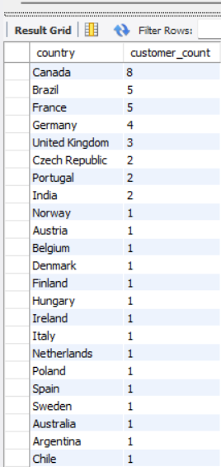
Demographics Analysis
1. North America: Core Market
Canada & USA = largest customer base.
Strong market penetration and success.
2. Europe & South America: Emerging Presence
Growing customer base in key countries (Brazil, France, Germany, UK).
3. Global Reach: Expansion Opportunities
Individual customers worldwide.
Potential for growth, but consider diverse market needs.

Slide 7

Churn Rate Analysis
Churn Rate Overview:
Overall Churn Rate: 19.88%
Indicates that approximately 1 in 5 customers leaves annually.
Yearly Churn Pattern:
2018: 2 churned customers
2019: 4 churned customers
2020: 5 churned customers
Increasing Trend: Yearly churn has been rising, signaling growing customer attrition.
Recommendations:
Loyalty programs and personalized offers to improve retention.
Conduct customer feedback to understand and address dissatisfaction.
Strengthen engagement strategies to retain new customers.

Slide 8
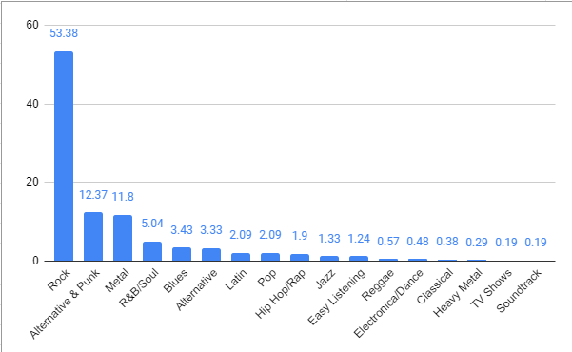
Genre Sales Analysis
1. Genre Popularity: Rock is King
Rock music dominates sales (50%+).
Alternative & Punk, Metal also show strong performance.
2. Business Recommendations
Prioritize Rock, Alternative & Punk, and Metal in inventory and marketing.
Implement genre-specific promotions to boost sales.
Percentage sales contribution of genres in USA

Slide 9
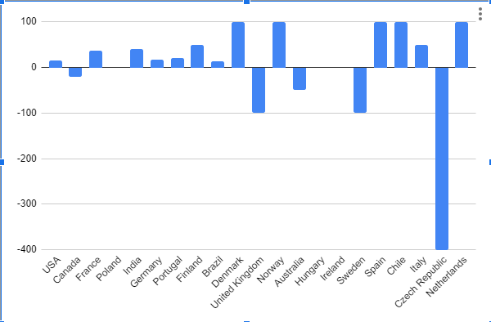
Geographical Analysis
1. Churn Rate & Economic Development
Developed economies (USA, Canada, etc.) show low/negative churn.
Developing economies (India, Chile, etc.) have higher churn.
2. Business Recommendations
High-GDP Countries: Increased advertising to further solidify market share.
Lower-GDP Countries: Offer budget-friendly options to attract and retain customers.
Churn rate based on Countries

Slide 10

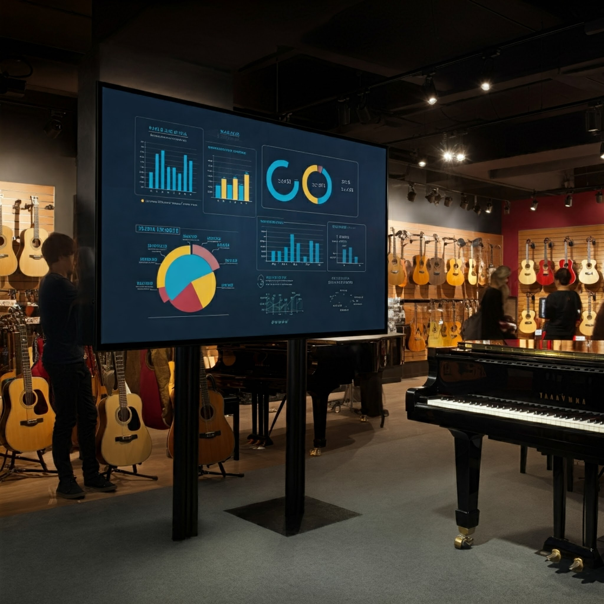
Long Term v/s Short Term Customers
1. Customer Lifetime Value
Long-term customers spend more and buy more items.
Customer retention is key!
2. Segmentation Opportunity
Tailor marketing based on customer "term" (e.g., new vs. long-term).
3. Business Recommendation: Focus on Retention
Prioritize strategies to keep customers coming back (loyalty programs, personalized recommendations, etc.).

Slide 11
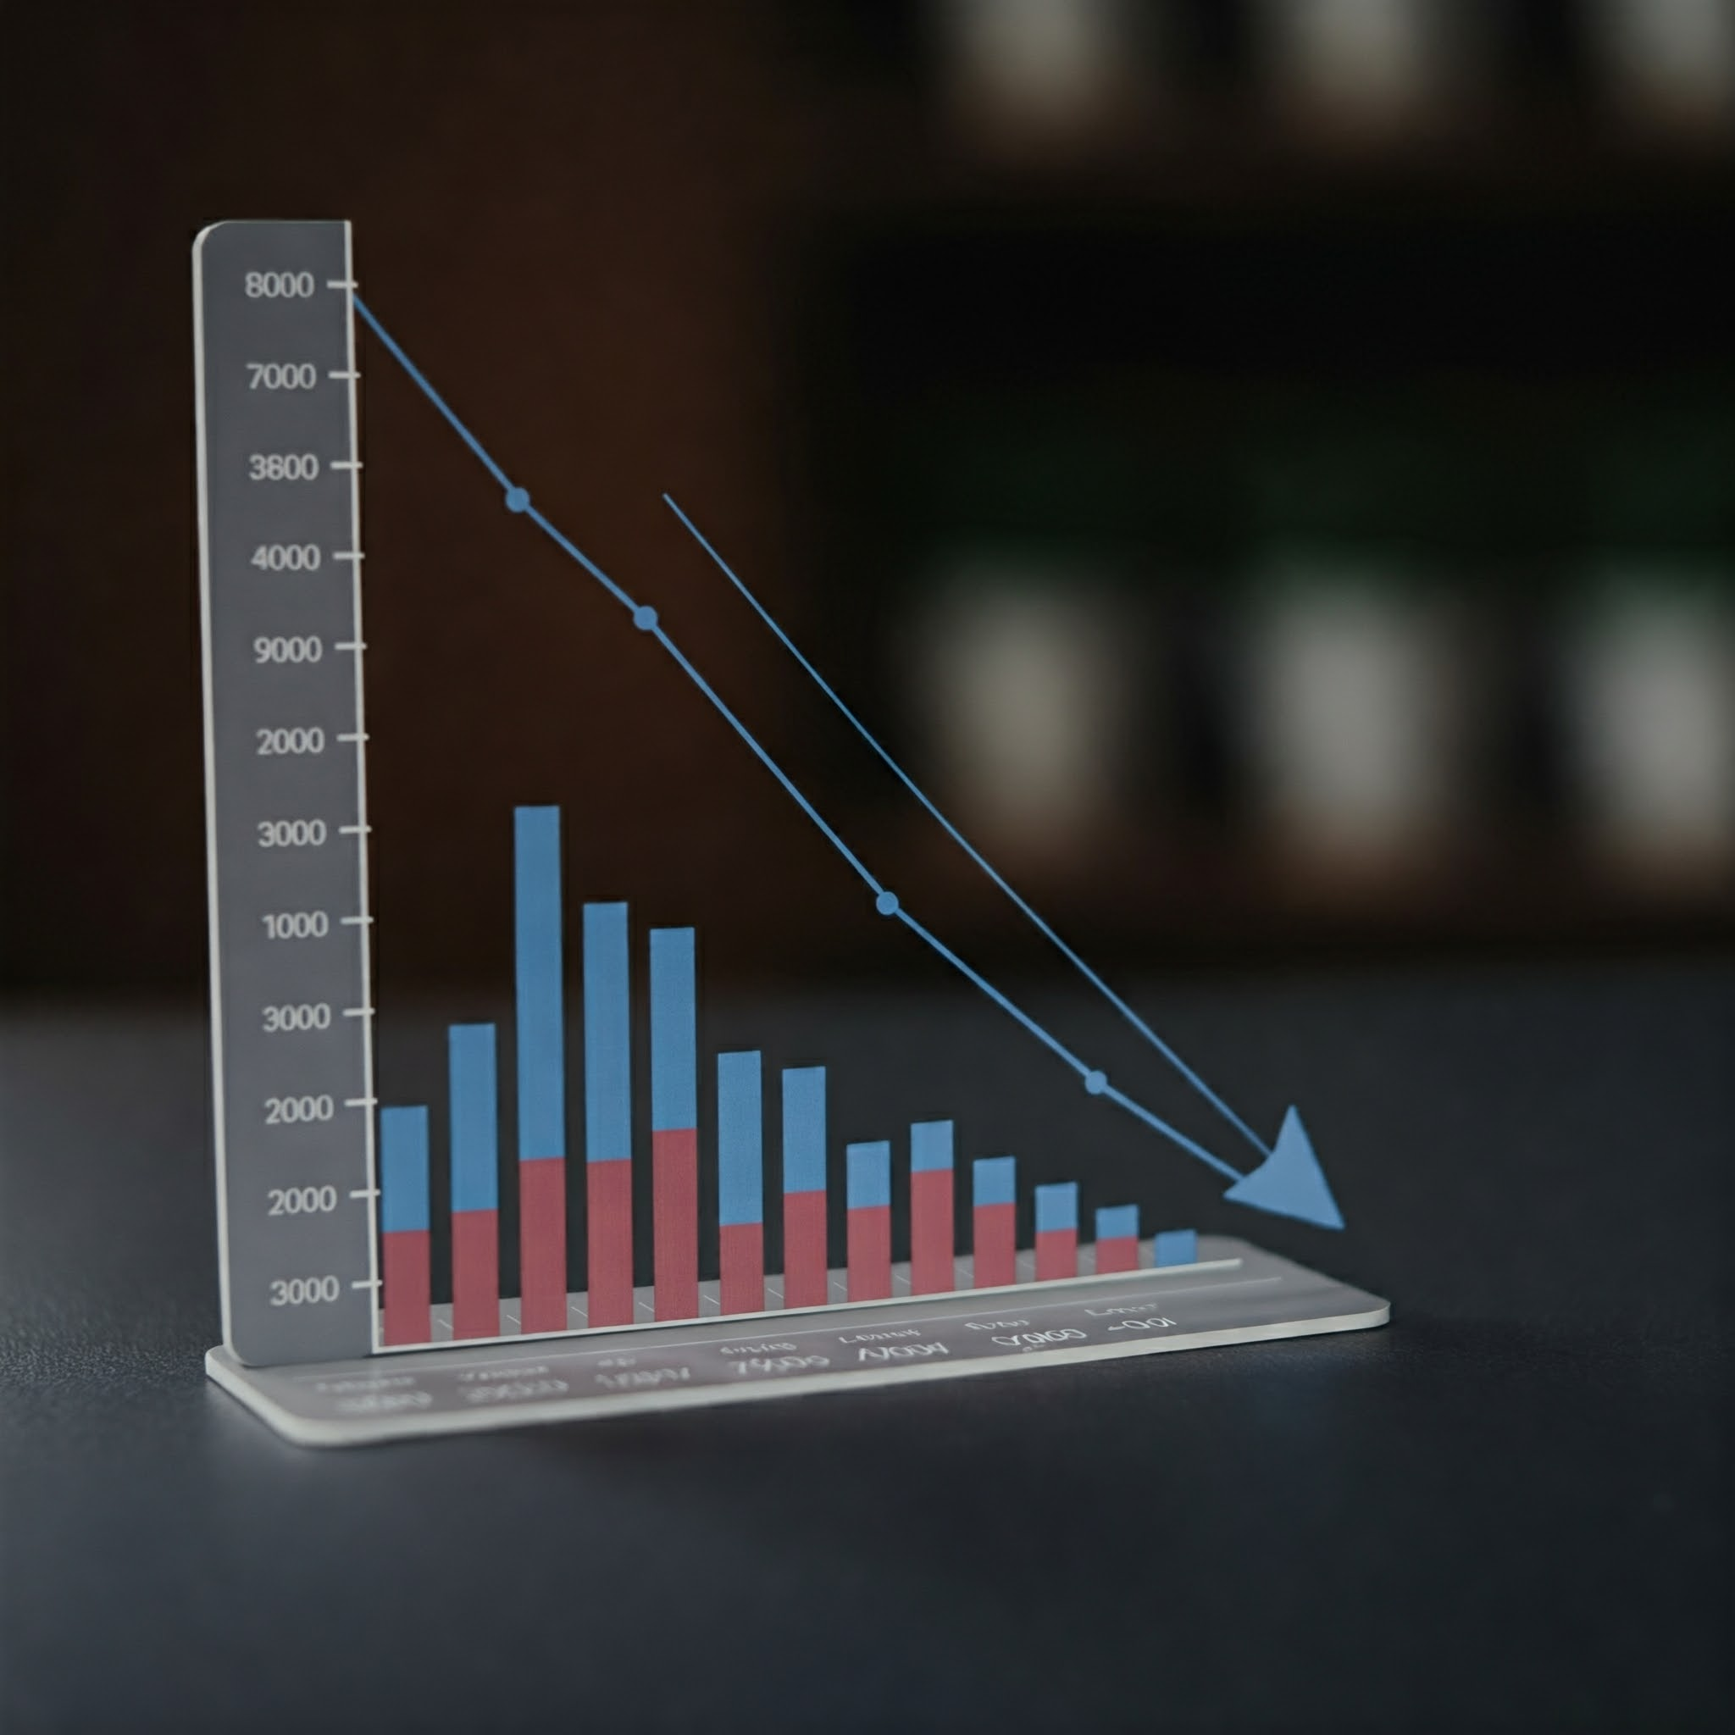
Customer Risk Profiling
Understanding Customer Churn and Spending Behavior
Inactivity Breeds Churn: Longer gaps between purchases increase the likelihood of customers churning.
Engagement Matters: Customers who buy more often are more likely to stay.
Spending is a Key Indicator: Low spenders may be on the verge of churning.
Demographics Play a Role: Age and gender can influence churn and spending, but more data and further analysis is required.

Slide 12
Recommendations
Focus on customer retention:
Optimize for high-value customers:
Tailor strategies to different markets:
Explore new customer acquisition channels:
Reward Loyalty: Implement loyalty programs.
Personalize: Targeted recommendations and marketing.
Excellent Service: Build strong customer relationships.
Identify & Nurture: Focus on high value and long-term customers.
Exclusive Benefits: Offer personalized experiences.
Regional Campaigns: Tailor marketing by location.
Cultural Sensitivity: Consider language and preferences.
Explore New Markets: Identify growth opportunities.
Localize: Consider partnerships and targeted marketing.

Slide 13

Recommendations
Operations and Product:
1
Optimize inventory management
Align inventory with popular genres and regional preferences.
Ensure sufficient stock of popular items to meet demand
2
Enhance the customer experience
Improve website and app usability.
Offer localized versions of the platform.
Provide efficient and cost-effective shipping options.
3
Explore new product offerings
Consider expanding product lines based on customer preferences and market trends.
Offer exclusive content/bundles to attract
and retain customers.

Slide 14

Conclusions
Boost Retention: Loyalty programs, personalized marketing.
Value High-Value Customers: Exclusive offers for long-term customers.
Data Quality: Ensure accurate data for reliable insights.
Targeted Strategies: Region-specific campaigns.
Gather More Data: Collect demographics for better targeting.
Closing Statement:
By acting on these insights, Chinook can optimize its operations, enhance customer engagement, and drive sustainable growth in a competitive market.

