Slide 1
CALIBRE USING DRC/LVS
Chapter 01
Calibre Basic Concepts
A complete beginner's guide to Calibre Physical Verification
▸ What is Calibre?
▸ Calibre Interactive GUI
▸ IC Design Flow
▸ RVE Results Viewer
▸ SVRF Files
▸ Online Documentation

Slide 2
Learning Objectives
Chapter 01 — Calibre Basic Concepts
01
Explain how Calibre physical verification fits into an IC design flow
04
List important attributes of the SVRF language
02
Describe the overall Calibre physical verification process flow
05
Understand Calibre Interactive GUI and how to run DRC/LVS jobs
03
Name the various types of SVRF files used by Calibre physical verification
06
View and interpret results using Calibre RVE

Slide 3
What is Calibre?
Industry-leading Physical Verification Tool by Siemens EDA
Calibre is used to verify that an IC layout is correct before fabrication. It performs two core tasks:
DRC — Design Rule Checking
LVS — Layout vs. Schematic
Checks that the physical layout follows the manufacturing rules set by the foundry.
Examples:
• Metal lines too close together
• Shape too small for manufacturing
• Spacing violations
Compares the layout against the original circuit schematic to ensure they match electrically.
Examples:
• Missing connections
• Wrong transistor sizes
• Short circuits
ℹ️ Simple Rule: DRC = "Is the layout manufacturable?" | LVS = "Does the layout match the design intent?"

Slide 4
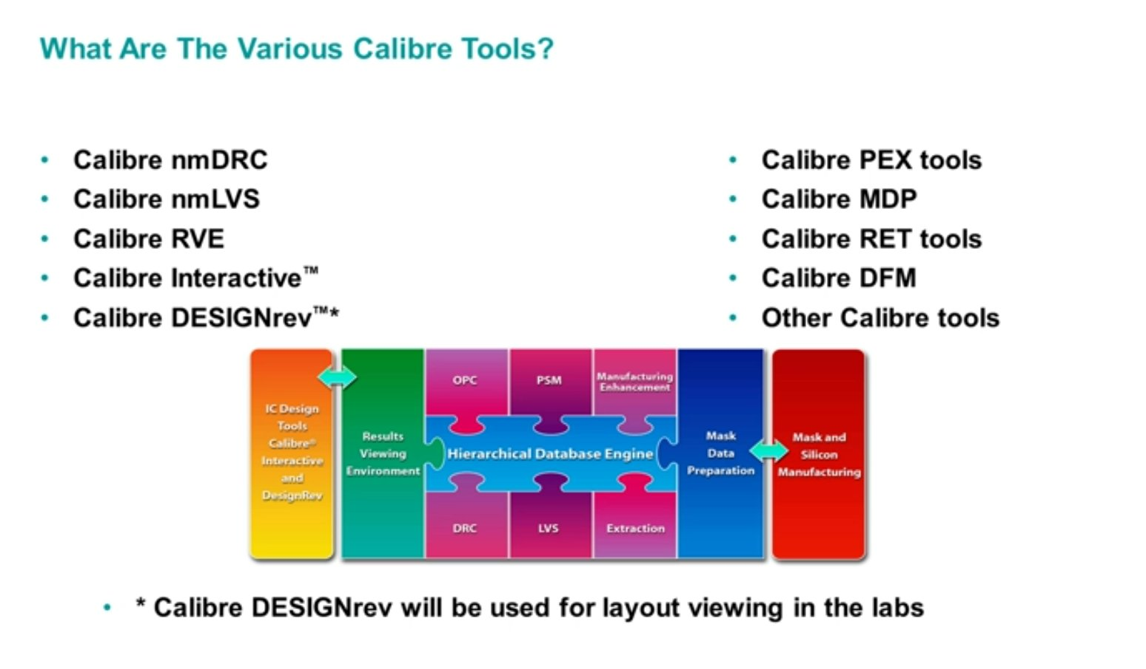
The Calibre Tool Suite
Calibre is a family of tools — not just one program

Slide 5
Calibre Tools — Quick Reference
What each tool does
Tool | Purpose
Calibre nmDRC | Runs Design Rule Checks on the layout
Calibre nmLVS | Runs Layout vs. Schematic verification
Calibre RVE | Results Viewing Environment — view verification results
Calibre Interactive™ | GUI frontend to set up and run Calibre jobs
Calibre DESIGNrev™ | Layout viewer — open and inspect GDS files
Calibre PEX tools | Parasitic Extraction
Calibre MDP | Mask Data Preparation
Calibre DFM | Design for Manufacturability
Tool
Purpose
Calibre nmDRC
Runs Design Rule Checks on the layout
Calibre nmLVS
Runs Layout vs. Schematic verification
Calibre RVE
Results Viewing Environment — view verification results
Calibre Interactive™
GUI frontend to set up and run Calibre jobs
Calibre DESIGNrev™
Layout viewer — open and inspect GDS files
Calibre PEX tools
Parasitic Extraction
Calibre MDP
Mask Data Preparation
Calibre DFM
Design for Manufacturability
💡 In labs, Calibre DESIGNrev is used for layout viewing — it is the entry point to launch Calibre Interactive.

Slide 6
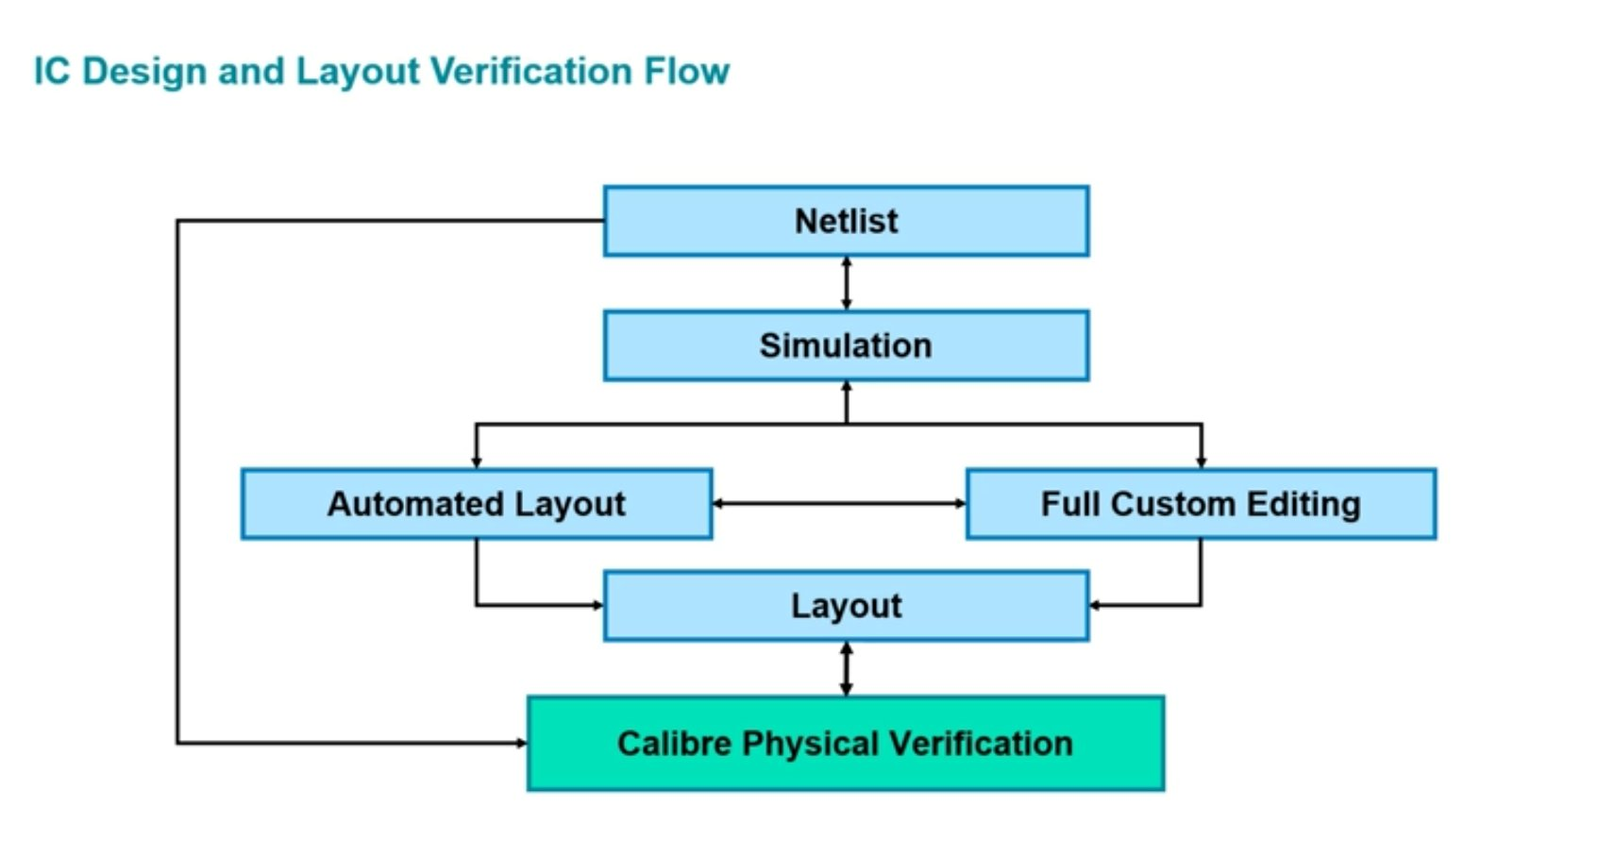
IC Design Flow — Where Does Calibre Fit?
Physical verification is the final gate before tape-out
Netlist
1
Circuit schematic generates a netlist (components + connections)
Simulation
2
Netlist is simulated to verify electrical behavior
Layout
3
Circuit translated to physical shapes via automated or custom editing
Calibre Verification
4
DRC + LVS checks. Errors → fix layout → re-run (iterative loop)

Slide 7
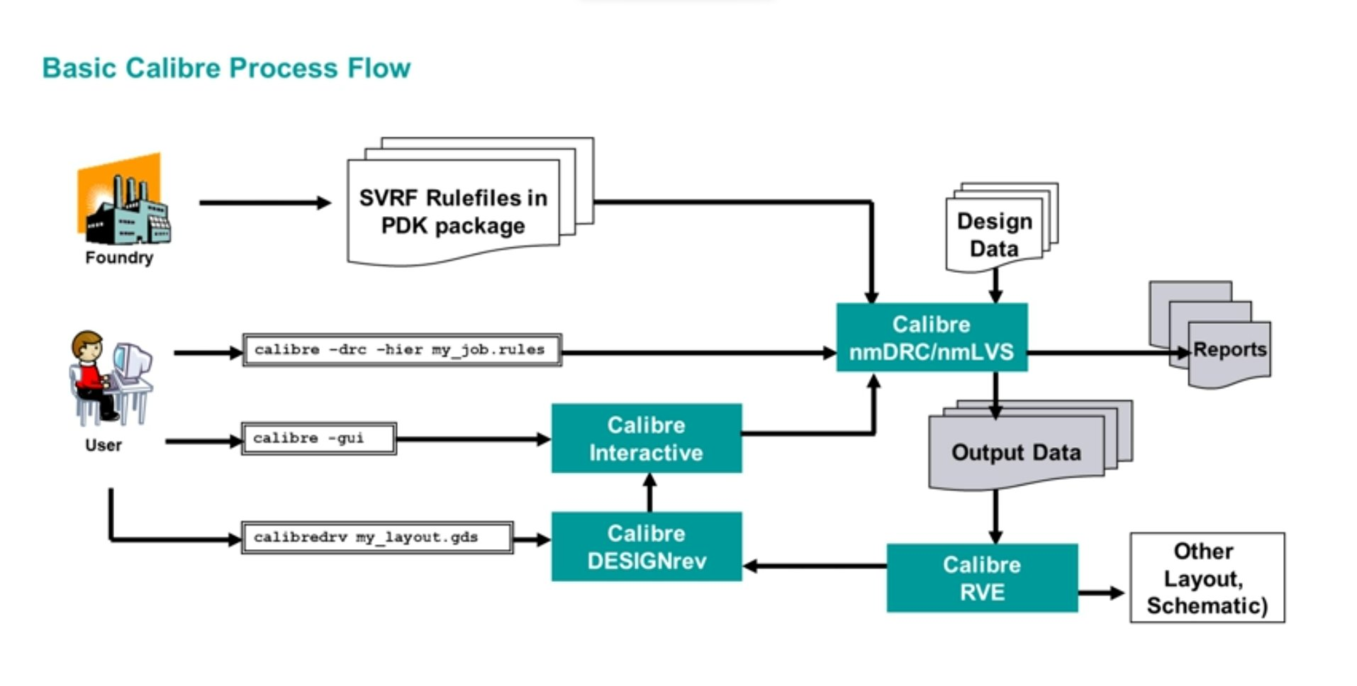
Basic Calibre Process Flow
How the foundry, user, and tools connect together
ℹ️ Foundry provides SVRF rule files in the PDK package — these contain all manufacturing rules.
⚠️ Do NOT use '&' at the end of the calibredrv command!

Slide 8
Key Calibre Commands
The most important commands every Calibre user must know
Run DRC from command line (hierarchical mode)
calibre -drc -hier my_job.rules
Launch Calibre Interactive GUI
calibre -gui
Launch DRC GUI directly
calibre -gui -drc
Launch DRC GUI with pre-loaded runset
calibre -gui -drc demo_runset
Open layout in Calibre DESIGNrev
calibredrv my_layout.gds
Launch RVE to view DRC results
calibre -rve demo_drc.db
Open online documentation
mgcdocs
⚠️ Never add & at the end of calibredrv — it will cause DESIGNrev to malfunction!

Slide 9
Calibre Glossary — Key Terms
Essential terminology every Calibre user must know
SVRF
Standard Verification Rule Format
The command language used by ALL Calibre applications. Think of it as Calibre's programming language.
Rule Check
DRC Result
Creates DRC result database output when layout data meets specified criteria defined in the rules file.
RDB
Results Database
An ASCII file containing verification results with optional properties. Output of a DRC run.
SVDB
Standard Verification Database
All directories and files created during a Calibre nmLVS run.
RVE
Results Viewing Environment
The Calibre tool used to view and navigate physical verification results interactively.

Slide 10
What is SVRF?
Standard Verification Rule Format — the language of Calibre
SVRF is the scripting language that Calibre uses for ALL its operations. It has two categories of content:
Category 1 — From Foundry
Category 2 — From User
Technology specific instructions: • DRC Rules
(min metal width, spacing rules...)
• LVS connectivity rules
(device recognition)
Job and user specific setup: • I/O file specifications
(layout path, results path...)
• User-specified job options
(output format, options...)
NOT specified in SVRF (use command line instead):
Run type (flat/hierarchical) • Multiple processors • LVS job type • Extracted netlist file name

Slide 11
Three Types of SVRF Files
Calibre merges all SVRF files into one at runtime
Process Rule File
Job SVRF File
User SVRF File
From: Foundry / PDK
From: User
From: User (Optional)
✓ Contains all technology-specific DRC and LVS rules
✓ Contains job-specific information
✓ Created for specific run needs
✓ Provided as part of the PDK package
✓ Layout file path and top cell
✓ Select/deselect specific DRC checks
✓ NEVER edited by the user
✓ Results database file name
✓ Specify parallel transistor reduction
✓ Example: golden_rules
✓ INCLUDE statements for other files
✓ Can be reused across projects
LAYOUT PATH "demo.gds" LAYOUT PRIMARY "TOP" DRC RESULTS DATABASE "demo_drc.db" ASCII INCLUDE "golden_rules"

Slide 12
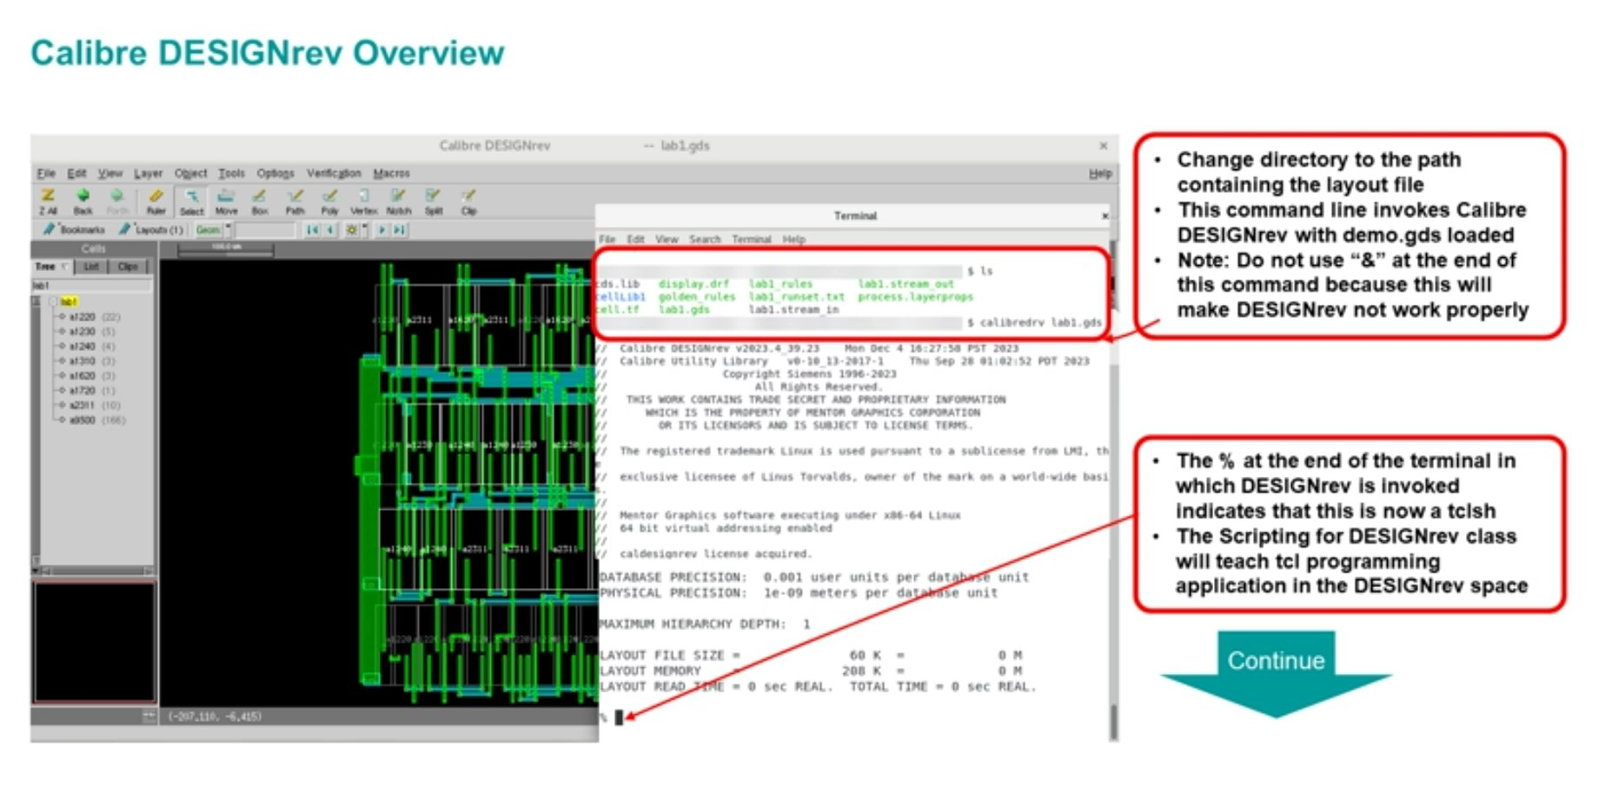
Calibre DESIGNrev — Layout Viewer
The starting point for all Calibre verification work
cd /path/to/layout/
calibredrv lab1.gds
ℹ️ The % symbol at terminal after launching DESIGNrev indicates it is running in tcsh shell mode.

Slide 13
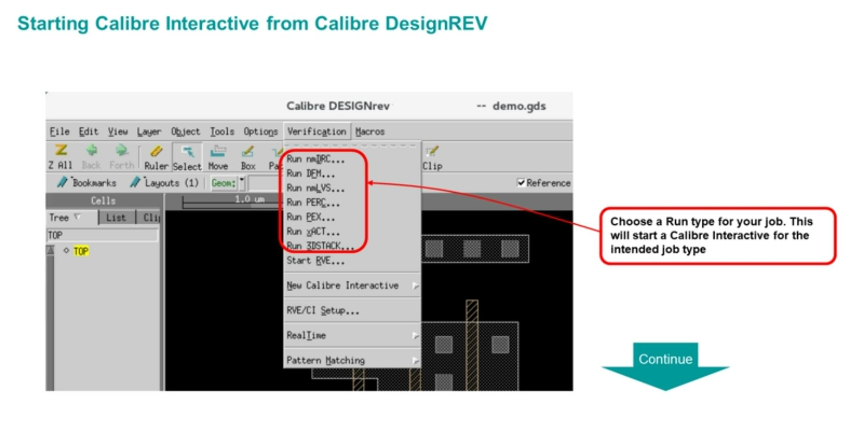
Starting Calibre Interactive
Launch from DESIGNrev Verification menu
💡 Choose: Verification menu → Run nmDRC... (or Run nmLVS...) — this starts Calibre Interactive for the intended job type.

Slide 14
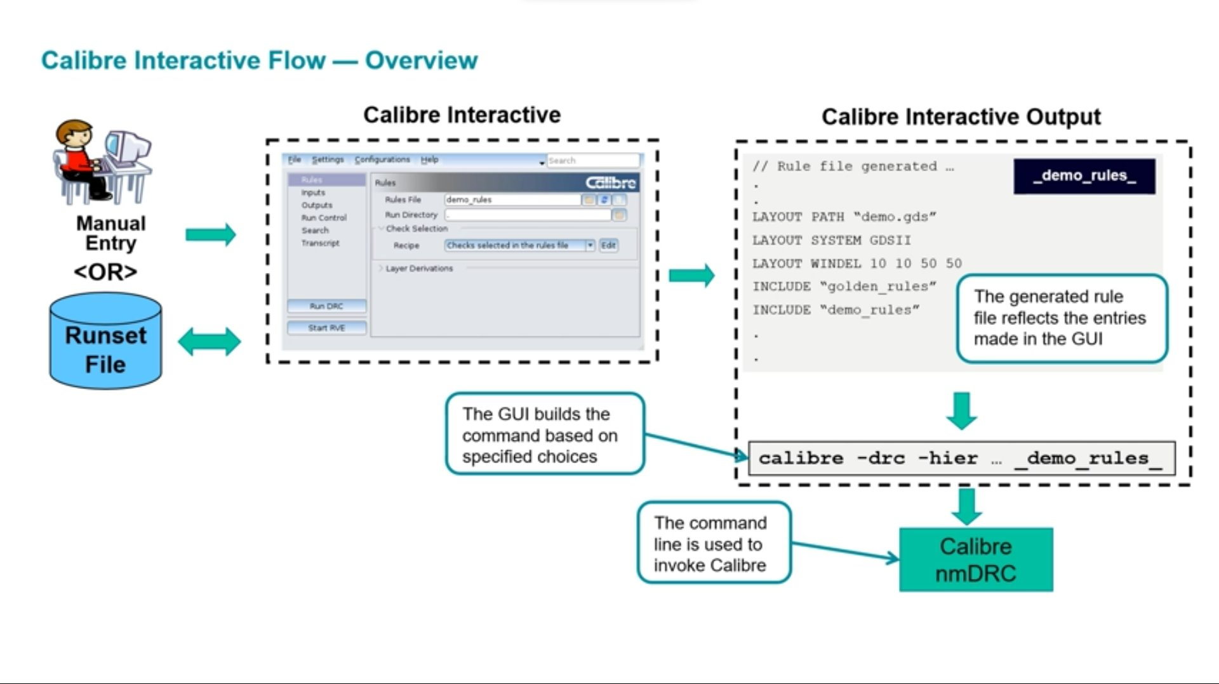
Calibre Interactive Flow — Overview
GUI → generates rule file → builds command → invokes Calibre nmDRC

Slide 15
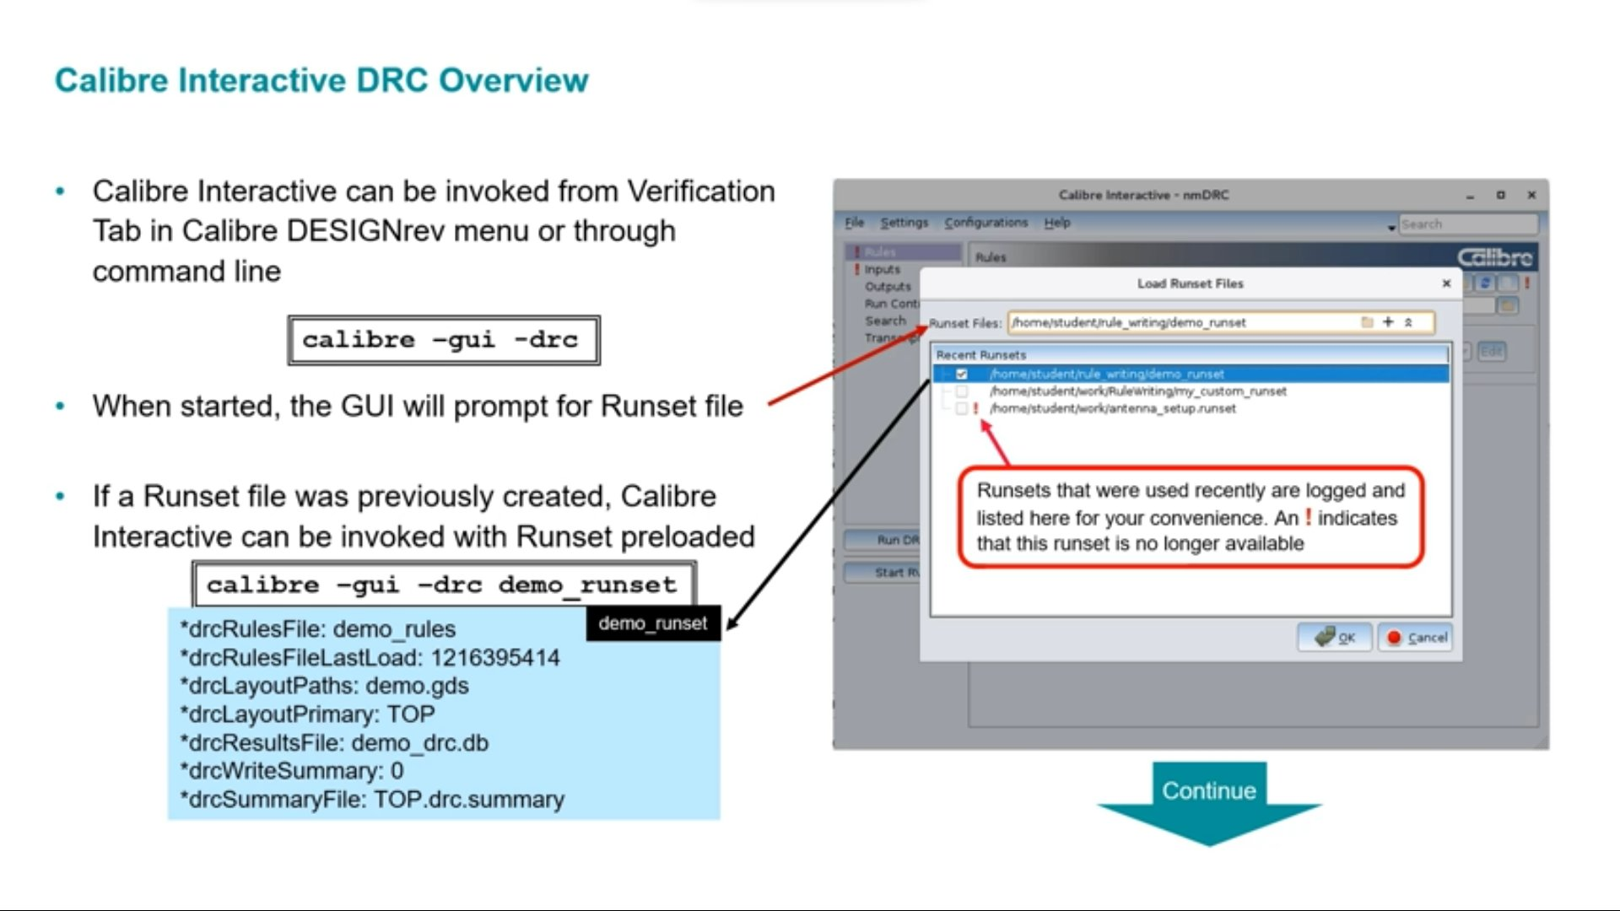
Calibre Interactive — DRC Setup
Loading a Runset and configuring your DRC job
calibre -gui -drc demo_runset
⚠️ Runsets with ! icon are no longer available at that path.

Slide 16
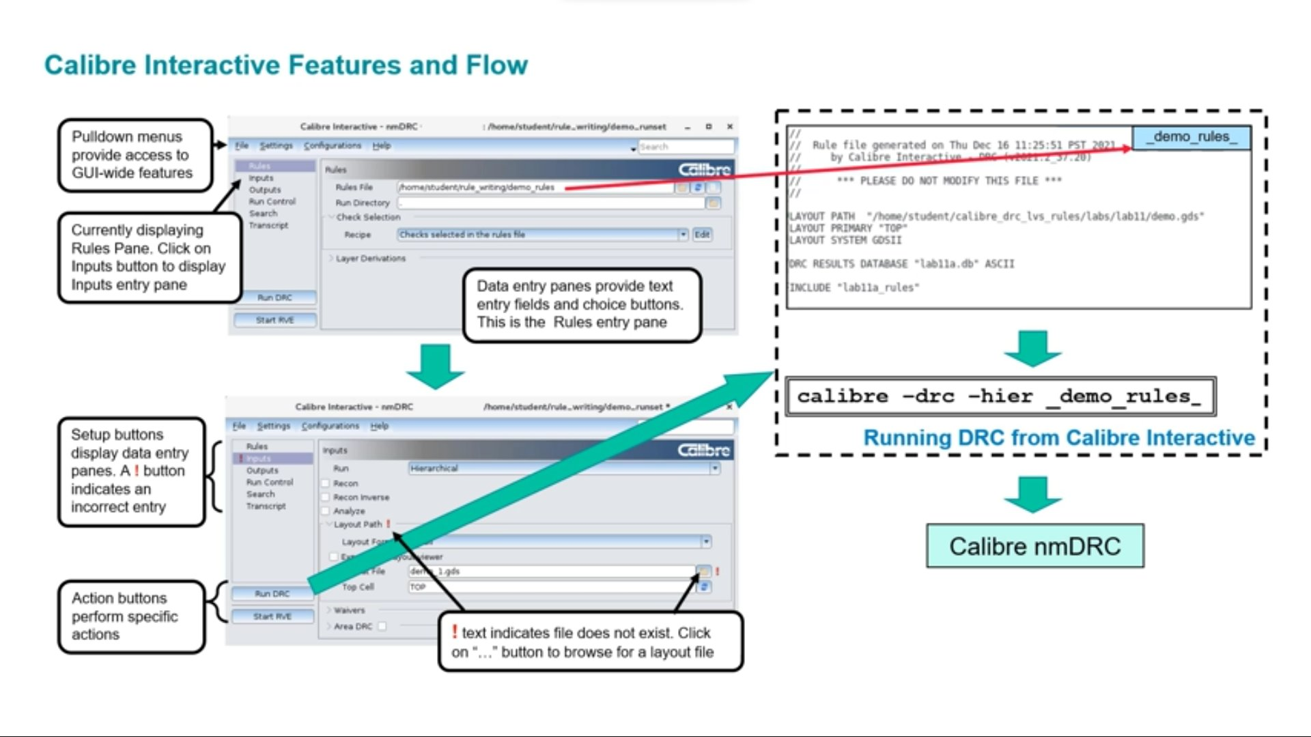
Calibre Interactive — Features & Panels
Understanding the GUI layout and workflow
⚠️ A ! (exclamation) button next to a field means an incorrect entry or a file that does not exist — always fix before running!

Slide 17
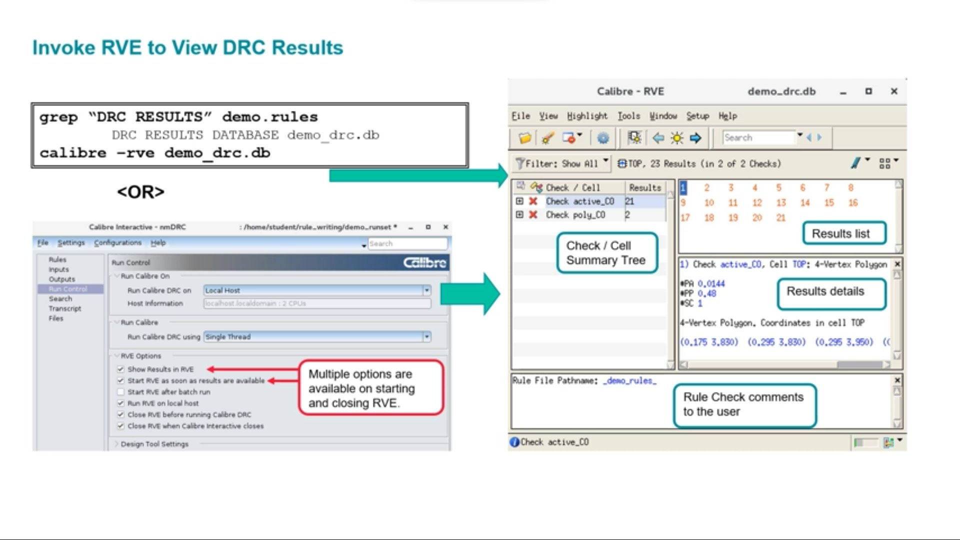
Viewing Results in Calibre RVE
Results Viewing Environment — navigate DRC/LVS errors
1. Check/Cell Summary Tree — all checks + error counts
2. Results List — individual error instances
3. Results Details — coordinates and geometry of each error

Slide 18
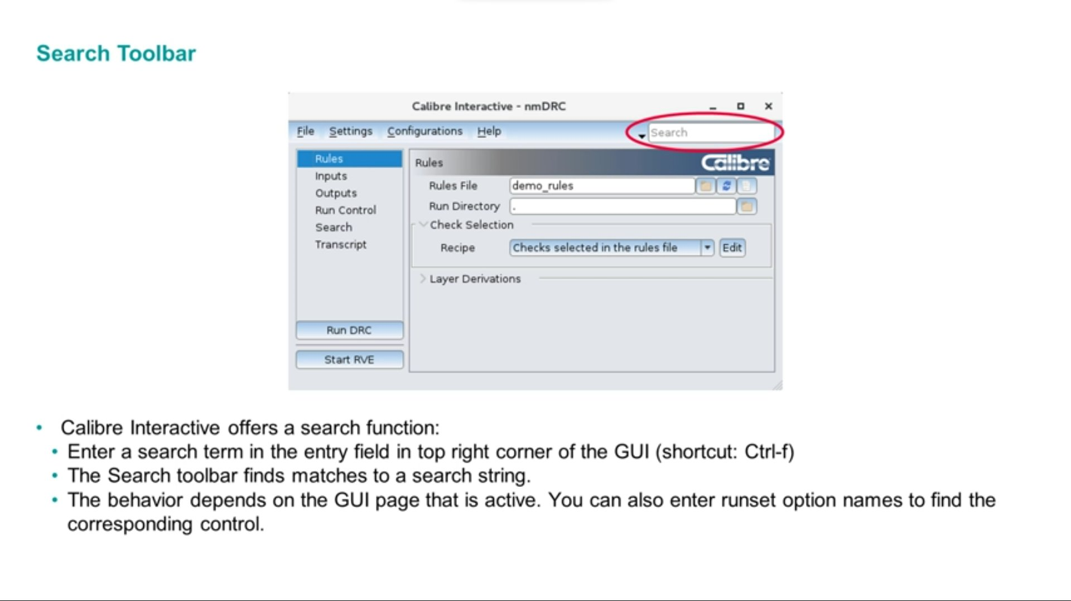
Search Toolbar in Calibre Interactive
Quickly find any setting using Ctrl+F
💡 Press Ctrl+F or click the top-right Search field. Type any runset option name to jump directly to that control.

Slide 19
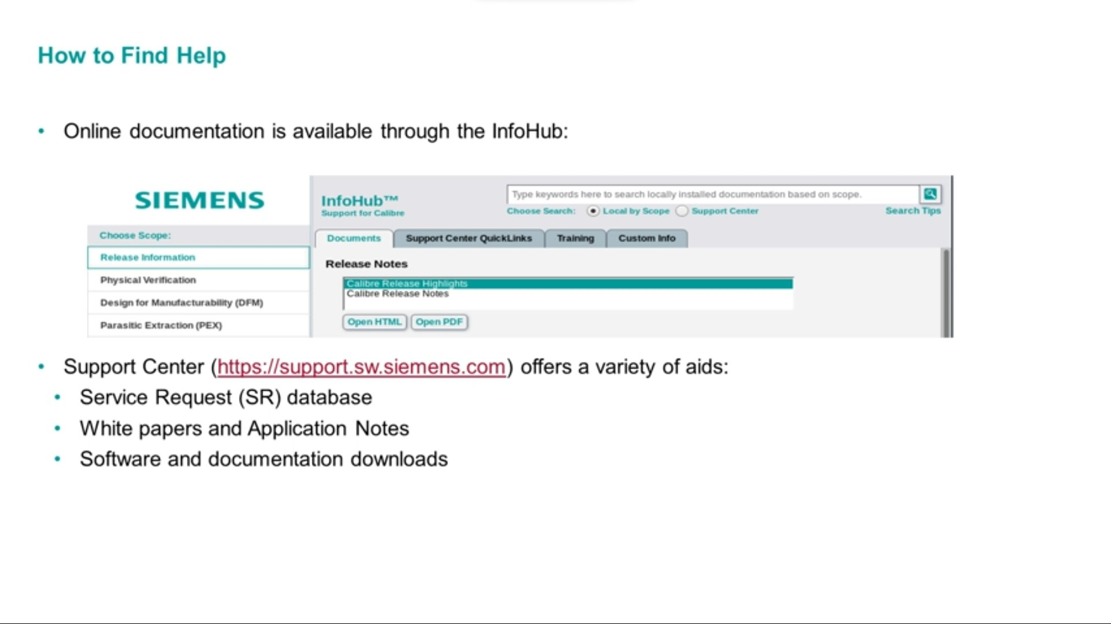
Accessing Online Documentation
InfoHub + Siemens Support Center
How to Access Help
Command Line:
mgcdocs
From GUI:
Help → Help and Manuals
Support Center:
support.sw.siemens.com
ℹ️ InfoHub provides locally installed docs searchable by scope.

Slide 20
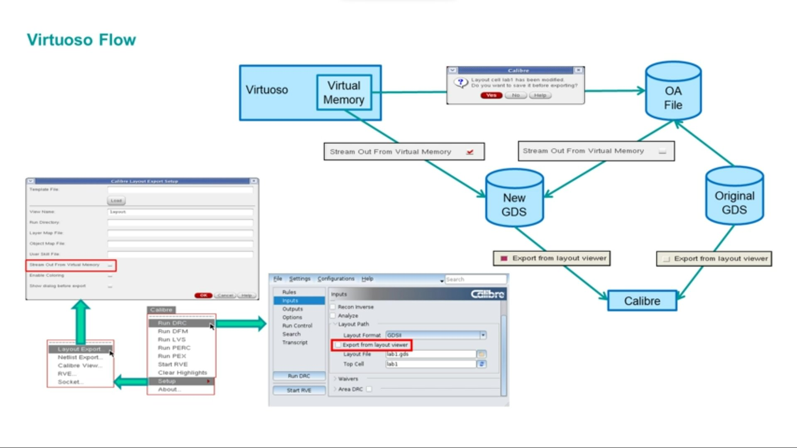
Virtuoso Integration Flow
Using Calibre from within Cadence Virtuoso
💡 Enable 'Export from layout viewer' in Calibre Interactive Inputs panel to auto-stream layout from Virtuoso instead of using a static GDS file.

Slide 21
Chapter 01 — Summary
Key takeaways from Calibre Basic Concepts
Concept
Key Takeaway
Calibre DRC
Checks layout against foundry manufacturing rules
Calibre LVS
Compares layout to original schematic
SVRF
The command language used by ALL Calibre applications
Process SVRF
From foundry — contains technology rules, never edit
Job SVRF
From user — specifies files, paths, and job options
Runset
Saved GUI settings for reuse across sessions
RVE
Tool to view, navigate, and debug DRC/LVS results
DESIGNrev
Layout viewer — entry point to launch Calibre Interactive
InfoHub
Online documentation portal (also: mgcdocs command)

Slide 22
Chapter 01 Complete!
Calibre Basic Concepts
Next: Chapter 02 — Calibre nmDRC Basics

