Slide 1
API LED CONNECTIVITY

Slide 2
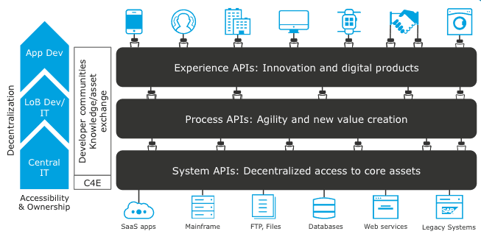

Slide 3
Experience API
The Experience API is defined to expose the end user to the API. So, we should define and implement the high-level logic in the API. The purpose of this API is to interact with the Process API and process the output to the end user with the process status.

Slide 4
Process API
In the Process API, we are doing file extension validation. Except for the .csv file, this API will not process any files. Once the validation is successful, extract the contents of the CSV file and send them to the System API for further processing.

Slide 5
System API
Once we get the JSON input from the Process API, we will validate the content one by one with the Mule validator. If any validation fails, the API will get the actual reason for the validation and reject the flow and pass the reason to the Experience API through the Process API. If the validation of all the content succeeds, process the data for the database to insert/update the record.

