Slide 1

EE518 - POWER CONVERTER ANALYSIS AND DESIGN LAB
Hardware Implementation of Buck – Boost converter
Under guidance of
Dr. Kalaiselvi J.
Assistant professor
Presented by
Shubham Raj(2023EEM1052)
Shubham Faujdar(2023EEM1051)
Department of Electrical Engineering
Indian Institute of Technology, Ropar

Slide 2
Hardware Impementation of Buck-Boost Converter
Component used:
1-Phase transformer 230V//15-0-15V
Mosfet (IRF460),
TLP-250
Voltage Regulator(IC 7815)
Diode(1N4007)
LED
Diode Bridge Rectifier(DBR)
Resistance (33 ohm, 1 kilo ohm)
Inductance (1.6 milli Henry )
Filter capacitance (47 micro farad,100v)

Slide 3
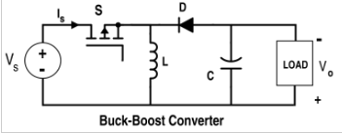
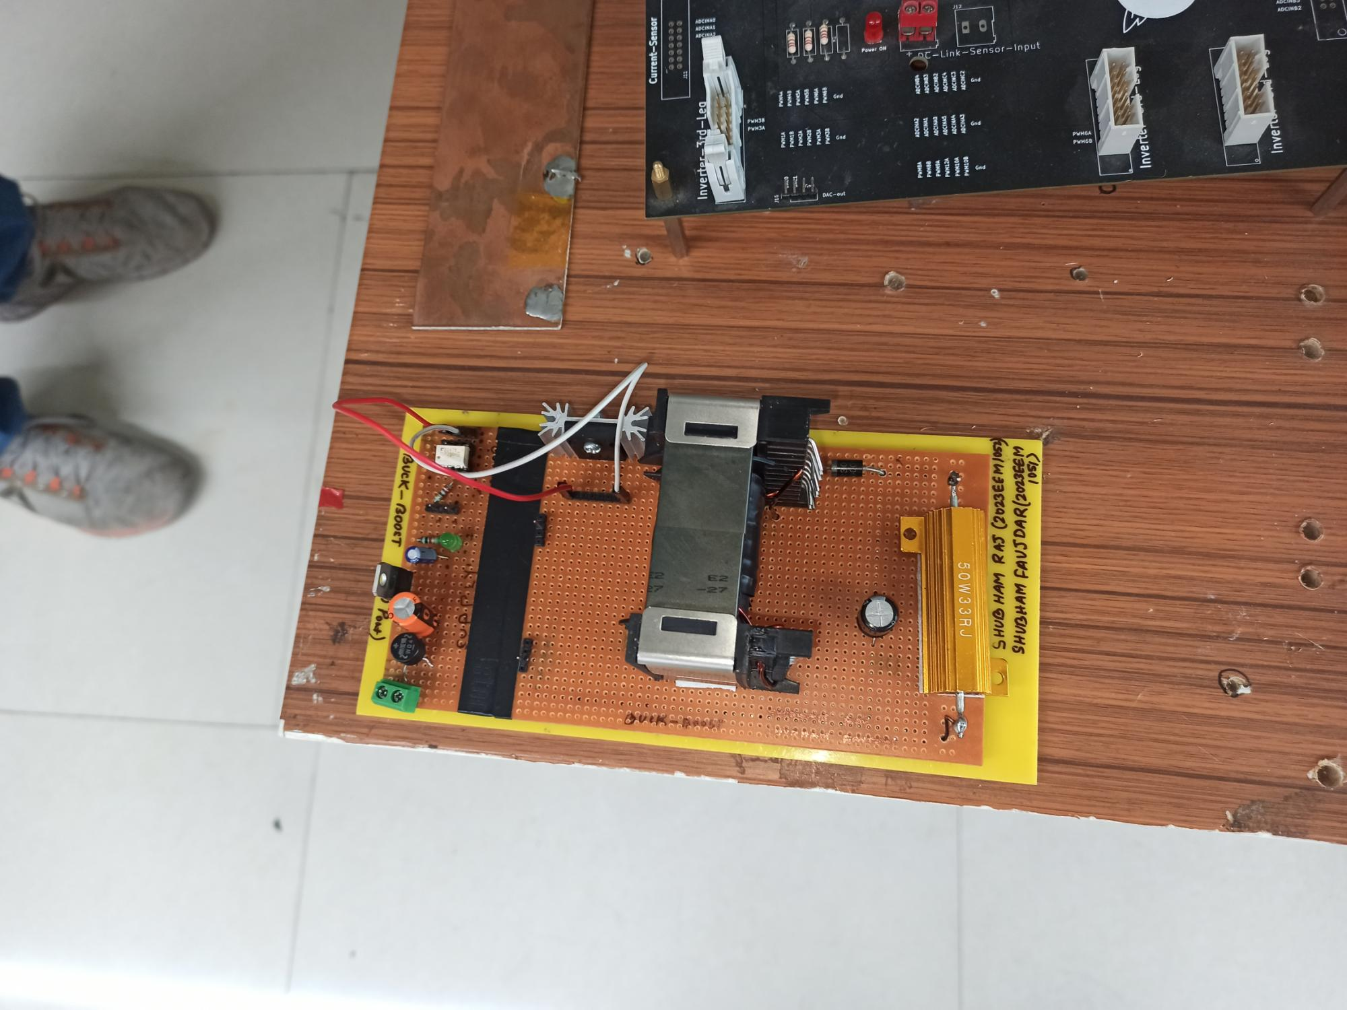
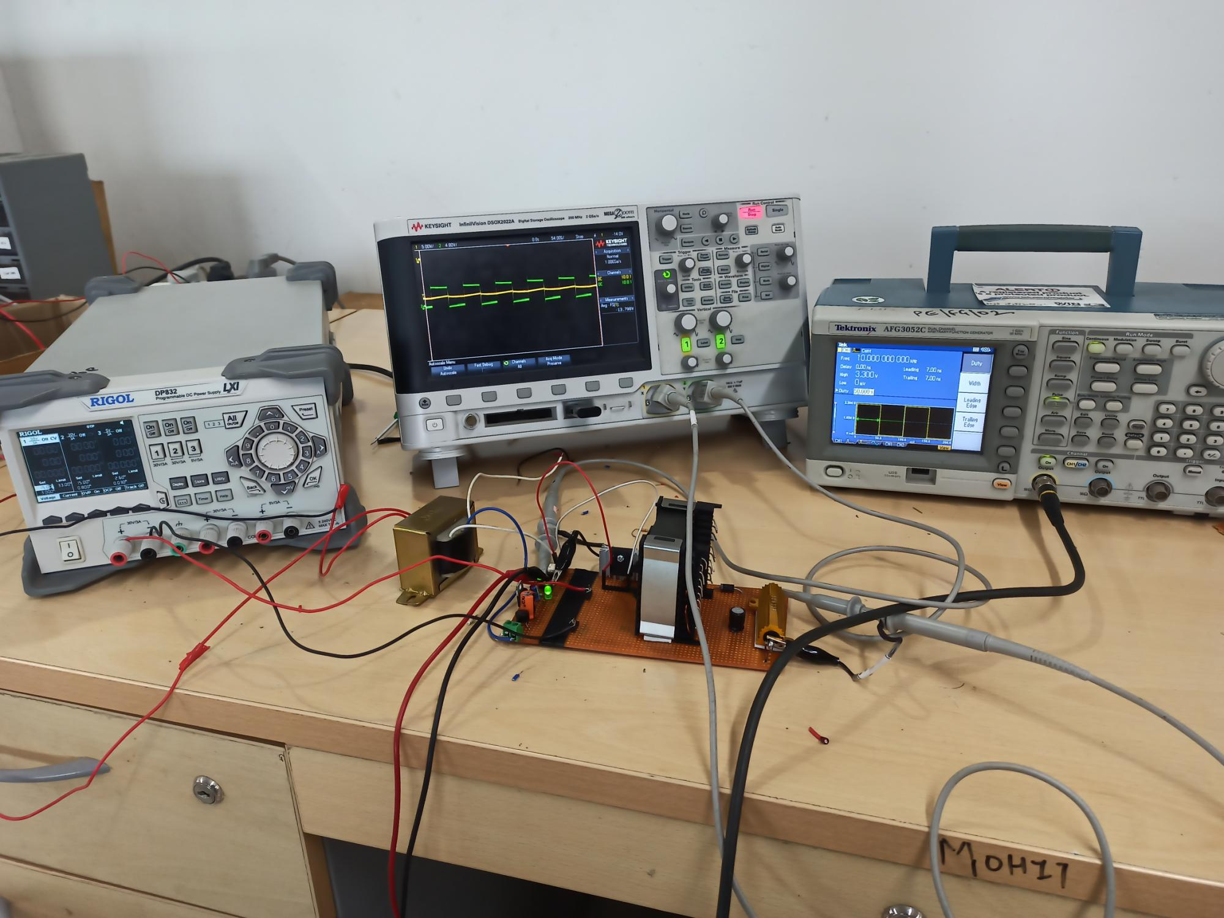
Rating of BUCK-BOOST:
Variable Dc input voltages used : 1 to 30 (volt).
Power Rating : 50 watts.
Inductor value: 1.6 milli henry.
output capacitor : 47 micro farad.
output Resistance : 33 ohm.
Variable Duty cycle : 0-1.
Hardware Setup :

Slide 4
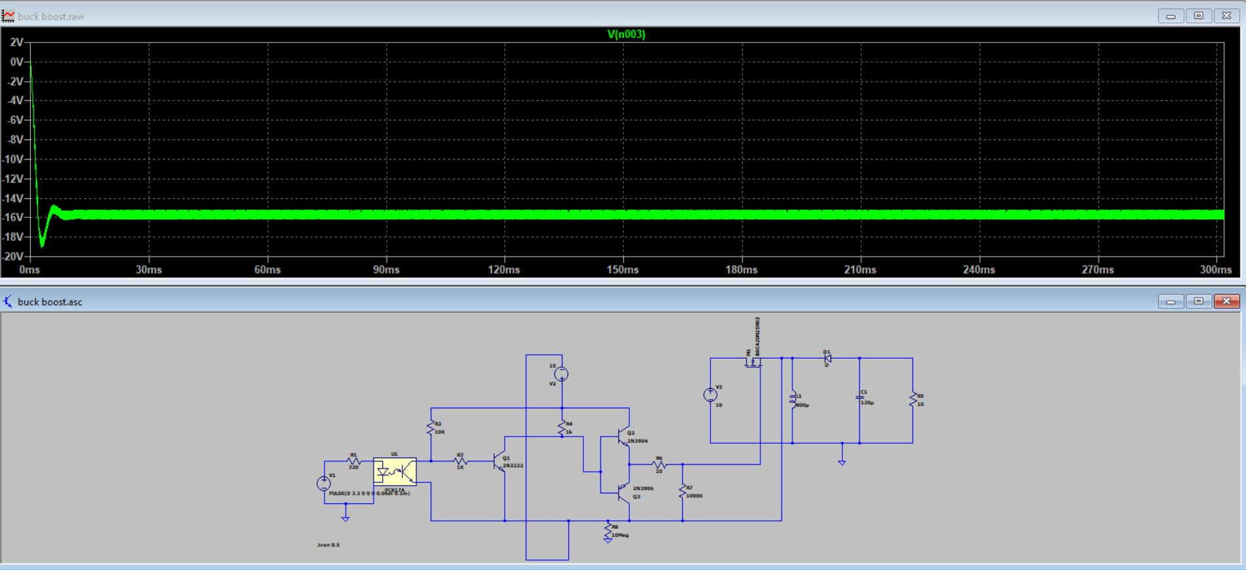
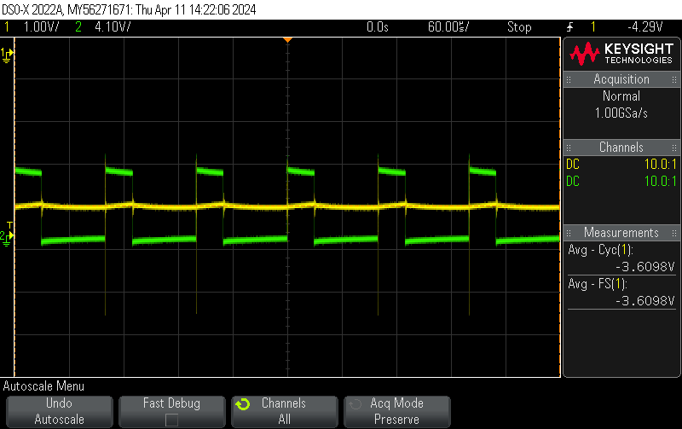
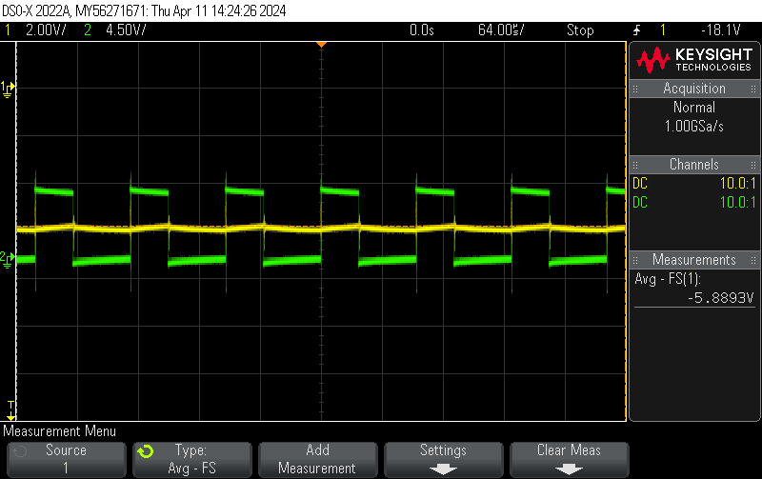
SIMULATION RESULTS:
HARDWARE RESULTS:(BUCK-MODE)

Slide 5
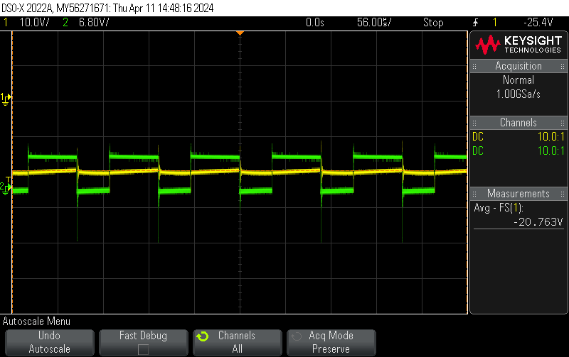
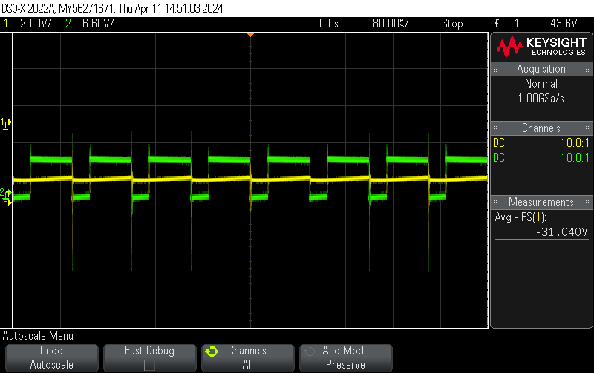
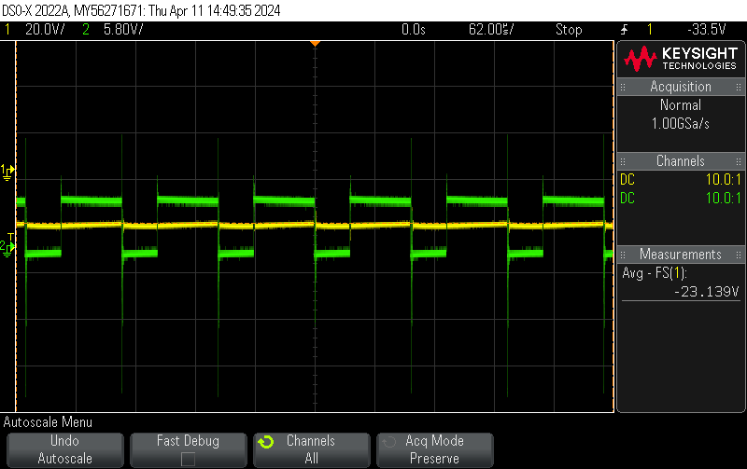
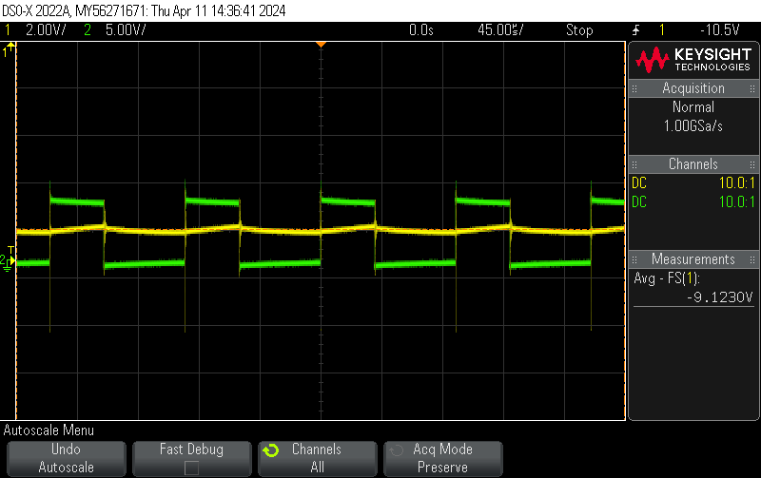
HARDWARE RESULTS : (BOOST MODE)
Duty=0.5 Vin=10v and Vout=9.123v

Slide 6
THANK YOU

