Slide 1
International Institute of Information Technology, Hyderabad
Study and Implement Van Emde Boas Tree and Splay tree and compare with Red Black Tree
Shubham Agrawal(2019201085)
Shrayans Jain(2019201086)

Slide 2
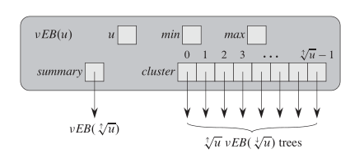
Van Emde Boas Tree
Van Emde Boas tree (or vEB tree) supports insert(), delete, find(), successor() and predecessor() operations in O(Log Log u) time, and max() and min() in O(1) time.

Slide 3
Recurrence Relation :
T(u) = T(√u) + O(1)
Solution of this recurrence is,
T(u) = O(Log Log u)

Slide 4
Splay Tree
Splay tree is also self-balancing BST like AVL and Red-Black Trees.
The main idea of splay tree is to bring the recently accessed item to root of the tree, this makes the recently searched item to be accessible in O(1) time if accessed again.
The idea is to use locality of reference (In a typical application, 80% of the access are to 20% of the items).

Slide 5
Operations :
Since, Splay is BST. All splay tree operations run in
O(log n) time on average, where n is the number of entries
in the tree.
Any single operation can take Theta(n) time in the worst
case.

Slide 6
Red-Black Tree
A red-black tree is a self-balancing binary search tree with one extra bit of storage per node: its color, which can be either RED or BLACK.
Properties
1. Every node is either red or black.
2. The root is black.
3. Every NULL leaf is black.
4. If a node is red, then both its children are black.
5. For each node, all simple paths from the node to descendant leaves contain the same number of black nodes.

Slide 7
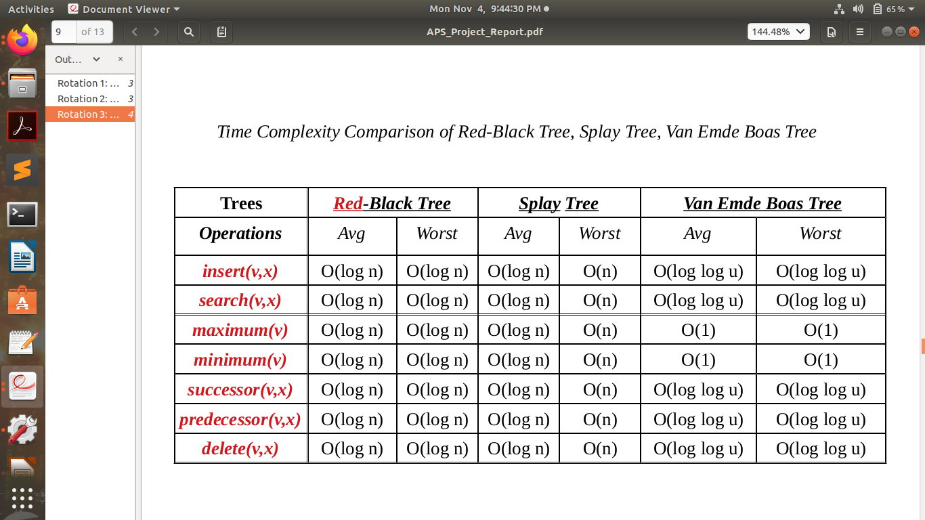
Time Complexity Comparison

Slide 8
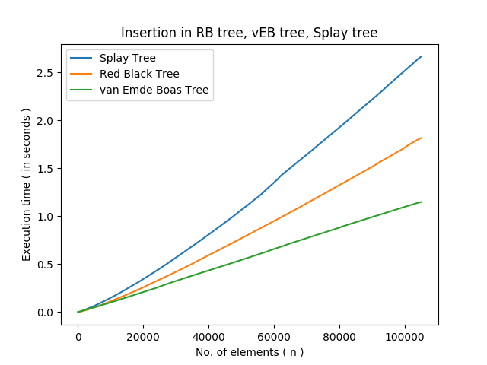
1. Insertion

Slide 9
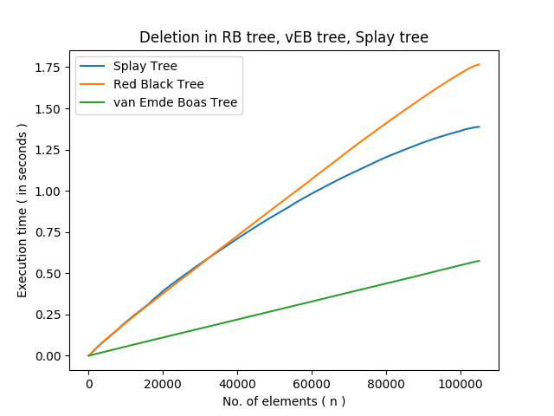
2. Deletion

Slide 10
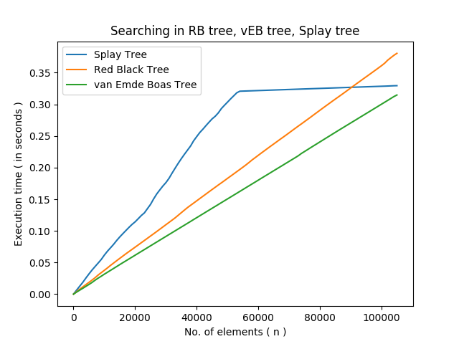
3. Search

Slide 11
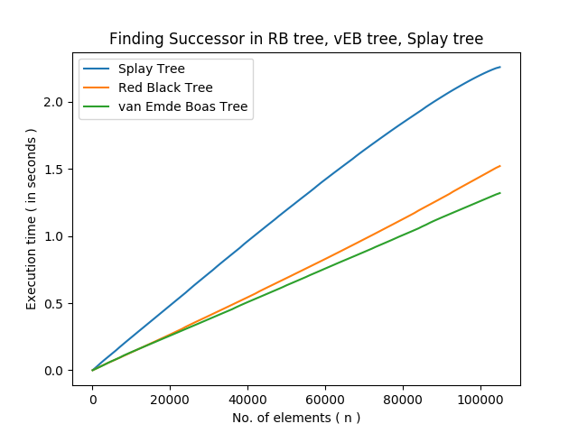
4. Successor

Slide 12
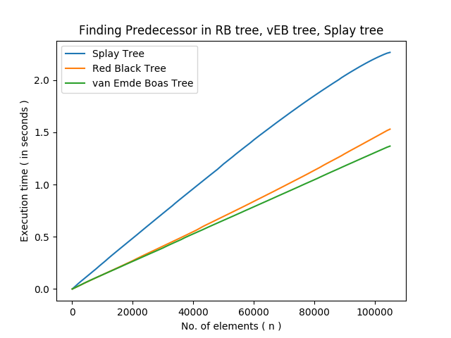
5. Predecessor

Slide 13
Conclusion:
If we know the range of the data set in advance, then we can go for van emde boas tree.
If we don’t the range in advance, then red black is the best choice.
If we want to improve the recent search time, then we should go for splay tree.

Slide 14
References:
https://ocw.mit.edu/divide-conquer-van-emde-boas-trees/
https://www.geeksforgeeks.org/
http://web.stanford.edu/class/cs166/lectures/14/Small14.pdf
Introduction to Algorithms ( CLRS book)

