Slide 1
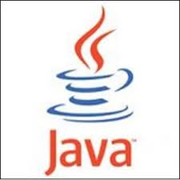

Slide 2
Introduction
JAVA is a general purpose object oriented programming language developed by Sun Microsystems of USA in 1991.
Originally called Oak by James Gosling, one of the inventors of the language.
Java was designed for the development of software for consumer electronic devices like TV, VCR etc.

Slide 3


Slide 4
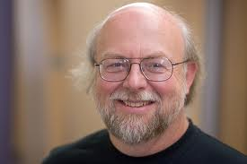

Slide 5
Java Features
Compiled and Interpreted.
Platform Independent and Portable.
Object Oriented.
Robust and Secure.
Distributed.
Familiar, Simple and Small.
Multithreaded and Interactive.

Slide 6
Compiled and Interpreted
Usually a computer language is either compiled or interpreted.
First, Java compiler translate source code into what is known as bytecode instructions.
In the second stage, Java interpreter generates machine code that can be directly executed by the machine that is running the Java programs.

Slide 7
Platform Independent and Portable
When programs were written in the traditional language, there was no guarantee that it would run (execute) on other platform or would run some other day because of continuous upgradations of the OS or processors etc.
The Java language had the JVM that made an attempt to overcome this problem.

Slide 8
Object Oriented
Java is a true object-oriented language.
Almost everything in Java is an Object.
The object model in Java is simple and easy to extend.

Slide 9
Robust and Secure
Java is a robust language. It provides many safeguards to ensure reliable code. It has strict compile & runtime checking for data types. Deallocation of memory in Java is completely automatic as Java provides a garbage collection for unused objects.
Security becomes an important issue for a language that is used for programming on Internet. Java system not only verify all memory access but also ensure that no viruses are communicated with an Applet.

Slide 10
Distributed
Java is designed as a distributed language for creating applications on networks. It has the ability to share both data & programs.
Java applications can open & access remote objects on Internet as easily as they can do in a local system.
It is capable of handling the TCP / IP protocols.

Slide 11
Familiar, Simple and Small
Java is a small & simple language.
If a person is well versed with C or C++ syntax & generics, it will not be difficult to understand the Java language.

Slide 12
Multithreaded & Interactive
Multithreaded means handling multiple tasks simultaneously.
Java supports multithreaded programs. This means that we need not wait for the application to finish one task before beginning another.

Slide 13
JVM

Slide 14
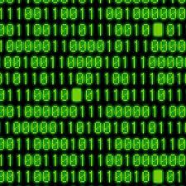


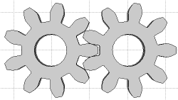
Class Demo
{
~~~~~~~
~~~~~~
~~~~~~
}
2
3
Hello Java
bytecode
Program
.class
Final Output
.java
JVM
Java Compiler
Java Interpreter
JIT Compiler
.obj
1
javac
4

Slide 15
Java Virtual Machine (JVM)
The output produced by a Java compiler is not an executable code.
It is a “byte code”.
A byte code is a highly optimized set of instructions that are executed by the Java run time system, which is commonly referred as Java Virtual Machine (JVM).
JVM is an interpreter for the byte code.
Byte Code requires JVM for execution.

Slide 16
Java Development Kit (JDK)
The JDK is a software package from the Sun Microsystems. It provides tools for users of the Java language to integrate & execute applets & applications.
It also contain libraries necessary to create & execute Java applications & applets.

Slide 17
Java Development Kit (JDK)
Appletviewer – for viewing Java applets.
Javac – Java compiler.
Java – Java interpreter.
Javah – for C header files.
Javadoc – for creating HTML documents.
Jdb – Java debugger.

Slide 18
Java
Source
Code
Java
Compiler
Applet
Type
Application
Type
Java
Web Browser
Java
Interpreter
Output
Output

Slide 19
General structure of a Java Program
Documentation Section
Package Statement
Import Statements
Interface Statements
Class Definition
Main Method

Slide 20
C++
Java
C++ is platform-dependent.
C++ is mainly used for system programming.
C++ supports operator overloading.
C++ supports pointers. You can write pointer program in C++.
C++ uses compiler only.
C++ supports both call by value and call by reference.
C++ supports structures and unions.
C++ supports multiple inheritance.
Java is platform-independent.
Java is mainly used for application programming.
Java doesn't support operator overloading.
Java supports pointer internally. We can't write the pointer program.
Java uses compiler & interpreter both.
Java supports call by value only.
Java doesn't support structures and unions.
Java doesn't support multiple inheritance through class. It can be achieved by interfaces in java.

Slide 21
Sample Java Program
class Test
{
public static void main(String[] args)
{
System.out.println(“Welcome to K2");
}
}

Slide 22
public
It is an Access modifier, which specifies from where and who can access the method.
Making the main() method public makes it globally available.
It is made public so that JVM can invoke it from outside the class as it is not present in the current class.
Error: Main method not found in class, please define the main method as:
public static void main(String[] args) or a JavaFX application class must extend javafx.application.Application

Slide 23
static
It is a keyword which is when associated with a method, makes it a class related method.
The main() method is static so that JVM can invoke it without instantiating the class.
This also saves the unnecessary wastage of memory which would have been used by the object declared only for calling the main() method by the JVM.
Error: Main method is not static in class test, please define the main method as:
public static void main(String[] args)

Slide 24
void
It is a keyword and used to specify that a method doesn’t return anything.
As main() method doesn’t return anything, its return type is void. As soon as the main() method terminates, the java program terminates too.
Hence, it doesn’t make any sense to return from main() method as JVM can’t do anything with the return value of it.
Error: Main method not found in class, please define the main method as:
public static void main(String[] args) or a JavaFX application class must extend javafx.application.Application

Slide 25
main
It is the name of Java main method. It is the identifier that the JVM looks for as the starting point of the java program. It’s not a keyword.
Error: Main method not found in class, please define the main method as:
public static void main(String[] args) or a JavaFX application class must extend javafx.application.Application

Slide 26
String[] args
It stores Java command line arguments and is an array of type java.lang.String class. Here, the name of the String array is args but it is not fixed and user can use any name in place of it.
Apart from the above mentioned signature of main, you could use
public static void main(String args[]) or
public static void main(String… args)
to call the main function in java.

Slide 27
Data Types
Every variable in Java has a Data type.
Data type specify the size & type of values that can be stored.
Primitive types also called Intrinsic or Built in types.
Derived types also known as reference types.

Slide 28
Data Types in Java
Primitive (Intrinsic)
Non-Primitive (Derived)
Numeric
Non-Numeric
Classes
Arrays
Character
Boolean
Interface
Integer
Floating Point

Slide 29
Variables
A variable is an identifier that denotes a storage location used to store a data value.
Variable may take different values at different times during the execution of the program.
Variable must begin with alphabet or underscore ( _ ).
It should not be a keyword.
White space is not allowed.
Digits can be used in variable name.
Variable names can be of any length.
Uppercase & Lowercase are distinct.

Slide 30
Decision making & Branching
Java supports two branching or selection statements.
They enable to control the flow of the program execution.
If statement
Switch statement

Slide 31
If & Switch stetment
If (condition) switch (variable)
{ {
True value case val1:
} break;
else case val2:
{ break;
False value default :
} }

Slide 32
The ? : operator
Java includes the ternary operator (?) that replace the if then else in a way.
Expression1 ? Expression2 : Expression3
ans= (a>b) ? “A” : “B”;

Slide 33
Decision Making & Looping
The process of repeatedly executing a block of statements is known as looping.
Java does not define goto statement.
Java supports three looping statements
The while statements.
The do statements.
The for statements.

Slide 34
While & Do
while (condition) do
{ {
------- -------
------- -------
} } while (condition);

Slide 35
For
for ( initialition ; condition ; inc./dec. )
{
-----------
-----------
}

Slide 36
Jumps in loops
while (condition) do
{ {
------- -------
if (condition) if (condition)
{ {
break; break;
} }
} } while (condition);

Slide 37
Jumps in loops
for (------------) for
{ {
------- for(---------)
if (condition) { if (condition)
{ {
break; break;
} }
} }
}

Slide 38
Jumps in loops
while (condition) do
{ {
------- -------
if (condition) if (condition)
{ {
continue; continue;
} }
} } while (condition);

Slide 39
Jumps in loops
for (------------)
{
-------
if (condition)
{
continue;
}
}

Slide 40
Labelled Loop
According to nested loop, if we put break statement in inner loop, compiler will jump out from inner loop and continue the outer loop again.
What if we need to jump out from the outer loop using break statement given inside inner loop?
The answer is, we should define lable along with colon(:) sign before loop.

Slide 41
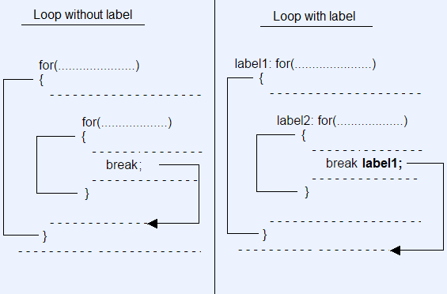
Labelled Loop

Slide 42
for-each Loop
The for-each loop is used to traverse array or collection in java. It is easier to use than simple for loop because we don't need to increment value and use subscript notation.
It works on elements basis not index. It returns element one by one in the defined variable.
for(Type var : array)
{
//code to be executed
}

Slide 43
Thank You
9130013411

