Slide 1
Inheritance

Slide 2
Inheritance
Inheritance is one of the most important concept in object-oriented programming.
The mechanism of deriving a new class from an old one is called Inheritance or Derivation.
It is always better to reuse something that already exists rather than trying to create the same again.
The reuse of a class that has already been tested, debugged and used many times can save the effort to developing and testing.

Slide 3
Car
Sports Car
Luxury Car
Sports Car and Luxury Car are sub classes or child classes of Car class and Car class is the super or parent class of Luxury Car and Sports Car.

Slide 4
Each subclass inherits all variables and methods from the super class except private variables and methods.
However, subclasses are not limited to the variables and methods provided to them by their super class.
Subclasses can add variables and methods or can change the definition of the existing methods according to their own requirements.

Slide 5
Deriving Classes
We use extends keyword to create child class in java as follows:
class child-class extends parent-class
{
Class body
…
}

Slide 6
class Shape
{
}
class Oval extends Shape
{
}
class Triangle extends Shape
{
}

Slide 7
Java Class Hierarchy
The topmost class in the java class hierarchy is called “Object”.
If you declare a class which does not sub class of any super class than your class is considered to be the child class of the class Object.

Slide 8
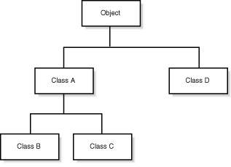
Java Class Hierarchy

Slide 9

Types of Inheritance
Single Inheritance
Multilevel Inheritance
Hierarchical Inheritance

Slide 10
Single Inheritance
A derived class with only one base class is called Single Inheritance.
A
B

Slide 11
Multilevel Inheritance
The mechanism of deriving a class from another derived class is known as Multilevel Inheritance.
A
B
C

Slide 12
Hierarchical Inheritance
If more than one class inherits properties of one class then it is known as Hierarchical Inheritance.
A
B
C

Slide 13
Constructor Calling Order
When you create an object of child class then child class constructor first calls the parent class default constructor before it performs its own initialization.
The parent class constructor calls its super class constructor and so on.
This is necessary because if the parent class is not properly initialize how the child class object can be created properly.

Slide 14
super
If you don’t want to invoke the default constructor of super class but want other constructor than you use super to invoke the parent class constructor.
super(4);
This will invoke the parent class constructor that would take one int argument. Call to parent class constructor with super would be the first statement in the child class constructor.

Slide 15
You can also invoke any method or variable of super class in the child class with the super keyword.
super.methodname( );
super.variablename = 7;

Slide 16
Method
Overriding

Slide 17
Method Overriding
When a child class defines a method with the same name and signature as the parent, then it is said that the child’s version overrides the parent’s version.
When an overridden method is called from child class object, the version in the child class is called not the parent class version.

Slide 18
The return type, method name, number and type of the parameters of overridden method in the child class must match with the method in the super class.
You can call the super class method from the child class with super keyword.
super.overriddenMethodName( );

Slide 19
Final
Keyword

Slide 20
final keyword has three usages:
Final Keyword
Variables
Classes
Methods
To create constants
To prevent inheritance
To prevent method overriding

Slide 21
1. Final variables
Final modifier used with the variables specify that the variable has a constant value and it cannot changed.
If final variable is declared but not yet initialized, it’s called a blank final variable or uninitialized final variable. It can be initialized in the constructor only.
The blank final variable can be static, which will be initialized in the static block only.
final double PI = 3.14;

Slide 22
2. Final methods
When we use the keyword final with methods then it specifies that the method cannot be overridden in the child class.
Is final method inherited? : Yes, final method is inherited but you cannot override it.
What is final parameter? : If you declare any parameter as final, you cannot change the value of it.
Can we declare a constructor final? : No, because constructor is never inherited.
final void volume( )
{
}

Slide 23
3. Final classes
The keyword final can be applied to classes. If this is done, the class cannot be inherited. This provides security features and stops further extensions of the class.
All Wrapper Classes like Integer, Float etc. are final classes. We cannot extend them.
use of final with classes is to create an immutable class like the predefined String class. You cannot make a class immutable without making it final.
final class City
{
}

Slide 24
Abstraction

Slide 25
Abstract Classes
An abstract class is a class that is partially implemented and whose purpose is solely represent abstract concept.
Abstract classes are made up of one or more abstract methods.
Abstract classes cannot be instantiated because they represent abstract concept.

Slide 26
Abstract Class Declaration
public abstract class Food
{
}
As Food is abstract class so the following statement will not compile.
x
Food f = new Food();

Slide 27
Abstract Methods
An abstract method is a method which has no implementation (method body).
The body of this method is provided by a subclass of the class in which the abstract method is declared.
The syntax of abstract method is:
public abstract void draw( );

Slide 28
Abstract Classes & Methods Concepts
Abstract class cannot be instantiated, it means cannot create object of abstract class with new keyword.
Abstract class can only be sub classed.
A class derived from abstract class must override all of the parent class’s abstract methods. If it does not define all methods then it will declare itself as abstract.
An abstract class can inter mix abstract and non abstract methods.
An abstract method is a method which has no implementation (body).
Abstract class and method cannot be declared as final, static or private.

Slide 29
Interface

Slide 30
Interface
An interface defines a protocol of behaviour that can be implemented by any class anywhere in the class hierarchy either they are related or not.
An interface defines a set of methods but does not implement them.
A class that implements the interface agrees to implement (method body) all the methods defined in the interface.

Slide 31
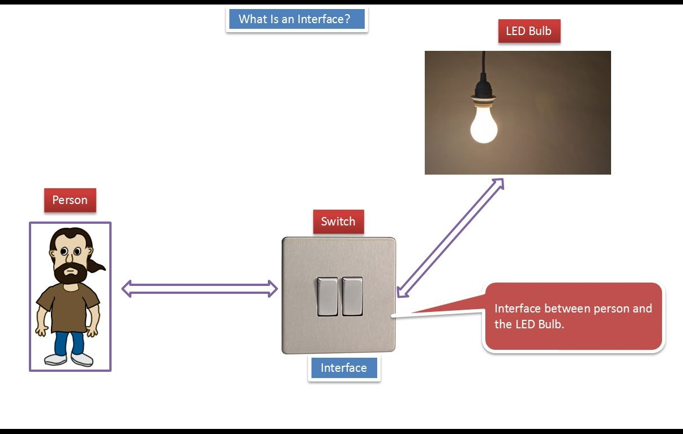

Slide 32
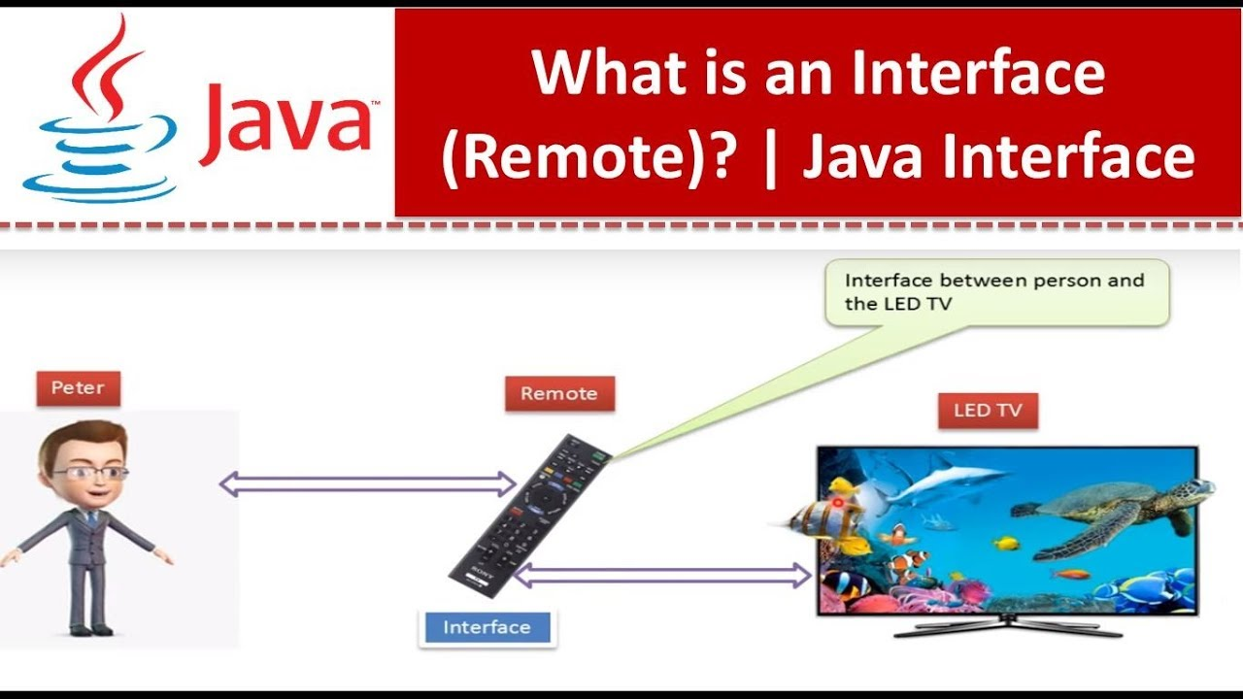

Slide 33
Declaring Interface
public interface Database
{
public final static int a = 4;
public final static int b = 5;
public abstract void insert();
public abstract void update();
public abstract void delete();
}
All variables are public final & static by default
All methods are public abstract by default

Slide 34
Implementing Interface
public class Oracle implements Database
{
public void insert( )
{}
public void update( )
{}
public void delete( )
{}
}
The above class must need to define all the methods in the interface Data.

Slide 35
Implementing Multiple Interfaces
Class can implement more than one interface.
public class Oracle implements Database, Connection, Command
{
}
Now this class has to define all the abstract methods of Database, Connection & Command interfaces.

Slide 36
Interfaces Inheritance
An interface can extend another interface.
public interface Database
{
}
public interface MySql extends Database
{
}

Slide 37
Interfaces & Multiple Inheritance
An interface can extends any number of interfaces.
public interface Database
{
}
public interface Con
{
}
public interface MySql extends Database, Con
{
}

Slide 38
Interface
vs.
Abstract Class

Slide 39
Interface
Abstract Class
Interface is declared with the interface keyword.
Abstract class is declared with the class keyword.
An interface cannot define any method (no body).
An abstract class can define some methods.

Slide 40
Interface
Abstract Class
We implement interface on class using implements keyword.
We extends abstract classes using extends keyword.
We can implement multiple interfaces on a single java class.
We can not extend more than one abstract class.
Interfaces are not part of the class hierarchy.
Abstract classes are part of the class hierarchy.

Slide 41
Nested
Classes

Slide 42
Nested Classes
Java lets you define a class as a member of another class. These classes are called nested classes.
As a member of its enclosing class, a nested class has a special privilege:
It has unlimited access to its enclosing class's members, even if they are declared private.

Slide 43
public class Shape
{
public class Point
{
}
}
Like static variables and methods, a nested class can also be declared static.
A static nested is called just a static nested class.
A non-static nested class is called inner class.

Slide 44
Creating Object of Nested Class
public class Shape
{
Point p = new Point();
public class Point
{
Shape s = new Shape();
}
}
Inner class object
Outer class object

Slide 45
Creating Object of Nested Class in Third Class
public class Shape
{
public class Point
{
}
}
public class Test
{
public static void main(String args[])
{
Shape.Point p = new Shape().new Point();
}
}
Inner class object

Slide 46
Extending Nested Class through Inheritance
public class Shape
{
public class Point
{
}
}
public class Oval extends Shape
{
public class CenterPoint extends Shape.Point
{
}
}

Slide 47
9130013411
Thank You

