Slide 1




Group Project: Labour Economics
Labour Participation of Urban married women in India
Presented by:
Bhut Shubham Kishorbhai (H77-25)
Abantika Karmakar (H74-25)
Farzana Ehsaan (H14-25)
Shivam Bhardwaj (H64-25)
Botta Navaneeth (H65-25)
Teella Bharath Kalyan (H86-25)

Slide 2



CORE ECONOMIC QUESTION & RELEVENT LABOR MARKET CONCEPTS
CORE QUESTION: How do preferences and wage rates affect the labour participation decision of married women in urban India?
Labour Supply Theory (Work–Leisure Choice)
Labour supply reflects time allocation between paid work and leisure based on wages and preferences, including unpaid household work.
Substitution Effect
Higher wages increase the incentive to work by raising the relative return to labour.
01
02
Income Effect
Higher household income reduces labour supply; in urban India, husband’s income often leads to withdrawal.
Household Decision-Making Models
Labour supply decisions are made at the household level, with husband’s earnings acting as non-labour income.
04
03
Opportunity Cost of Time
Domestic and childcare responsibilities raise the cost of market work, discouraging participation.
05
Notes:
The labour market behaviour of married women in urban India presents a significant economic paradox. Despite robust GDP growth, falling fertility rates, and rising female educational attainment, the Urban Female Labour Force Participation Rate (LFPR) remains stubbornly low compared to global peers. This phenomenon defies the standard development trajectory observed in East Asian and Western economies.

Slide 3
DATA & INTERPRETATION
Data Source: Periodic Labour Force Survey (PLFS), 2023–2024
Final sample: ~40k urban married women (from ~400k observations) analyzed on 30 parameters
Social Group | Count | Share of Population (%) | Participation Rate (%)
Scheduled Tribe (ST) | 3152 | 7.9 | 43.8
Scheduled Caste (SC) | 5978 | 14.9 | 28.8
OBC | 17057 | 42.6 | 24.5
General/Others | 13896 | 34.7 | 21.6
Education | Participation Rate (%) | Median Monthly Wage (₹)
4. Post-Grad+ | 40.038536 | 35000.0
1. Low/Illiterate | 28.998399 | 5000.0
3. Graduate/Tech | 24.060275 | 15000.0
2. Middle/Secondary | 23.755622 | 6500.0
LFPR issue is participation, not unemployment: Only 1.7% unemployed; 71% out due to domestic duties.
Necessity drives work, not wages: ST women show highest participation despite low earnings.
Income effect dominates for others: OBC & General groups have low participation despite higher incomes.
Education shows U-shape: Participation lowest at mid-education levels despite moderate wages.
Wage dispersion & skill gaps weaken incentives: Highly skewed wages and limited technical training reduce returns to work.
Notes:
1 min

Slide 4
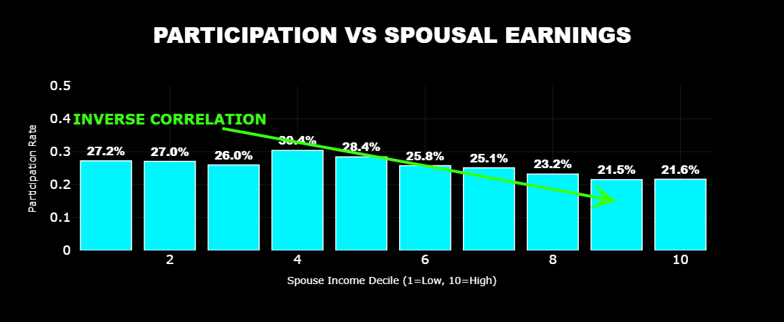
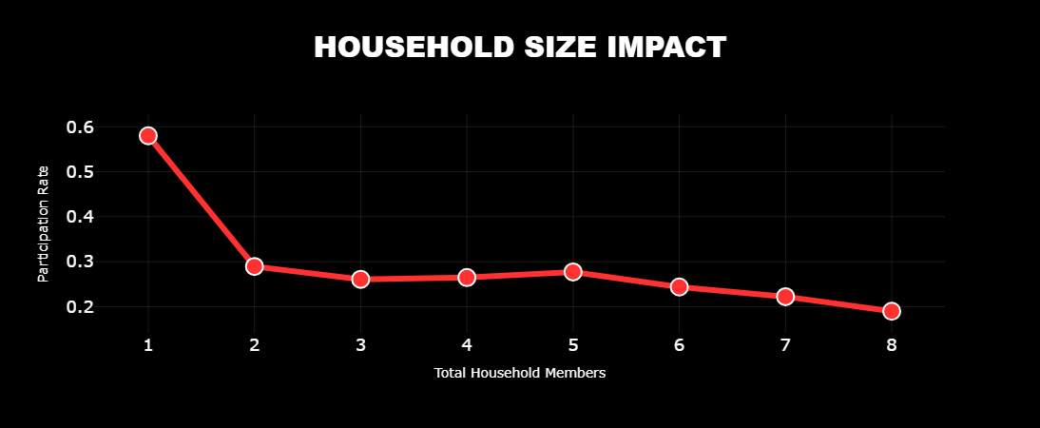
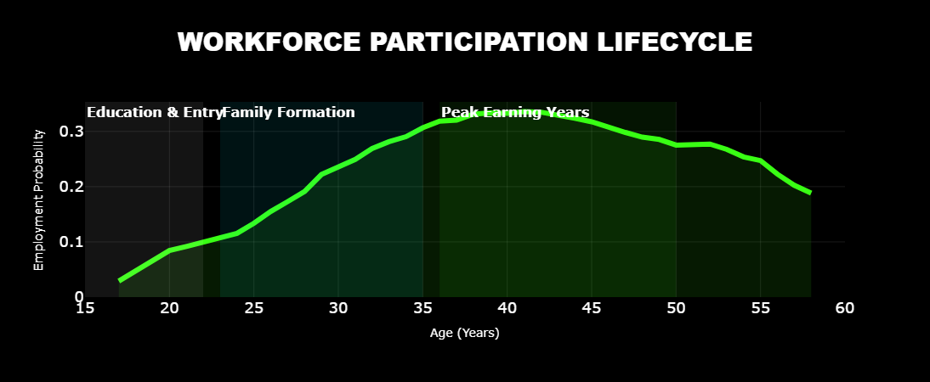
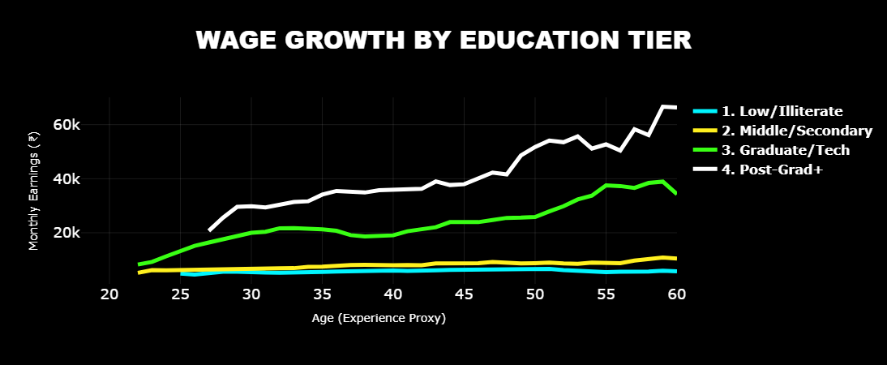
KEY INSIGHTS
Notes:
1.5 min

Slide 5


PREDICTIVE ANALYTICS WITH MACHINE LEARNING
Employment prediction
Wage prediction
Random Forest Classification (Participation)
Age is the strongest predictor, while higher spousal income significantly reduces participation.
Household size lowers participation, and higher qualifications do not ensure labour market entry.
Random Forest Regression (Wages)
Though weak for Employment participation, Education is strongest predictor of wage.
Factors affecting wages differ from those affecting participation, underscoring non-wage constraints on labour supply.
Notes:
1.5 min

Slide 6
CONCLUSION
• Labour supply decisions of married women in urban India are driven primarily by household income, life-cycle constraints, and social norms rather than wages alone.
• Education strongly increases wages but has a limited effect on labour force participation, revealing a persistent participation–wage mismatch.
• Income effects arising from spousal earnings significantly reduce women’s labour supply, especially during prime working ages.
• Household size and childcare responsibilities raise the opportunity cost of market work, further discouraging participation.
• The evidence points to non-linear and context-dependent labour supply behaviour, underscoring the limits of purely market-based explanations.
Notes:
.5 min

Slide 7

THANK YOU
Dashboard link: : https://plfsanalysis.streamlit.app/

Slide 8
Appendix
PLFS Datasource: https://microdata.gov.in/NADA/index.php/catalog/213
All the code involving Data Processing, Analysis and Machine Learning models: https://github.com/ShubhamBhut/PLFS-Analysis---LE-Assignment

