Slide 1

Introduction to Programming
A Step-by-Step Introduction

Slide 2
Introduction to Programming
Definition:
Programming is the process of designing and building an executable computer program to accomplish a specific computing result.
Importance:
Understanding programming is crucial as it is the foundation of software development.

Slide 3
Steps in Programming
1. Problem Definition: Understand the problem you need to solve.
2. Algorithm Design: Create a step-by-step solution.
3. Flowchart Creation: Visual representation of the algorithm.
4. Coding: Writing the code in a programming language.
5. Testing: Running the program to find and fix errors.
6. Debugging: Identifying and resolving issues in the code.

Slide 4
Understanding Flowcharts
Definition:
A flowchart is a diagram that represents a process or algorithm, showing the steps as various boxes of different kinds, and their order by connecting them with arrows.
Key Symbols:
Oval: Start/End
Rectangle: Process
Diamond: Decision
Arrow: Flow of Control

Slide 5
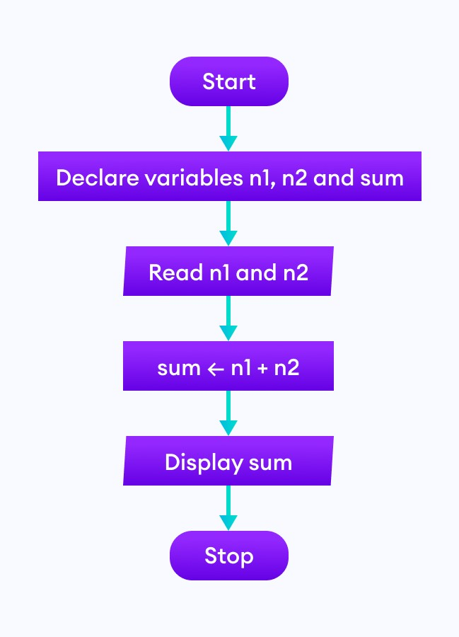
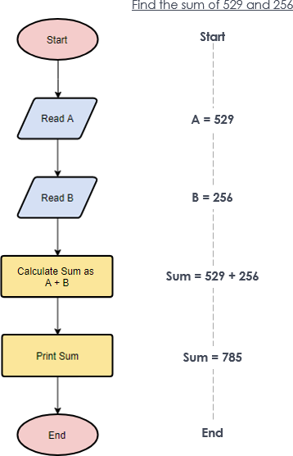
Examples of Flowchart

Slide 6
Introduction to Algorithms
Definition:
An algorithm is a finite sequence of well-defined steps to solve a specific problem.
Characteristics:
Finiteness: Must terminate after a finite number of steps.
Definiteness: Each step must be precisely defined.
Input/Output: Should take inputs and produce outputs.

Slide 7
Example of Algorithm
Algorithm to Find the Largest of Two Numbers
Step 1: Start
Step 2: Input two numbers: A and B
Step 3: If A is greater than B, then A is the largest.
Step 4: Else, B is the largest
Step 5: End
This algorithm directly compares two numbers and identifies the larger one.

Slide 8
Coding Concepts
Variables: Storage locations identified by a name.
Data Types: Types of data (e.g., int, float, char).
Control Structures: If-else, loops (for, while).
Functions: Reusable code blocks that perform a specific task.
Syntax: The set of rules that defines the combinations of symbols considered correctly structured.

Slide 9
Types of Programming Languages
Machine-Level Language:
Description: Low-level language consisting of binary code (0s and 1s).
Pros/Cons: Fast execution but difficult to understand and write.
2. Assembly Language:
Description: Low-level language with symbolic code, easier than machine code.
Pros/Cons: Easier than machine code but still complex.
3. High-Level Language:
Description: Languages closer to human languages (e.g., Python, Java).
Pros/Cons: Easier to read, write, and maintain but less efficient than low-level languages.

Slide 10
Conclusion
Summary:
Recap of the steps in programming, the importance of flowcharts, algorithms, and the types of programming languages.
Final Thoughts:
Programming is a skill that combines logic, creativity, and problem-solving.
Almost all programs consist of the same basic 'building blocks', assembled in different ways to achieve a particular goal.
Variables, data types, sequence, selection, and iteration are examples of these basic concepts, which all new programmers need to learn.

