Slide 1

Autonomous Weed Cutter
TCTD Challenge
Inter IIT Tech-Meet 2018 IIT Patna

Slide 2
OBJECTIVE
To design farm tools that reduce drudgery and provide intelligent automation.

Slide 3
Problems Faced by Farmers
Sowing of seeds in the fields at proper distance and proper spacing.
Transplantation of germinated wheat, maize and paddy grains to new fields.
Removing of weeds grown in between the rows of crops, plantation and trees
Use of costly and harmful herbicides (to eliminate the weeds), which affects the crop a lot.
Problem of pests and insects that grow on the crops destroying them.
Huge amount of water required to irrigate the crops.
Problem of Cattle : they harm and destroy plants and crops on a mass scale.
Problem of harvesting and planting of crops for small scale farmers due to lack of manual labor.

Slide 4
Post survey analysis
Inference of problems faced by farmers-
Absence of technological resources and education (crop advisories & information about the weather forecast, natural calamities, automation (sensor based) real-time control functions, Irrigation & Fustigation scheduling etc. to optimize per unit inputs to outputs ).
Improper irrigation (only one-third of the cropped area is under irrigation).
Lack of Mechanization (most of the agricultural operations in larger parts are carried on by human hand using simple and conventional tools and implements).
Reluctance to accept complex solutions
Majority farmers in India have small farms

Slide 5
Discussion with farmers and stakeholders
Idea | Reasons for rejection
AUTOMATED WATERING AND IRRIGATION | Surface Irrigation is widely used
CROP SPRAYING | Not feasible for small farms
WEED REMOVAL SYSTEM | Accepted
SEEDLING TRANSPLANTER | Unsuitable conditions for an automation
FIELD MONITORING USING DRONES | Reluctant to accept complex technology

Slide 6
Autonomous Weed Remover

Slide 7
Reasons for selection
Economically Feasible
Acquiescent
Applicable in diverse farms
Energy Efficient

Slide 8
Existing solutions
Manual removal (manually plucking)
Thermal removal (flame weeder)
Buried drip irrigation (limiting weeds access to water)
Herbicides (selective herbicides kill certain targets, leaving the desired crop relatively unharmed)
Mechanical solutions (power weeder or weed cutters)

Slide 9
Working Principle
Differentiate the main Crop & weed from the field
Uproots the weeds
Prevents harm to the sown crop by turning away from it

Slide 10


Slide 11
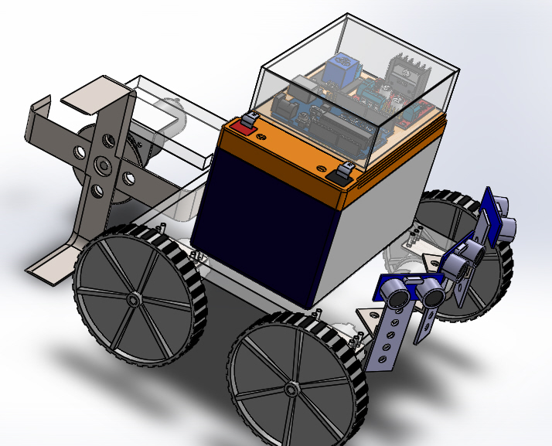
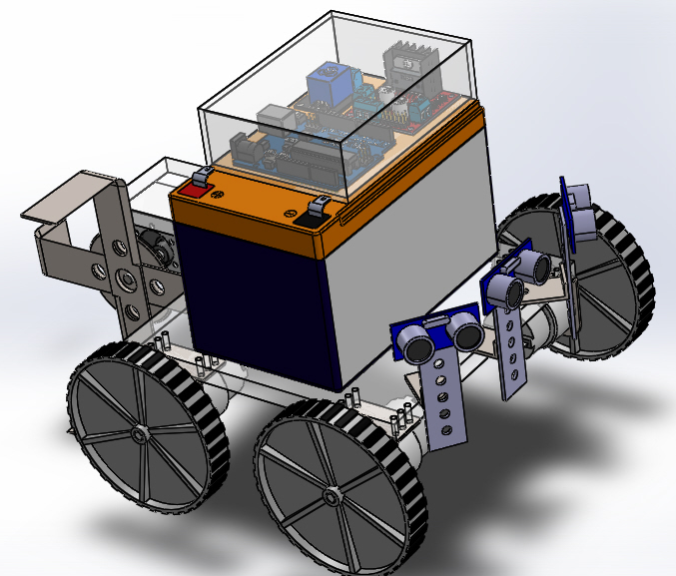
CAD Model

Slide 12
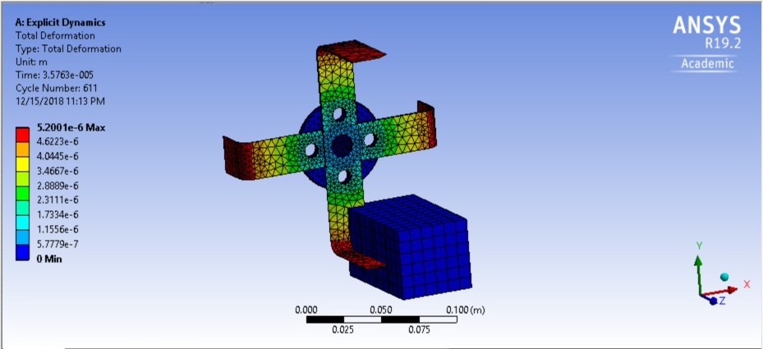
Dynamic Analysis

Slide 13
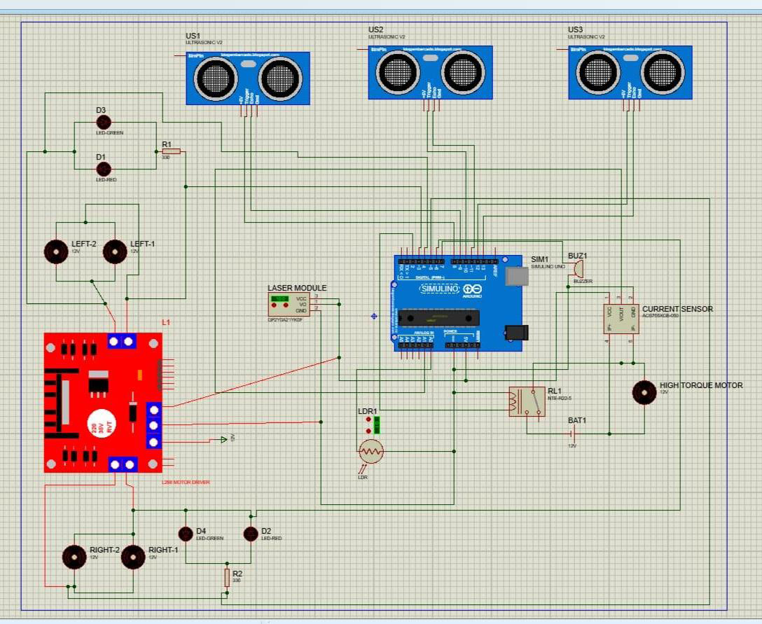
CIRCUIT SCHEMATIC

Slide 14
Comparative Study between different types of Proximity Sensors
Characteristics | Inductive | Capacitive | Ultrasonic | VL53L0X
Material sensed | Ferrous Metals | Liquid, metals, dry goods | All Materials | All Material
Sensing distance | 0.5-120mm | 0 -50 mm | 0-50 mm | 5-2000 mm
Sensitivity | Good | Good | Excellent | Very good
Cost | 290 INR | 210 INR | 60 INR | 930 INR
Reliability | Very good | False trigger concern | False trigger concern | Good

Slide 15
COST INCURRED & EFFICIENCY CALCULATIONS
Battery life = 3.5 hrs = 1 basketball court area
1 Bigha = 8 basketball courts (7.87 exact)
1 Hectare = 3 Bighas (2.92 exact)
This infers about 8*3 = 24 charges required per hectare
Battery life- 250 cycles
10 hectares with a battery
Cost of electricity (for 10 Ha) = (12*9.2*240*6.5) / ( 1000*0.8) INR = 229.32 INR
( 12V operating voltage ; 9.2 Ahr battery ; Efficiency of battery 80% ; Cost per KWhr 6.5 )
Maintenance Cost : Cost of battery 2500 INR + Maintenance cost of components 800 INR
Therefore, cost incurred by our machine per hectare = 3530/10 = 353 INR

Slide 16
Business Analysis

Slide 17
Suitable Condition for working
Plantations should be on a planar region
Significant amount of intra-cropping distance
Minimum height difference of a few cm between the crop and weed

Slide 18
VEGETABLES Total area under cultivation : 10,290,000 Hectares Area our machine can be effective : 5,967,000 Hectares (57.1 %)
S.NO. | VEGETABLES | PRODUCTION | AREA
1 | Beans | 2278 | 230
2 | Bottle gourd |  | 157
3 | Brinjal | 12400 | 669
4 | Carrot | 1379 | 86
5 | Cucumber | 1142 | 78
6 | Chillies ( Green ) | 3406 | 287
7 | Lady Finger | 6146 | 528
8 | Bitter Gourd | 5452 | 546
9 | Potato | 46546 | 2164
10 | Radish | 2927 | 206
11 | Pumpkin | 1582 | 72
12 | Sweet Potato | 1639 | 135
13 | Tomato | 19697 | 809
TOTAL |  | 107166 | 5967

Slide 19
Crop | Fruits | Spices | Flowers & Aromatic | Others
Area under cultivation (Hectares) | 6,480,000 | 3,535,000 | 309,000 | Maze, Sugarcane and a few others increasing area by 36,170,000
Area suitable Machine (Hectares) | 584,000 | 763,000 | 309,000
27.44%

Slide 20
Total – 7769/-
PART | COST | QUANTITY | SUBTOTAL
ULTRASONIC SENSOR | 80/- | 3 | 240/-
LASER MODULE | 75/- | 1 | 75/-
LDR DETECTOR MODULE | 80/- | 1 | 80/-
LIPO BATTERY | 2500/- | 1 | 2500/-
ARDUINO | 250/- | 1 | 250/-
CURRENT SENSOR | 150/- | 1 | 150/-
BUZZER | 20/- | 1 | 20/-
RELAY SWITCH | 79/- | 1 | 79/-
MOTOR DRIVER | 80/- | 1 | 80/-
BATTERY CHARGER | 2300/- | 1 | 2300/-
COPPER CLAD BOARD | 80/- | 1 | 80/-
 |  | TOTAl | 5854/-
ACCESSORIES | PART COST | QUANTITY | SUBTOTAL
MACHINE SCREW | 5/- | 16 | 80/-
JOHNSON MOTORS | 800/- | 1 | 800/-
BASE MOTORS | 120/- | 4 | 480/-
MOTOR CLAMPS | 20/- | 4 | 80/-
MOTOR CLAMPS(JOHNSON) | 15/- | 1 | 15/-
WHEEL | 20/- | 4 | 80/-
CUTTER AND COMPONENTS | 100/- | 1 | 100/-
COUPLING | 129 | 1 | 129
 |  | TOTAL | 1635/-
MISCELLANEOUS
JUMPER | 1/- | 30 | 30/-
GLUESTICK | 10/- | 2 | 20/-
SOLDER WIRE |  |  | 10/-
PLYWOOD |  |  | 200/-
TAPE | 10/- | 2 | 20/-
 |  | TOTAL | 280/-

Slide 21
Further modifications and scope
We interacted with some governmental and non-governmental organizations such as Udyog Mitra; BIA (Bihar Industries Udyog Association); Department of Agriculture, Government of Bihar etc. and collected their feedback and reviews on our machine
An improvement in chassis and suspension system would widen the target areas of our machine.
Proximity sensors can be included in the design which would detect presence of any intruder in the field such as cows, Nilgais (Blue Bulls) etc.
A GPS tracker can be added in our machine so that it doesn’t go back to areas where the field has been already weeded.
Appropriate sensors which can measure the length of main crop will prove to be a boon for the farmers as this would give them information about the proper development of the crop and also warn them against any problem.
We could provide our machine in various sizes.

