Slide 1
PART I
Overview of
Data Communications
and
Networking

Slide 2
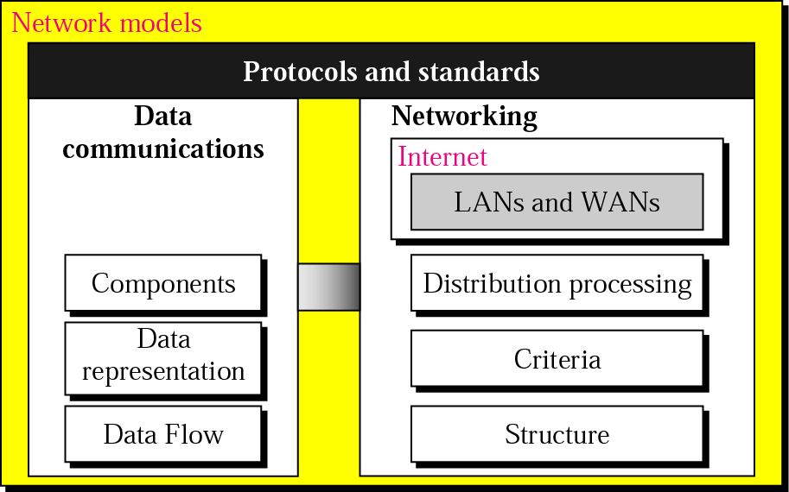
Overview

Slide 3
Chapters
Chapter 1 Introduction
Chapter 2 Network Models

Slide 4
Chapter 1
Introduction

Slide 5
1.1 Data Communication
Components
Data Representation
Direction of Data Flow

Slide 6
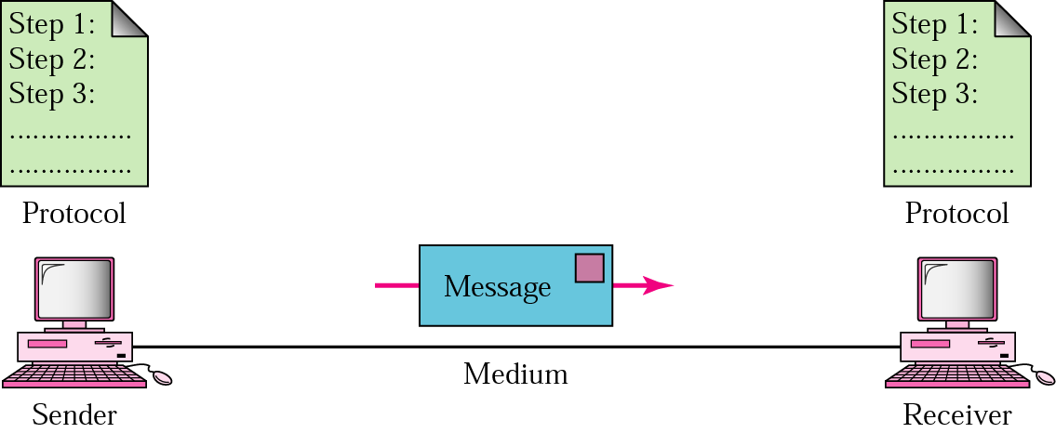
Figure 1.1 Five components of data communication

Slide 7
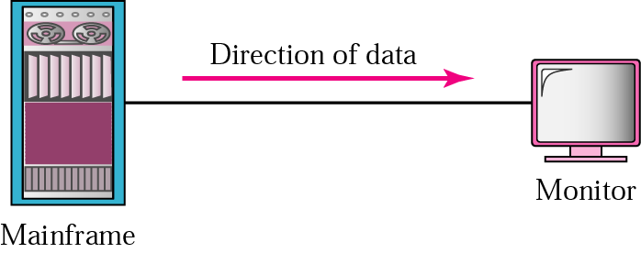
Figure 1.2 Simplex

Slide 8

Figure 1.3 Half-duplex

Slide 9

Figure 1.4 Full-duplex

Slide 10
1.2 Networks
Distributed Processing
Network Criteria
Physical Structures
Categories of Networks

Slide 11
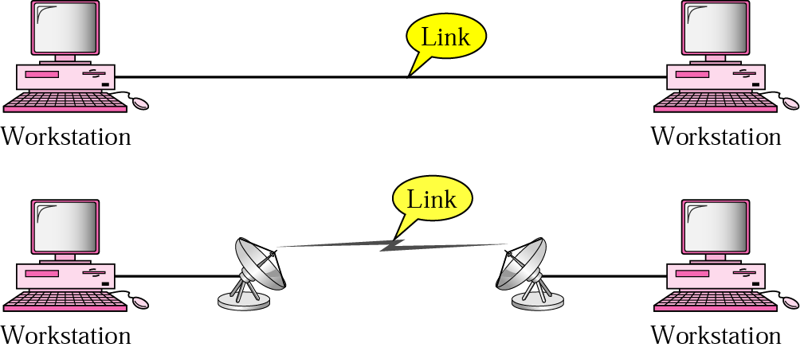
Figure 1.5 Point-to-point connection

Slide 12
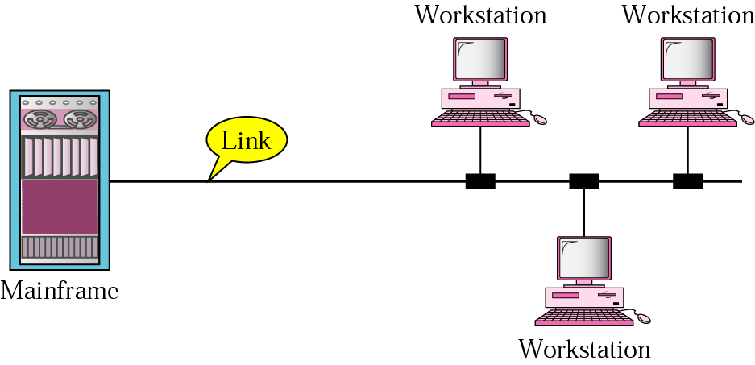
Figure 1.6 Multipoint connection

Slide 13
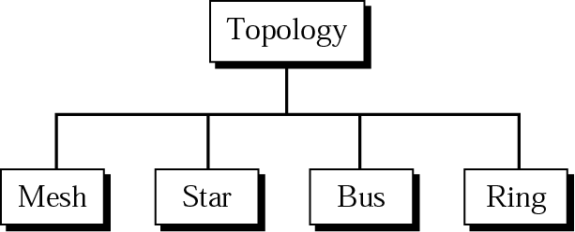
Figure 1.7 Categories of topology

Slide 14
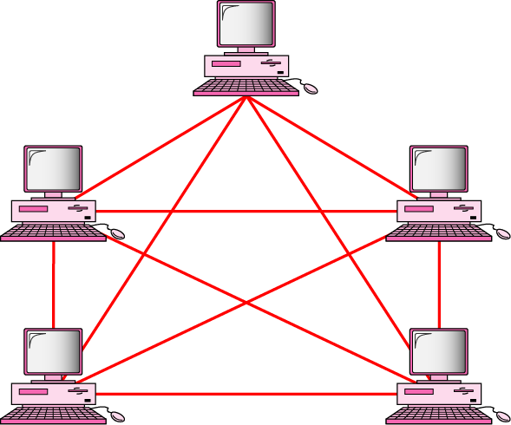
Figure 1.8 Fully connected mesh topology (for five devices)

Slide 15
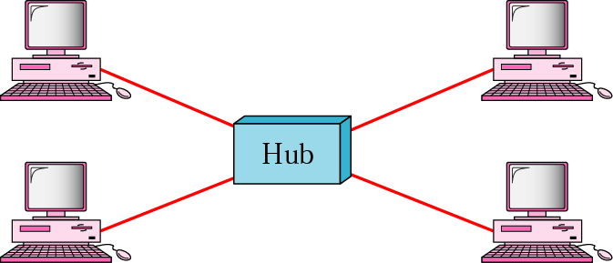
Figure 1.9 Star topology

Slide 16
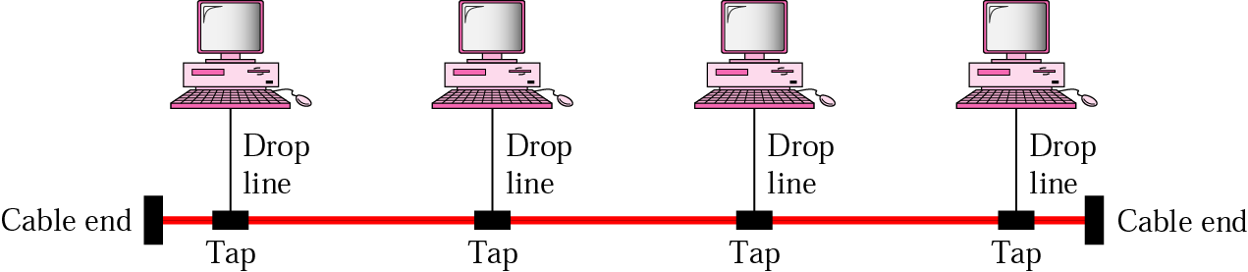
Figure 1.10 Bus topology

Slide 17
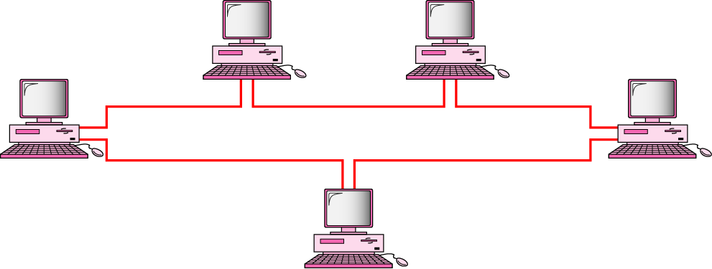
Figure 1.11 Ring topology

Slide 18
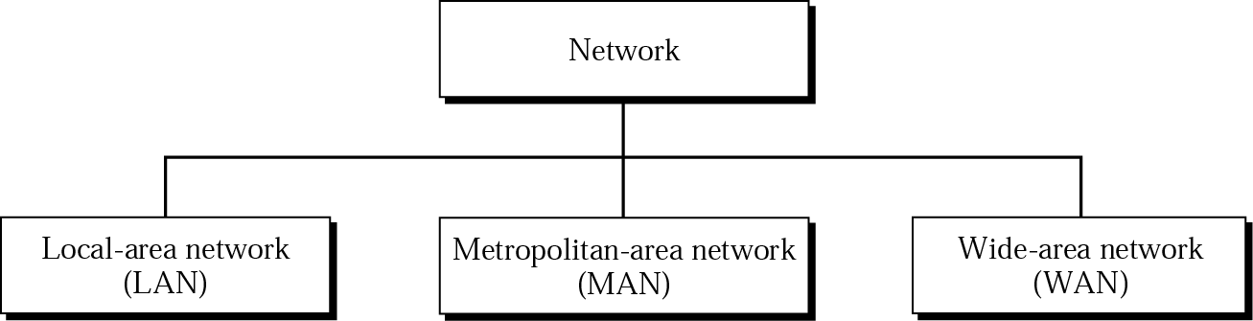
Figure 1.12 Categories of networks

Slide 19
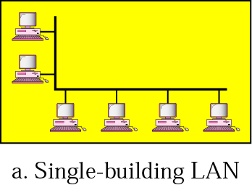
Figure 1.13 LAN

Slide 20
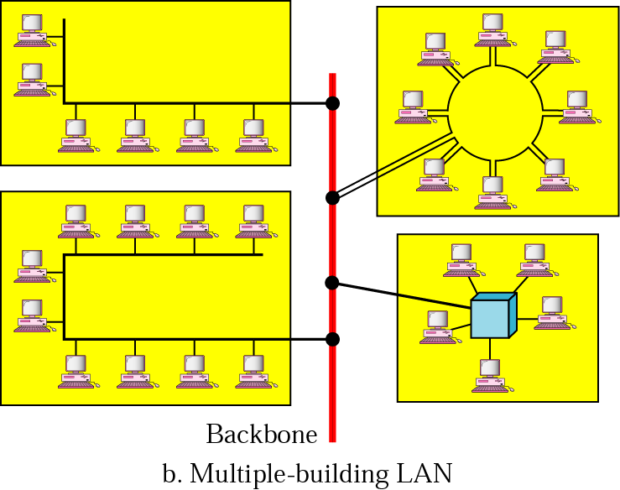
Figure 1.13 LAN (Continued)

Slide 21
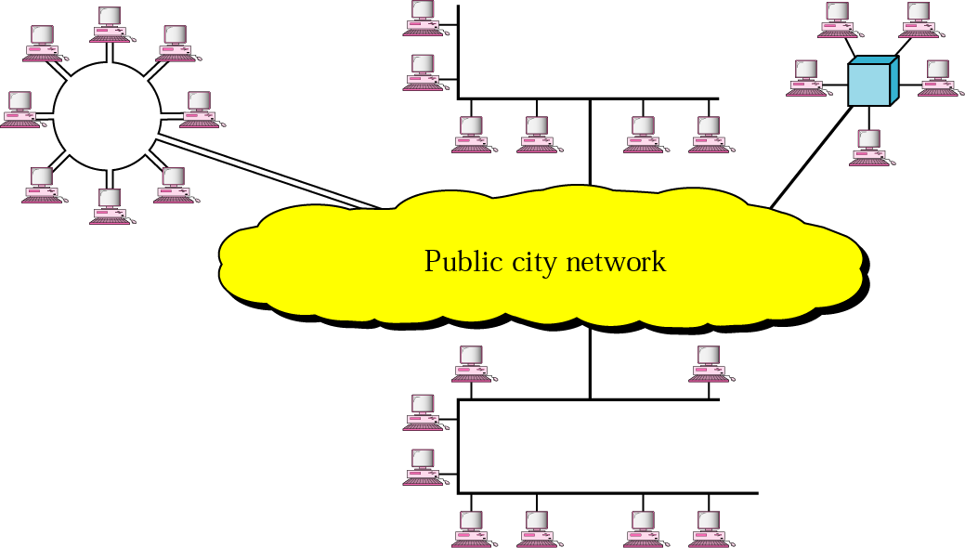
Figure 1.14 MAN

Slide 22
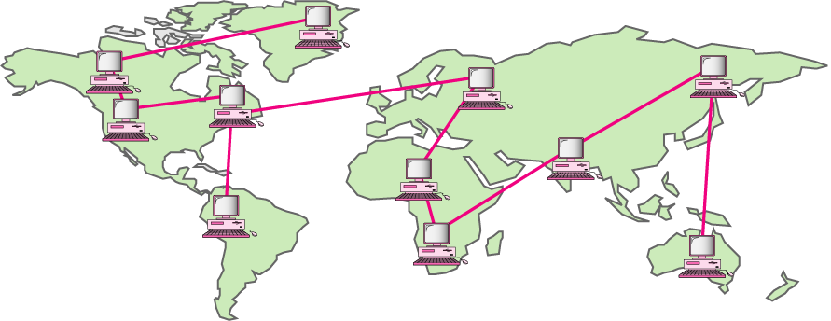
Figure 1.15 WAN

Slide 23
1.3 The Internet
A Brief History
The Internet Today

Slide 24
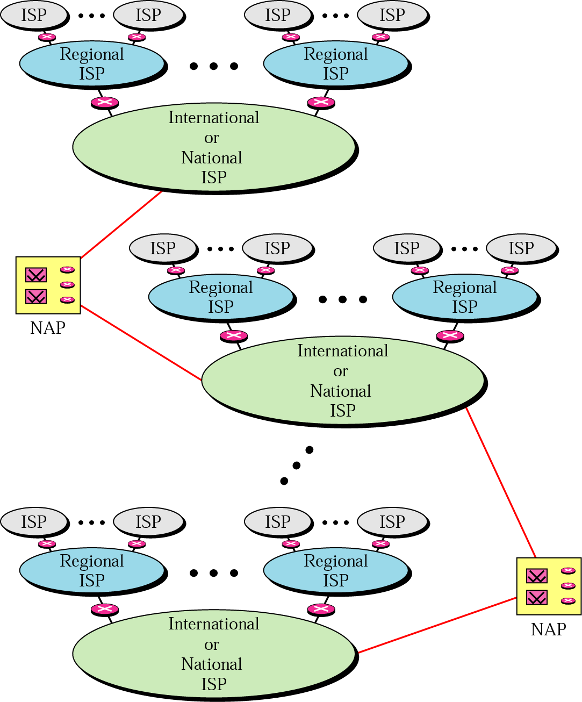
Figure 1.16 Internet today

Slide 25
1.4 Protocols and Standards
Protocols
Standards
Standards Organizations
Internet Standards

