Slide 1
Chapter 7
Transmission
Media

Slide 2
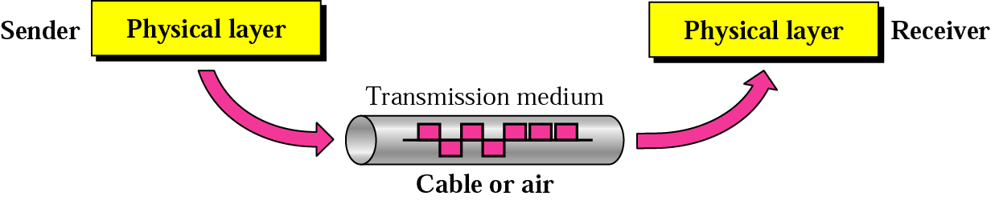
Figure 7.1 Transmission medium and physical layer

Slide 3
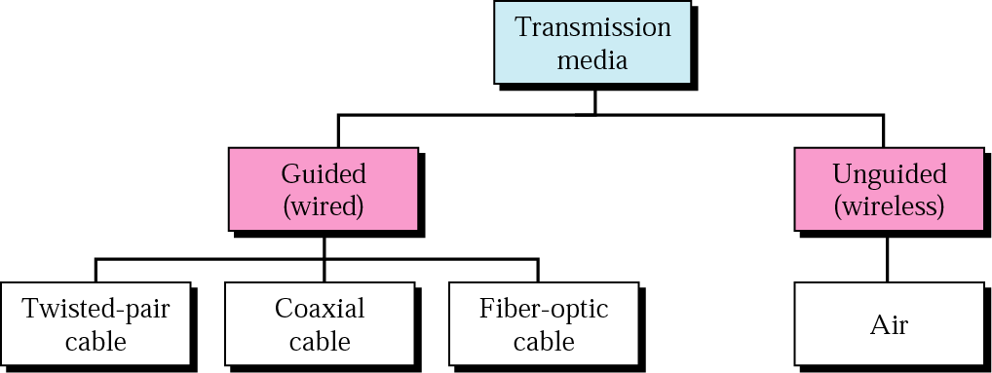
Figure 7.2 Classes of transmission media

Slide 4
7.1 Guided Media
Twisted-Pair Cable
Coaxial Cable
Fiber-Optic Cable

Slide 5

Figure 7.3 Twisted-pair cable

Slide 6
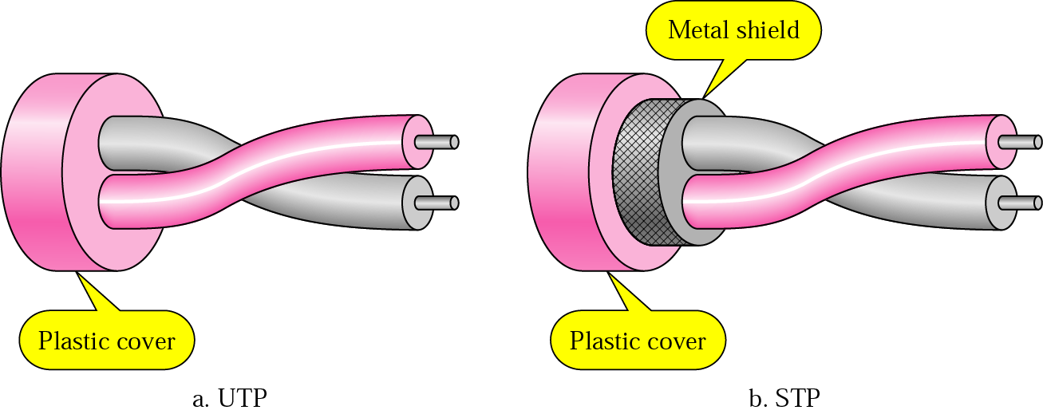
Figure 7.4 UTP and STP

Slide 7
Table 7.1 Categories of unshielded twisted-pair cables
Category | Bandwidth | Data Rate | Digital/Analog | Use
1 | very low | < 100 kbps | Analog | Telephone
2 | < 2 MHz | 2 Mbps | Analog/digital | T-1 lines
3 | 16 MHz | 10 Mbps | Digital | LANs
4 | 20 MHz | 20 Mbps | Digital | LANs
5 | 100 MHz | 100 Mbps | Digital | LANs
6 (draft) | 200 MHz | 200 Mbps | Digital | LANs
7 (draft) | 600 MHz | 600 Mbps | Digital | LANs

Slide 8
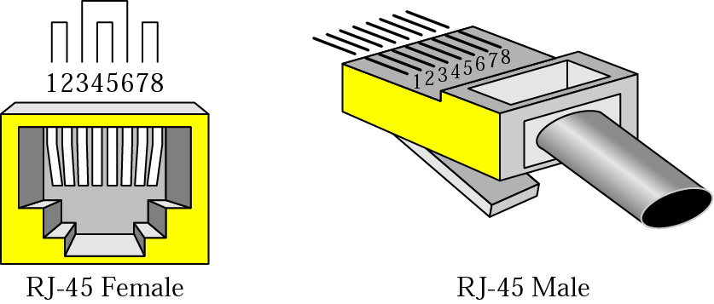
Figure 7.5 UTP connector

Slide 9
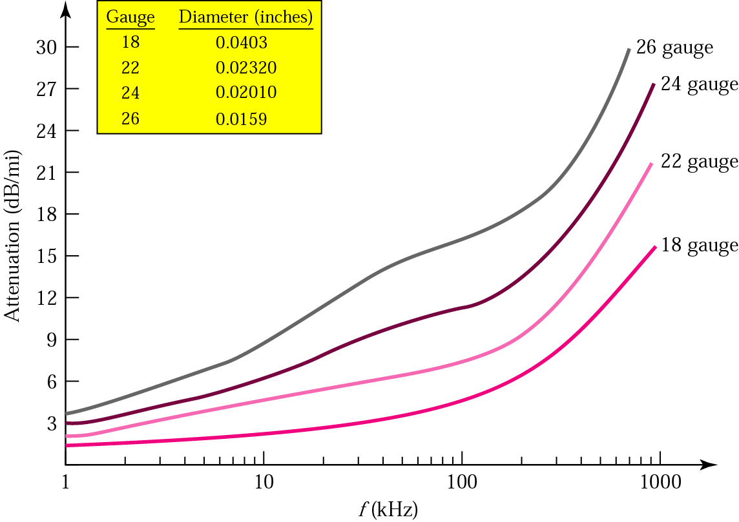
Figure 7.6 UTP performance

Slide 10
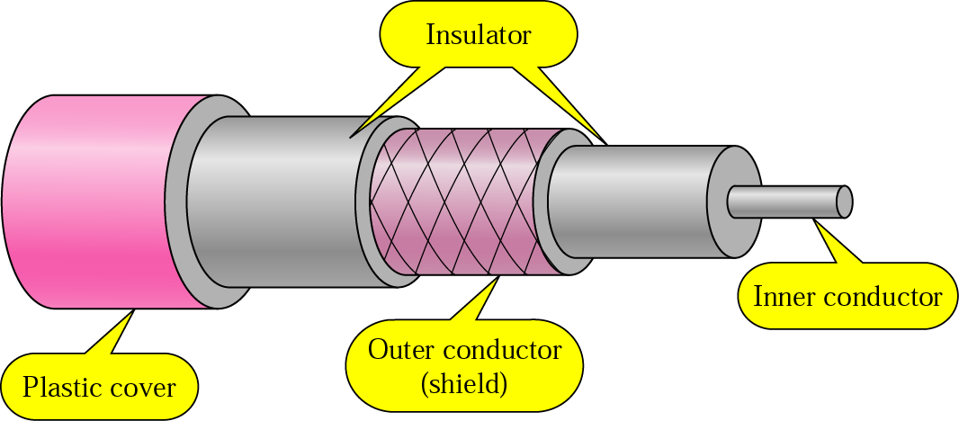
Figure 7.7 Coaxial cable

Slide 11
Table 7.2 Categories of coaxial cables
Category | Impedance | Use
RG-59 | 75 Ω | Cable TV
RG-58 | 50 Ω | Thin Ethernet
RG-11 | 50 Ω | Thick Ethernet

Slide 12
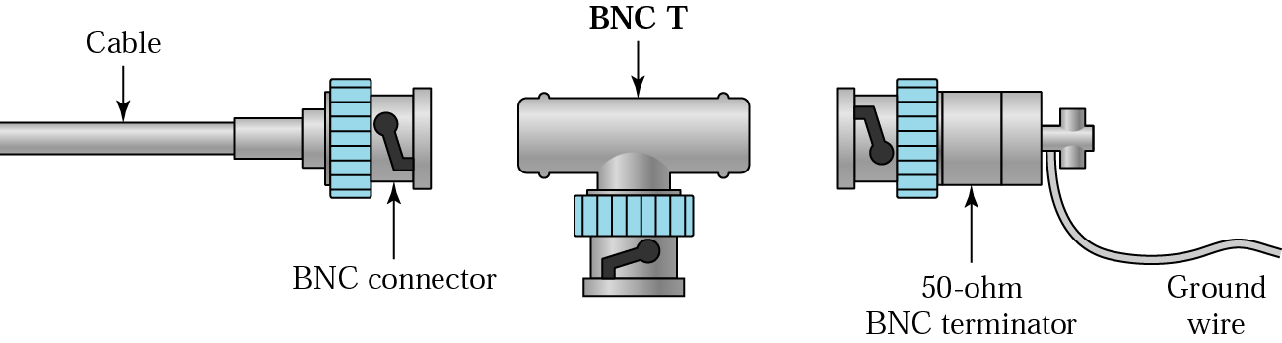
Figure 7.8 BNC connectors

Slide 13
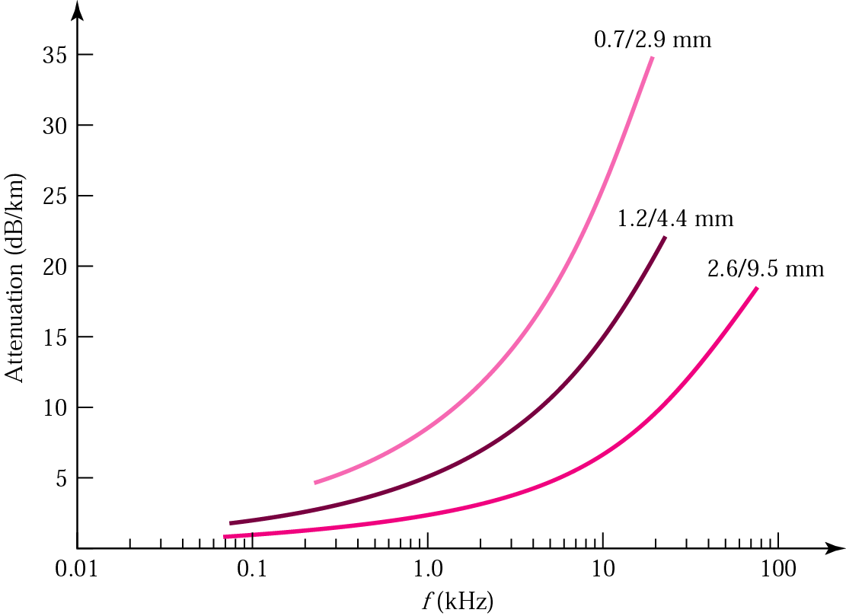
Figure 7.9 Coaxial cable performance

Slide 14
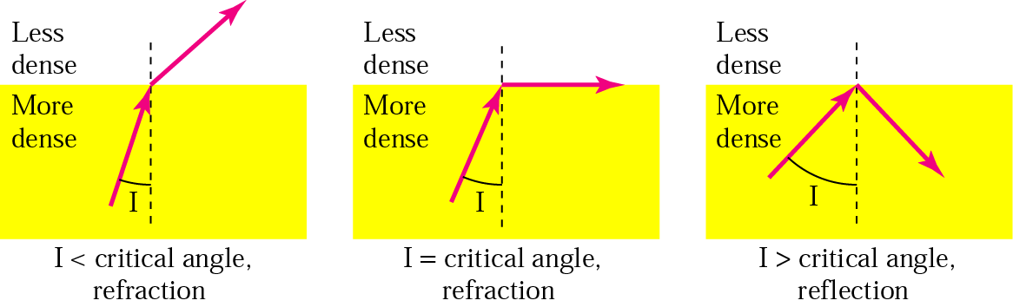
Figure 7.10 Bending of light ray

Slide 15

Figure 7.11 Optical fiber

Slide 16
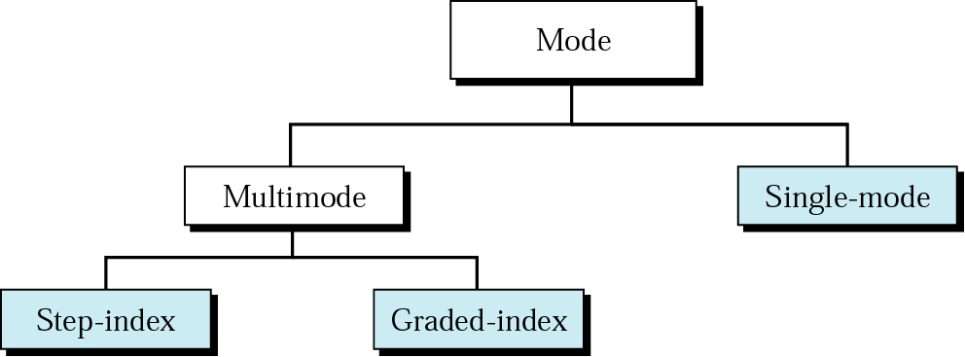
Figure 7.12 Propagation modes

Slide 17
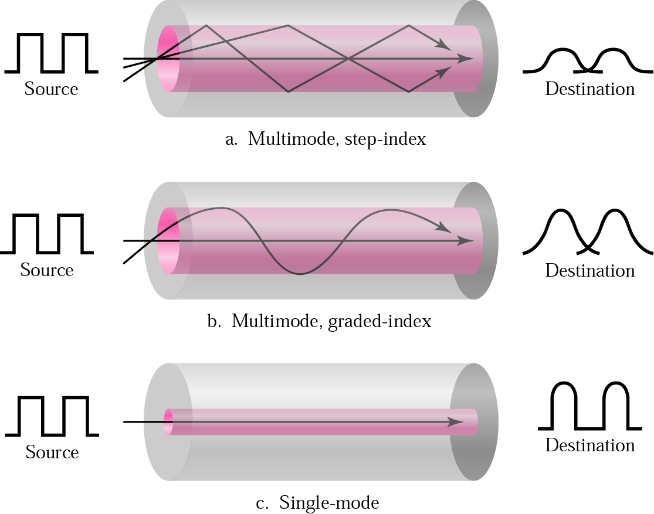
Figure 7.13 Modes

Slide 18
Table 7.3 Fiber types
Type | Core | Cladding | Mode
50/125 | 50 | 125 | Multimode, graded-index
62.5/125 | 62.5 | 125 | Multimode, graded-index
100/125 | 100 | 125 | Multimode, graded-index
7/125 | 7 | 125 | Single-mode

Slide 19
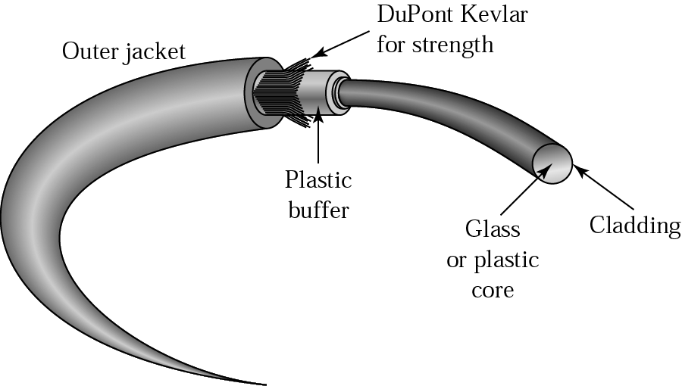
Figure 7.14 Fiber construction

Slide 20
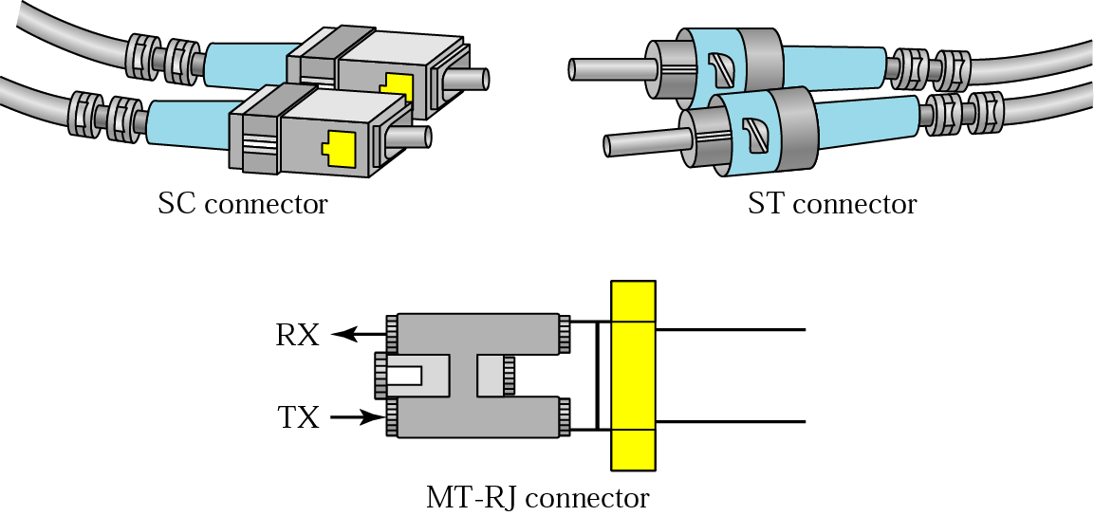
Figure 7.15 Fiber-optic cable connectors

Slide 21
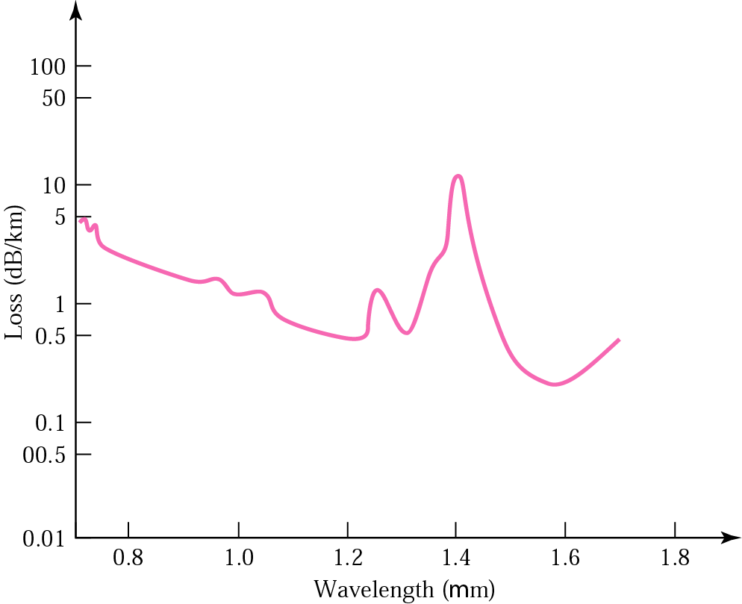
Figure 7.16 Optical fiber performance

Slide 22
7.2 Unguided Media: Wireless
Radio Waves
Microwaves
Infrared

Slide 23
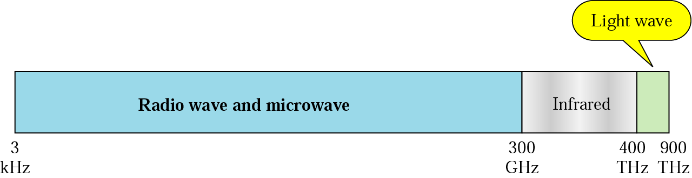
Figure 7.17 Electromagnetic spectrum for wireless communication

Slide 24
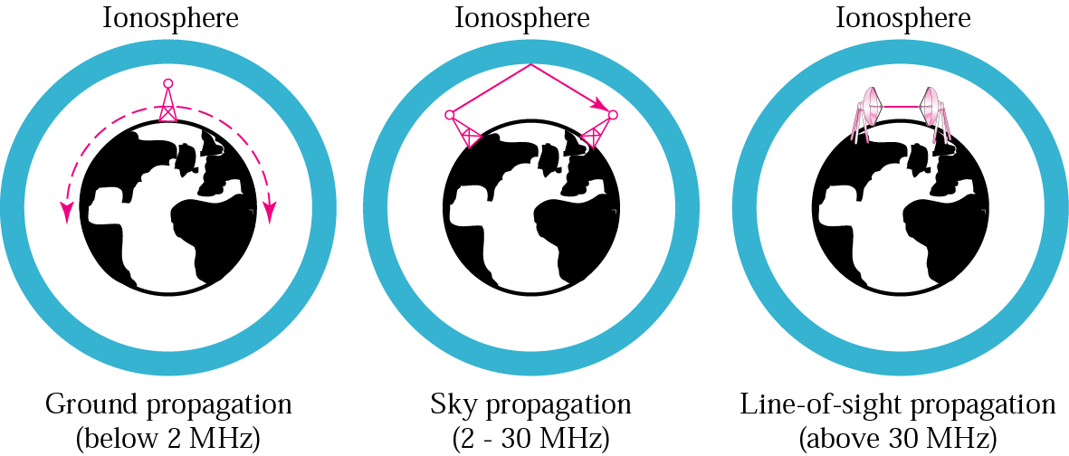
Figure 7.18 Propagation methods

Slide 25
Table 7.4 Bands
Band | Range | Propagation | Application
VLF | 3–30 KHz | Ground | Long-range radio navigation
LF | 30–300 KHz | Ground | Radio beacons and navigational locators
MF | 300 KHz–3 MHz | Sky | AM radio
HF | 3–30 MHz | Sky | Citizens band (CB), ship/aircraft communication
VHF | 30–300 MHz | Sky and line-of-sight | VHF TV, FM radio
UHF | 300 MHz–3 GHz | Line-of-sight | UHF TV, cellular phones, paging, satellite
SHF | 3–30 GHz | Line-of-sight | Satellite communication
EHF | 30–300 GHz | Line-of-sight | Long-range radio navigation

Slide 26
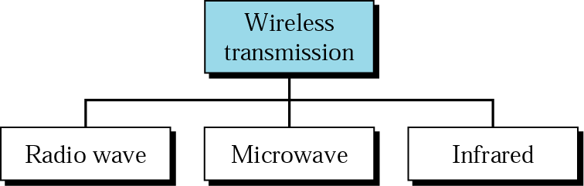
Figure 7.19 Wireless transmission waves

Slide 27
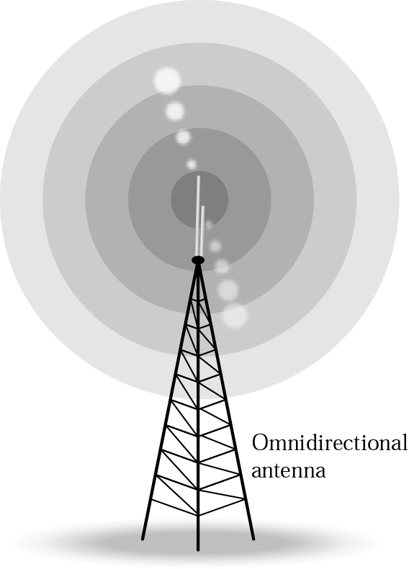
Figure 7.20 Omnidirectional antennas

Slide 28

Note:
Radio waves are used for multicast communications, such as radio and television, and paging systems.

Slide 29
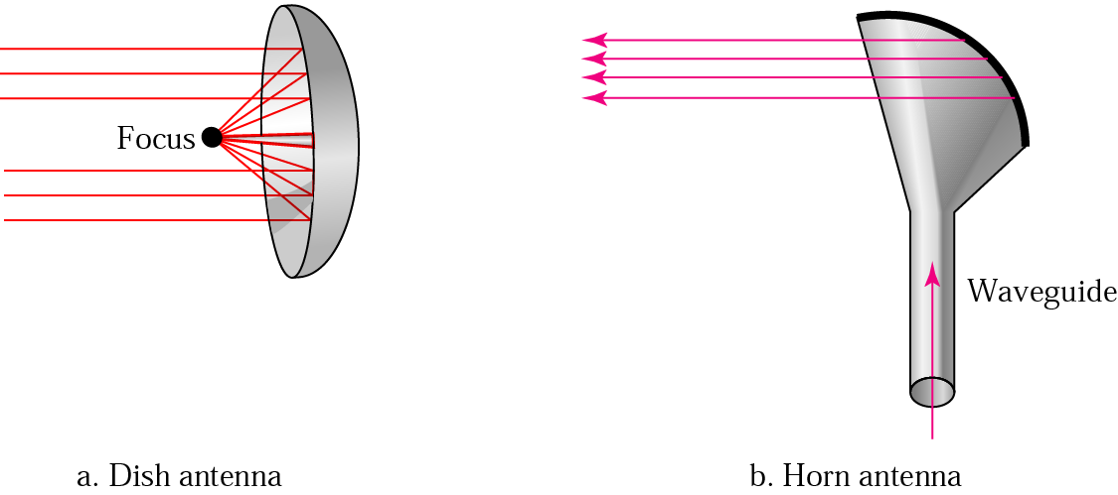
Figure 7.21 Unidirectional antennas

Slide 30
Note:
Microwaves are used for unicast communication such as cellular telephones, satellite networks, and wireless LANs.

Slide 31
Note:
Infrared signals can be used for short-range communication in a closed area using line-of-sight propagation.

