Slide 1
PART III
Data Link Layer

Slide 2

Position of the data-link layer

Slide 3
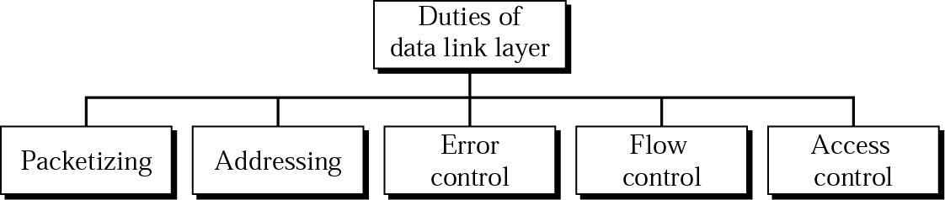
Data link layer duties

Slide 4
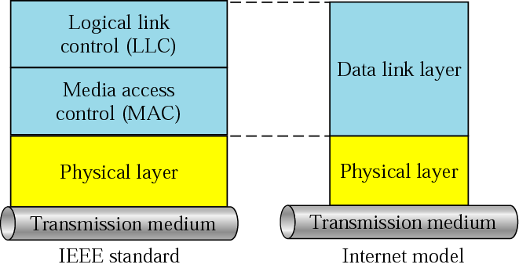
LLC and MAC sublayers

Slide 5
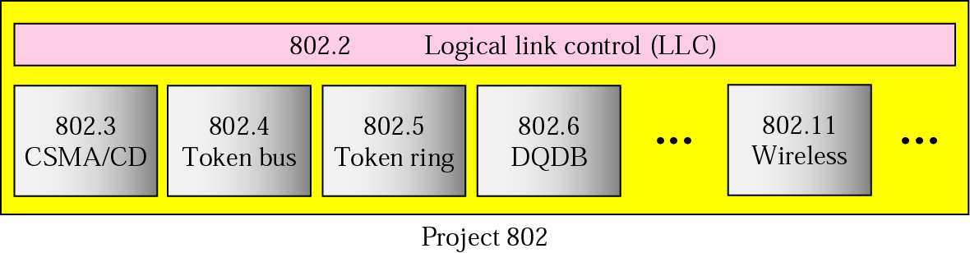
IEEE standards for LANs

Slide 6
Chapters
Chapter 10 Error Detection and Correction
Chapter 11 Data Link Control and Protocols
Chapter 12 Point-To-Point Access
Chapter 13 Multiple Access
Chapter 14 Local Area Networks
Chapter 15 Wireless LANs
Chapter 16 Connecting LANs
Chapter 17 Cellular Telephone and Satellite Networks
Chapter 18 Virtual Circuit Switching

Slide 7
Chapter 10
Error Detection
and
Correction

Slide 8

Note:
Data can be corrupted during transmission. For reliable communication, errors must be detected and corrected.

Slide 9
10.1 Types of Error
Single-Bit Error
Burst Error

Slide 10
Note:
In a single-bit error, only one bit in the data unit has changed.

Slide 11
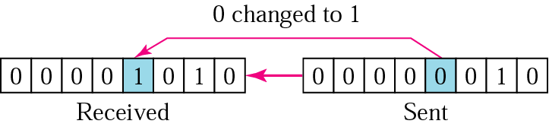
10.1 Single-bit error

Slide 12
Note:
A burst error means that 2 or more bits in the data unit have changed.

Slide 13
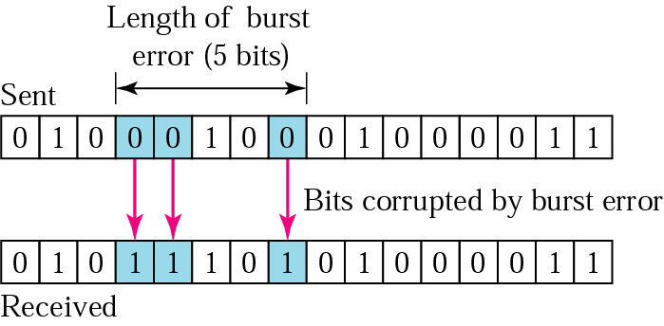
10.2 Burst error of length 5

Slide 14
10.2 Detection
Redundancy
Parity Check
Cyclic Redundancy Check (CRC)
Checksum

Slide 15
Note:
Error detection uses the concept of redundancy, which means adding extra bits for detecting errors at the destination.

Slide 16
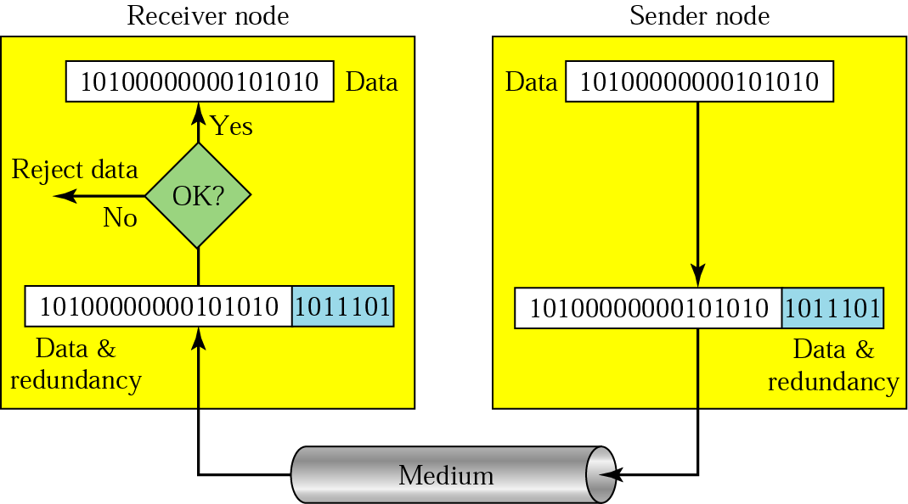
10.3 Redundancy

Slide 17
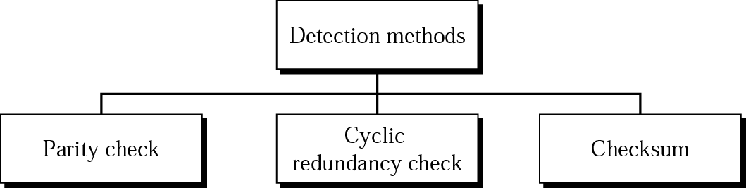
10.4 Detection methods

Slide 18
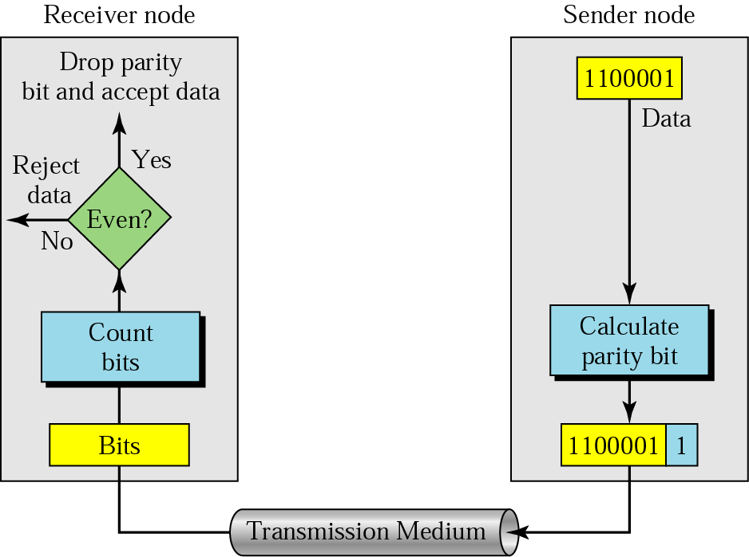
10.5 Even-parity concept

Slide 19
Note:
In parity check, a parity bit is added to every data unit so that the total number of 1s is even
(or odd for odd-parity).

Slide 20
Example 1
Suppose the sender wants to send the word world. In ASCII the five characters are coded as
1110111 1101111 1110010 1101100 1100100
The following shows the actual bits sent
11101110 11011110 11100100 11011000 11001001

Slide 21
Example 2
Now suppose the word world in Example 1 is received by the receiver without being corrupted in transmission.
11101110 11011110 11100100 11011000 11001001
The receiver counts the 1s in each character and comes up with even numbers (6, 6, 4, 4, 4). The data are accepted.

Slide 22
Example 3
Now suppose the word world in Example 1 is corrupted during transmission.
11111110 11011110 11101100 11011000 11001001
The receiver counts the 1s in each character and comes up with even and odd numbers (7, 6, 5, 4, 4). The receiver knows that the data are corrupted, discards them, and asks for retransmission.

Slide 23
Note:
Simple parity check can detect all single-bit errors. It can detect burst errors only if the total number of errors in each data unit is odd.

Slide 24
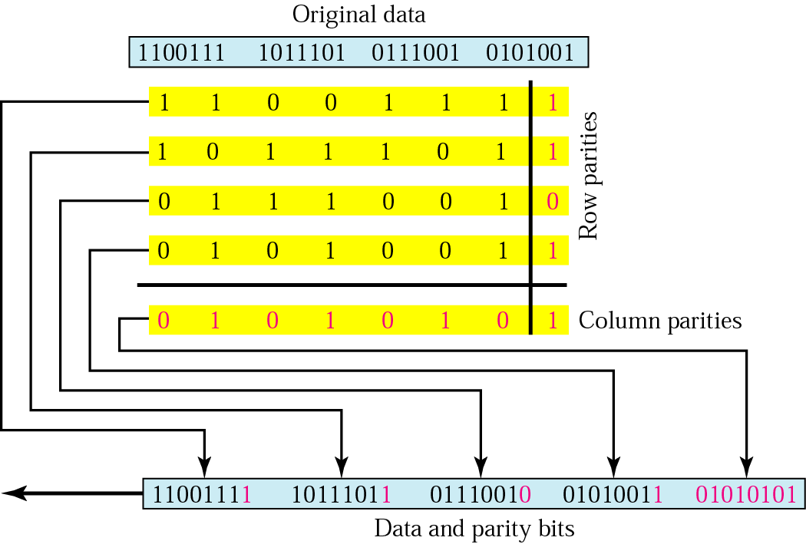
10.6 Two-dimensional parity

Slide 25
Example 4
Suppose the following block is sent:
10101001 00111001 11011101 11100111 10101010
However, it is hit by a burst noise of length 8, and some bits are corrupted.
10100011 10001001 11011101 11100111 10101010
When the receiver checks the parity bits, some of the bits do not follow the even-parity rule and the whole block is discarded.
10100011 10001001 11011101 11100111 10101010

Slide 26
Note:
In two-dimensional parity check, a block of bits is divided into rows and a redundant row of bits is added to the whole block.

Slide 27
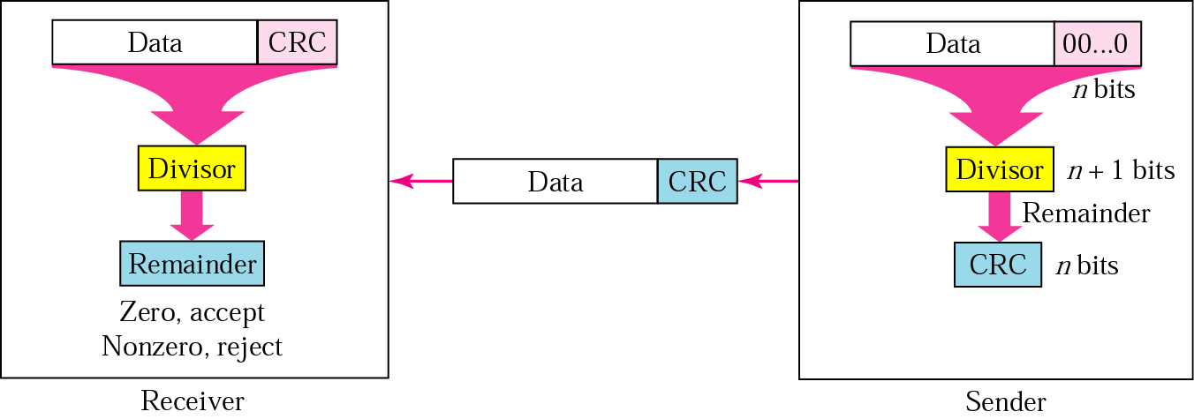
10.7 CRC generator and checker

Slide 28
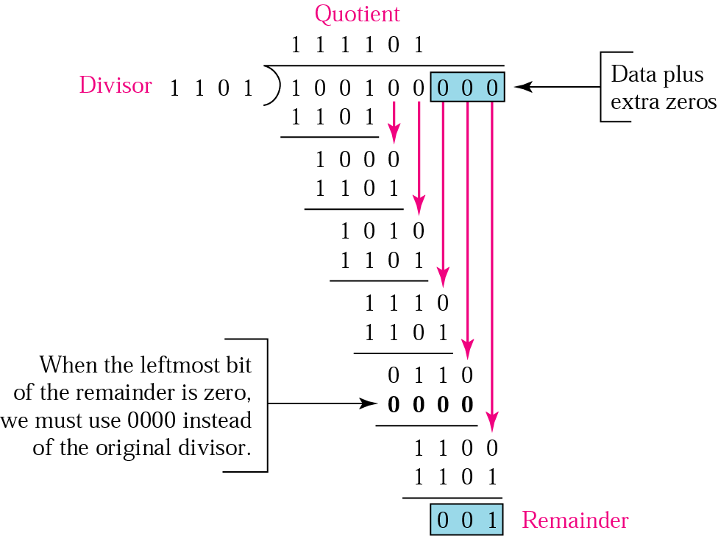
10.8 Binary division in a CRC generator

Slide 29
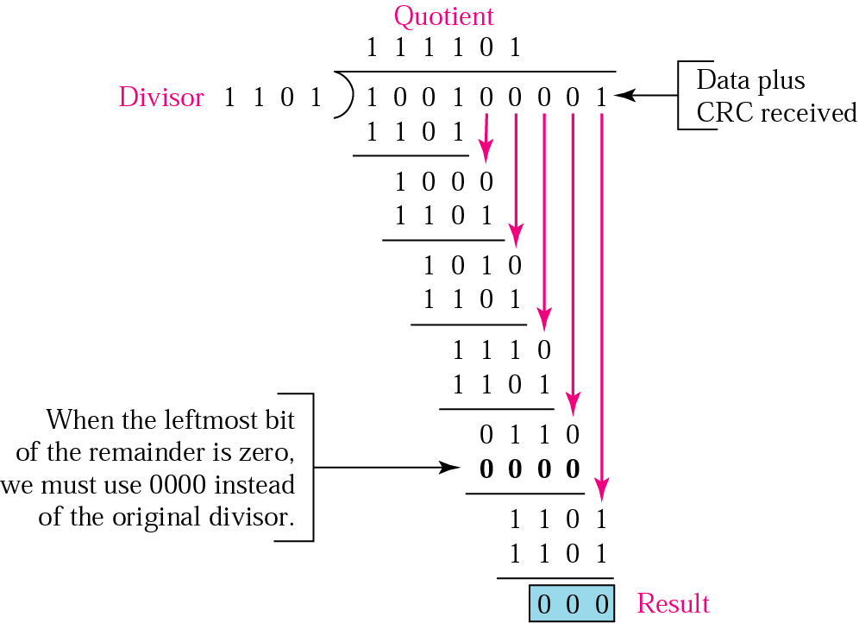
10.9 Binary division in CRC checker

Slide 30
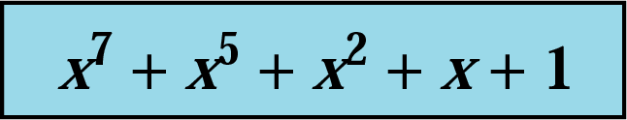
10.10 A polynomial

Slide 31
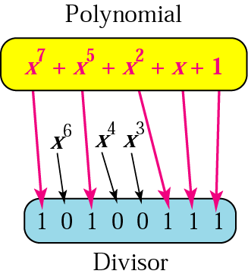
10.11 A polynomial representing a divisor

Slide 32
Table 10.1 Standard polynomials
Name | Polynomial | Application
CRC-8 | x⁸ + x² + x + 1 | ATM header
CRC-10 | x¹⁰ + x⁹ + x⁵ + x⁴ + x ² + 1 | ATM AAL
ITU-16 | x¹⁶ + x¹² + x⁵ + 1 | HDLC
ITU-32 | x³² + x²⁶ + x²³ + x²² + x¹⁶ + x¹² + x¹¹ + x¹⁰ + x⁸ + x⁷ + x⁵ + x⁴ + x² + x + 1 | LANs

Slide 33
Example 5
It is obvious that we cannot choose x (binary 10) or x² + x (binary 110) as the polynomial because both are divisible by x. However, we can choose x + 1 (binary 11) because it is not divisible by x, but is divisible by x + 1. We can also choose x² + 1 (binary 101) because it is divisible by x + 1 (binary division).

Slide 34
Example 6
The CRC-12
x¹² + x¹¹ + x³ + x + 1
which has a degree of 12, will detect all burst errors affecting an odd number of bits, will detect all burst errors with a length less than or equal to 12, and will detect, 99.97 percent of the time, burst errors with a length of 12 or more.

Slide 35
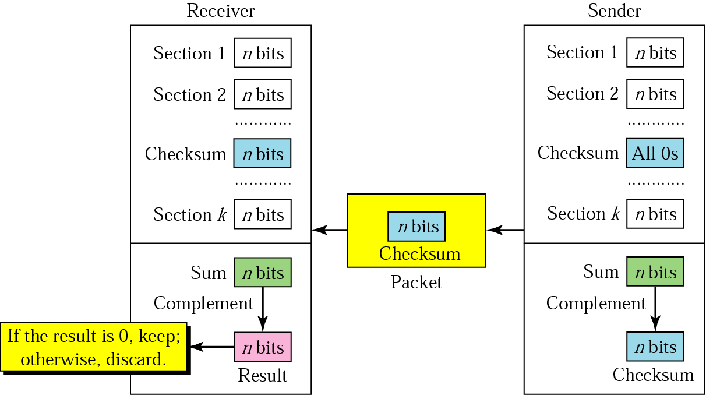
10.12 Checksum

Slide 36
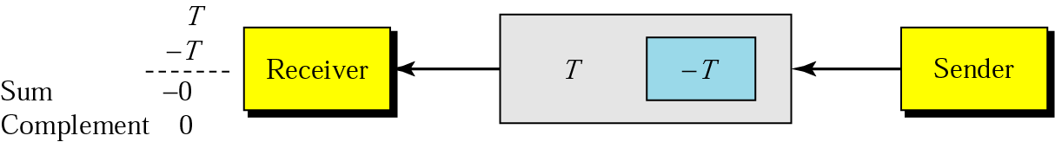
10.13 Data unit and checksum

Slide 37
Note:
The sender follows these steps:
The unit is divided into k sections, each of n bits.
All sections are added using one’s complement to get the sum.
The sum is complemented and becomes the checksum.
The checksum is sent with the data.

Slide 38
Note:
The receiver follows these steps:
The unit is divided into k sections, each of n bits.
All sections are added using one’s complement to get the sum.
The sum is complemented.
If the result is zero, the data are accepted: otherwise, rejected.

Slide 39
Example 7
Suppose the following block of 16 bits is to be sent using a checksum of 8 bits.
10101001 00111001
The numbers are added using one’s complement
10101001
00111001
------------
Sum 11100010
Checksum 00011101
The pattern sent is 10101001 00111001 00011101

Slide 40
Example 8
Now suppose the receiver receives the pattern sent in Example 7 and there is no error.
10101001 00111001 00011101
When the receiver adds the three sections, it will get all 1s, which, after complementing, is all 0s and shows that there is no error.
10101001
00111001
00011101
Sum 11111111
Complement 00000000 means that the pattern is OK.

Slide 41
Example 9
Now suppose there is a burst error of length 5 that affects 4 bits.
10101111 11111001 00011101
When the receiver adds the three sections, it gets
10101111
11111001
00011101
Partial Sum 1 11000101
Carry 1
Sum 11000110
Complement 00111001 the pattern is corrupted.

Slide 42
10.3 Correction
Retransmission
Forward Error Correction
Burst Error Correction

Slide 43
Table 10.2 Data and redundancy bits
Number of data bits m | Number of redundancy bits r | Total bits m + r
1 | 2 | 3
2 | 3 | 5
3 | 3 | 6
4 | 3 | 7
5 | 4 | 9
6 | 4 | 10
7 | 4 | 11

Slide 44
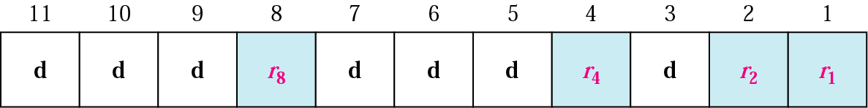
10.14 Positions of redundancy bits in Hamming code

Slide 45
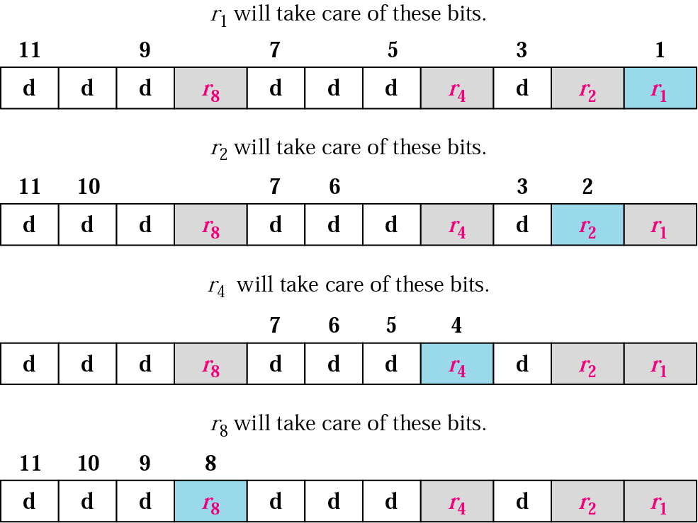
10.15 Redundancy bits calculation

Slide 46
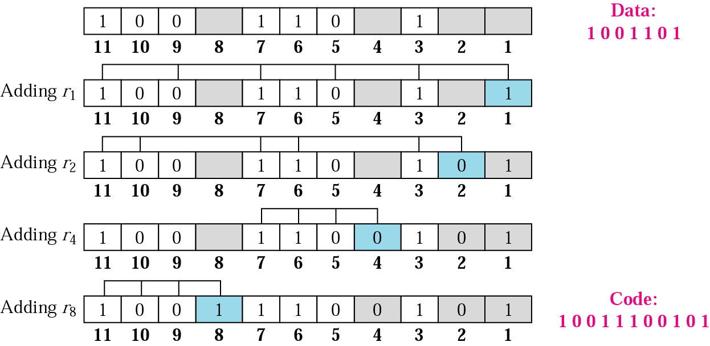
10.16 Example of redundancy bit calculation

Slide 47
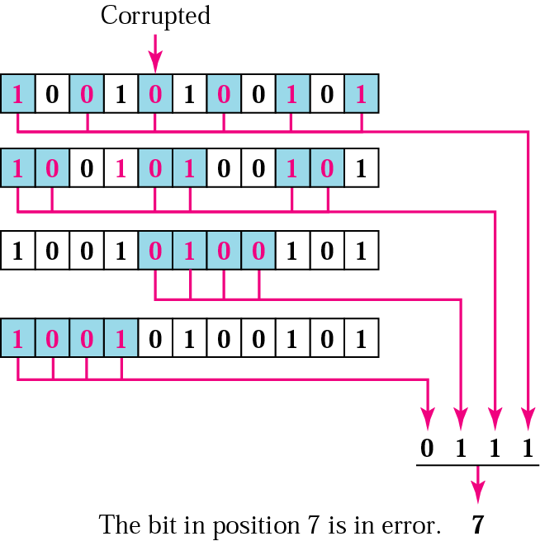
10.17 Error detection using Hamming code

Slide 48
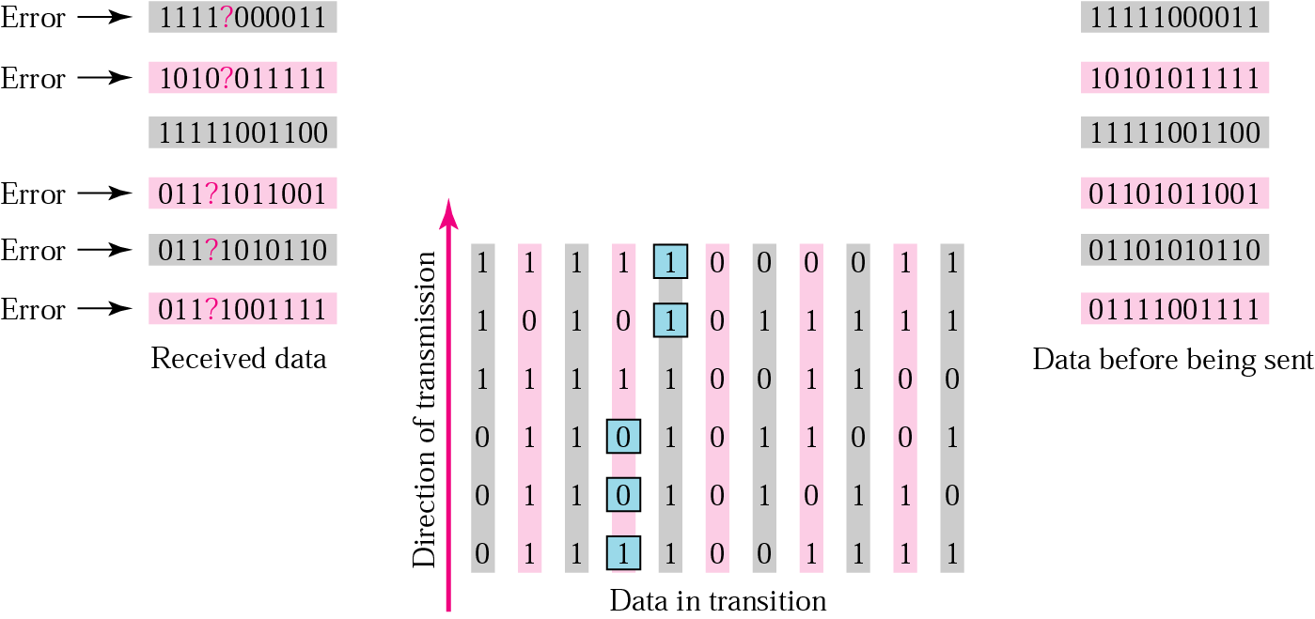
10.18 Burst error correction example

