Slide 1
Chapter 15
Network Layer
Protocols:
ARP, IPv4, ICMPv4,
IPv6, and ICMPv6

Slide 2
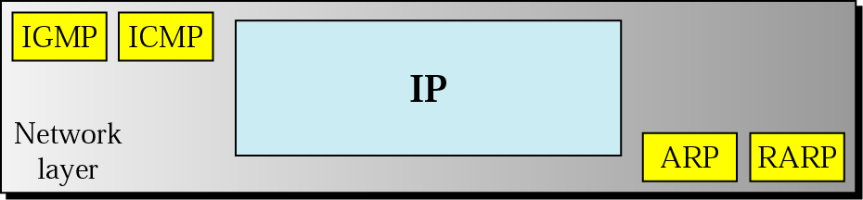
Figure 20.1 Protocols at network layer

Slide 3
20.1 ARP
Mapping
Packet Format
Encapsulation
Operation

Slide 4
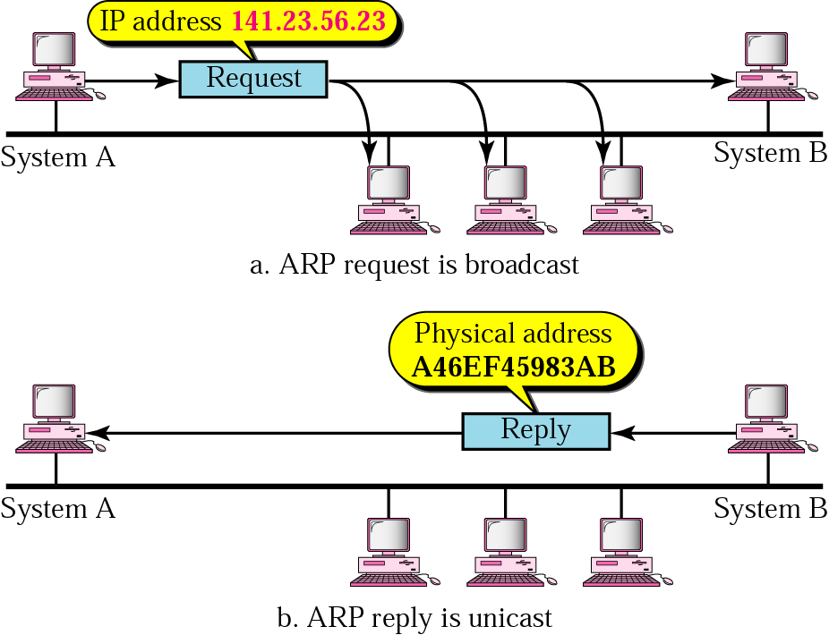
Figure 20.2 ARP operation

Slide 5
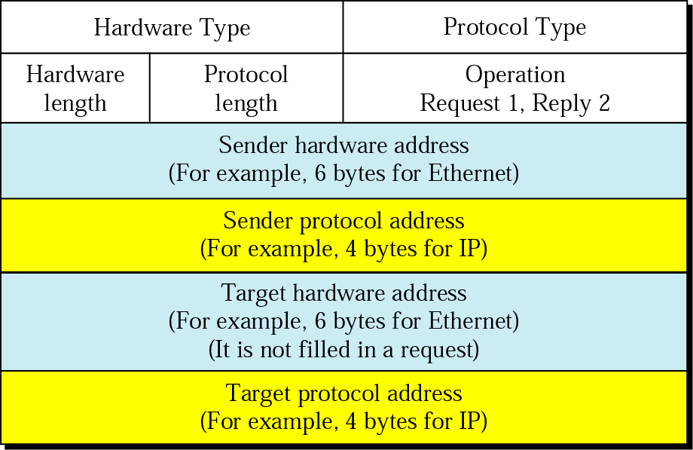
Figure 20.3 ARP packet

Slide 6
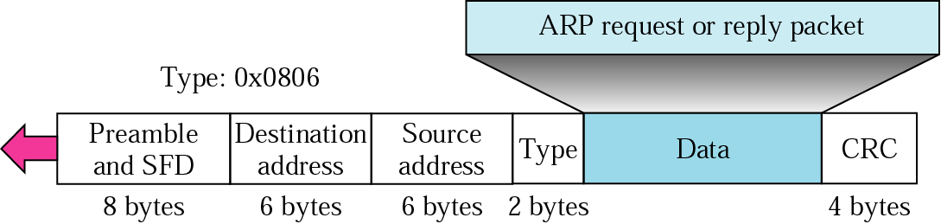
Figure 20.4 Encapsulation of ARP packet

Slide 7
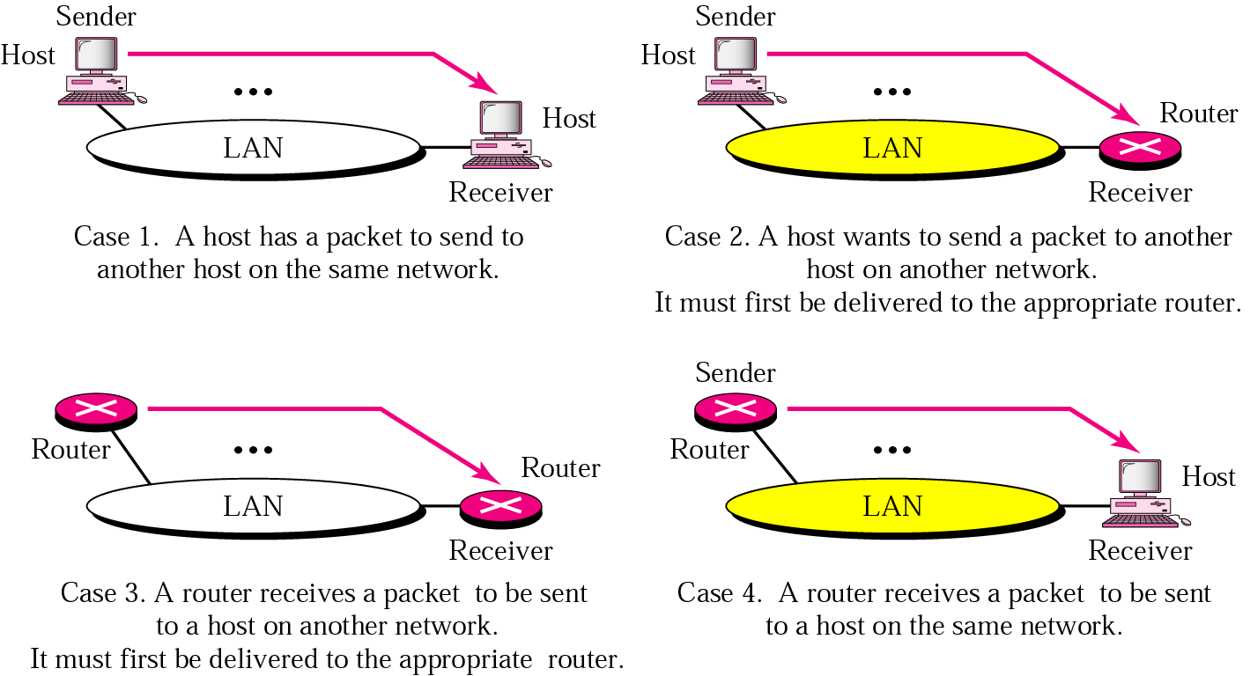
Figure 20.5 Four cases using ARP

Slide 8

Note:
An ARP request is broadcast; an ARP reply is unicast.

Slide 9
Example 1
A host with IP address 130.23.3.20 and physical address B23455102210 has a packet to send to another host with IP address 130.23.43.25 and physical address A46EF45983AB. The two hosts are on the same Ethernet network. Show the ARP request and reply packets encapsulated in Ethernet frames.
Solution
Figure 20.6 shows the ARP request and reply packets. Note that the ARP data field in this case is 28 bytes, and that the individual addresses do not fit in the 4-byte boundary. That is why we do not show the regular 4-byte boundaries for these addresses. Note that we use hexadecimal for every field except the IP addresses.

Slide 10
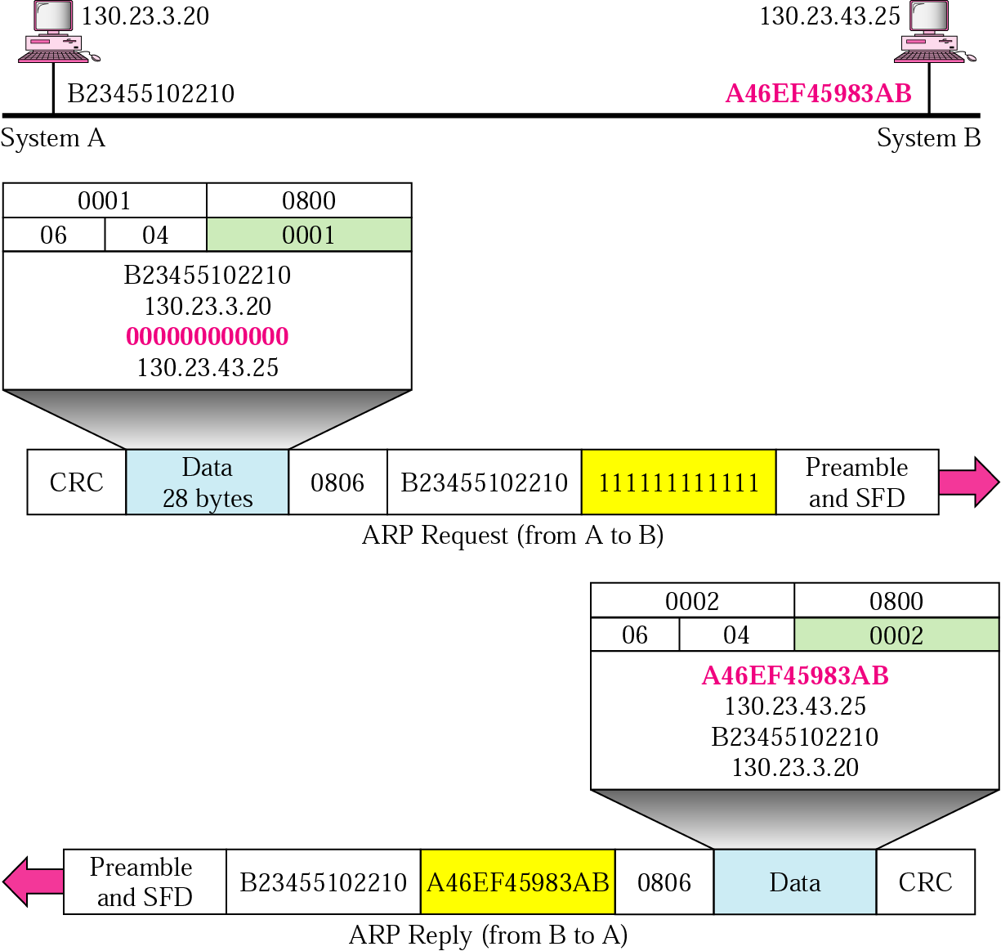
Figure 20.6 Example 1

Slide 11
20.2 IP
Datagram
Fragmentation

Slide 12
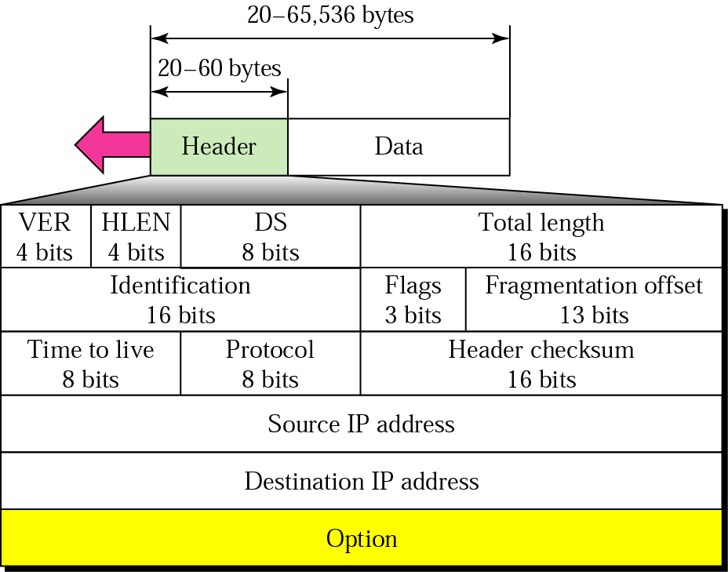
Figure 20.7 IP datagram

Slide 13
Note:
The total length field defines the total length of the datagram including the header.

Slide 14
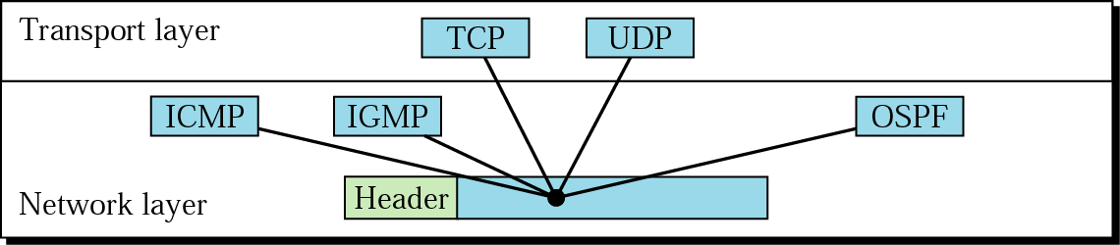
Figure 20.8 Multiplexing

Slide 15
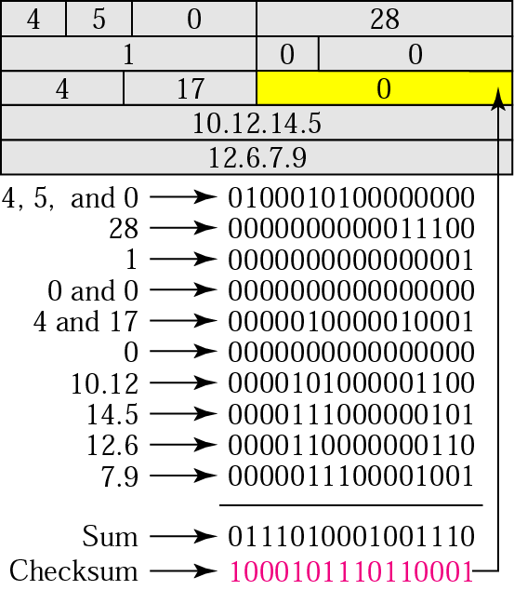
Figure 20.9 Example of checksum calculation

Slide 16
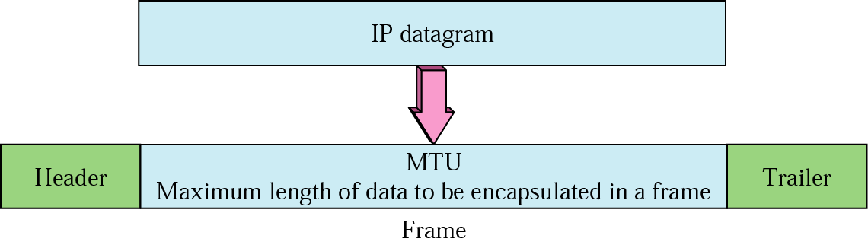
Figure 20.10 MTU

Slide 17
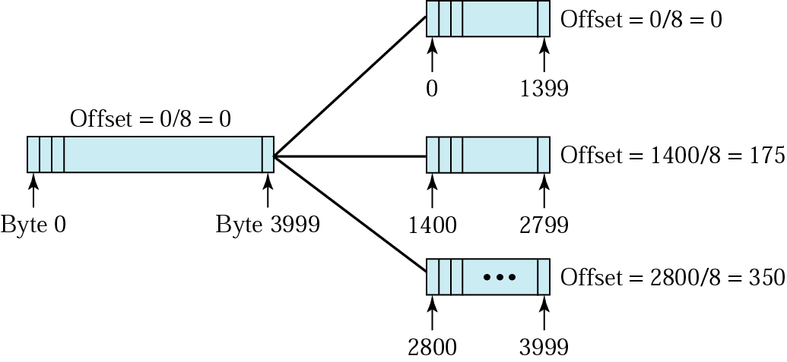
Figure 20.11 Fragmentation example

Slide 18
20.3 ICMP
Types of Messages

Slide 19
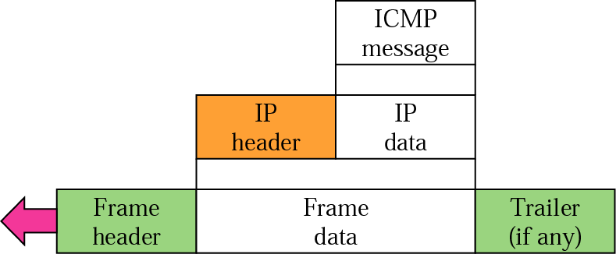
Figure 20.12 ICMP encapsulation

Slide 20
Note:
ICMP always reports error messages to the original source.

Slide 21
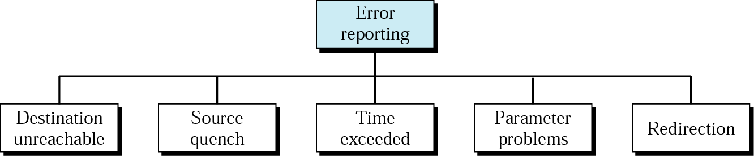
Figure 20.13 Error-reporting messages

Slide 22
Note:
There is no flow control or congestion control mechanism in IP.

Slide 23
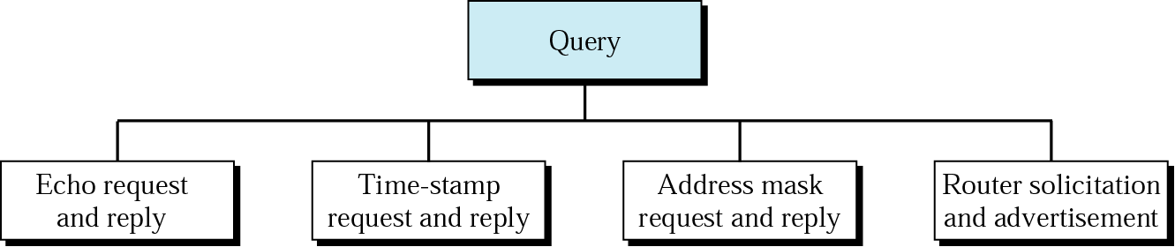
Figure 20.14 Query messages

Slide 24
20.4 IPv6
IPv6 Addresses
Categories of Addresses
IPv6 Packet Format
Fragmentation
ICMPv6
Transition

Slide 25
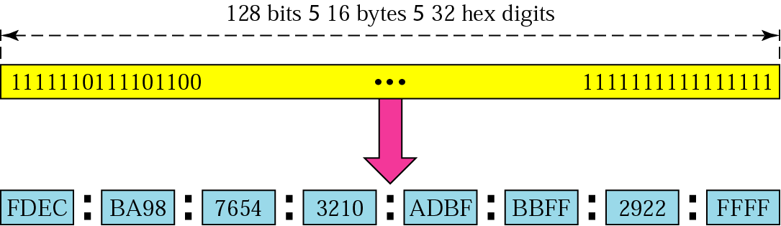
Figure 20.15 IPv6 address

Slide 26
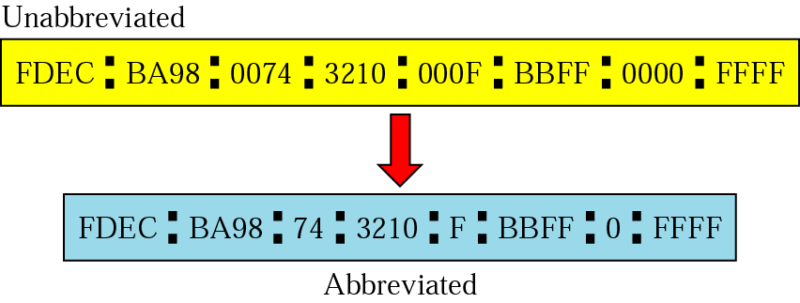
Figure 20.16 Abbreviated address

Slide 27
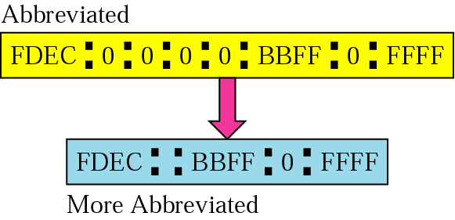
Figure 20.17 Abbreviated address with consecutive zeros

Slide 28
Figure 20.18 CIDR address

Slide 29
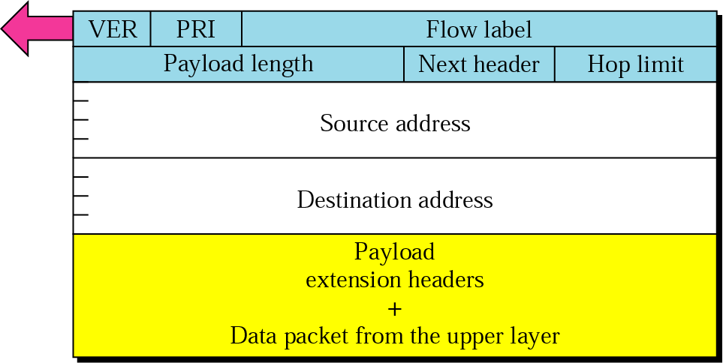
Figure 20.19 Format of an IPv6 datagram

Slide 30
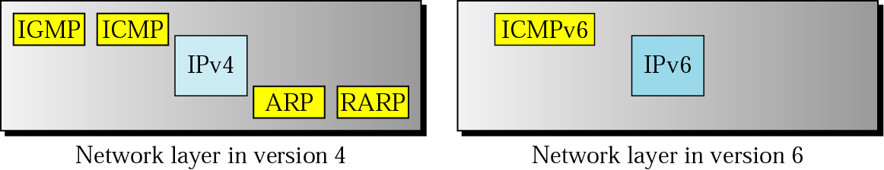
Figure 20.20 Comparison of network layers in version 4 and version 6

Slide 31
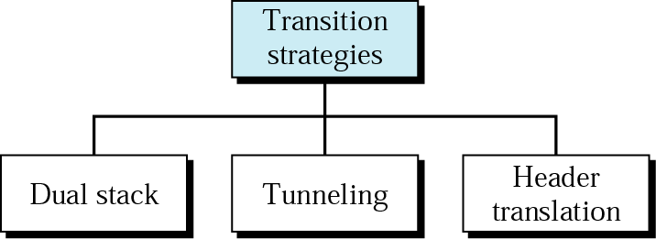
Figure 20.21 Three transition strategies

Slide 32
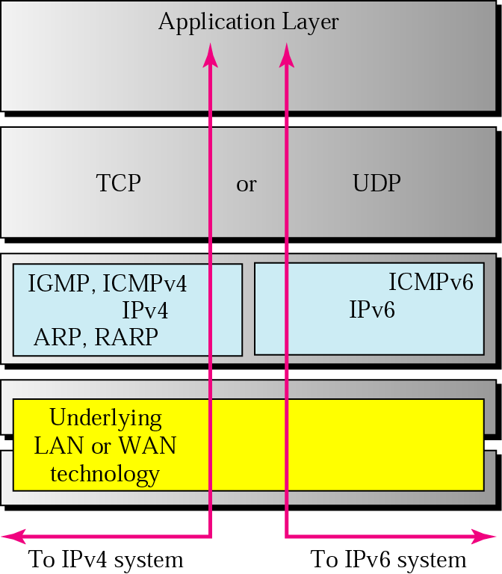
Figure 20.22 Three transition strategies

Slide 33
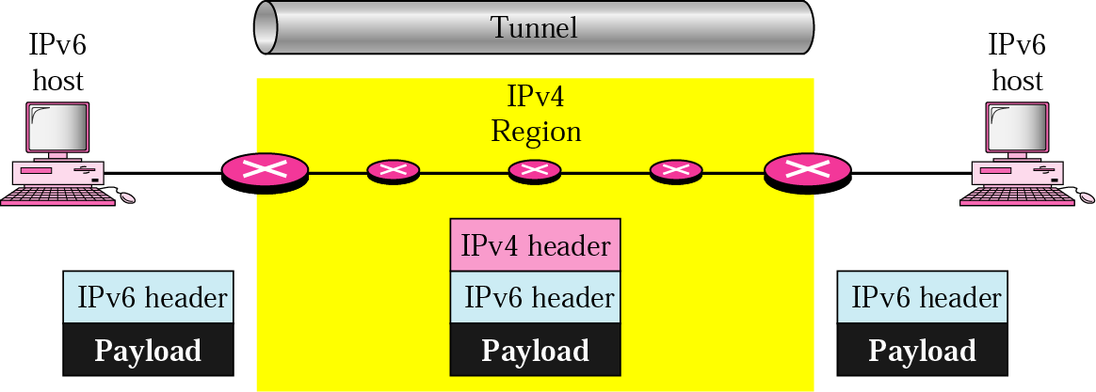
Figure 20.23 Tunneling

Slide 34
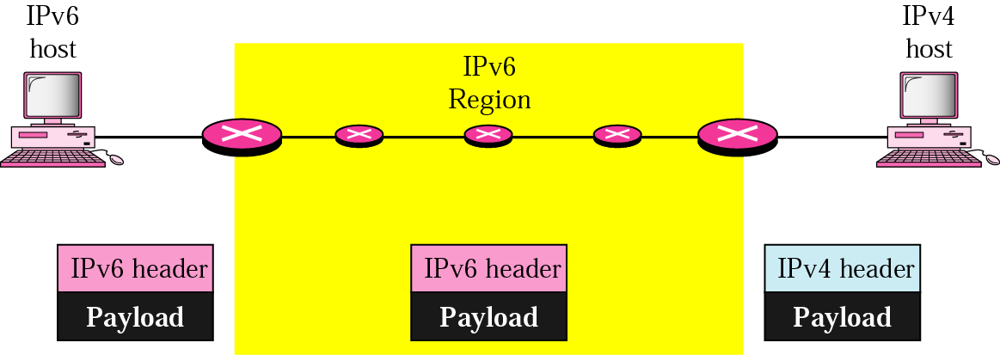
Figure 20.24 Header translation

