Slide 1
Chapter 21
Unicast and Multicast
Routing:
Routing Protocols

Slide 2
21.1 Unicast Routing
Metric
Interior and Exterior Routing

Slide 3
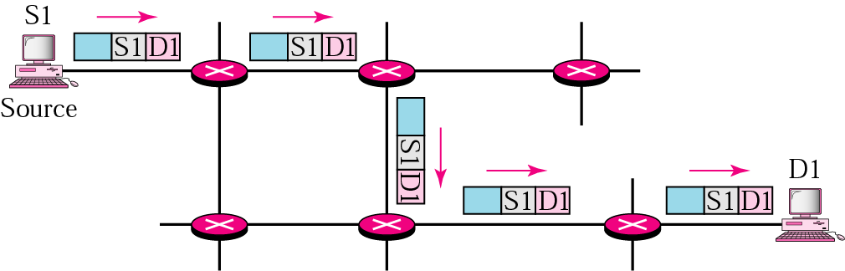
Figure 21.1 Unicasting

Slide 4

Note:
In unicast routing, the router forwards the received packet through only one of its ports.

Slide 5
21.2 Unicast Routing Protocols
RIP
OSPF
BGP

Slide 6
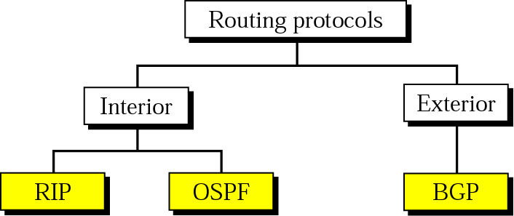
Figure 21.2 Popular routing protocols

Slide 7
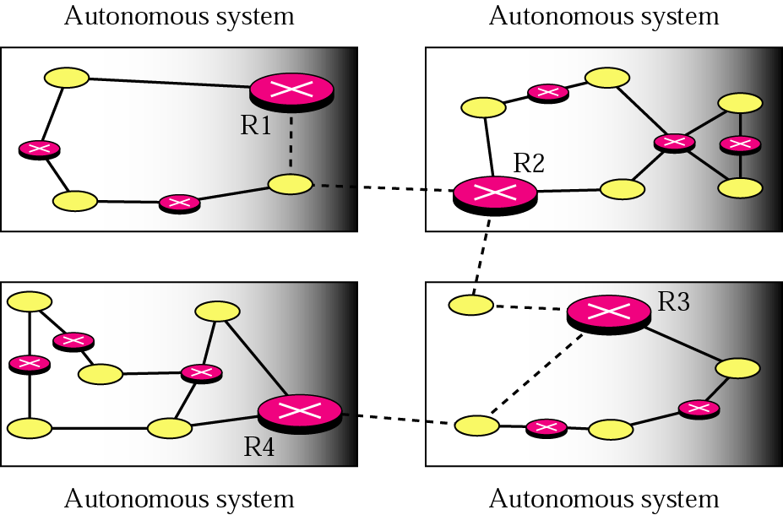
Figure 21.3 Autonomous systems

Slide 8
Table 21.1 A distance vector routing table
Destination | Hop Count | Next Router | Other information
163.5.0.0 | 7 | 172.6.23.4
197.5.13.0 | 5 | 176.3.6.17
189.45.0.0 | 4 | 200.5.1.6
115.0.0.0 | 6 | 131.4.7.19

Slide 9
RIP Updating Algorithm
Receive: a response RIP message
1. Add one hop to the hop count for each advertised destination.
2. Repeat the following steps for each advertised destination:
1. If (destination not in the routing table)
1. Add the advertised information to the table.
2. Else
1. If (next-hop field is the same)
1. Replace entry in the table with the advertised one.
2. Else
1. If (advertised hop count smaller than one in the table)
1. Replace entry in the routing table.
3. Return.

Slide 10
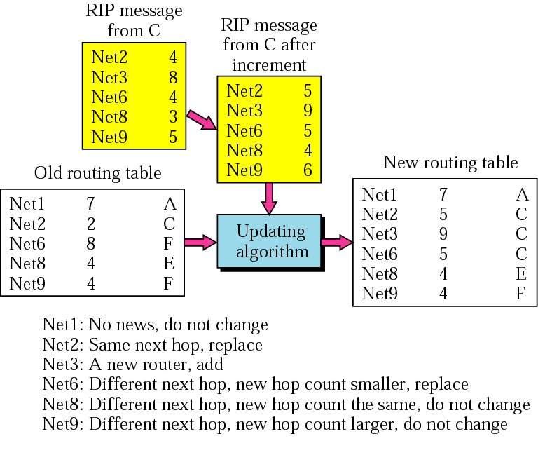
Figure 21.4 Example of updating a routing table

Slide 11
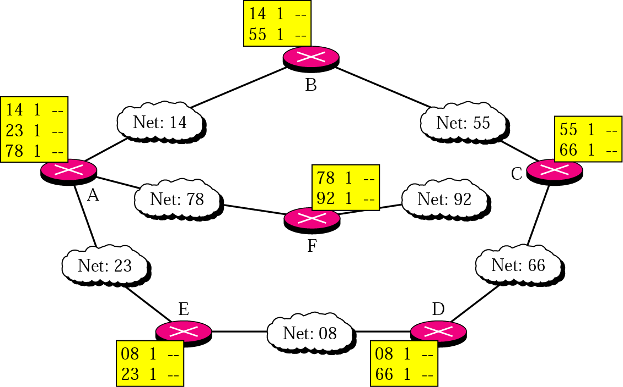
Figure 21.5 Initial routing tables in a small autonomous system

Slide 12
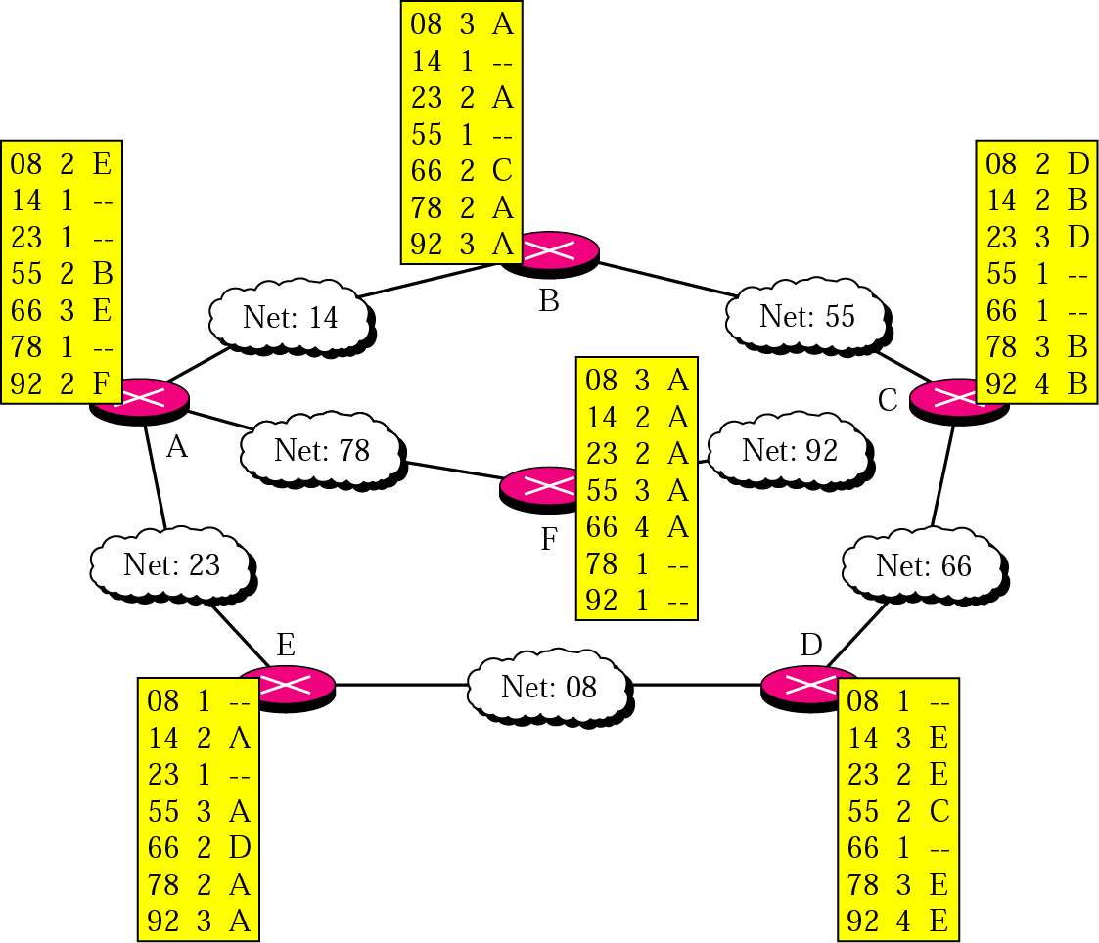
Figure 21.6 Final routing tables for Figure 21.5

Slide 13
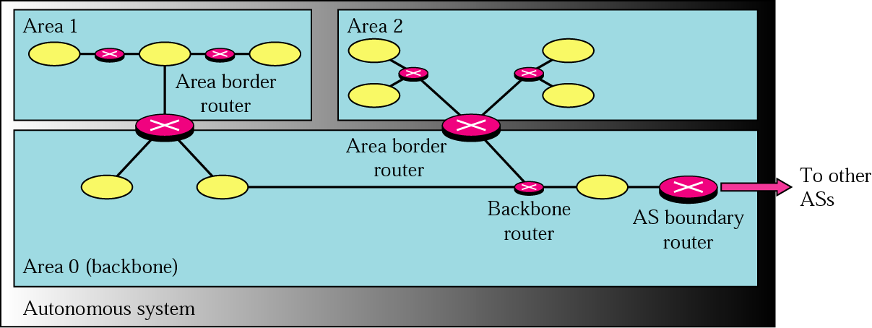
Figure 21.7 Areas in an autonomous system

Slide 14
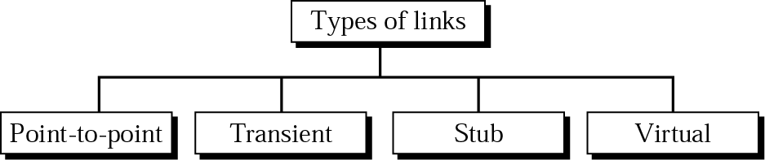
Figure 21.8 Types of links

Slide 15
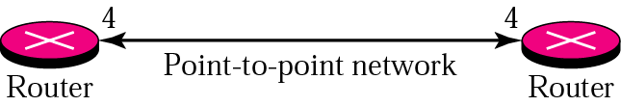
Figure 21.9 Point-to-point link

Slide 16
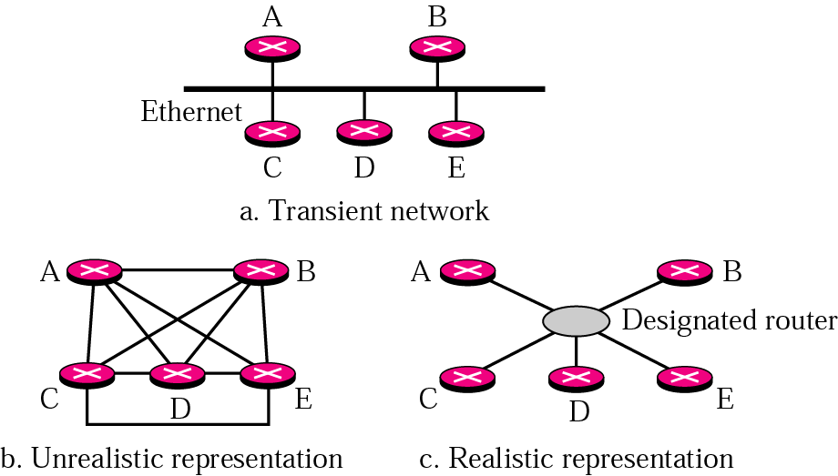
Figure 21.10 Transient link

Slide 17
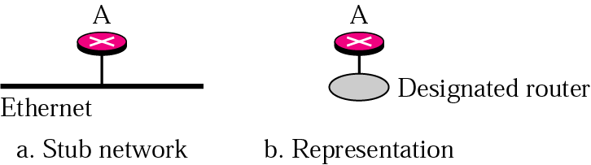
Figure 21.11 Stub link

Slide 18
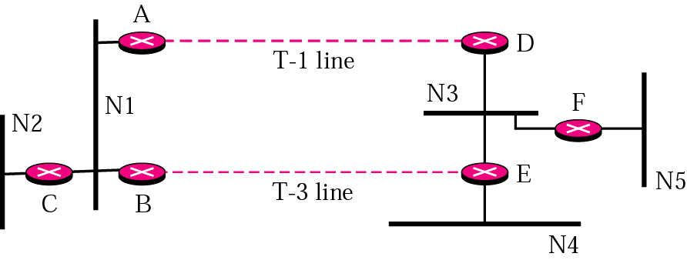
Figure 21.12 Example of an internet

Slide 19
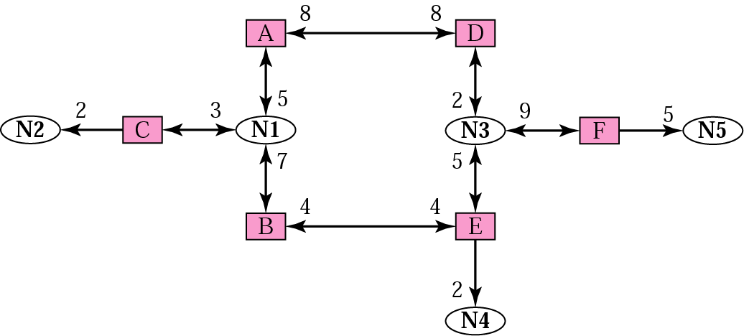
Figure 21.13 Graphical representation of an internet

Slide 20
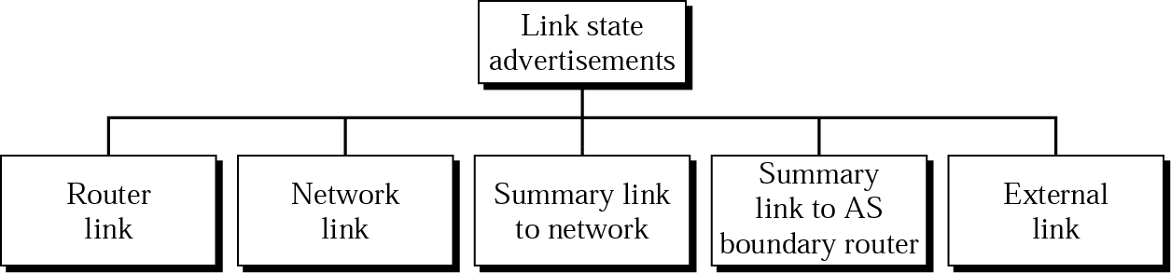
Figure 21.14 Types of LSAs

Slide 21
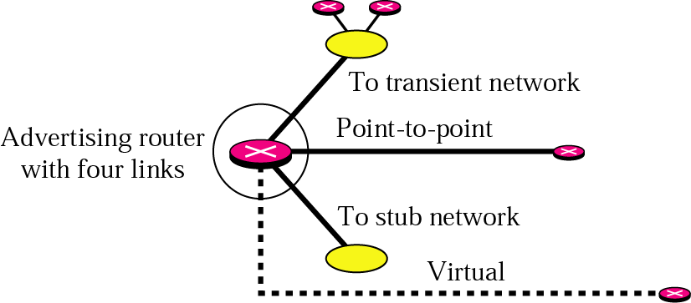
Figure 21.15 Router link

Slide 22
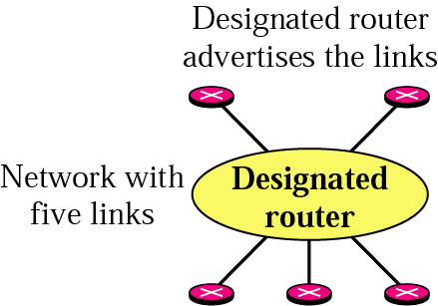
Figure 21.16 Network link

Slide 23
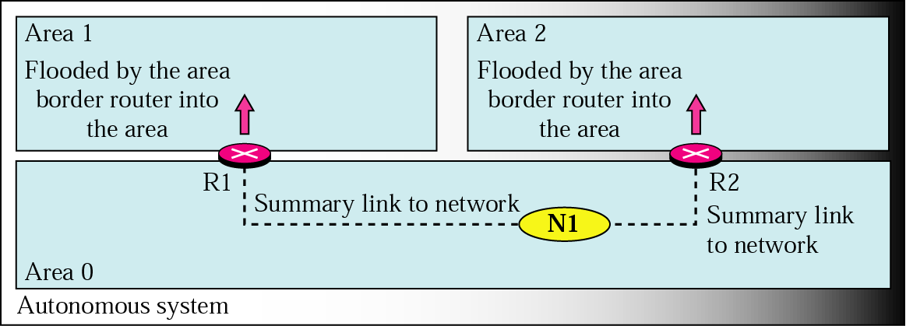
Figure 21.17 Summary link to network

Slide 24
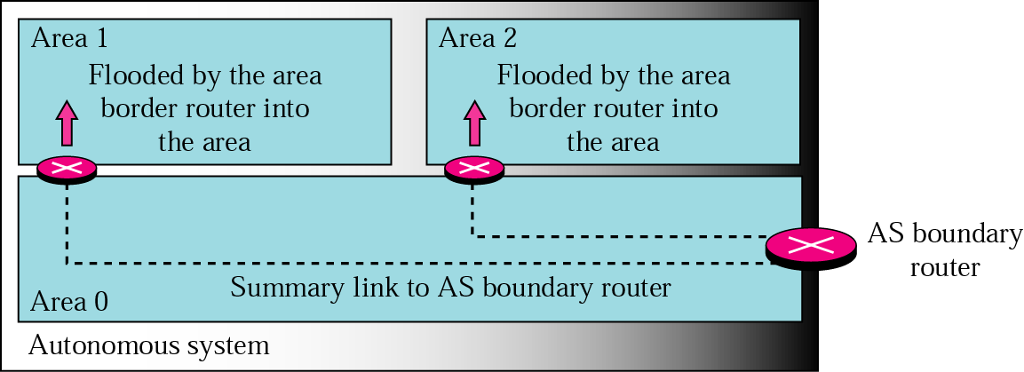
Figure 21.18 Summary link to AS boundary router

Slide 25
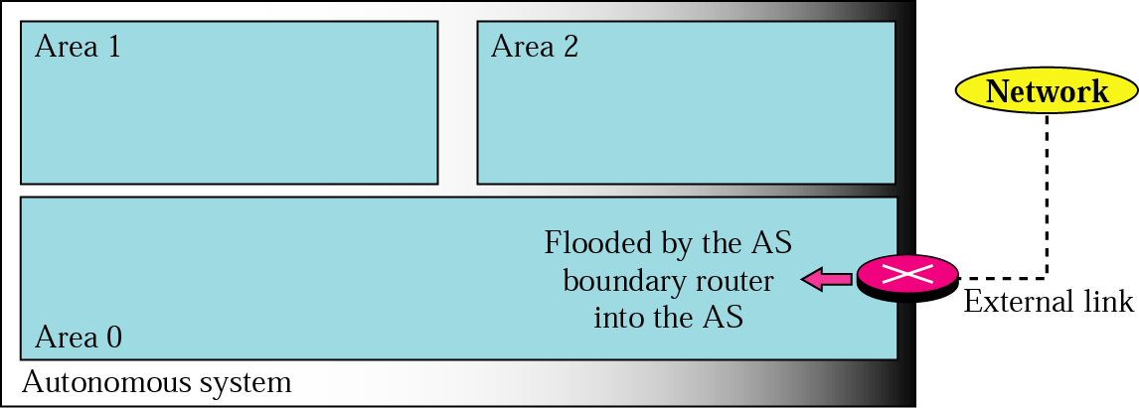
Figure 21.19 External link

Slide 26
Note:
In OSPF, all routers have the same link state database.

Slide 27
Dijkstra Algorithm
1. Start with the local node (router): the root of the tree.
2. Assign a cost of 0 to this node and make it the first permanent node.
3. Examine each neighbor node of the node that was the last permanent node.
4. Assign a cumulative cost to each node and make it tentative.
5. Among the list of tentative nodes
1. Find the node with the smallest cumulative cost and make it permanent.
2. If a node can be reached from more than one direction
1. Select the direction with the shortest cumulative cost.
6. Repeat steps 3 to 5 until every node becomes permanent.

Slide 28
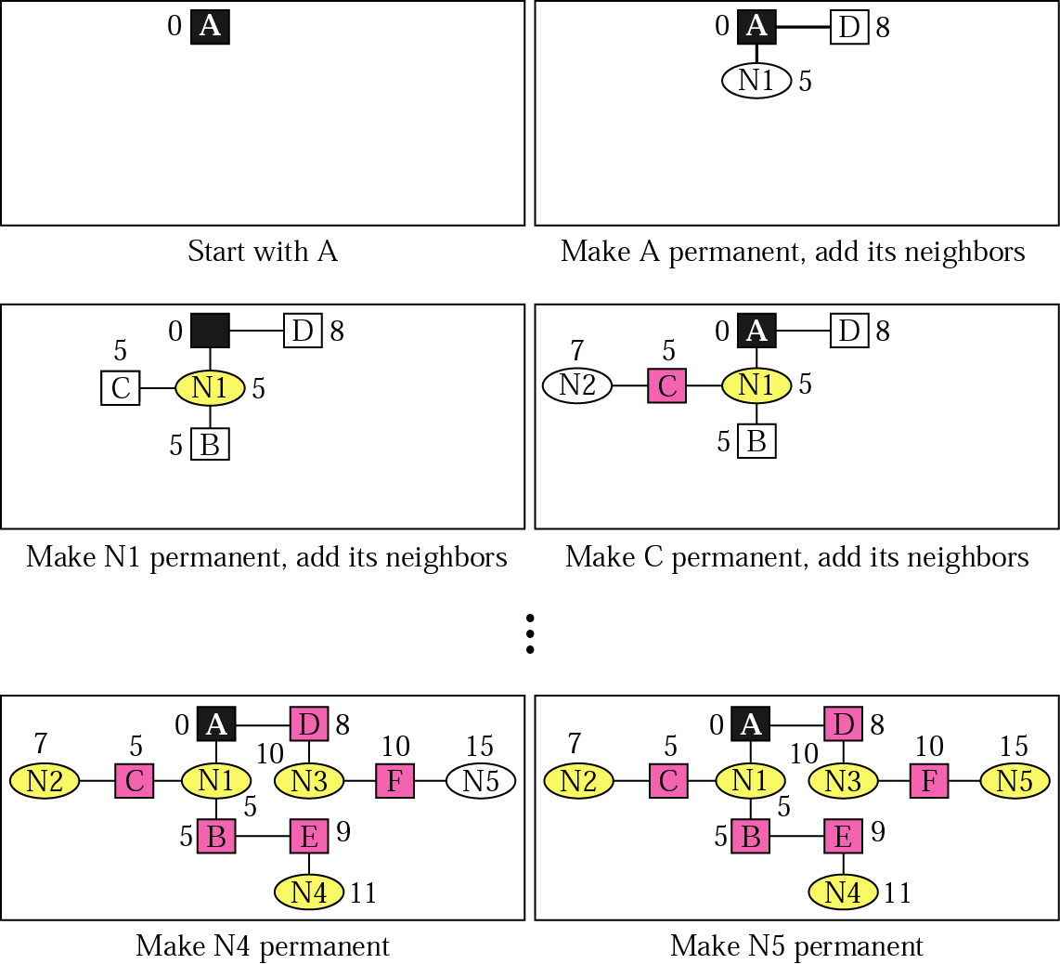
Figure 21.20 Shortest-path calculation

Slide 29
Table 21.2 Link state routing table for router A
Network | Cost | Next Router | Other Information
N1 | 5 | C
N2 | 7 | D
N3 | 10 | B
N4 | 11 | D
N5 | 15 | C

Slide 30
Table 21.3 Path vector routing table
Network | Next Router | Path
N01 | R01 | AS14, AS23, AS67
N02 | R05 | AS22, AS67, AS05, AS89
N03 | R06 | AS67, AS89, AS09, AS34
N04 | R12 | AS62, AS02, AS09

Slide 31
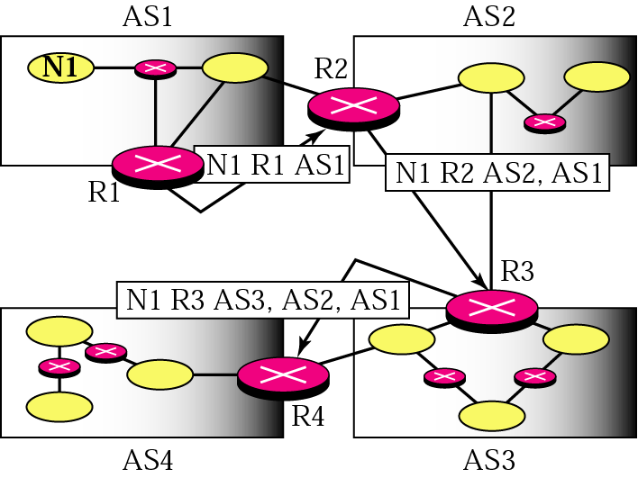
Figure 21.21 Path vector messages

Slide 32
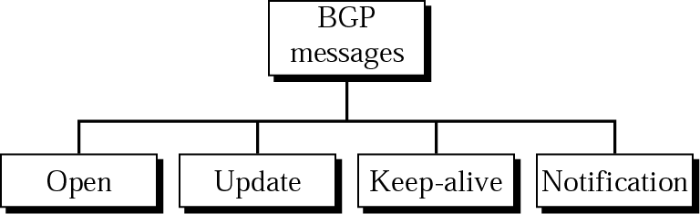
Figure 21.22 Types of BGP messages

Slide 33
21.3 Multicast Routing
IGMP
Multicast Trees
MBONE

Slide 34
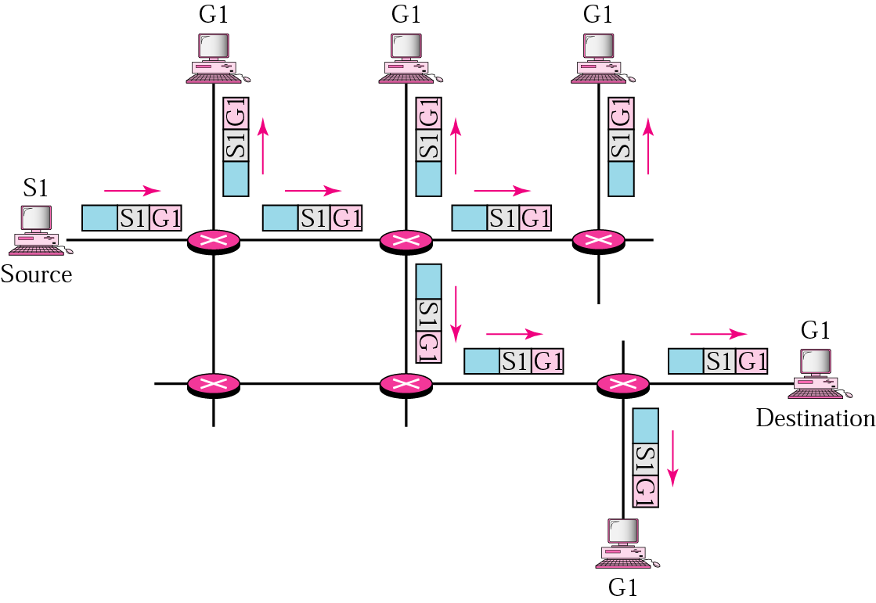
Figure 21.23 Multicasting

Slide 35
Note:
In multicast routing, the router may forward the received packet through several of its ports.

Slide 36
Note:
IGMP is a group management protocol. It helps a multicast router create and update a list of loyal members related to each router interface.

Slide 37
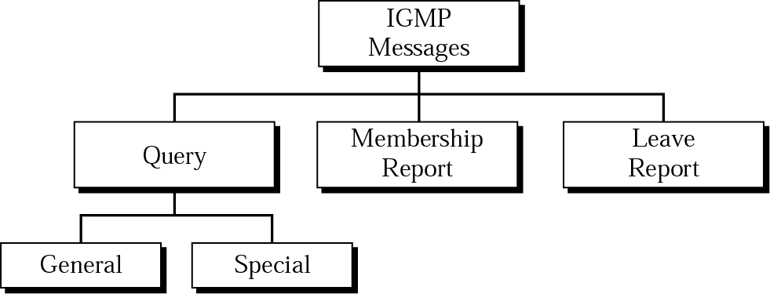
Figure 21.24 IGMP message types

Slide 38
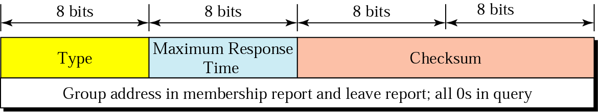
Figure 21.25 IGMP message format

Slide 39
Table 21.4 IGMP type field
Type | Value
General or special query | 0x11 or 00010001
Membership report | 0x16 or 00010110
Leave report | 0x17 or 00010111

Slide 40
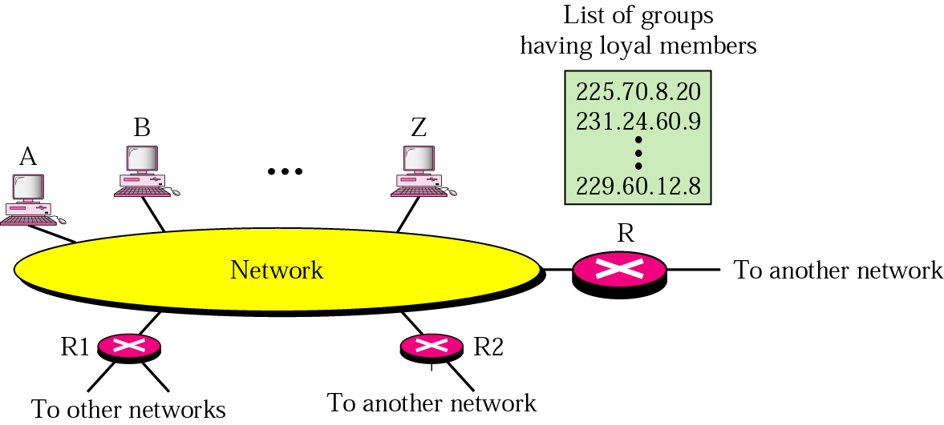
Figure 21.26 IGMP operation

Slide 41
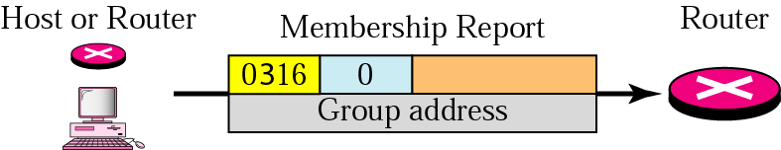
Figure 21.27 Membership report

Slide 42
Note:
In IGMP, a membership report is sent twice, one after the other.

Slide 43
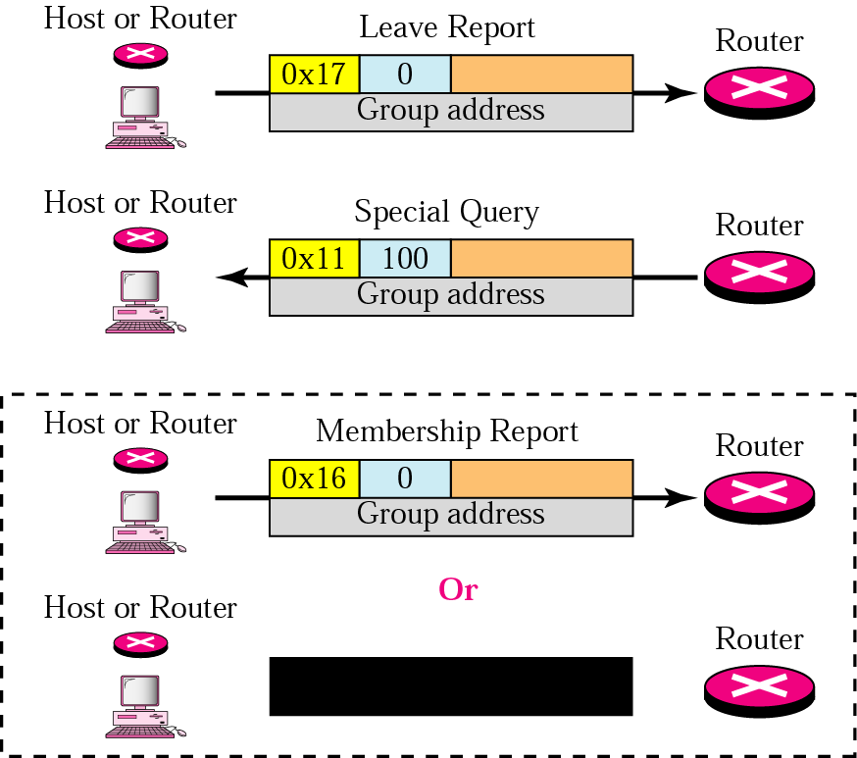
Figure 21.28 Leave report
No Response

Slide 44
Note:
The general query message does not define a particular group.

Slide 45
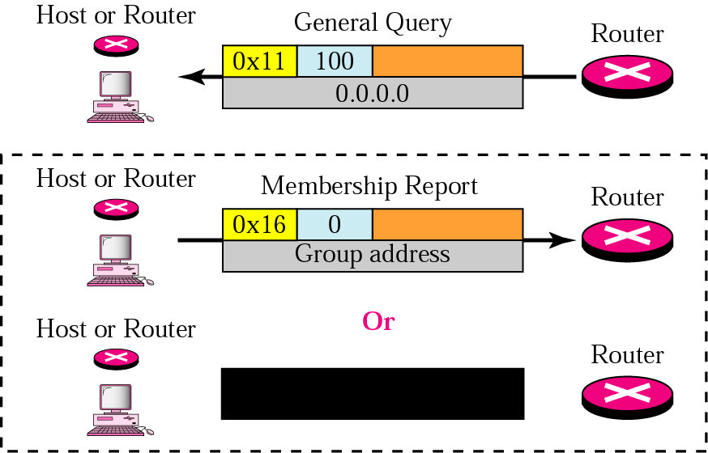
Figure 21.29 General query message
No Response

Slide 46
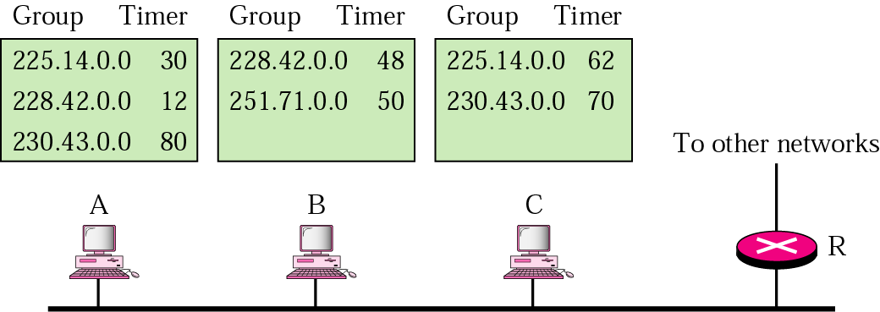
Example 1
Imagine there are three hosts in a network, as shown in Figure 21.30 (below). A query message was received at time 0; the random delay time (in tenths of seconds) for each group is shown next to the group address. Show the sequence of report messages.

Slide 47
Solution
The events occur in this sequence:
Time 12. The timer for 228.42.0.0 in host A expires and a membership report is sent, which is received by the router and every host including host B which cancels its timer for 228.42.0.0.
Time 30. The timer for 225.14.0.0 in host A expires and a membership report is sent, which is received by the router and every host including host C which cancels its timer for 225.14.0.0.
Time 50. The timer for 251.71.0.0 in host B expires and a membership report is sent, which is received by the router and every host.
Time 70. The timer for 230.43.0.0 in host C expires and a membership report is sent, which is received by the router and every host including host A which cancels its timer for 230.43.0.0.

Slide 48
Note:
In a source-based tree approach, the combination of source and group determines the tree.

Slide 49
Note:
In the group-shared tree approach, the group determines the tree.

Slide 50
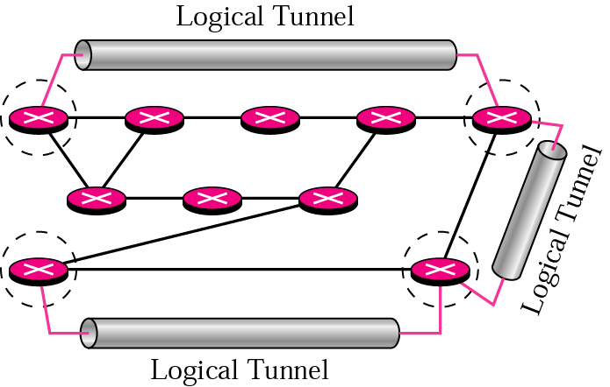
Figure 21.31 Logical tunneling

Slide 51
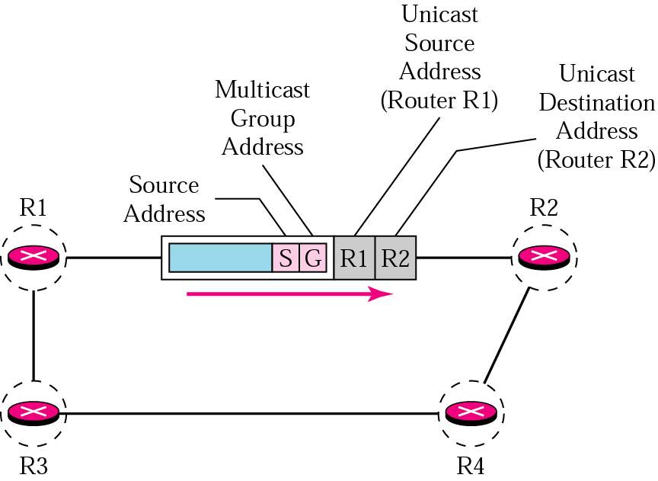
Figure 21.32 MBONE

Slide 52
21.4 Multicast Routing Protocols
DVMRP
MOSPF
CBT
PIM

Slide 53
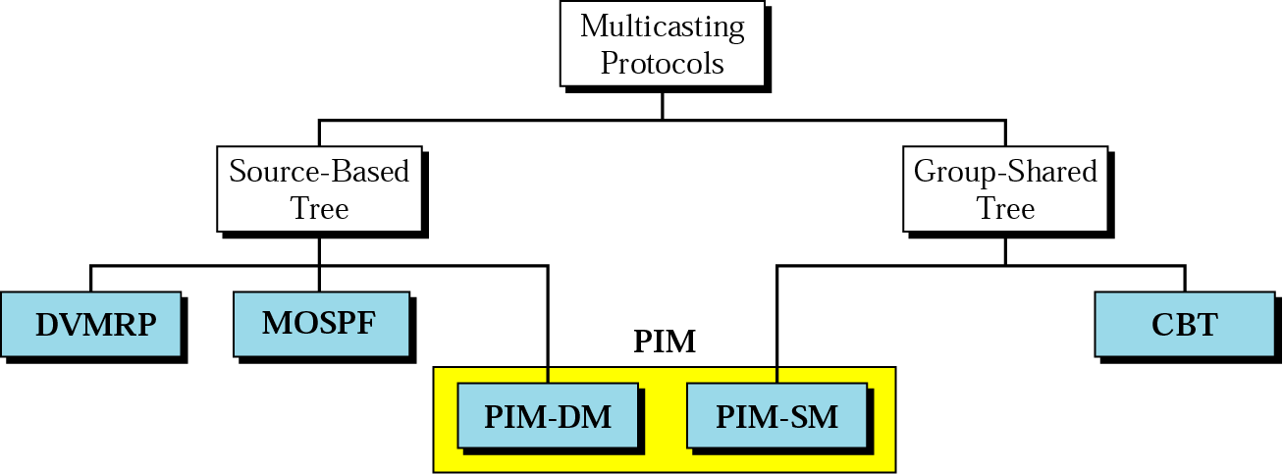
Figure 21.33 Multicast routing protocols

Slide 54
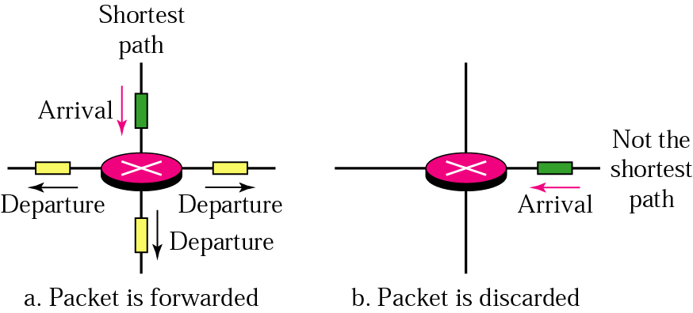
Figure 21.34 Reverse path forwarding

Slide 55
Note:
In reverse path forwarding, the router forwards only the packets that have traveled the shortest path from the source to the router; all other copies are discarded. RPF prevents the formation of loops.

Slide 56
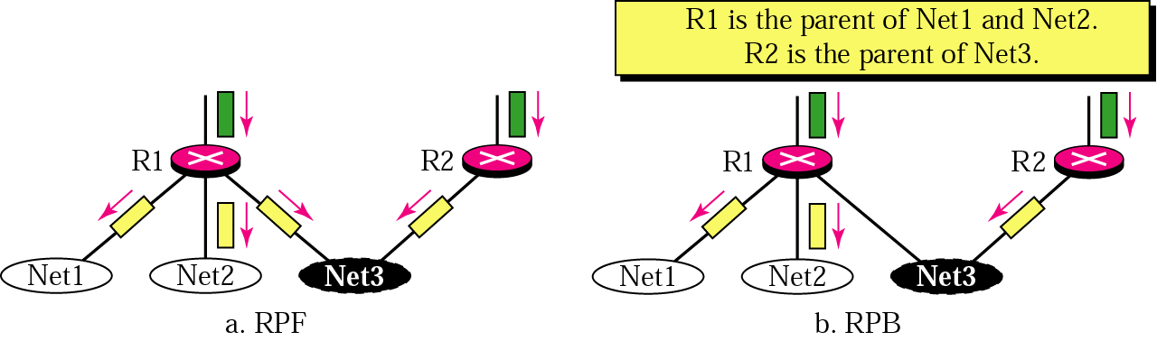
Figure 21.35 RPF versus RPB

Slide 57
Note:
RPB creates a shortest-path broadcast tree from the source to each destination.
It guarantees that each destination receives one and only one copy of the packet.

Slide 58
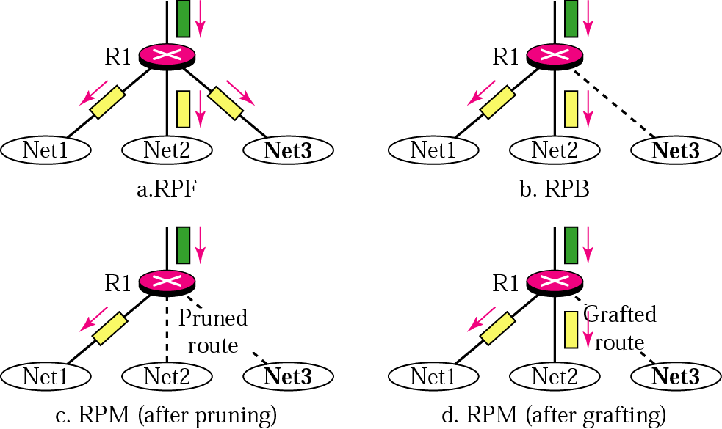
Figure 21.36 RPF, RPB, and RPM

Slide 59
Note:
RPM adds pruning and grafting to RPB to create a multicast shortest-path tree that supports dynamic membership changes.

Slide 60
Figure 21.35 RPF versus RPB

Slide 61
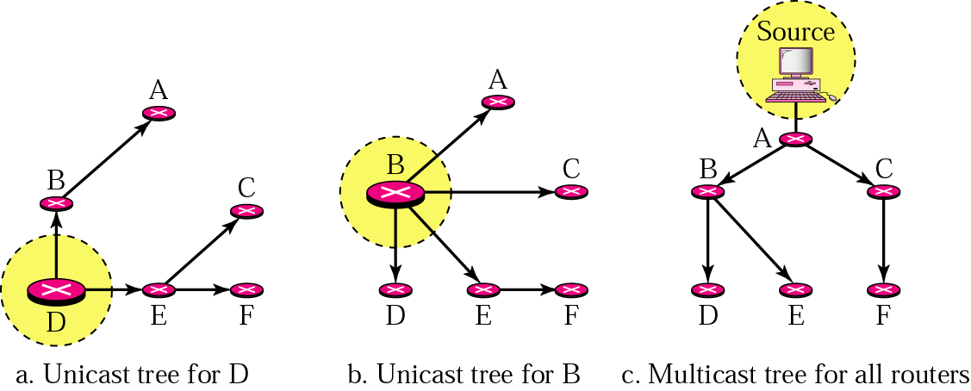
Figure 21.37 Unicast tree and multicast tree

Slide 62
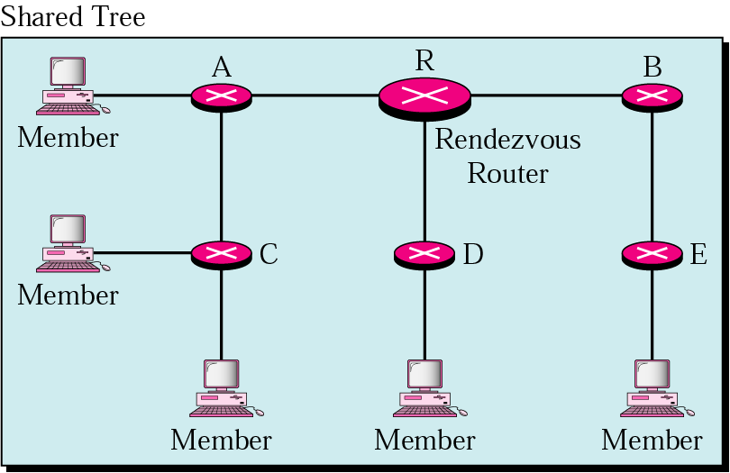
Figure 21.38 Shared-group tree with rendezvous router

Slide 63
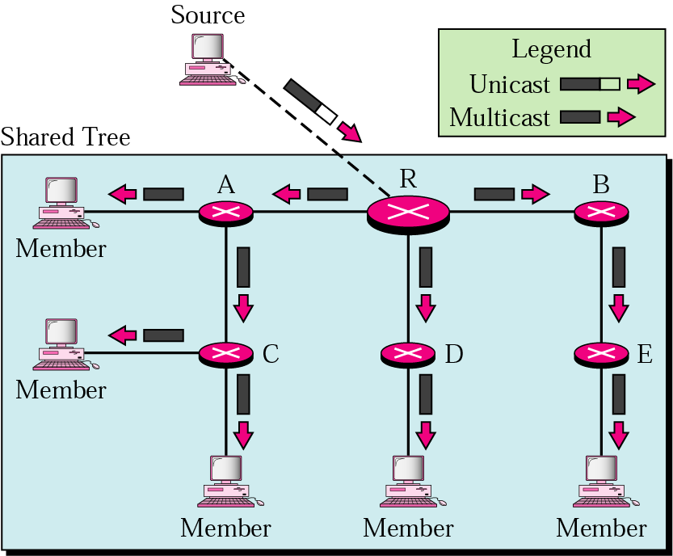
Figure 21.39 Sending a multicast packet to the rendezvous router

Slide 64
Note:
In CBT, the source sends the multicast packet to the core router. The core router decapsulates the packet and forwards it to all interested hosts.

Slide 65
Note:
PIM-DM uses RPF and pruning and grafting strategies to handle multicasting. However, it is independent of the underlying unicast protocol.

Slide 66
Note:
PIM-SM is similar to CBT but uses a simpler procedure.

