Slide 1
Chapter 23
Congestion Control
and
Quality of Service

Slide 2
23.1 Data Traffic
Traffic Descriptor
Traffic Profiles

Slide 3
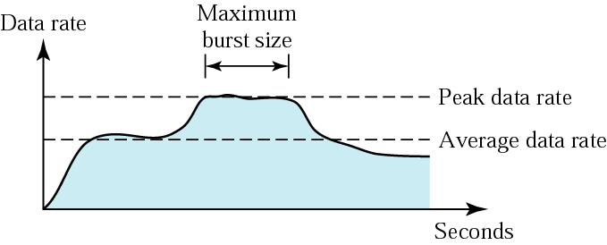
Figure 23.1 Traffic descriptors

Slide 4
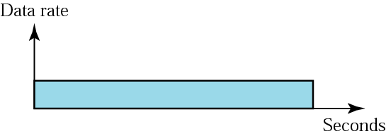
Figure 23.2 Constant-bit-rate traffic

Slide 5
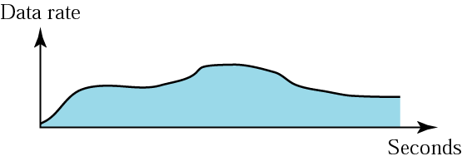
Figure 23.3 Variable-bit-rate traffic

Slide 6
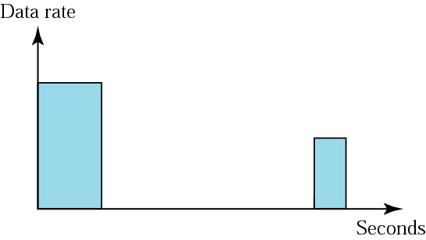
Figure 23.4 Bursty traffic

Slide 7
23.2 Congestion
Network Performance

Slide 8
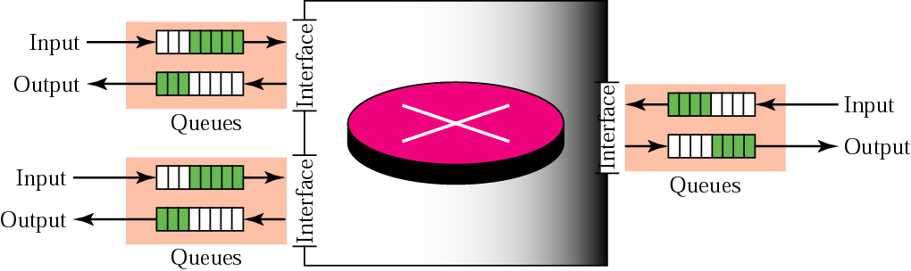
Figure 23.5 Incoming packet

Slide 9
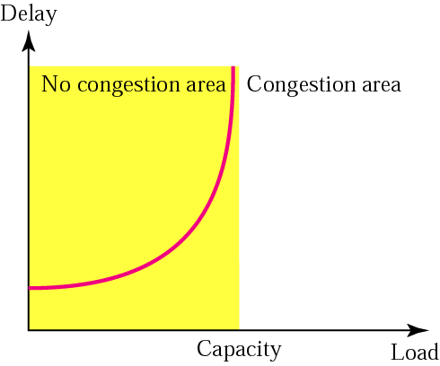
Figure 23.6 Packet delay and network load

Slide 10
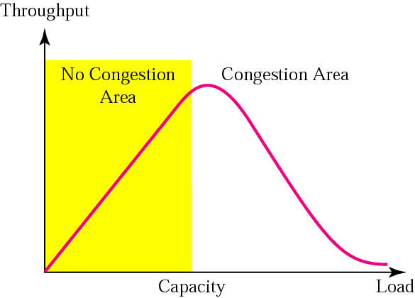
Figure 23.7 Throughput versus network load

Slide 11
23.3 Congestion Control
Open Loop
Open Loop
Closed Loop

Slide 12
23.4 Two Examples
Congestion Control in TCP
Congestion Control in Frame Relay

Slide 13

Note:
TCP assumes that the cause of a lost segment is due to congestion
in the network.

Slide 14
Note:
If the cause of the lost segment is congestion, retransmission of the segment does not remove
the cause—it aggravates it.

Slide 15
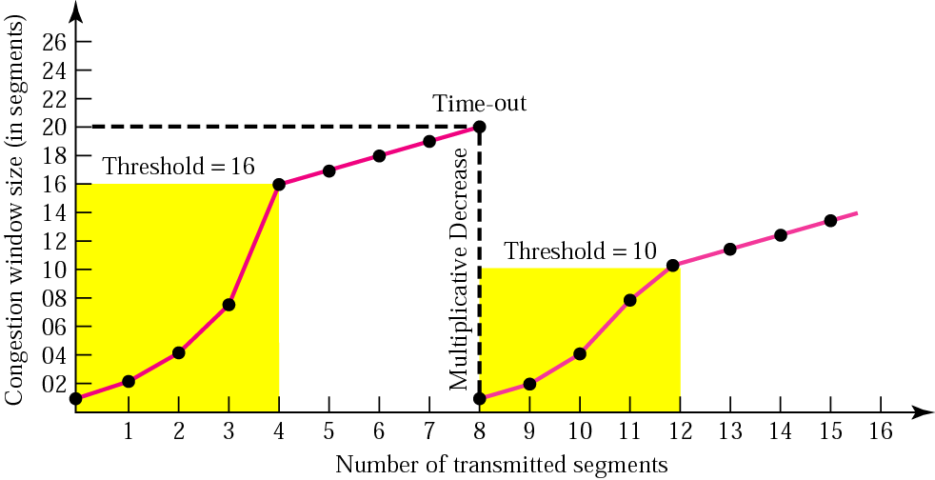
Figure 23.8 Multiplicative decrease

Slide 16
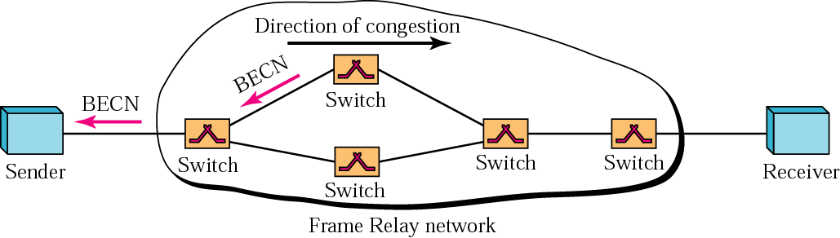
Figure 23.9 BECN

Slide 17
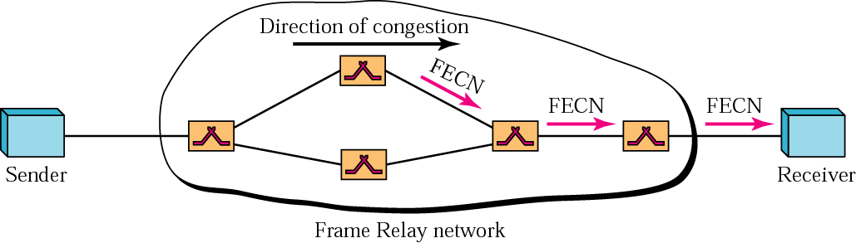
Figure 23.10 FECN

Slide 18
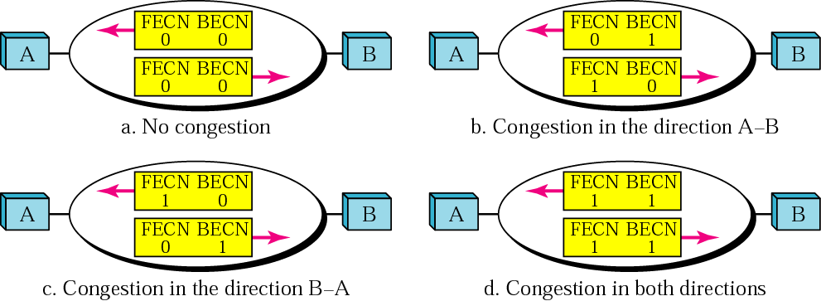
Figure 23.11 Four cases of congestion

Slide 19
23.5 Quality of Service
Flow Characteristics
Flow Classes

Slide 20
23.6 Techniques to Improve QoS
Scheduling
Traffic Shaping
Resource Reservation
Admission Control

Slide 21
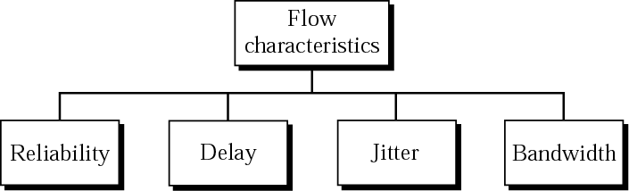
Figure 23.12 Flow characteristics

Slide 22
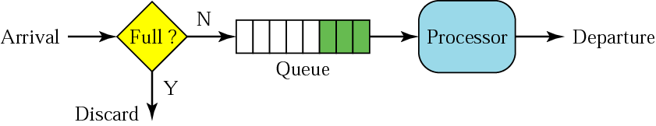
Figure 23.13 FIFO queue

Slide 23
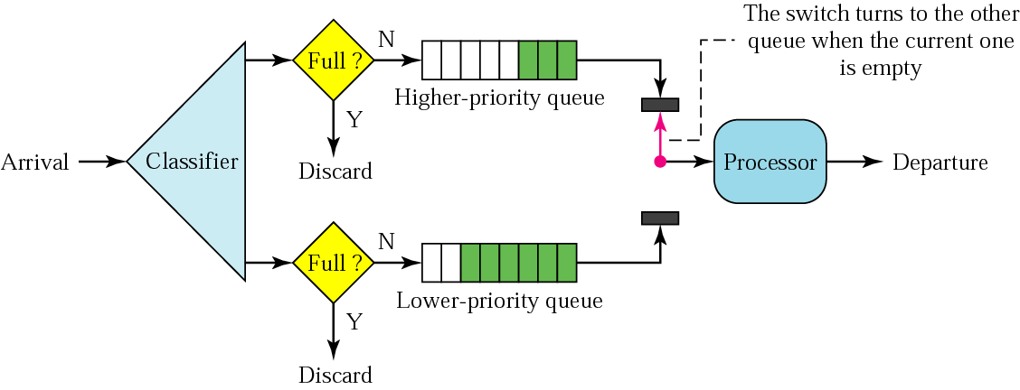
Figure 23.14 Priority queuing

Slide 24
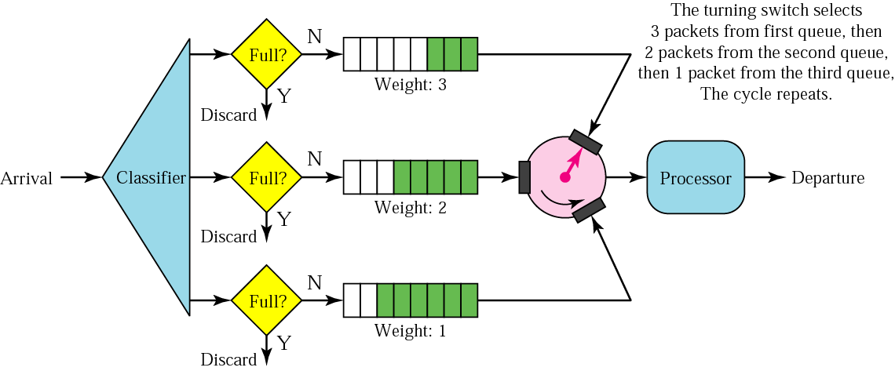
Figure 23.15 Weighted fair queuing

Slide 25
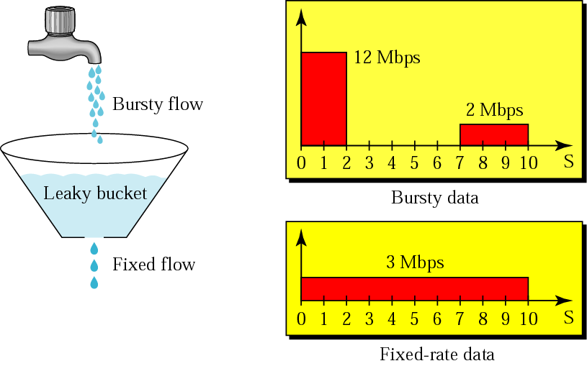
Figure 23.16 Leaky bucket

Slide 26
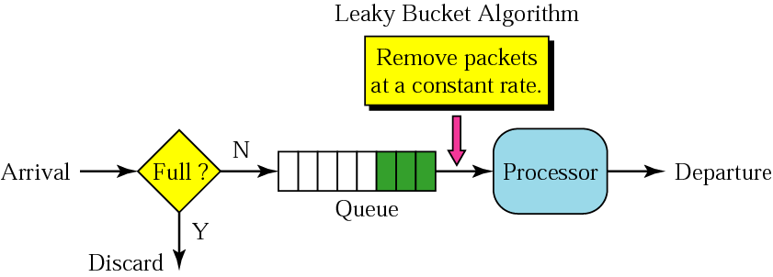
Figure 23.17 Leaky bucket implementation

Slide 27
Note:
A leaky bucket algorithm shapes bursty traffic into fixed-rate traffic by averaging the data rate. It may drop the packets if the bucket is full.

Slide 28
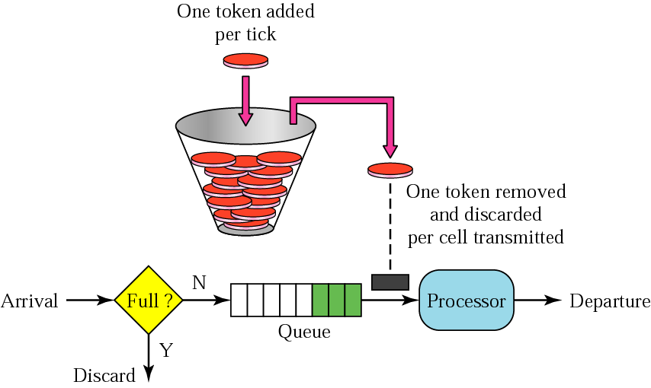
Figure 23.18 Token bucket

Slide 29
Note:
The token bucket allows bursty traffic at a regulated maximum rate.

Slide 30
23.7 Integrated Services
Signaling
Flow Specification
Admission
Service Classes
RSVP

Slide 31
Note:
Integrated Services is a flow-based QoS model designed for IP.

Slide 32
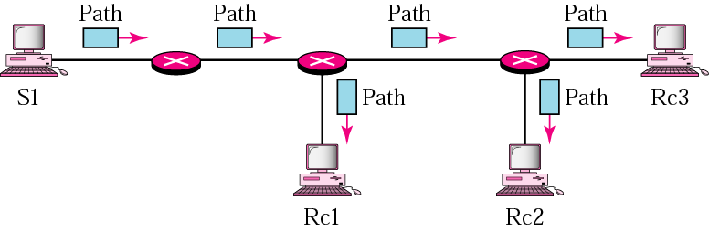
Figure 23.19 Path messages

Slide 33
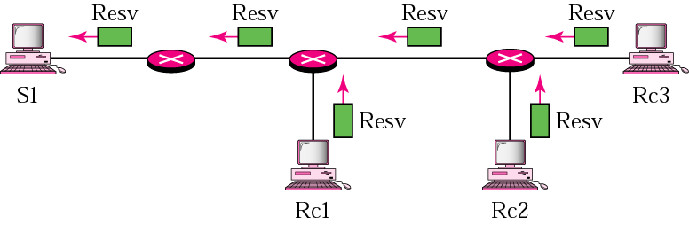
Figure 23.20 Resv messages

Slide 34
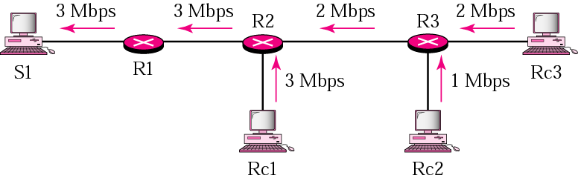
Figure 23.21 Reservation merging

Slide 35
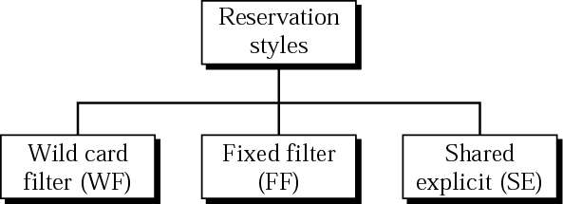
Figure 23.22 Reservation styles

Slide 36
23.8 Differentiated Services
An Alternative to
Integrated Services

Slide 37
Note:
Differentiated Services is a class-based QoS model designed for IP.

Slide 38

Figure 23.23 DS field

Slide 39
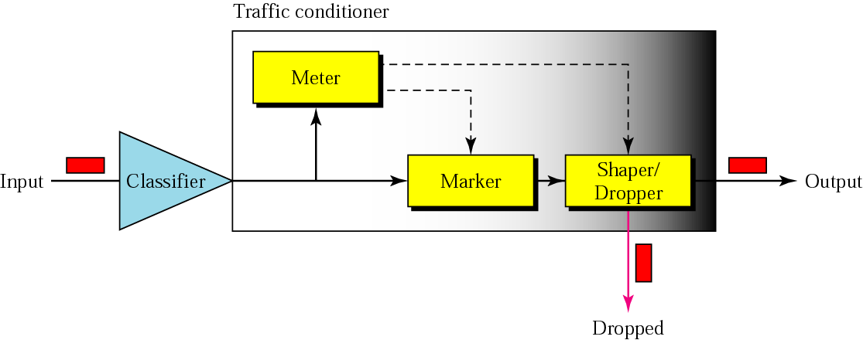
Figure 23.24 Traffic conditioner

Slide 40
23.9 QoS in Switched Networks
QoS in Frame Relay
QoS in ATM

Slide 41
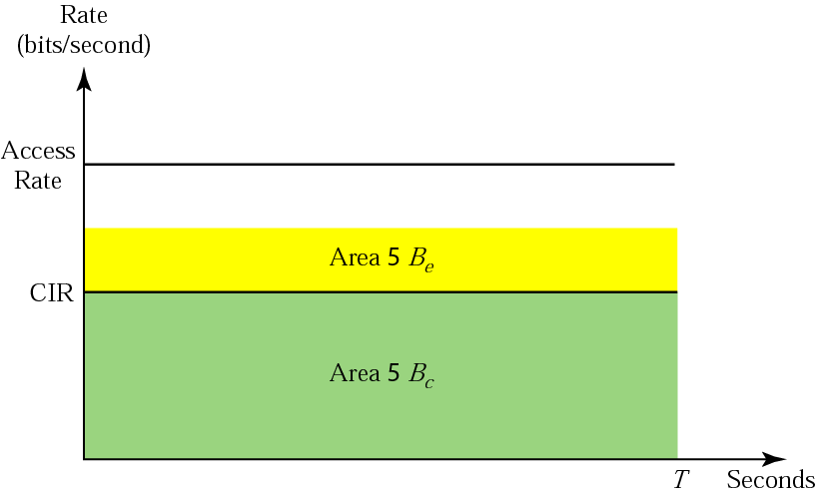
Figure 23.25 Relationship between traffic control attributes

Slide 42
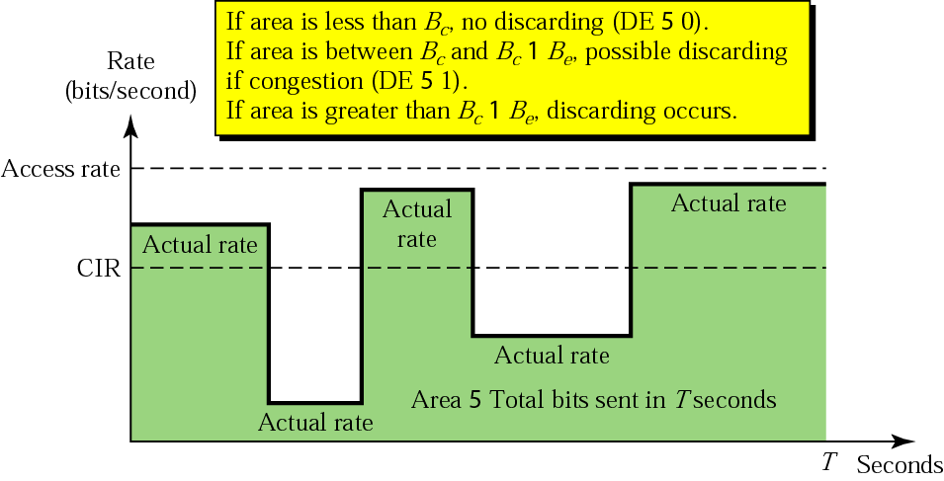
Figure 23.26 User rate in relation to Bc and Bc + Be

Slide 43
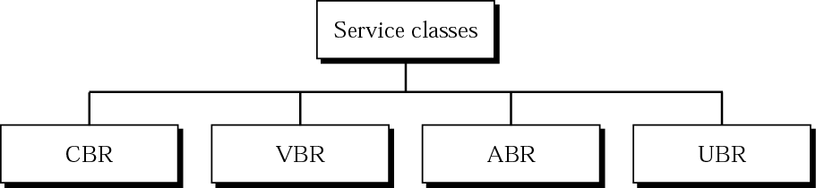
Figure 23.27 Service classes

Slide 44
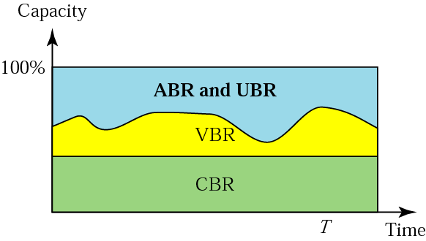
Figure 23.28 Relationship of service classes to the total capacity

