Slide 1
Lecture #: MIDI
 Anupam Mukherjee

Slide 2
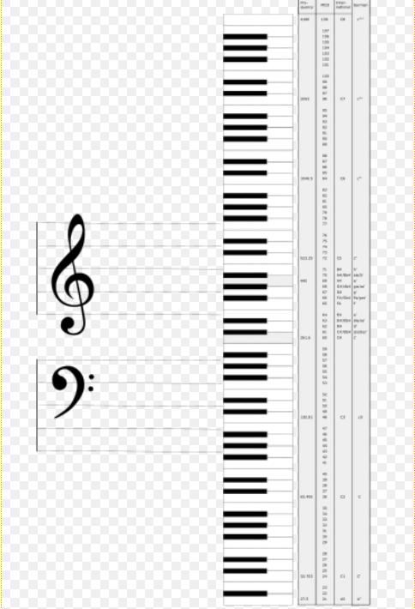
Musical Instrument Digital Interface
is an industry-standard protocol defined in 1983 that enables electronic musical instruments, computers, and other equipment to communicate, control, and synchronize with each other. MIDI allows computers, synthesizers, MIDI controllers, sound cards, samplers and drum machines to control one another, and to exchange system data
The relationship between music and computer has become more and more important, specially considering the development of MIDI and it’s important contribution in the music industry today.

Slide 3
Overview
The MIDI interface between electronic musical instruments and computers is a small piece of equipment that plug directly into the computer serial port and allows the transmission of musical signals
MIDI is a standard that manufacturer of musical instruments have agreed upon. It is a set of specifications they use in building their instrument so that the instruments of different manufacturers, can without difficulty, communicate musical information between one another.

Slide 4
Interfaces
MIDI connector diagram
The physical MIDI interface uses DIN 5/180° connectors.
Logically, MIDI is based on a ring network topology, with a transceiver inside each device. The transceivers physically and logically separate the input and output lines, meaning that MIDI messages received by a device in the network not intended for that device will be re-transmitted on the output line (MIDI-OUT). This introduces a delay, one that is long enough to become audible on larger MIDI rings.

Slide 5
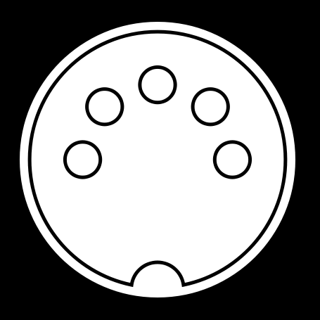
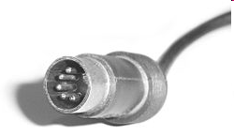
Five-pin male 180° DIN connector
MIDI connector Diagram

Slide 6
MIDI components
It has two different components --------------
Hardware connects the equipment. It specifies the physical connection between musical instruments. MIDI port, MIDI cable that deals with electronic signal are the H/W components.
A data format encodes the information traveling through the hardware. The MIDI data format is digital; the data are grouped into MIDI message. Each MIDI message communicate one musical event between machines.

Slide 7
The MIDI File Format
MIDI files are structured into chunks.
Each chunk consists of:
Type | Length | Data
4 bytes | 4 bytes | Length bytes

Slide 8
 A 4-byte chunk type (ascii)
 A 4-byte length (32 bits, msb first)
 length bytes of data
➲ There are two types of chunks:
1. Header Chunks
which have a chunk type of "MThd"
2. Track Chunks
which have a chunk type of "MTrk"

Slide 9
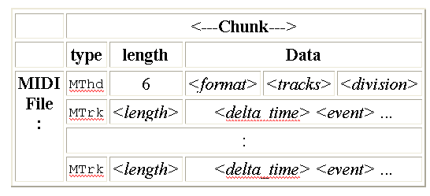
A MIDI file consists of a single header chunk followed by one or more track chunks.

Slide 10
Example of MIDI message creation
When a musician presses a piano key, the MIDI interface creates a MIDI message where the beginning of the note with its stroke intensity is encoded. This message is transmitted to another machine. In the moment they key is released, a corresponding signal (MIDI message) is transmitted again.
For 10 minutes of music, this process creates about 200 kb of MIDI data.

Slide 11
Important tips…..
If a musical instrument satisfies both components of the MIDI standard, the instrument is a MIDI device (e.g. synthesizer)
Capable of communicating with other MIDI devices through channel.
The MIDI standard specifies 16 channels.
The MIDI standard specifies 128 instruments, including noise effects (e.g. telephone, air craft), with unique nos. Ex →
0 ------------------------> Acoustic Grad Piano
12 ------------------------> Marimba
40 ------------------------> Violin
73 ------------------------> Flute

Slide 12
MIDI have 4 reception modes
i) Mode1: Omni On / Poly;
ii) Mode2: Omni On/ Mono;
iii) Mode3: Omni Off/ Poly;
iv) Mode4: Omni Off/ Mono;

