Slide 1

Note: The data and information in this document is reflective of a hypothetical situation and client. This document is to be used for KPMG Virtual Internship purposes only.
Sprocket Central Pty Ltd
Data analytics approach
Shubham Tiwari
KPMG Data Analyst Virtual Intern

Slide 2
Note: The data and information in this document is reflective of a hypothetical situation and client. This document is to be used for KPMG Virtual Internship purposes only.
Agenda
Introduction
Data Exploration
Model Development
Interpretation

Slide 3
Note: The data and information in this document is reflective of a hypothetical situation and client. This document is to be used for KPMG Virtual Internship purposes only.
Introduction
New Customer Analysis
After Analysing the Existing Datasets (Transactions, CustomerDemographic, CustomerAddress) and Exploring Relationship within them, following are the features recommended for New Customers:
Age distribution histogram
Past 3 years Bike Purchase history
Job Industry
No. of Car Owns
Wealth Segment

Slide 4
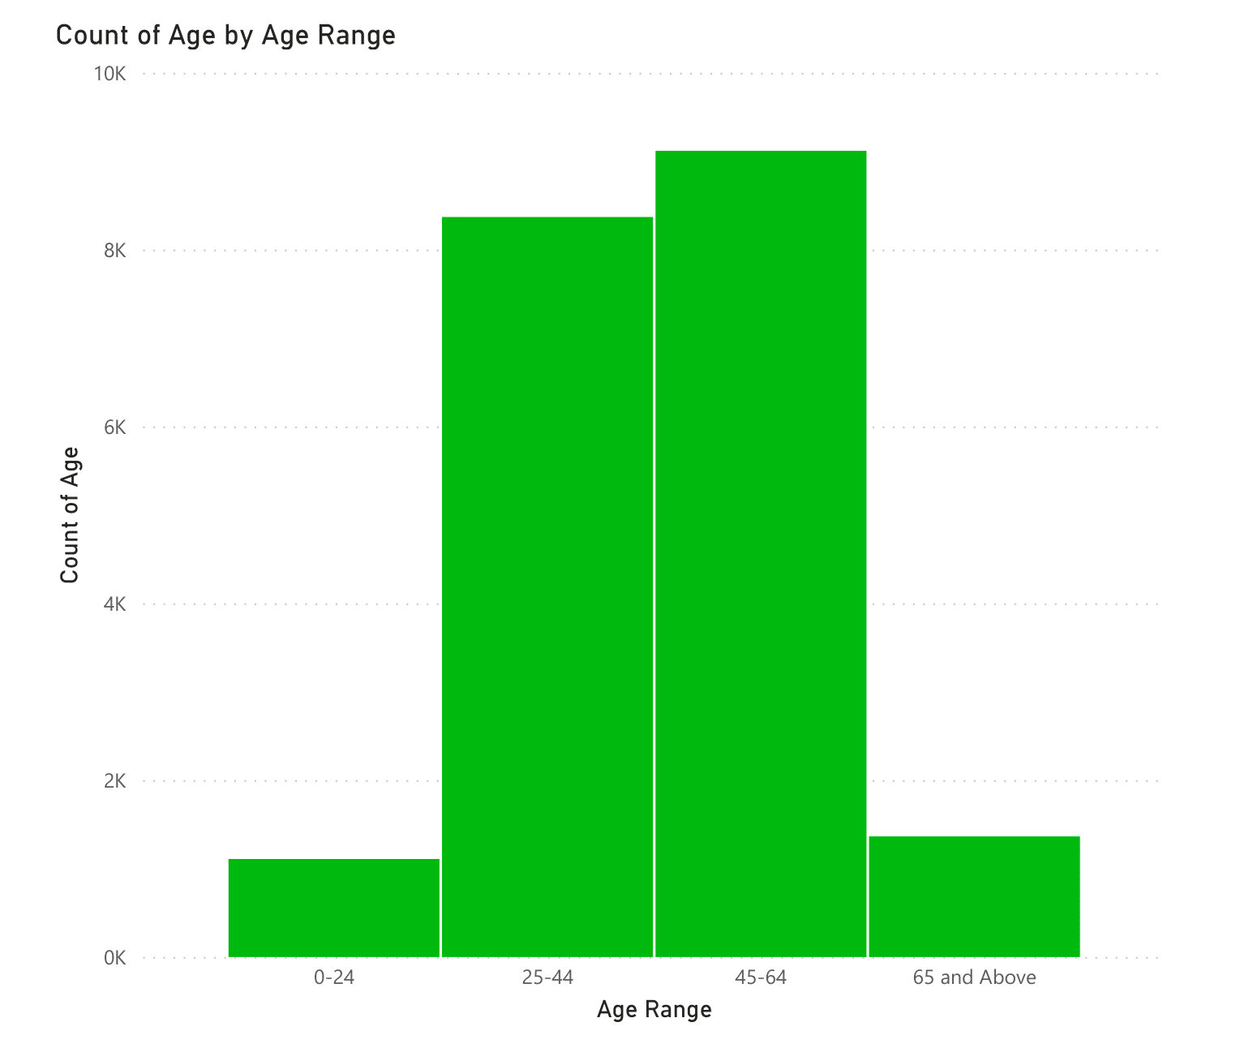
Note: The data and information in this document is reflective of a hypothetical situation and client. This document is to be used for KPMG Virtual Internship purposes only.
Data Exploration
Age distribution histogram
At 9,118, 45-64 had the highest Count of Age and was 722.92% higher than 0-24, which had the lowest Count of Age at 1,108.﻿﻿
﻿﻿45-64 had the highest Count of Age at 9,118, followed by 25-44, 65 and Above, and 0-24.﻿﻿
﻿﻿﻿45-64 accounted for 45.68% of Count of Age.﻿﻿
﻿﻿Across all 4 Age Range, Count of Age ranged from 1,108 to 9,118.﻿﻿

Slide 5
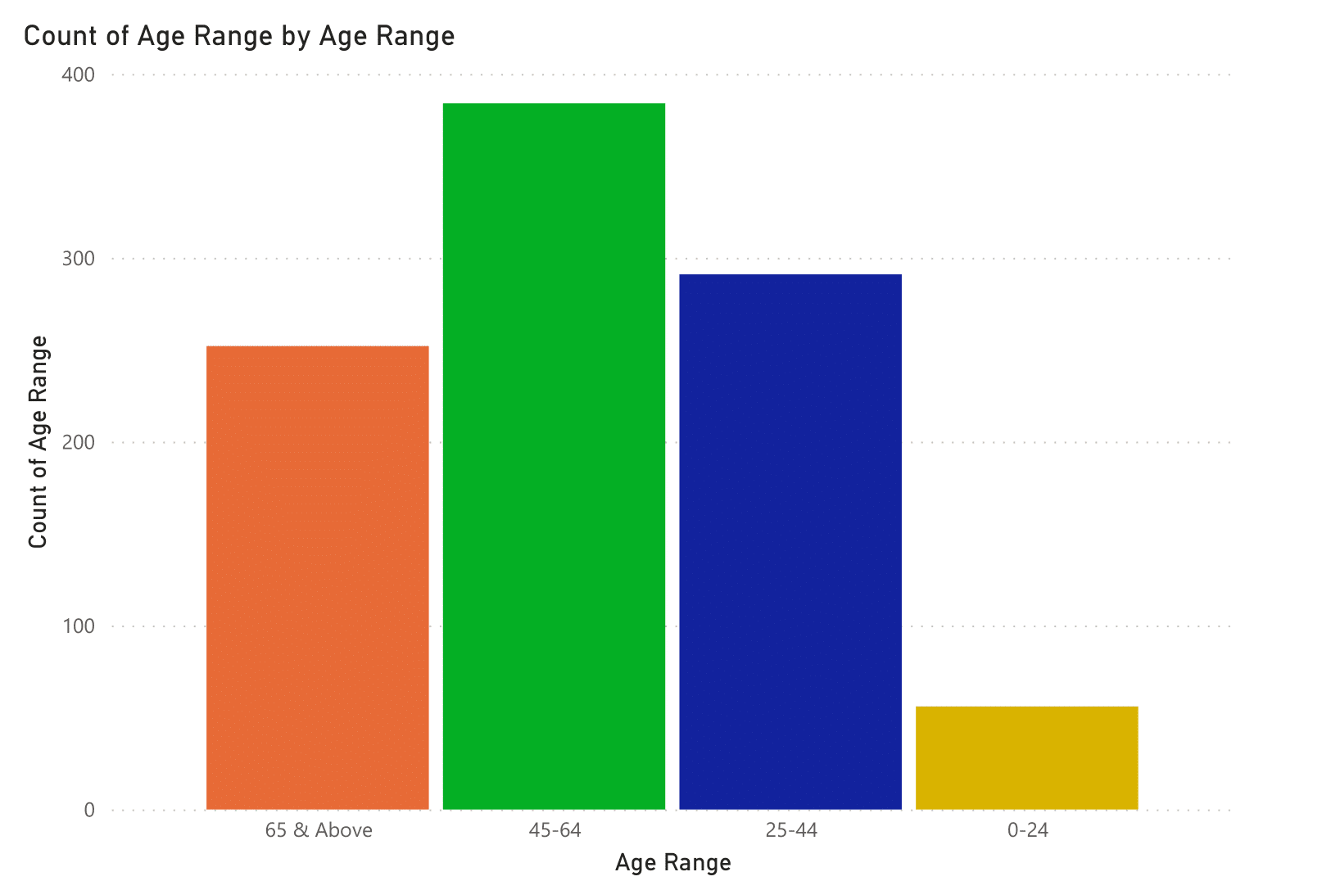
Note: The data and information in this document is reflective of a hypothetical situation and client. This document is to be used for KPMG Virtual Internship purposes only.
Data Exploration
Age distribution histogram
At 384, 45-64 had the highest Count of Age Range and was 585.71% higher than 0-24, which had the lowest Count of Age Range at 56.﻿﻿
﻿﻿45-64 had the highest Count of Age Range at 384, followed by 25-44, 65 & Above, and 0-24.﻿﻿
﻿﻿45-64 accounted for 39.06% of Count of Age Range.﻿﻿
﻿﻿Across all 4 Age Range, Count of Age Range ranged from 56 to 384.﻿﻿

Slide 6
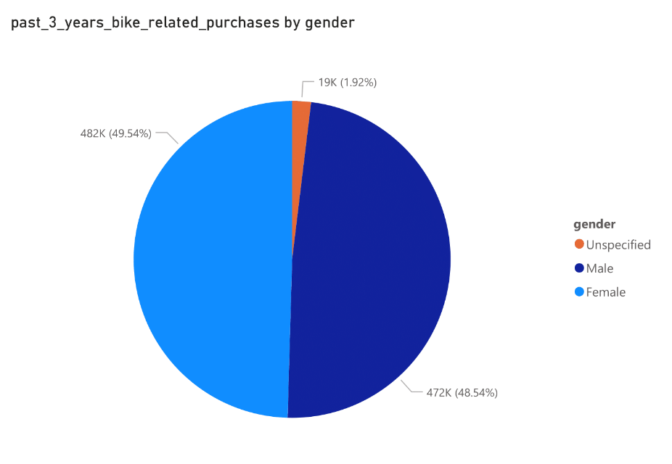
Note: The data and information in this document is reflective of a hypothetical situation and client. This document is to be used for KPMG Virtual Internship purposes only.
Data Exploration
Bike purchases within the last 3 years by Gender for Existing Customer
Female had the highest past_3_years_bike_related_purchases at 482083, followed by Male at 472297 and Unspecified at 18677.﻿﻿
﻿﻿Female accounted for 49.54% of past_3_years_bike_related_purchases.﻿﻿

Slide 7
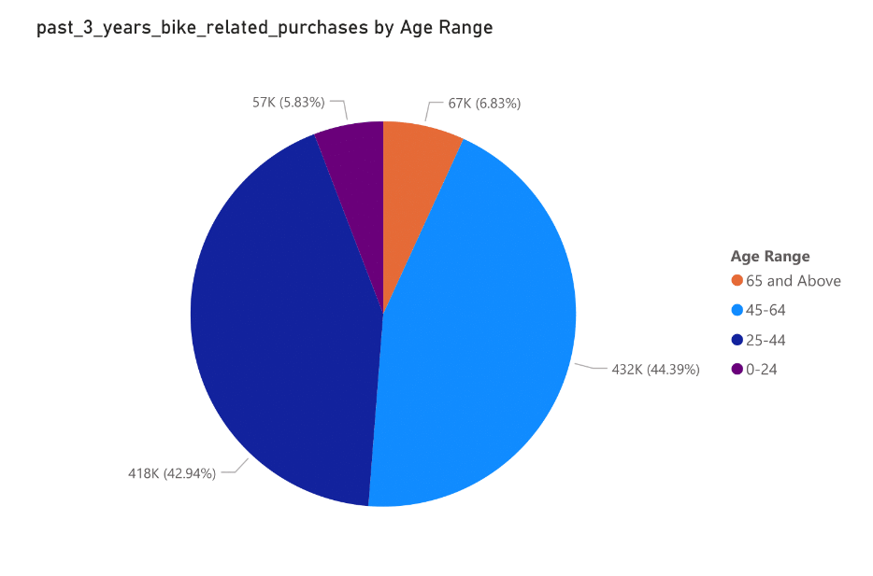
Note: The data and information in this document is reflective of a hypothetical situation and client. This document is to be used for KPMG Virtual Internship purposes only.
Data Exploration
Bike purchases within the last 3 years by Age for Existing Customer
45-64 had the highest past_3_years_bike_related_purchases at 431982, followed by 25-44, 65 and Above, and 0-24.﻿﻿
﻿﻿45-64 accounted for 44.39% of past_3_years_bike_related_purchases.﻿﻿

Slide 8
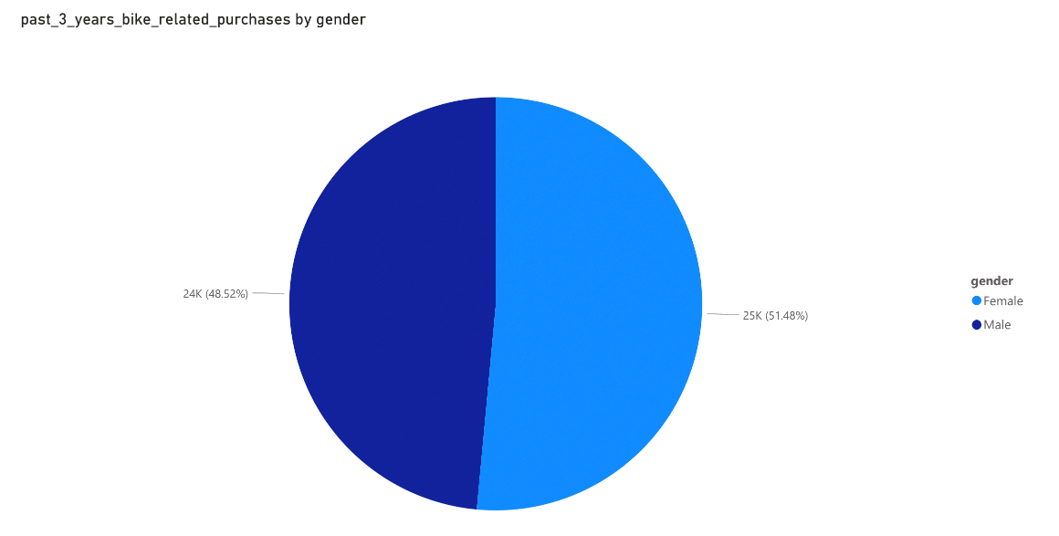
Note: The data and information in this document is reflective of a hypothetical situation and client. This document is to be used for KPMG Virtual Internship purposes only.
Data Exploration
Bike purchases within the last 3 years by Gender for New Customer
﻿past_3_years_bike_related_purchases for Female (25212) was higher than Male (23765).﻿﻿
﻿﻿Female accounted for 51.48% of past_3_years_bike_related_purchases.﻿﻿

Slide 9
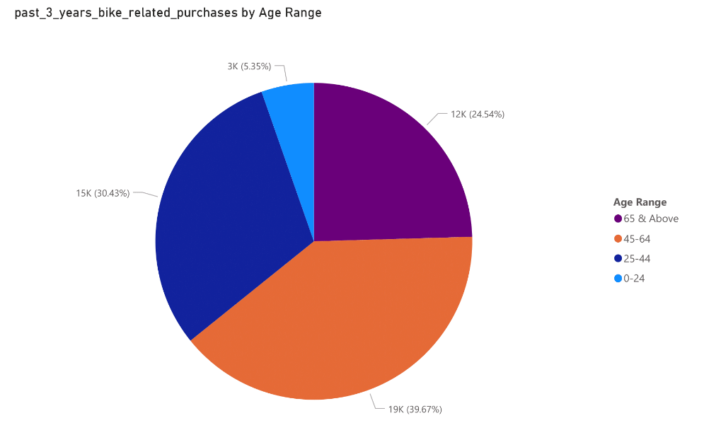
Note: The data and information in this document is reflective of a hypothetical situation and client. This document is to be used for KPMG Virtual Internship purposes only.
Data Exploration
Bike purchases within the last 3 years by Age for New Customer
﻿At 19429, 45-64 had the highest past_3_years_bike_related_purchases and was 641.00% higher than 0-24, which had the lowest past_3_years_bike_related_purchases at 2622.﻿﻿
﻿﻿45-64 had the highest past_3_years_bike_related_purchases at 19429, followed by 25-44, 65 & Above, and 0-24.﻿﻿
﻿﻿45-64 accounted for 39.67% of past_3_years_bike_related_purchases.﻿﻿
﻿﻿Across all 4 Age Range, past_3_years_bike_related_purchases ranged from 2622 to 19429.﻿﻿
The distribution of the two groups is somewhat comparable, therefore depending on your marketing plan, you may strive to increase the number of male customers or concentrate on increasing the retention of female customers.

Slide 10
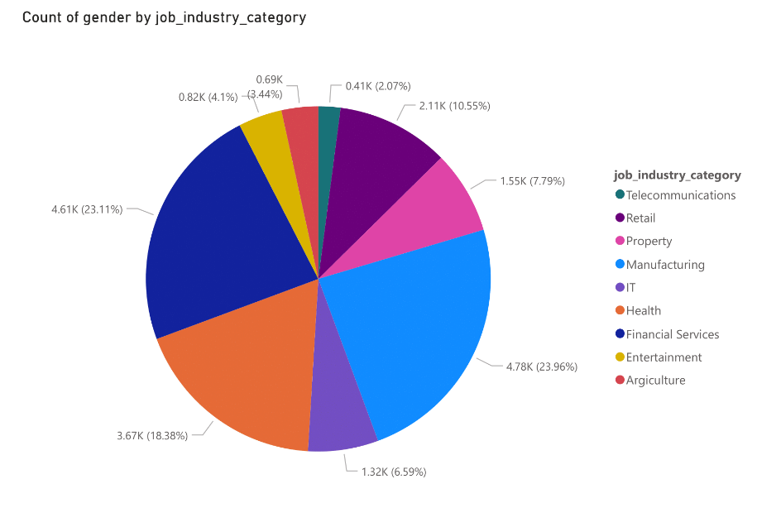
Note: The data and information in this document is reflective of a hypothetical situation and client. This document is to be used for KPMG Virtual Internship purposes only.
Data Exploration
Job industry category for Existing Customer
﻿At 4,783, Manufacturing had the highest Count of gender and was 1,058.11% higher than Telecommunications, which had the lowest Count of gender at 413.﻿﻿
﻿﻿Manufacturing accounted for 23.96% of Count of gender.﻿﻿
﻿﻿Across all 9 job_industry_category, Count of gender ranged from 413 to 4,783.﻿﻿

Slide 11
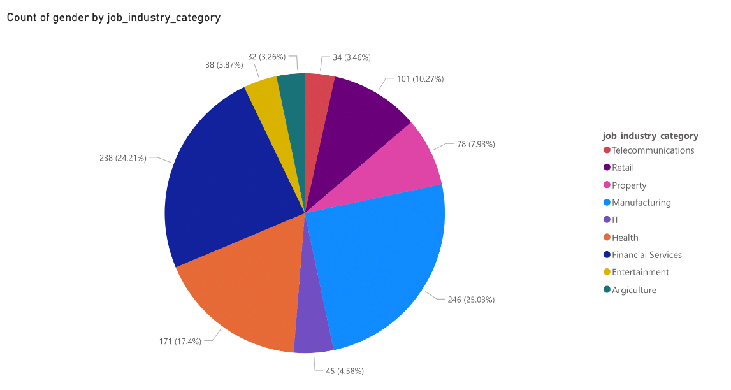
Note: The data and information in this document is reflective of a hypothetical situation and client. This document is to be used for KPMG Virtual Internship purposes only.
Data Exploration
Job industry category for New Customer
﻿﻿At 246, Manufacturing had the highest Count of gender and was 668.75% higher than Agriculture, which had the lowest Count of gender at 32.﻿﻿
﻿﻿Manufacturing accounted for 25.03% of Count of gender.﻿﻿
﻿﻿Across all 9 job_industry_category, Count of gender ranged from 32 to 246.﻿﻿

Slide 12
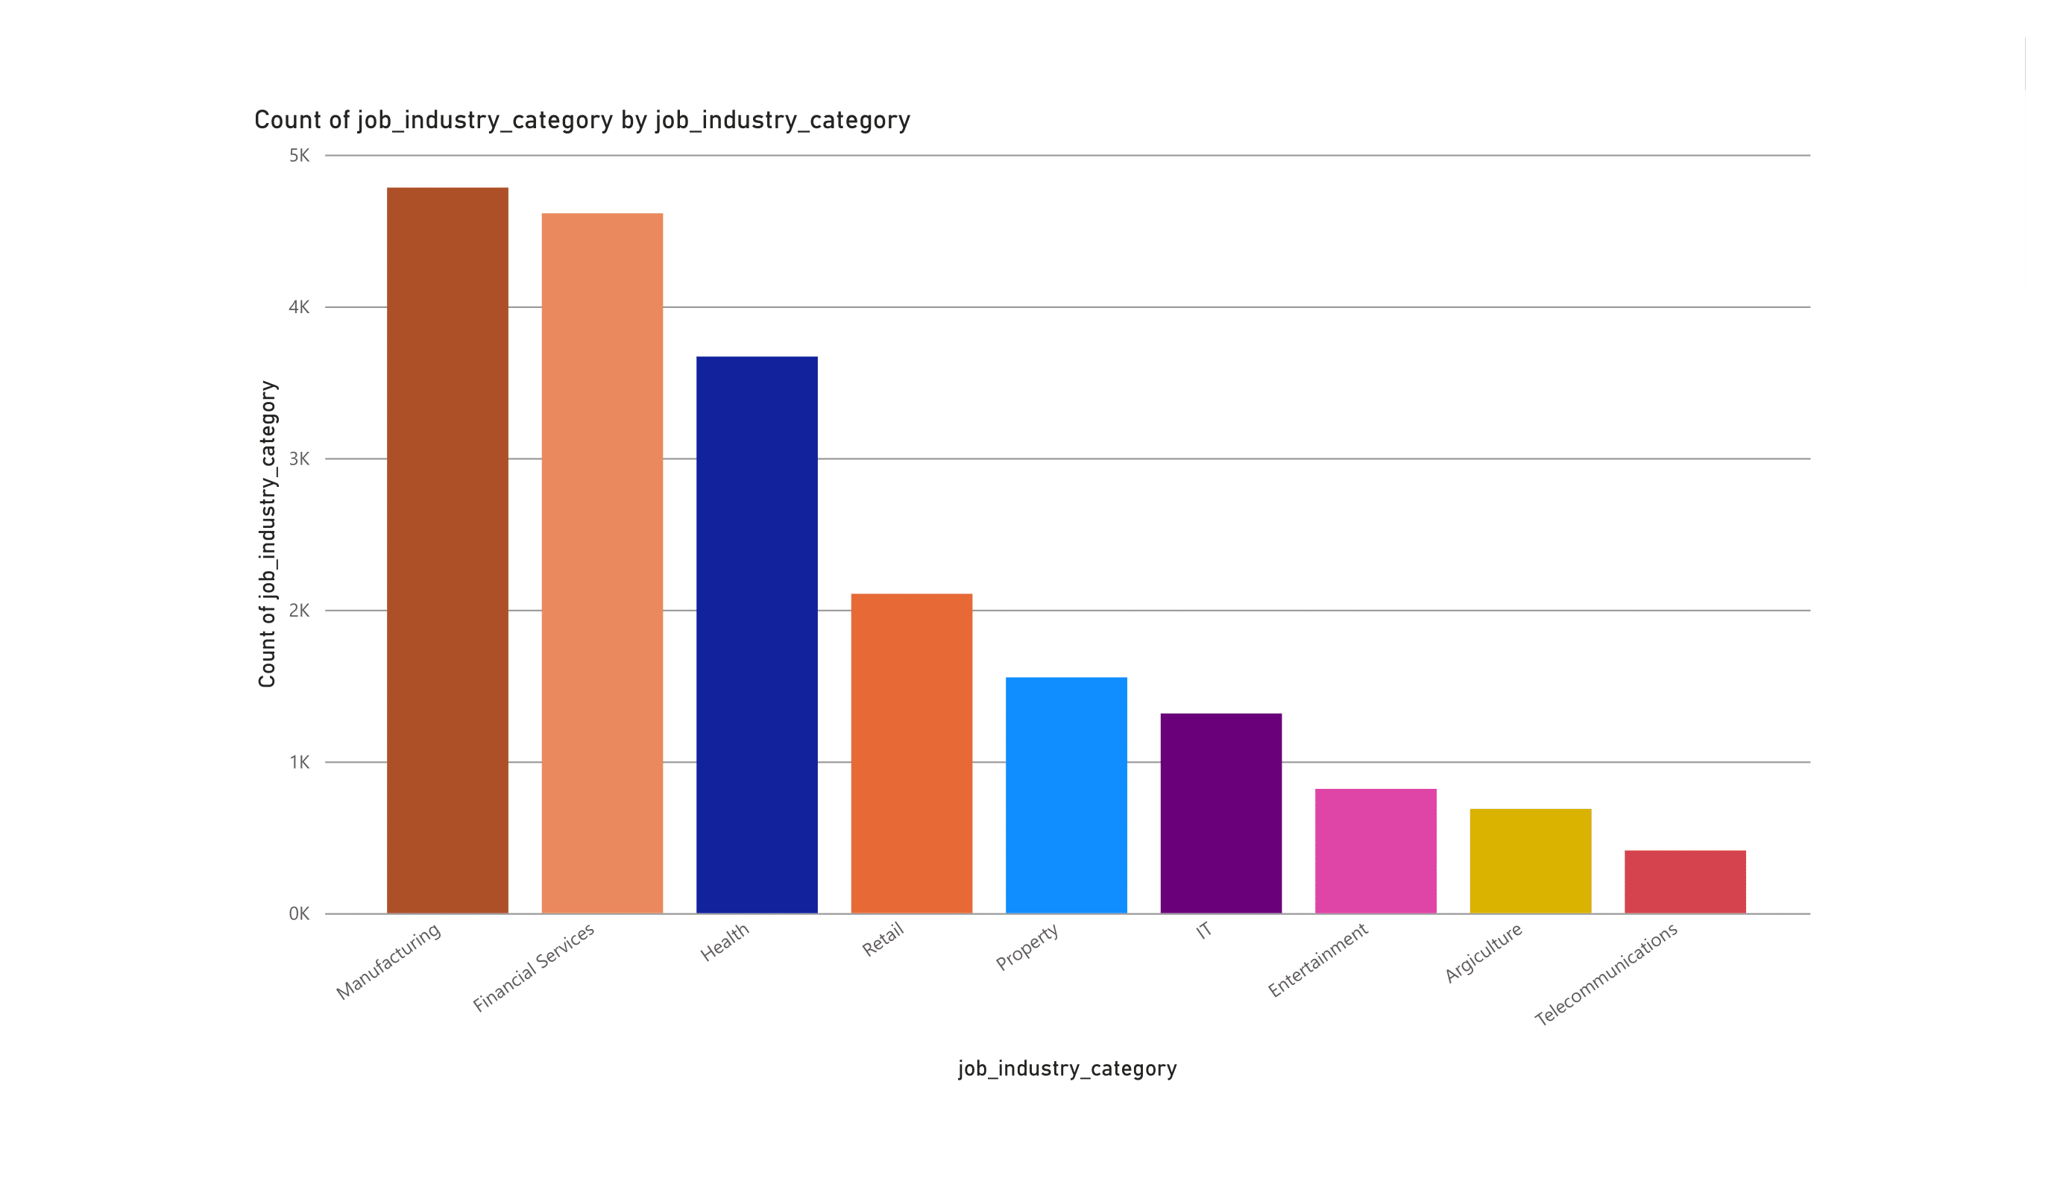
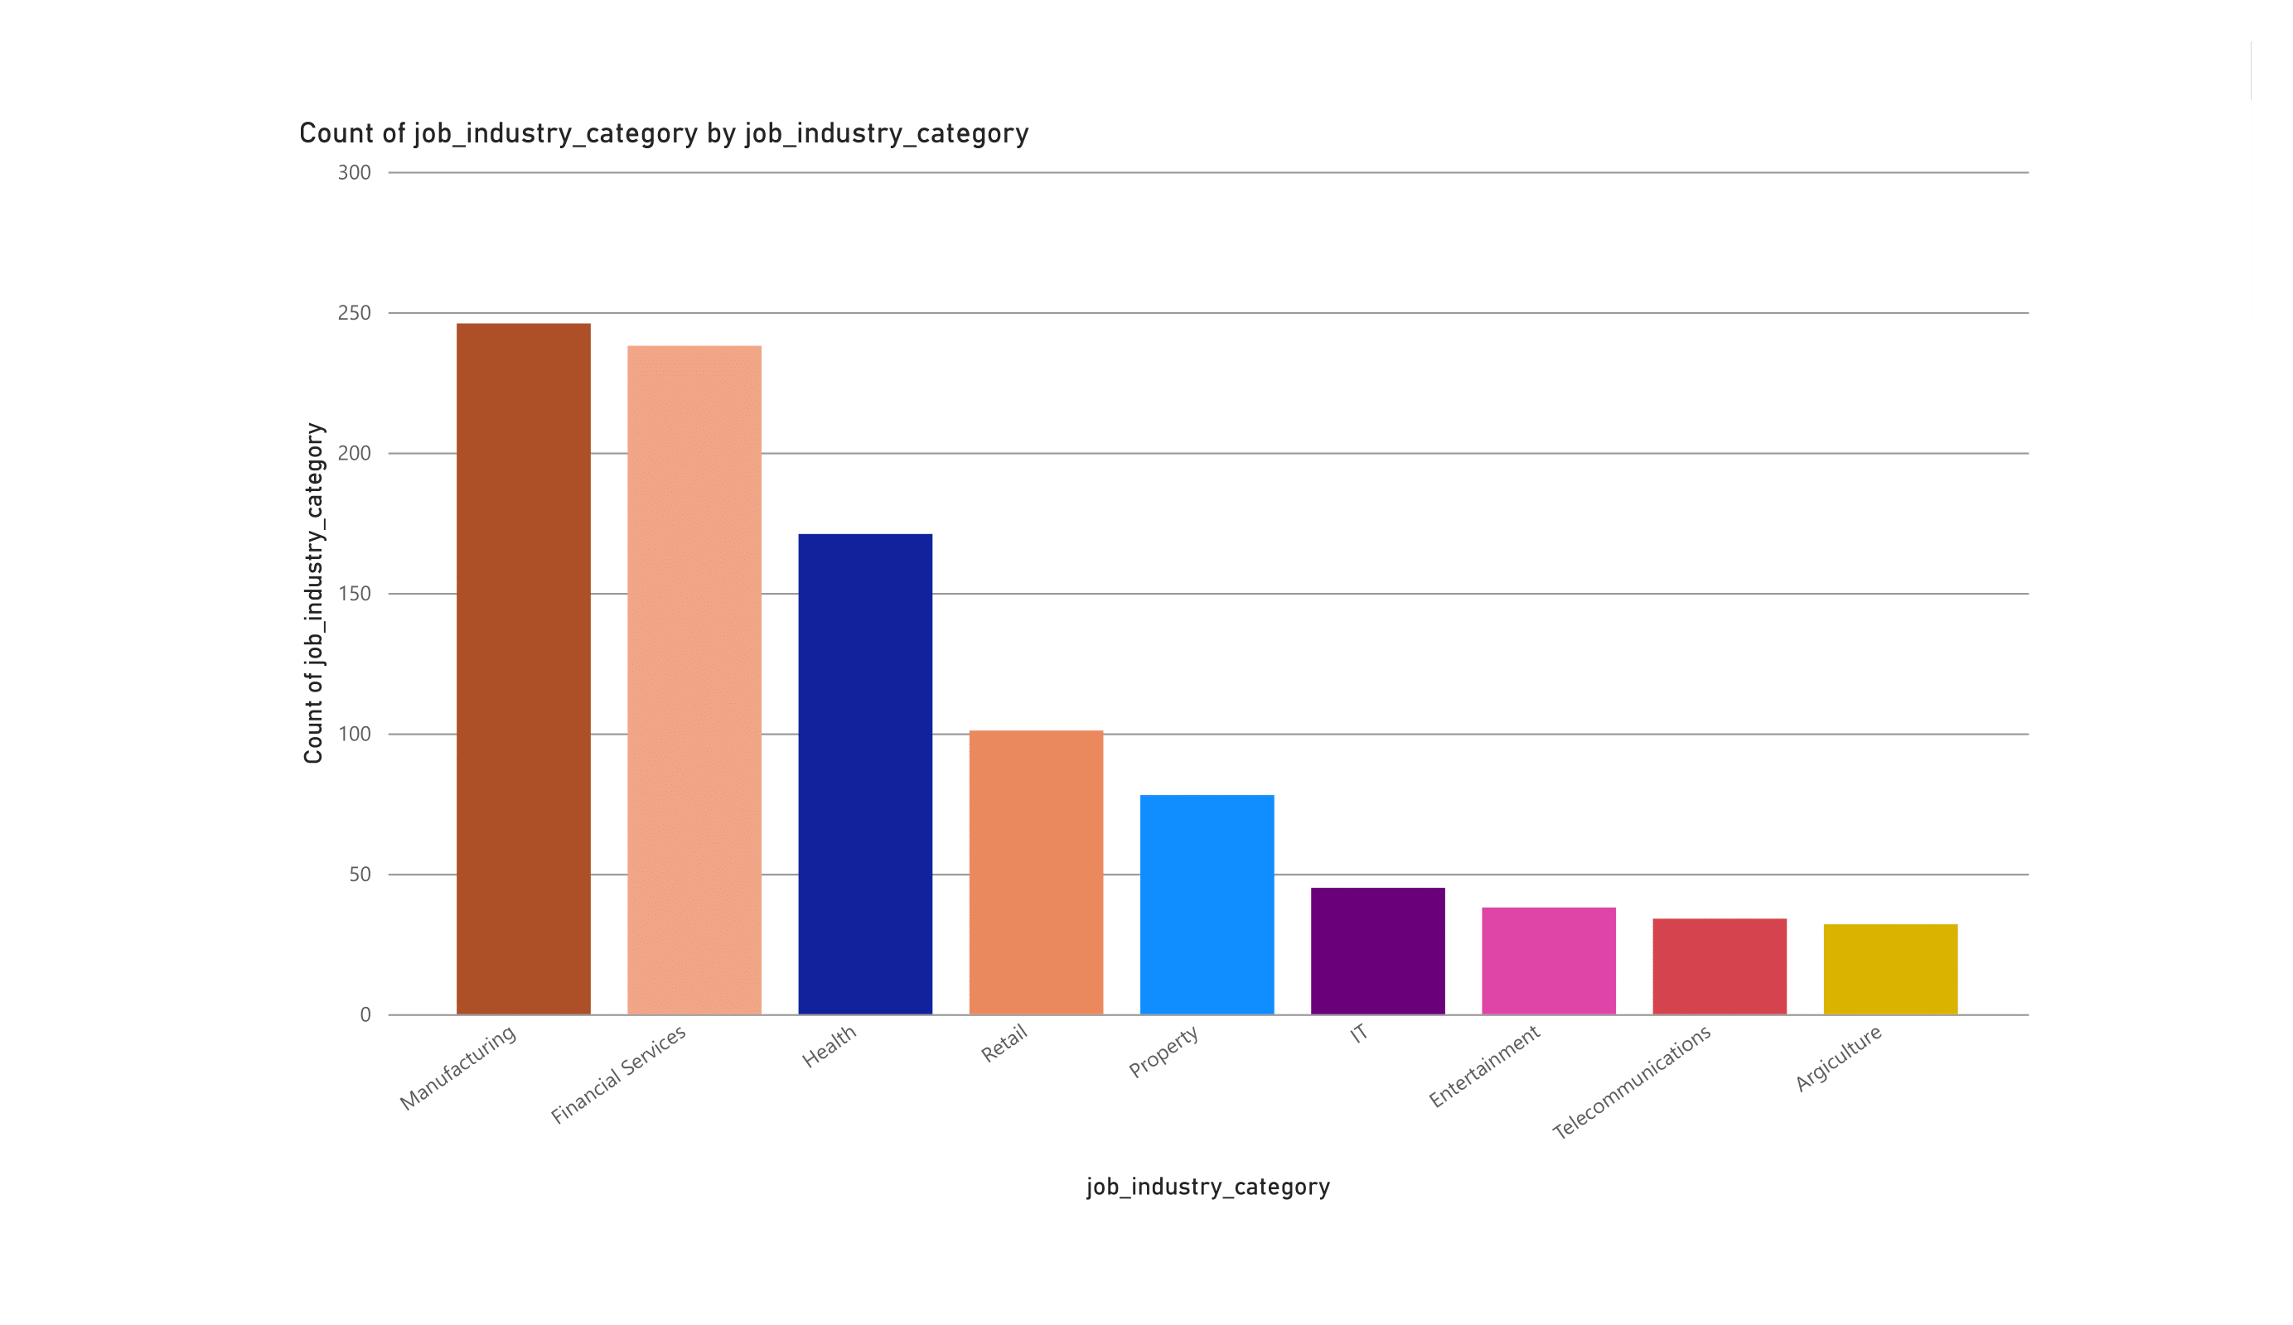
Note: The data and information in this document is reflective of a hypothetical situation and client. This document is to be used for KPMG Virtual Internship purposes only.
Data Exploration
﻿﻿The new customers' industrial profile and that of the existing ones are rather comparable. For the original group, financial services, manufacturing, and health are the top three industries (respectively).For the new group, manufacturing, financial services, and health are the top three industries (respectively).

Slide 13
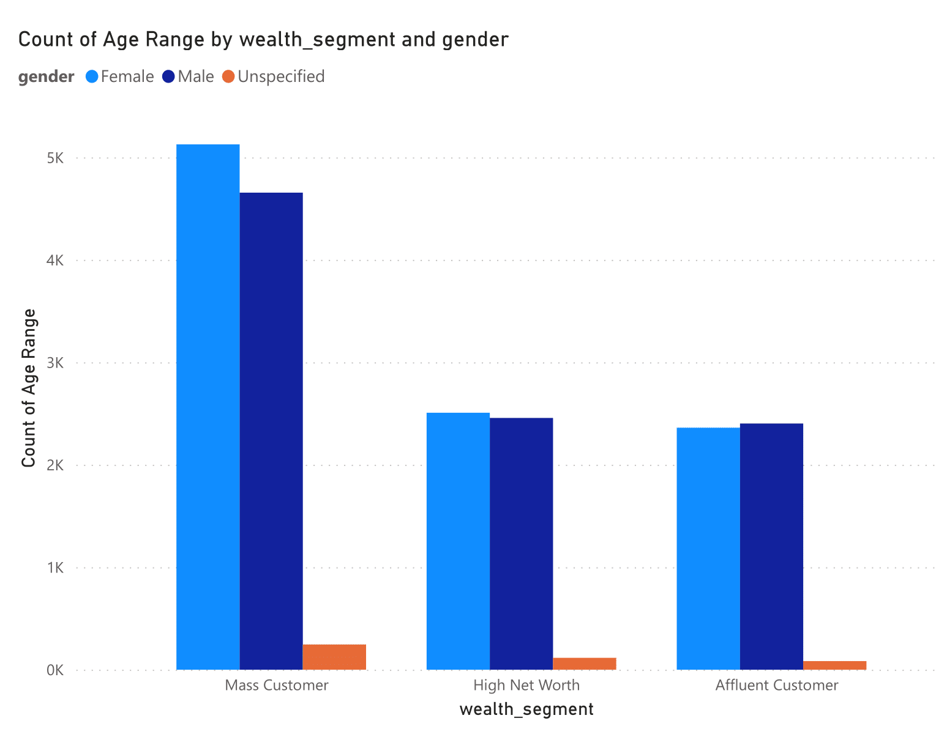
Note: The data and information in this document is reflective of a hypothetical situation and client. This document is to be used for KPMG Virtual Internship purposes only.
Data Exploration
Wealth segments for Existing Customer
﻿﻿﻿Female had the highest total Count of Age Range at 9,997, followed by Male at 9516 and Unspecified at 446.﻿﻿
﻿﻿Mass Customer in gender made up 25.69% of Count of Age Range.﻿﻿﻿
﻿﻿Female had the highest average Count of Age Range at 3,332.33, followed by Male at 3172 and Unspecified at 148.67.﻿﻿

Slide 14
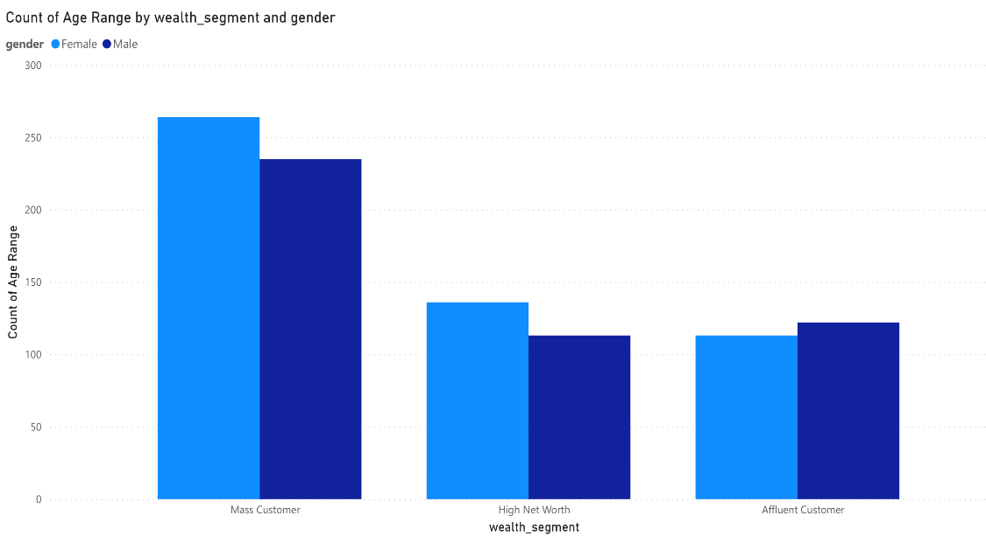
Note: The data and information in this document is reflective of a hypothetical situation and client. This document is to be used for KPMG Virtual Internship purposes only.
Data Exploration
Wealth segments for New Customer
﻿﻿﻿﻿Total Count of Age Range was higher for Female (513) than Male (470).﻿﻿
﻿﻿Mass Customer in gender made up 26.86% of Count of Age Range.﻿﻿
﻿﻿Average Count of Age Range was higher for Female (171) than Male (156.67).﻿﻿
﻿﻿Count of Age Range for Female and Male diverged the most when the wealth segment was Mass Customer, when Female were 29 higher than Male.﻿﻿
The average and median age of the new group is older. The largest demographic of clients is Mass Customers, which is safe for all ages. Compared to "High Net" and "Affluent" clients, the share of "Mass" customers is relatively lower in the new groups. The two aforementioned groups should be our primary emphasis.

Slide 15
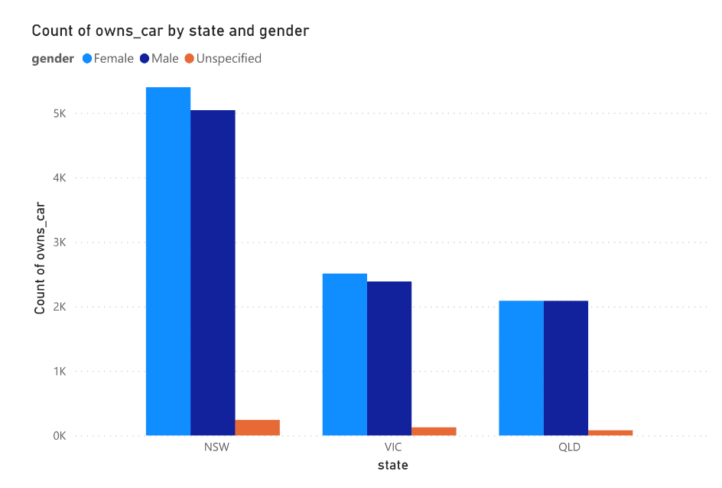
Note: The data and information in this document is reflective of a hypothetical situation and client. This document is to be used for KPMG Virtual Internship purposes only.
Data Exploration
Numbers of cars owned in each state for Existing Customer
﻿﻿Female had the highest total Count of owns car at 9,997, followed by Male at 9516 and Unspecified at 446.﻿﻿
﻿﻿NSW in gender made up 27.06% of Count of owns car.﻿﻿
﻿﻿Female had the highest average Count of owns car at 3,332.33, followed by Male at 3172 and Unspecified at 148.67.﻿﻿

Slide 16
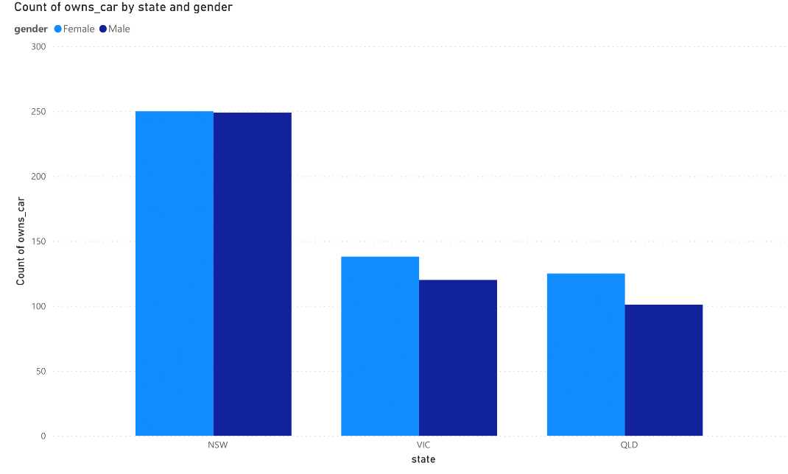
Note: The data and information in this document is reflective of a hypothetical situation and client. This document is to be used for KPMG Virtual Internship purposes only.
Data Exploration
Numbers of cars owned in each state for New Customer
﻿﻿﻿﻿﻿Total Count of gender was higher for Female (513) than Male (470).﻿﻿
﻿﻿NSW in gender made up 25.43% of Count of gender.﻿﻿
﻿﻿Average Count of gender was higher for Female (171) than Male (156.67).﻿﻿
﻿﻿Count of gender for Female and Male diverged the most when the state was QLD, when Female were 24 higher than Male.﻿﻿

Slide 17
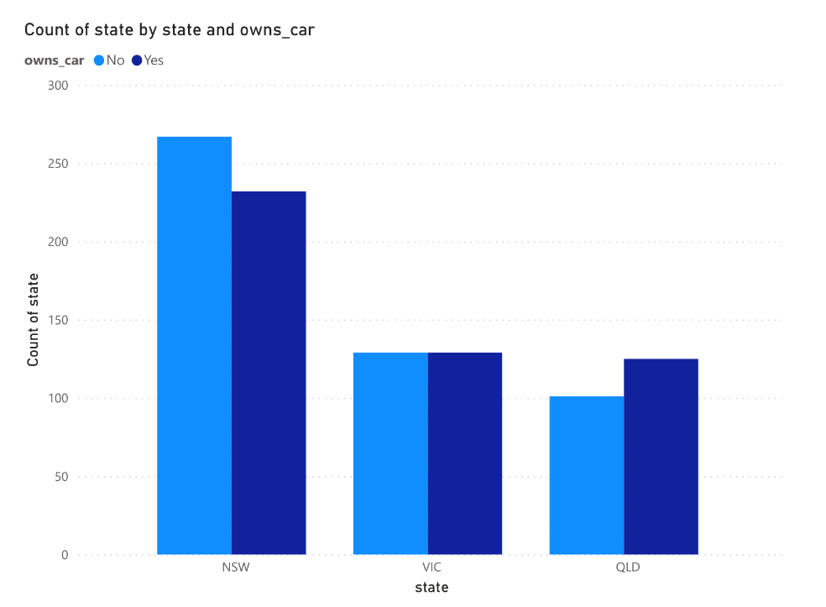
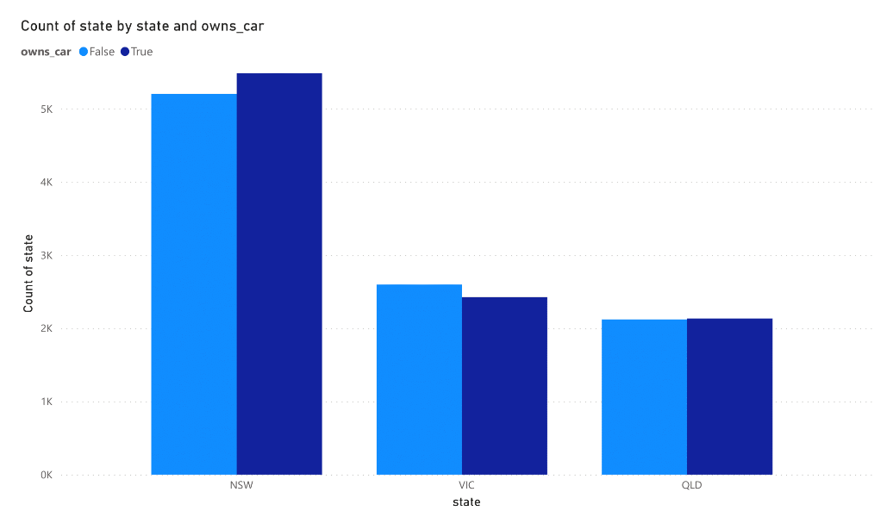
Note: The data and information in this document is reflective of a hypothetical situation and client. This document is to be used for KPMG Virtual Internship purposes only.
Data Exploration
The highest percentage of automobiles are owned in NSW, although the proportion of non-car owners is also higher. The number of cars owned is next greatest in VIC, while the percentage of non-owners is roughly equal. Since QLD has the fewest automobile owners, we may concentrate our efforts there.

Slide 18
Note: The data and information in this document is reflective of a hypothetical situation and client. This document is to be used for KPMG Virtual Internship purposes only.
Model Development
RFM Analysis
Recency
The last day on which a customer performed a transaction was taken as the recency parameter.
Customers were divided into 4 quartiles and given a R_Score.
Frequency
The frequency of transactions done by a particular customer was taken as the frequency parameter.
Customers were divided into 4 quartiles and given a F_Score.
Monetary Value
The average profit per customer was taken as the monetary value parameter.
Customers were divided into 4 quartiles and given a M_Score

Slide 19
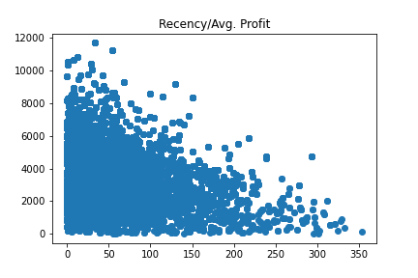
Note: The data and information in this document is reflective of a hypothetical situation and client. This document is to be used for KPMG Virtual Internship purposes only.
Model Development
RFM Analysis

Slide 20
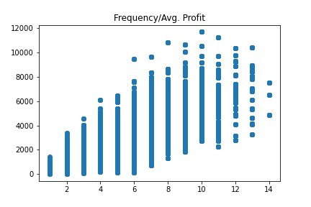
Note: The data and information in this document is reflective of a hypothetical situation and client. This document is to be used for KPMG Virtual Internship purposes only.
Model Development
RFM Analysis

Slide 21
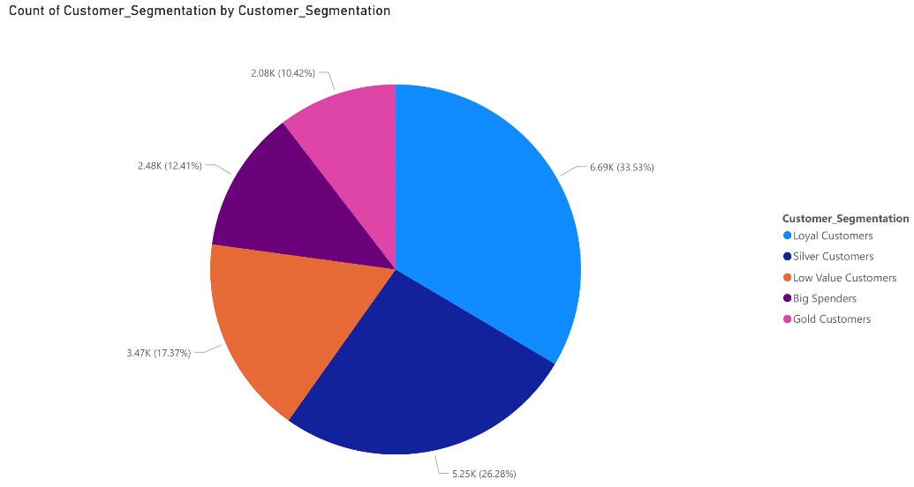
Note: The data and information in this document is reflective of a hypothetical situation and client. This document is to be used for KPMG Virtual Internship purposes only.
Model Development
RFM Analysis
Based on the RFM Class, five customer tiers were identified:
Big Spenders: These customers have recently made a purchase, are frequent and are most profitable.
Loyal Customers
Gold Customers
Silver Customers
Low Level Customers: These customers have not made any recent purchase, are not frequent and do not contribute majorly.

Slide 22
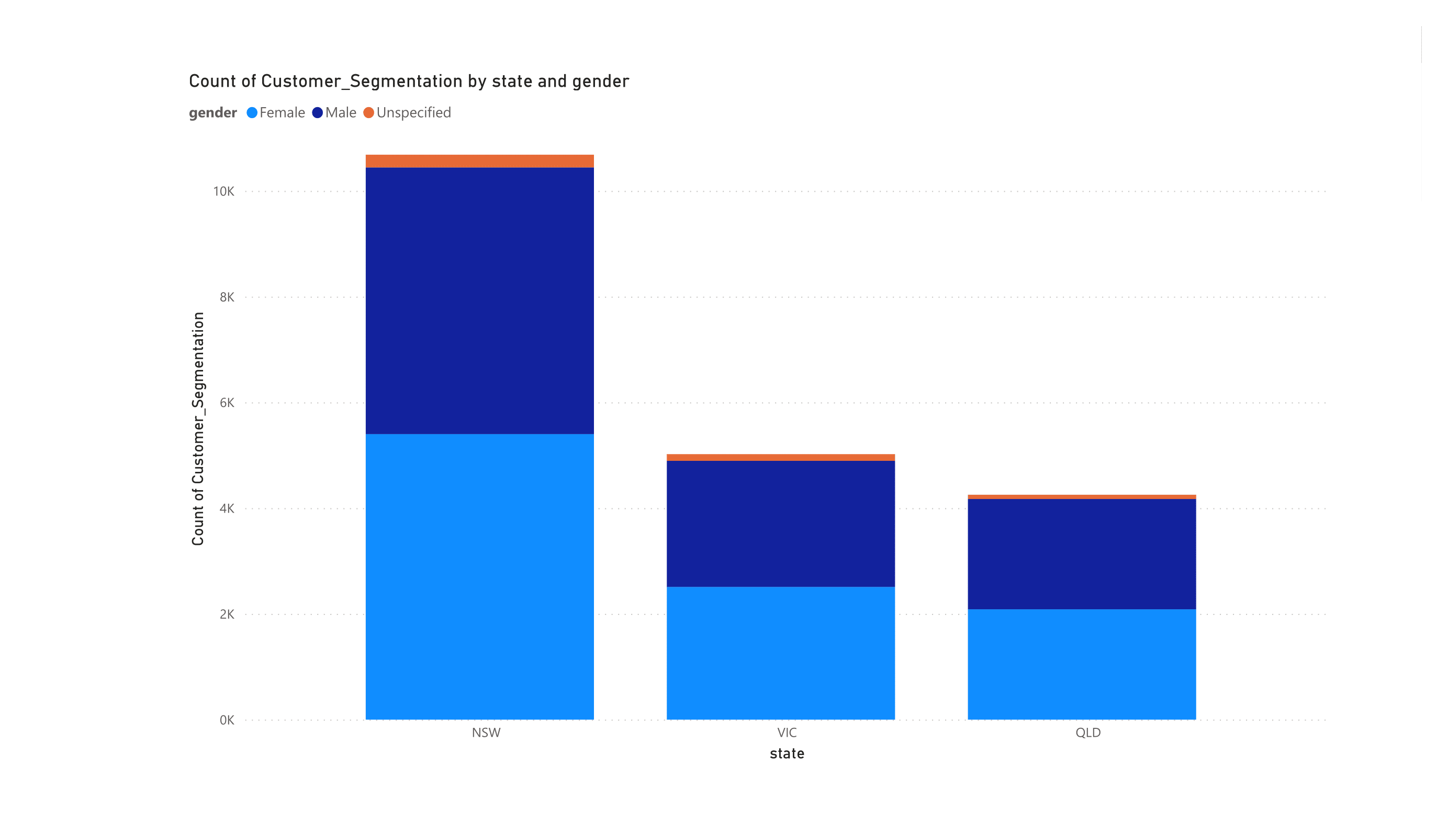
Note: The data and information in this document is reflective of a hypothetical situation and client. This document is to be used for KPMG Virtual Internship purposes only.
Interpretation
RFM Analysis

Slide 23
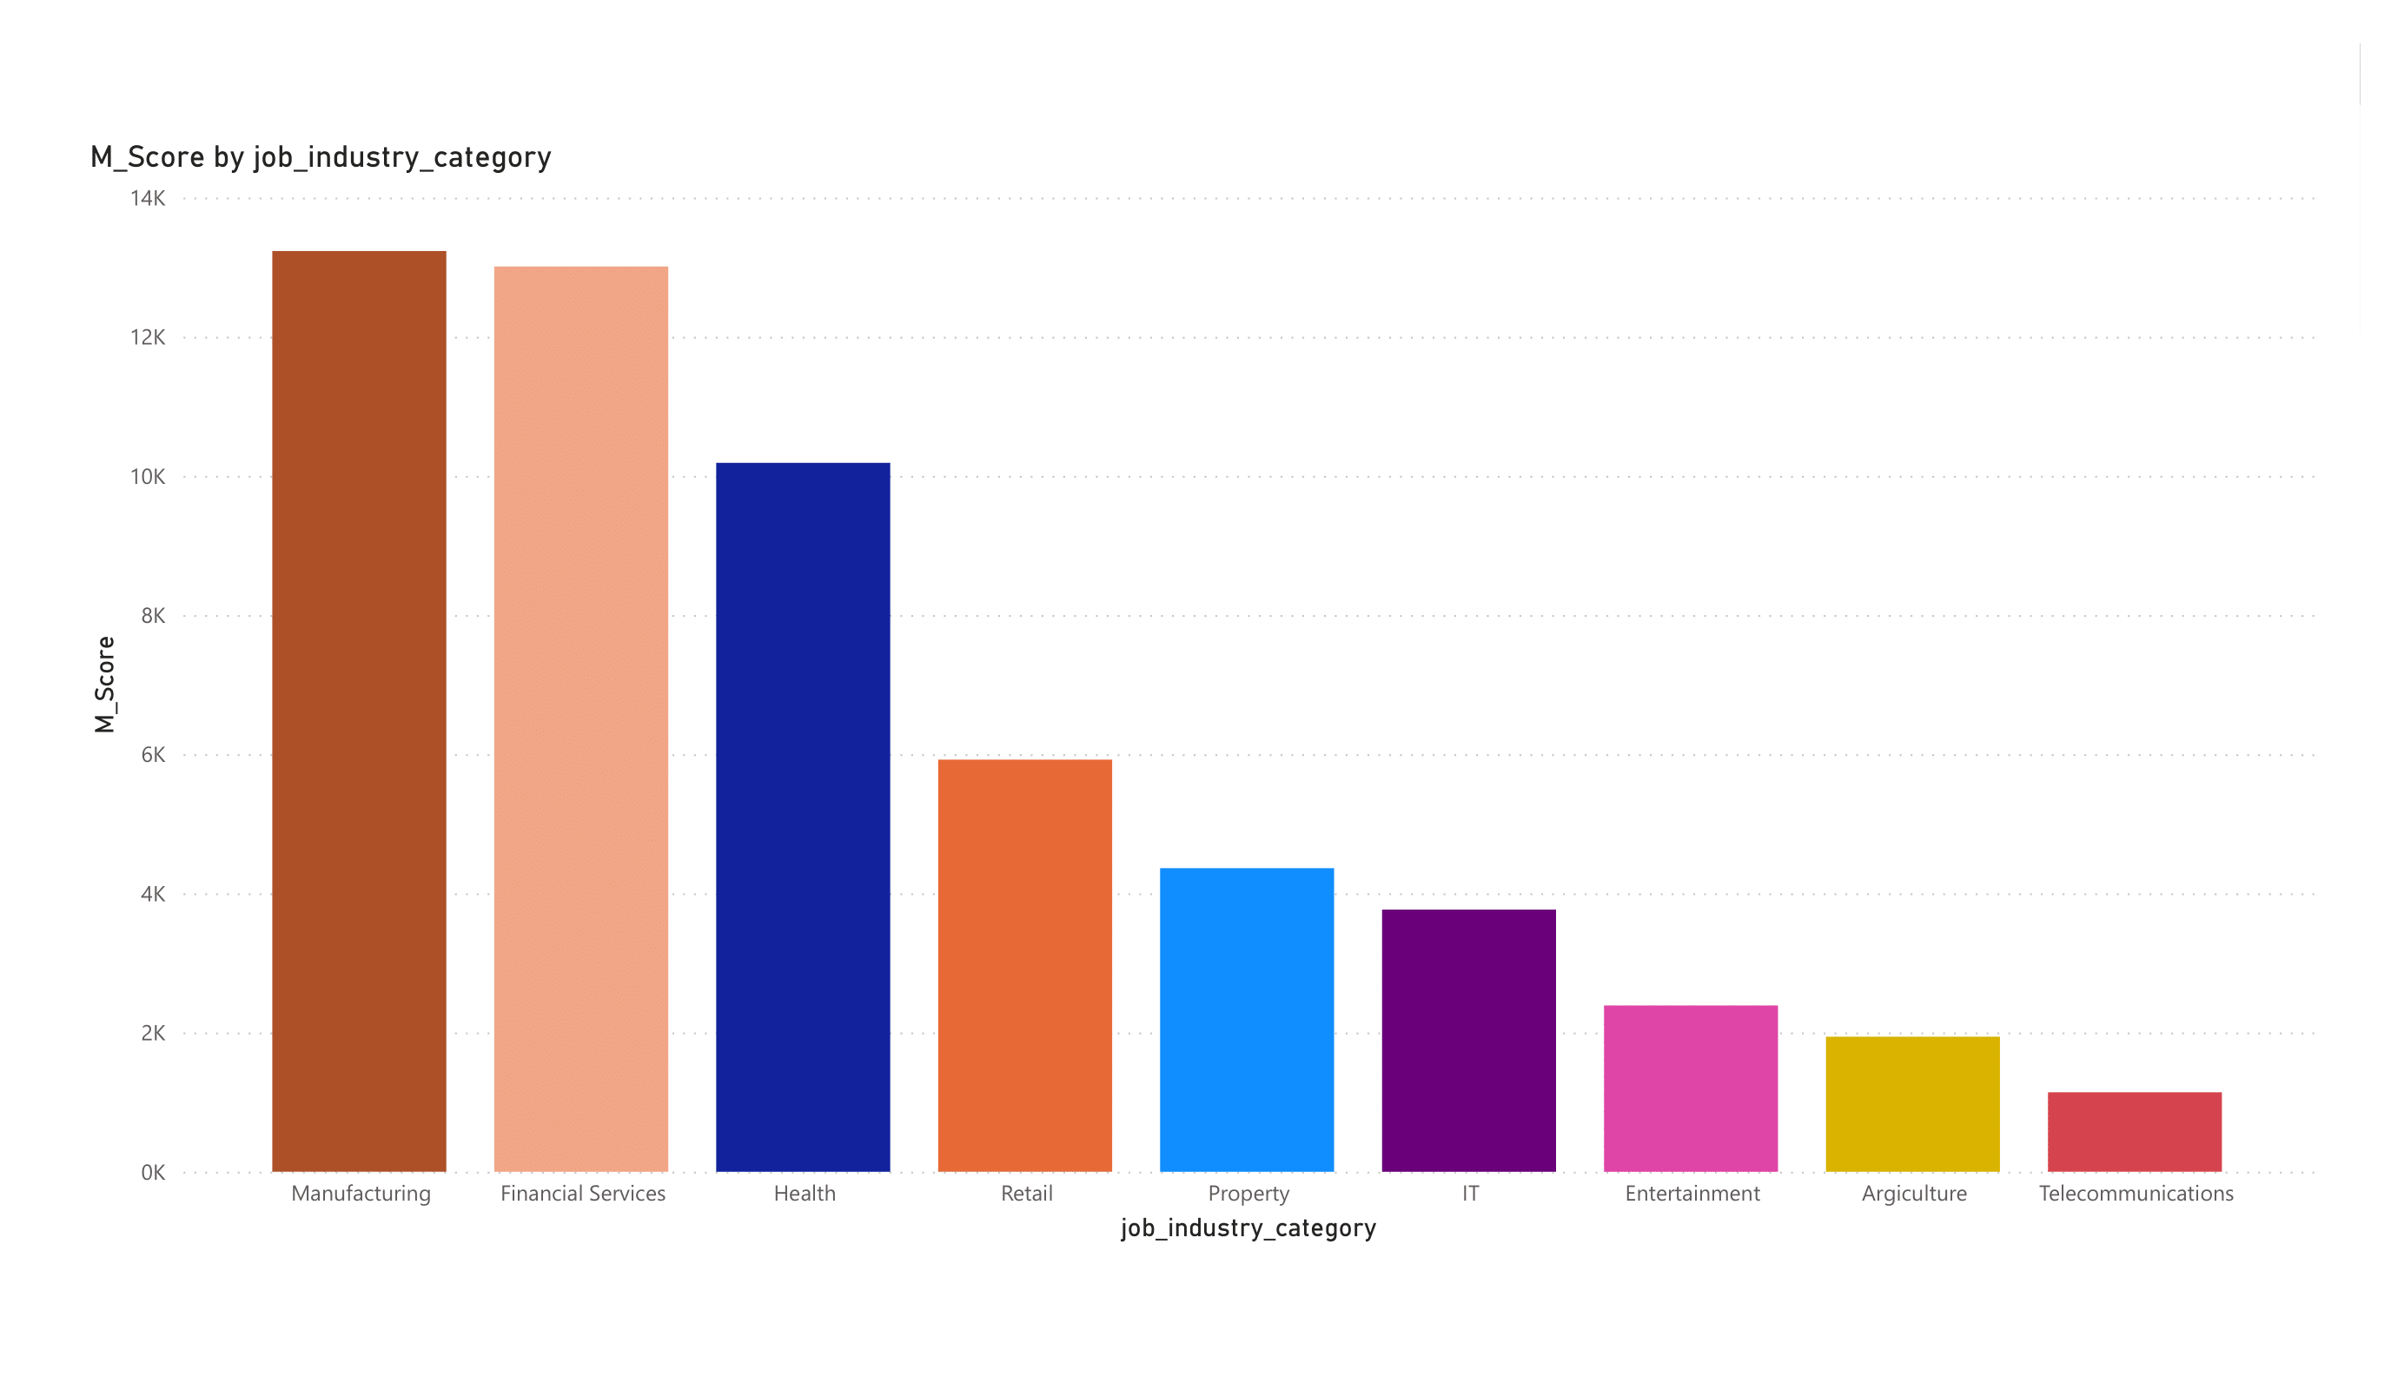
Note: The data and information in this document is reflective of a hypothetical situation and client. This document is to be used for KPMG Virtual Internship purposes only.
Interpretation
RFM Analysis

Slide 24
Note: The data and information in this document is reflective of a hypothetical situation and client. This document is to be used for KPMG Virtual Internship purposes only.
Interpretation
Targeting Methodology
Customers having high RFM Scores can be filtered and targeted.
The customers have made recent purchases, are frequent, and drive the most profits.

Slide 25
Note: The data and information in this document is reflective of a hypothetical situation and client. This document is to be used for KPMG Virtual Internship purposes only.
Appendix

Slide 26
Note: The data and information in this document is reflective of a hypothetical situation and client. This document is to be used for KPMG Virtual Internship purposes only.
Appendix
https://github.com/ShubhamGTiwari/KPMG_Virtual_Internship

