Slide 1

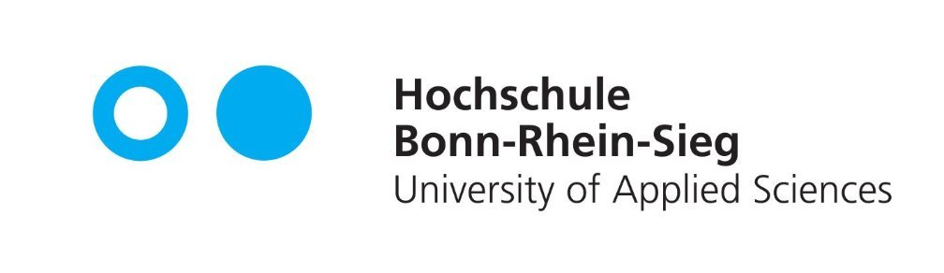

Robot Task Scheduling Using MDP
Probabilistic Reasoning
Ibrahim Memon
Shubham Gawande

Slide 2
Project Overview
The goal is to efficiently coordinate multiple agents (taxis) to complete a set of tasks (pickups and drop-offs) in a grid environment.
Optimization is done using MDP for task scheduling.

Slide 3
MDP Framework
States:
Position of each agent on the grid.
Status of each task (pickup and drop-off locations).
Agent occupancy status (whether an agent is carrying a passenger).
Actions:
Movement: Agents can move up, down, left, or right.
Pickup & Drop off: Agents can pick up a passenger if they are at a pickup location and drop off if they are at the correct drop-off location.

Slide 4
MDP Framework
Positive Rewards:
Pickup Reward: +20 points for successfully picking up a passenger.
Dropoff Reward: +50 points for successfully dropping off a passenger at the correct location.
Collaborative Reward: +10 points for actions that contribute to overall task completion.
Negative Rewards:
Step Penalty: -1 point for each time step to encourage efficiency.
Wrong Action Penalty: -5 points for attempting invalid actions (e.g., picking up without a passenger present).
Task Distribution Penalty: -5 points for unbalanced task distribution among agents.

Slide 5
MDP Framework
Transitions:
Movement:
If an agent moves to a valid adjacent cell, its position changes accordingly.
Transition Probability: 1.0 (deterministic) for valid moves; 0 for invalid moves (e.g., hitting a wall).
Pickup:
If an agent is at the passenger's location and attempts a pickup, the task status changes to reflect the passenger being picked up.
Transition Probability: 1.0 if the agent is at the correct location; 0 otherwise.
Drop off:
If an agent is at the correct drop-off location and attempts a drop-off, the task is marked as completed.
Transition Probability: 1.0 if the agent is at the correct location; 0 otherwise.

Slide 6
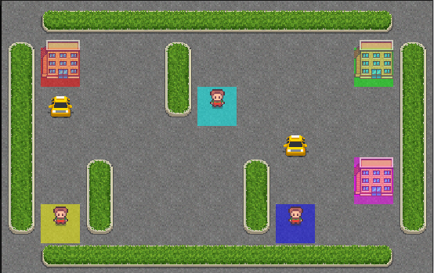
Environment Setup
The grid includes walls, special locations (R, G, C, M, Y, B), and open spaces for agents to navigate.
The taxis and hotels can only spawn on these colored blocks

Slide 7
Policy Iteration
Policy iteration is an algorithm for finding the optimal policy in an MDP.
It alternates between policy evaluation and policy improvement until convergence.
Policy Evaluation : Calculate the value function for the current policy.
Policy Improvement: Update the policy based on the calculated value function to increase the expected reward.

Slide 8
Future Work
Current model assumes limited state and actions
Transition probabilities are fixed and do not adapt based on robot performance or any external factors
We can implement adaptive transition probabilities that change based on historical performance and environmental factors
Have more complex reward structures

Slide 9
Thank You

