Slide 1

Department of Electronics and Communication Engineering
Movie Rating Prediction Using Multivariable Regression
SI No. | NAME | USN
1 | Onkar Thorushe | 02FE21BEC056
2 | Shubham Ghadage | 02FE21BEC034
3 | Pooja Nandgaon | 02FE21BEC058
4 | Neela Saloni | 02FE21BEC047

Slide 2
Problem Statement
Developing a Multivariable Regression Model for Predicting Movie Ratings.

Slide 3
Introduction
Choosing Factors: First, we pick important things like movie genre, director style, cast, budget, and marketing to see how they affect the movie rating.
Looking at Data: We carefully study data to understand how these factors relate to the movie ratings. This helps us see patterns and connections.
Building the Model: Using the chosen factors, we create a model that shows how they work together to predict movie ratings. We adjust the model to make it as accurate as possible.
4. Checking Predictions: We use the model to predict ratings for new movies. Then, we compare these predictions with actual ratings to make sure our model is doing a good job in understanding what makes a movie popular.

Slide 4








Block diagram :
Data Collection & Analysis
from .csv file (kaggle)
Input
Data Preprocessing
Building a Predictive System
Model Evaluation (accuracy scores)
Model Training

Slide 5
SI NO | PAPER TITLE | OBJECTIVE | METHOD/ALGORITHUM | ADAVANTAGE
1 | Movie Success Prediction Using ML | he paper aims to predict the success of a movie based on different attributes/features such as movie crew movie plot (storyline), box-office revenue, audience and critics reviews/ratings. | Random Forest, Decision Tree | Model Evaluation
2 | Research on Movie Rating Prediction Algorithms | To address the challenges of information overload and information labyrinth in the era of data explosion on movie and video websites. | 1.RF Method 2. MCBF-SVD Algorithm: | Dependency on Explicit Data

Slide 6
EXPLANATION :
1.Data Loading and Library Import :
Importing Pandas, Seaborn, and Matplotlib.
Loading the dataset from a CSV file.
2. Displaying Data Overview :
Displaying the first 10 and last 10 rows of the dataset.
3. Dataset Information :
Printing the number of rows and columns.
Providing information about the dataset, including data types.
4. Average Rating by Director :
Calculating and displaying the average rating for each director.
5. Number of Movies Per Year :
Creating a count plot to show the distribution of movies per year.
6. Top Rated Movies Analysis :
Displaying the top 10 highest-rated movies along with their directors.
Visualizing a bar plot for the same information.
5

Slide 7
7. Highest Revenue Movies Analysis :
Displaying the top 10 highest revenue movies.
Visualizing a bar plot for the same information.
8. Average Rating by Year :
Calculating and displaying the average rating of movies for each year.
9. Rating vs Revenue Relationship :
Creating a scatter plot to explore the relationship between movie ratings and revenue.
10. Classifying Movies Based on Ratings :
Defining a function to classify movies into categories based on ratings (Excellent, Good, or Average).
Applying the function to create a new column in the dataset.These code blocks collectively provide a comprehensive analysis of the movie dataset, covering data overview, director ratings, yearly trends, and relationships between ratings and revenue.

Slide 8
Reference:
[1] Muhammad Hassan Latif and Hammad Afzal. Prediction of moviespopularity using machine learning techniques, 2016.http://paper.ijcsns.org/07_book/ 201608/20160820.pdf
[2] Nikhil Apte, Mats Forssell, and Anahita Sidhwa. Predicting movierevenue. CS229, Stanford University, 2011.
[3] Sitaram Asur and Bernardo A Huberman. Predicting the future withsocial media. In Web Intelligence and Intelligent Agent Technology(WI-IAT), 2010 IEEE/WIC/ACM International Conference on, volume1, pages 492–499. IEEE, 2010.
[4] Karl Persson. Predicting movie ratings: A comparative study on randomforests and support vector machines, 2015

Slide 9
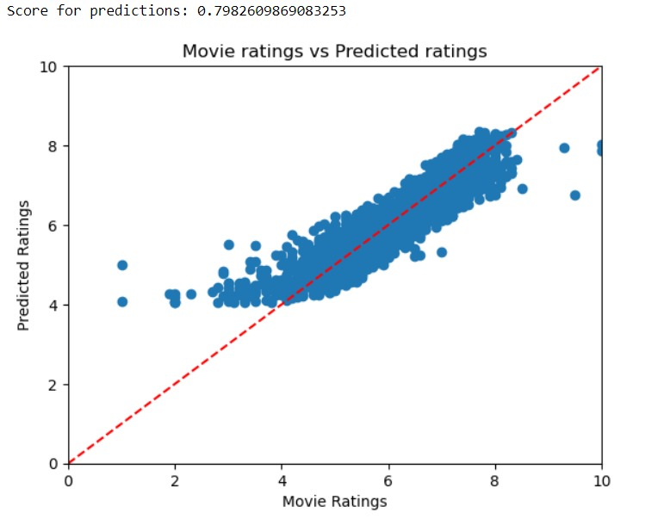
Output:

Slide 10
Future Outcomes:
Enhanced Predictive Models
Personalized Recommendations
Continuous Model Refinement
Cross-Platform Prediction

Slide 11
GITHUB Link:
https://github.com/ShubhamGhadage123/ML_college_assignment/upload/main

Slide 12
Thank You

