Slide 1
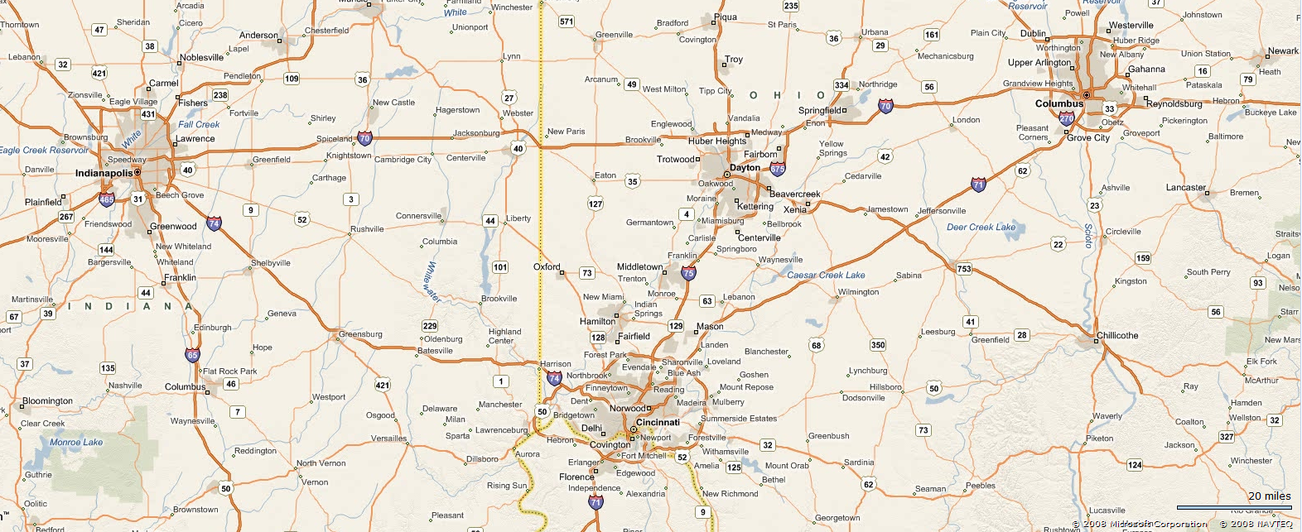
Travelling Salesman problem
Submitted by:
Hariom Bairwa (13135044)
Harish Choudhary(13135045)
K. Shubham Bhimrao (13135050)

Slide 2
Travelling Salesman Problem
Introduction
Mathematical formulation
Applications
Different approaches
Comparison and results
Conclusion

Slide 3
Introduction
Given a list of cities and the distances between each pair of cities, what is the shortest possible route that visits each city exactly once and returns to the origin city?

Slide 4

Mathematical formulation
Given a ‘cost matrix’ C = (c_{ij}), where c_{ij} represents the cost of going from city i to city j, (i, j = 1, ..., n), find a permutation (i₁, i₂, i₃, ..., i_{n}) of the integers from 1 through n that minimizes the quantity:
$$C_{i_{1}i_{2}}+C_{i_{2}i_{23}}+.…………+C_{i_{n}i_{1}}$$

Slide 5
Applications
Drilling of printing circuit boards
X-ray crystallography
Computer wiring
Order picking problem in warehouses
Vehicle routing
Mask plotting in PCB production

Slide 6
Greedy algorithm
Steps:
start on an arbitrary vertex as current vertex.
find out the shortest edge connecting current vertex and an unvisited vertex V.
set current vertex to V.
mark V as visited.
if all the vertices in domain are visited, then terminate.
Go to step 2.

Slide 7
Dynamic programming
Steps:
Create an array dist[] of size |V| with all values as infinite except dist[src] where src is source vertex.
Do following |V|-1 times where |V| is the number of vertices in given graph. Do for each edge u-v If dist[v] > dist[u] + weight of edge uv, then update dist[v] dist[v] = dist[u] + weight of edge uv
for each edge u-v If dist[v] > dist[u] + weight of edge uv, then “Graph contains negative weight cycle”

Slide 8
Genetic algorithm
Based on natural evolution
Steps:
Randomly create the initial population of individual string of the given TSP problem and create a matrix representation of the cost of the path.
Assign the fitness to each chromosome in the population using fitness criteria measure
F(x) = 1/x where, x represents the total cost of the string.
Create new off-spring population from two existing chromosomes in the parent population by applying crossover operator.
Mutate the resultant off-springs if required.
Repeat step 3 and 4 until we get an optimal solution to the problem.

Slide 9
Neural network

Slide 10
Comparison and result

Slide 11
Conclusion

