Slide 1

BANKING ANALYTICAL CRM
DEVELOPMENT

Slide 2
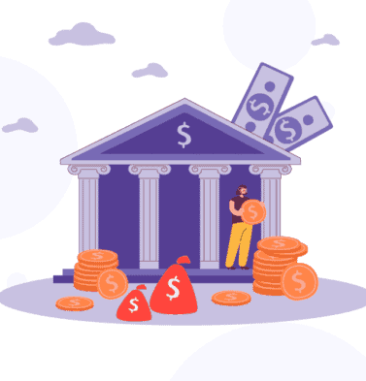
BANK CHURN ANALYSIS
Objective is to extract meaningful insights from various customer-related data Sets ,with the help of SQL and power BI Dashboard The bank aims to reduce customer churn, improve service delivery, and enhance customer satisfaction. I have Provide with datasets including customer demographics, transaction details, customer exit information and active customer profile
DATA PREPARATION : Explore and clean datasets, merging relevant data for analysis key Customer Segmentation: Customer churn is increasing steadily, indicating the need for better retention strategies.
Churn Analysis: identify reasons for customer customer attrition using transaction data and demographics
Delivery Analysis : Evaluate response and resolution times, identify areas for improvement. Customer satisfaction
BANK ANALYSIS

Slide 3
Analysis: Analyze feedback data to measure satisfaction level and address concerns.
Power BI Dashboard Creation: Design interactive dashboard showcasing key insights and trends for stakeholders and we can modify the data with the help of Dax functions.
Optimization : continuously monitor metrics, gather feedback, and iterate on dashboard design for on going improvement.

Slide 4
DATA INTRODUCTION
RowNumber: The row number in the dataset, likely used for reference or indexing.
CreditScore: A numerical representation of the customer’s creditworthiness.
Credit score:
Excellent: 800–850
Very Good: 740–799
Good: 670–739
Fair: 580–669
Poor: 300–579
GeographyID: A numerical identifier that likely corresponds to a geographical location, such as a country or region.
GenderID: A numerical identifier for the customer's gender, where for example, '1' could represent male and '2' could represent female.

Slide 5
Age: The age of the customer.
Tenure: The number of years the customer has been with the bank.
Balance: Current balance in the customer's account.
NumOfProducts: refers to the number of products that a customer has purchased through the bank.
HasCrCard: denotes whether or not a customer has a credit card. This column is also relevant, since people with a credit card are less likely to leave the bank.
1 represents credit card holder
0 represents non credit card holder
IsActiveMember: active customers are less likely to leave the bank (as per the criteria defined by the bank for identifying the activeness).
1 represents Active Member
0 represents Inactive Member
Estimated Salary: as with balance, people with lower salaries are more likely to leave the bank compared to those with higher salaries.
Exited: whether or not the customer left the bank.
0 represents Retain
1 represents Exit
Bank DOJ: date when the Customer associated/joined with the bank.

Slide 6

CUSTOMER CHURN AND ITS IMPACT ON BUSINESS
One of the most important metrics for banks is customer churn, or the rate at which consumers discontinue utilizing a company's goods or services.
It has an immediate effect on earnings and profitability. We will examine our bank's customer turnover rates in this presentation, paying particular attention to gender, recent transactions, credit card holders, the quantity of items utilized, churn count based on credit score, and churn count based on region.
Our objective is to pinpoint the causes of customer attrition and suggest solutions that will increase client happiness and retention.

Slide 7

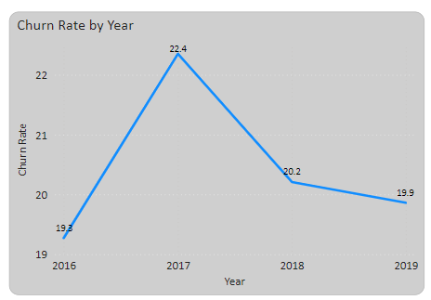
CHURN RATE TRENDS
Problem Statement:What is the current churn rate per year and overall, as well in the bank. Suggest some insights to the bank about which kind of customers are more likely to churn and what are the different strategies that can be used to decrease the churn rate.
Analysis: Customers who are more likely to leave the bank include those with shorter tenure, fewer products, inactive memberships, lower anticipated salaries, and no creditcard. Recommendation: Tailored marketing campaigns to re-engage inactive customers, tailored offers to encourage loyalty, enhanced customer service, and proactive retention initiatives like loyalty or rewards programs are some examples of strategies to lower the churn rate.

Slide 8
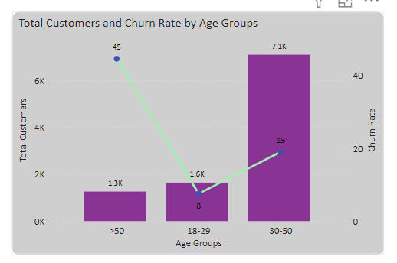
CHURN ANALYSIS BY AGE
Problem Statement: What is the relation between total customers and Age groups who have exited. Suggest some insights to the bank about which kind of age groups are more likely to churn
Analysis:
Age Group >50(45 Churn Rate):
High churn rate suggests potential dissatisfaction or unmet needs.
Reasons could include lack of personalized services or better offers
from competitors.
Recommend further investigation into specific pain points or service gaps.
Age Group 30-50(19 Churn Rate):
Significant churn rate indicating possible issues.
Factors may include retirement planning or changing financial priorities.
Tailor retention strategies based on understanding their financial needs and concerns.

Slide 9
SUGGESTIONS
Targeted Communication and Marketing:
Create campaigns that are centered on their financial objectives.
Emphasize services such as investing alternatives and retirement planning.
Personalized Offers and Services:
Offer tailored product bundles and exclusive discounts.
Customer Loyalty Programs:
Implement programs rewarding long-term customers.
Product Bundling and Cross-Selling:
Create bundled offerings to encourage multiple product usage.
Enhanced Client Support:
Improve assistance for senior citizens.
Teach representatives to handle their specific issues

Slide 10
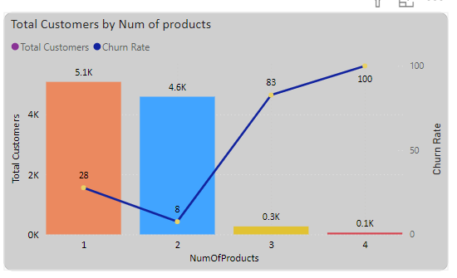
COUNT OF CUSTOMERID BY NUMBER OF PRODUCTS
Problem Statement:Analyse the relationship between the number of products and Total customers who have exited.
Key Points:
The largest number (5.1K) of customers use a single product.
As more products are utilized, the count decreases.
Encourage the use of multiple products by suggesting product bundling.
Analysis:
The reason behind single-product clients could be their limited banking demands or their perception of value.
Users that utilize multiple products exhibit greater loyalty, suggesting that product diversification should be promoted.

Slide 11
RECOMMENDATIONS
Offer bundled products or incentives for multiple product adoption.
Educate customers on the benefits of multiple products.
Enhance value proposition for using multiple products
Use data analytics for personalized product recommendations.
Launch targeted retention campaigns for single-product customers

Slide 12
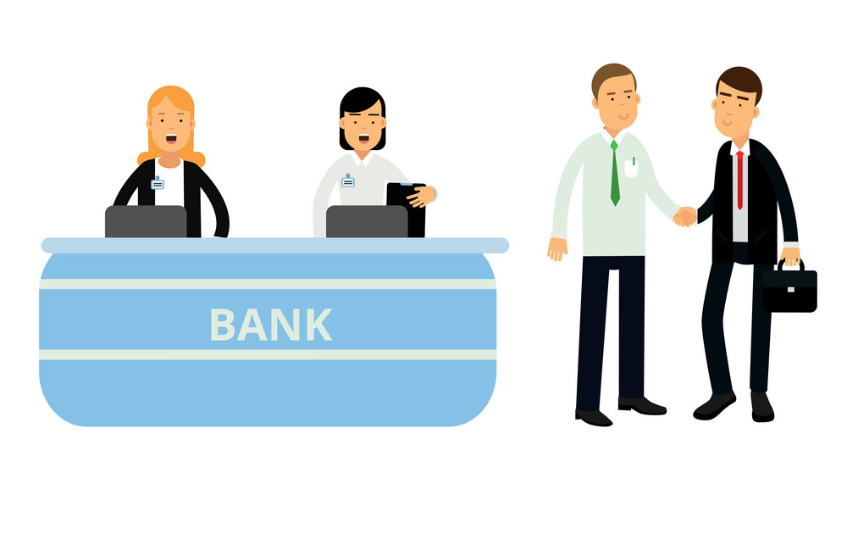
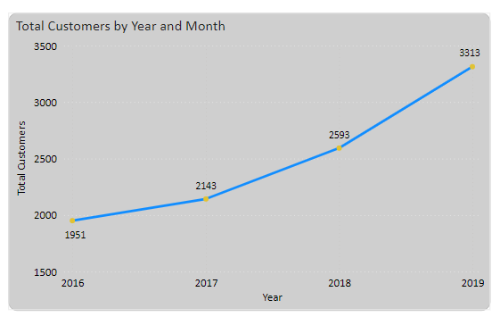
CUSTOMERS JOINING OVER THE YEAR
Problem Statement: Analyse the customers joining over the year.
Analysis: The bank's annual growth in new clients is a favorable trend that suggests future expansion prospects.
But even though the bank is getting more customers, it appears that it is having trouble keeping them around given the consistent attrition rate.

Slide 13
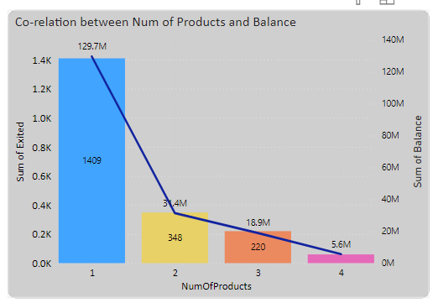
ACCOUNT BALANCE BY NUMBER OF PRODUCTS
Problem Statement:Analyse the relationship between the number of products and the account balance for customers who have exited.
Analysis:
Customers with higher product usage tend to
have higher total account balances.
Customers using 1 product contribute
significantly to the total account balance.
Recommendation:
Encourage customers to use multiple products
to increase overall account balances.
Offer incentives or rewards for customers
who adopt additional banking products.

Slide 14
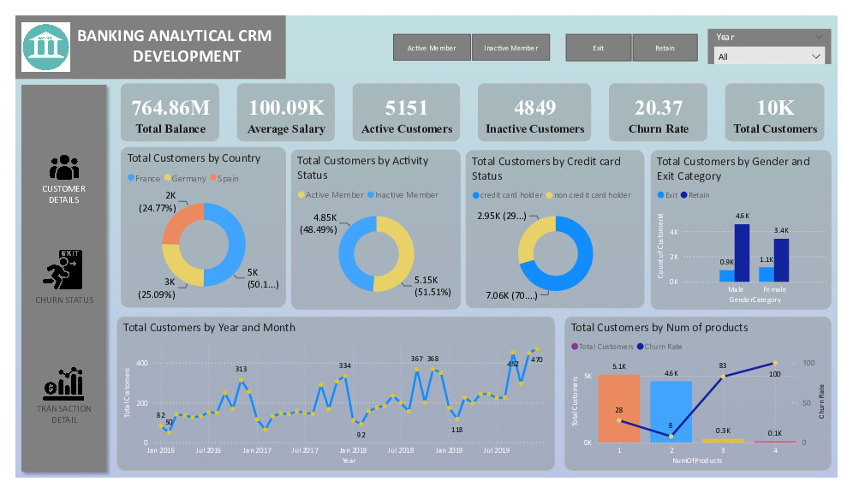
DASHBOARD

Slide 15
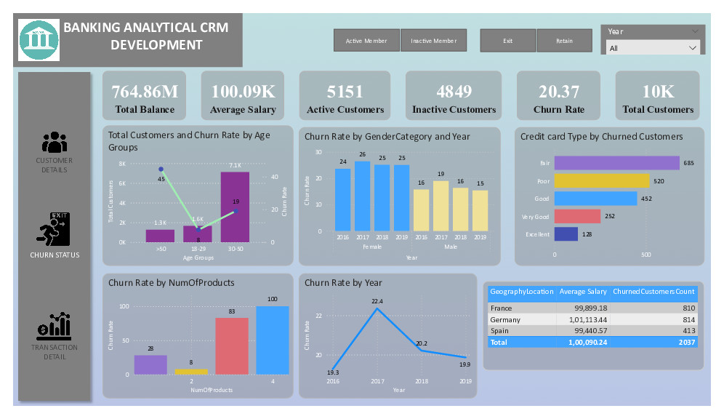
DASHBOARD

Slide 16
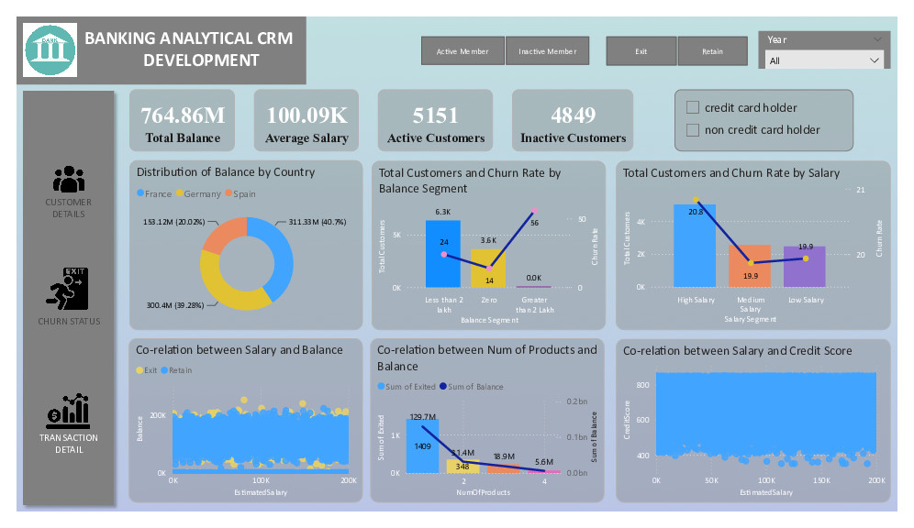
DASHBOARD

Slide 17
CONCLUSION
Over the years, the bank has seen a steady increase in customer acquisition, but at the same time, it has had a consistent churn rate.
Consumers who use fewer products and have worse credit scores are more prone to discontinue their subscriptions.
The age groups >50 and 30-50 exhibit the highest rates of turnover, suggesting difficulties with retention.
Key tactics for lowering churn include increasing client engagement, providing superior customer service, and providing competitive goods and services.
Customers in crucial age and credit score groups can be kept loyal with the use of tailored offers and targeted marketing.
All things considered, the bank can lower attrition, increase customer retention, and promote long-term client loyalty by emphasizing customer interaction, service enhancement, and focused tactics for particular customer segments.

Slide 18

THANK YOU

