Slide 1
FULL-STACK MERN & MONGODB ATLAS CAPSTONE
SmartInventory
Real-Time Warehouse & Stock Management Platform
A modern internal management system featuring atomic multi-document transactions, zero-negative-stock protection, real-time threshold monitoring, and complete audit logging.
PROJECT EVALUATION
Candidate Name:
Shubham Kumar
Registration No.:
12315449
Degree & Branch:
B.Tech Computer Science & Engg.
Department:
School of Computer Science & Engg.
Institution:
Lovely Professional University
Course:
MongoDB Database Design Mini-Project
Academic Year:
2025 – 2026

Slide 2
CONTEXT & PURPOSE • THE WHY BEHIND SMARTINVENTORY
Project Overview & Real-World Motivation
The Core Mission
Most growing businesses face a critical dilemma: manual spreadsheets (Excel/Google Sheets) cause costly stockouts, while enterprise ERPs (like SAP or Oracle) cost tens of thousands of dollars and require months of training.
SmartInventory provides the ideal sweet spot: a fast, intuitive, full-stack internal management portal that eliminates phantom stock, enforces atomic inventory updates, and automates reorder alerts without software bloat.
01
Eliminating Costly Phantom Inventory
When stock records on paper or spreadsheets disagree with physical warehouse shelves, shipments are delayed and customers leave. SmartInventory guarantees 100% record accuracy.
02
Instant Operational Transparency
Storekeepers and managers get a unified view of warehouse counts, supplier details, low-stock warnings, and historical logs across any device in real time.
03
Auditable Accountability & Compliance
Every single item entering or leaving the warehouse is permanently stamped with the authenticated user ID, transaction timestamp, and reference note.
TALKING POINT FOR PRESENTATION: "Begin by explaining why small-to-medium businesses struggle today. They outgrow Excel sheets because multiple staff edit them without controls, but they cannot afford multi-million dollar ERPs. SmartInventory solves this exact practical problem."
SmartInventory Capstone Project | B.Tech CSE (2025–2026) • Lovely Professional University

Slide 3
PROBLEM STATEMENT • WHY MANUAL & SPREADSHEET METHODS FAIL
The 4 Core Breakdown Points in Traditional Warehousing
01
02
03
04
Concurrency Chaos
Zero Audit Trail
Stockout Surprises
Data Corruption
What Happens: When two warehouse clerks log dispatches simultaneously in shared spreadsheets, rows overwrite silently without locking.
What Happens: Standard spreadsheets allow any staff member to modify or delete numbers with zero history of who touched it or why.
What Happens: Managers have no automated warnings when fast-moving items reach dangerous depletion thresholds.
What Happens: Hard-deleting a discontinued product in traditional tables permanently breaks past billing records.
Business Impact: Leads to negative stock balances and phantom inventory on physical shelves.
Business Impact: Internal shrinkage, theft, and delivery discrepancies become completely untraceable.
Business Impact: Orders get accepted but cannot be fulfilled, causing lost customer trust and delayed dispatches.
Business Impact: Orphans historical transaction rows and corrupts financial year-end tax calculations.
TALKING POINT FOR PRESENTATION: "Walk the evaluation panel across these 4 cards. Explain that concurrency overwrites cause phantom stock, lack of logs invites theft, missing threshold alerts cause emergency delays, and hard deletes break tax audits."
SmartInventory Capstone Project | B.Tech CSE (2025–2026) • Lovely Professional University

Slide 4
CORE SOLUTION • HOW OUR SYSTEM FIXES EVERY BREAKDOWN
The SmartInventory Solution Architecture
01
Real-Time Multi-Warehouse Tracking
03
Immutable Audit Journal
Provides an instantaneous, unified stock ledger across multiple storage locations with live quantity updates, eliminating manual spreadsheet consolidation.
SMART
INVENTORY
Central Operational Hub
Every single physical movement (Stock IN, OUT, Transfer) automatically logs an unalterable history record tied to the logged-in user, SKU, timestamp, and notes.
02
Zero-Negative-Stock Guard
04
Automated Threshold Alerts & KPIs
A two-tier validation barrier (React UI check + atomic MongoDB backend conditional update) guarantees that dispatches can never exceed physical on-hand quantity.
The dashboard dynamically flags products falling below minimum safety limits with visual color badges, while calculating total warehouse valuation instantly.
TALKING POINT FOR PRESENTATION: "Point to the central hub and the 4 satellites. Say: 'SmartInventory acts as the warehouse brain: it tracks stock in real time, strictly blocks overselling, maintains an unalterable audit log, and alerts managers before stockouts occur.'"
SmartInventory Capstone Project | B.Tech CSE (2025–2026) • Lovely Professional University

Slide 5
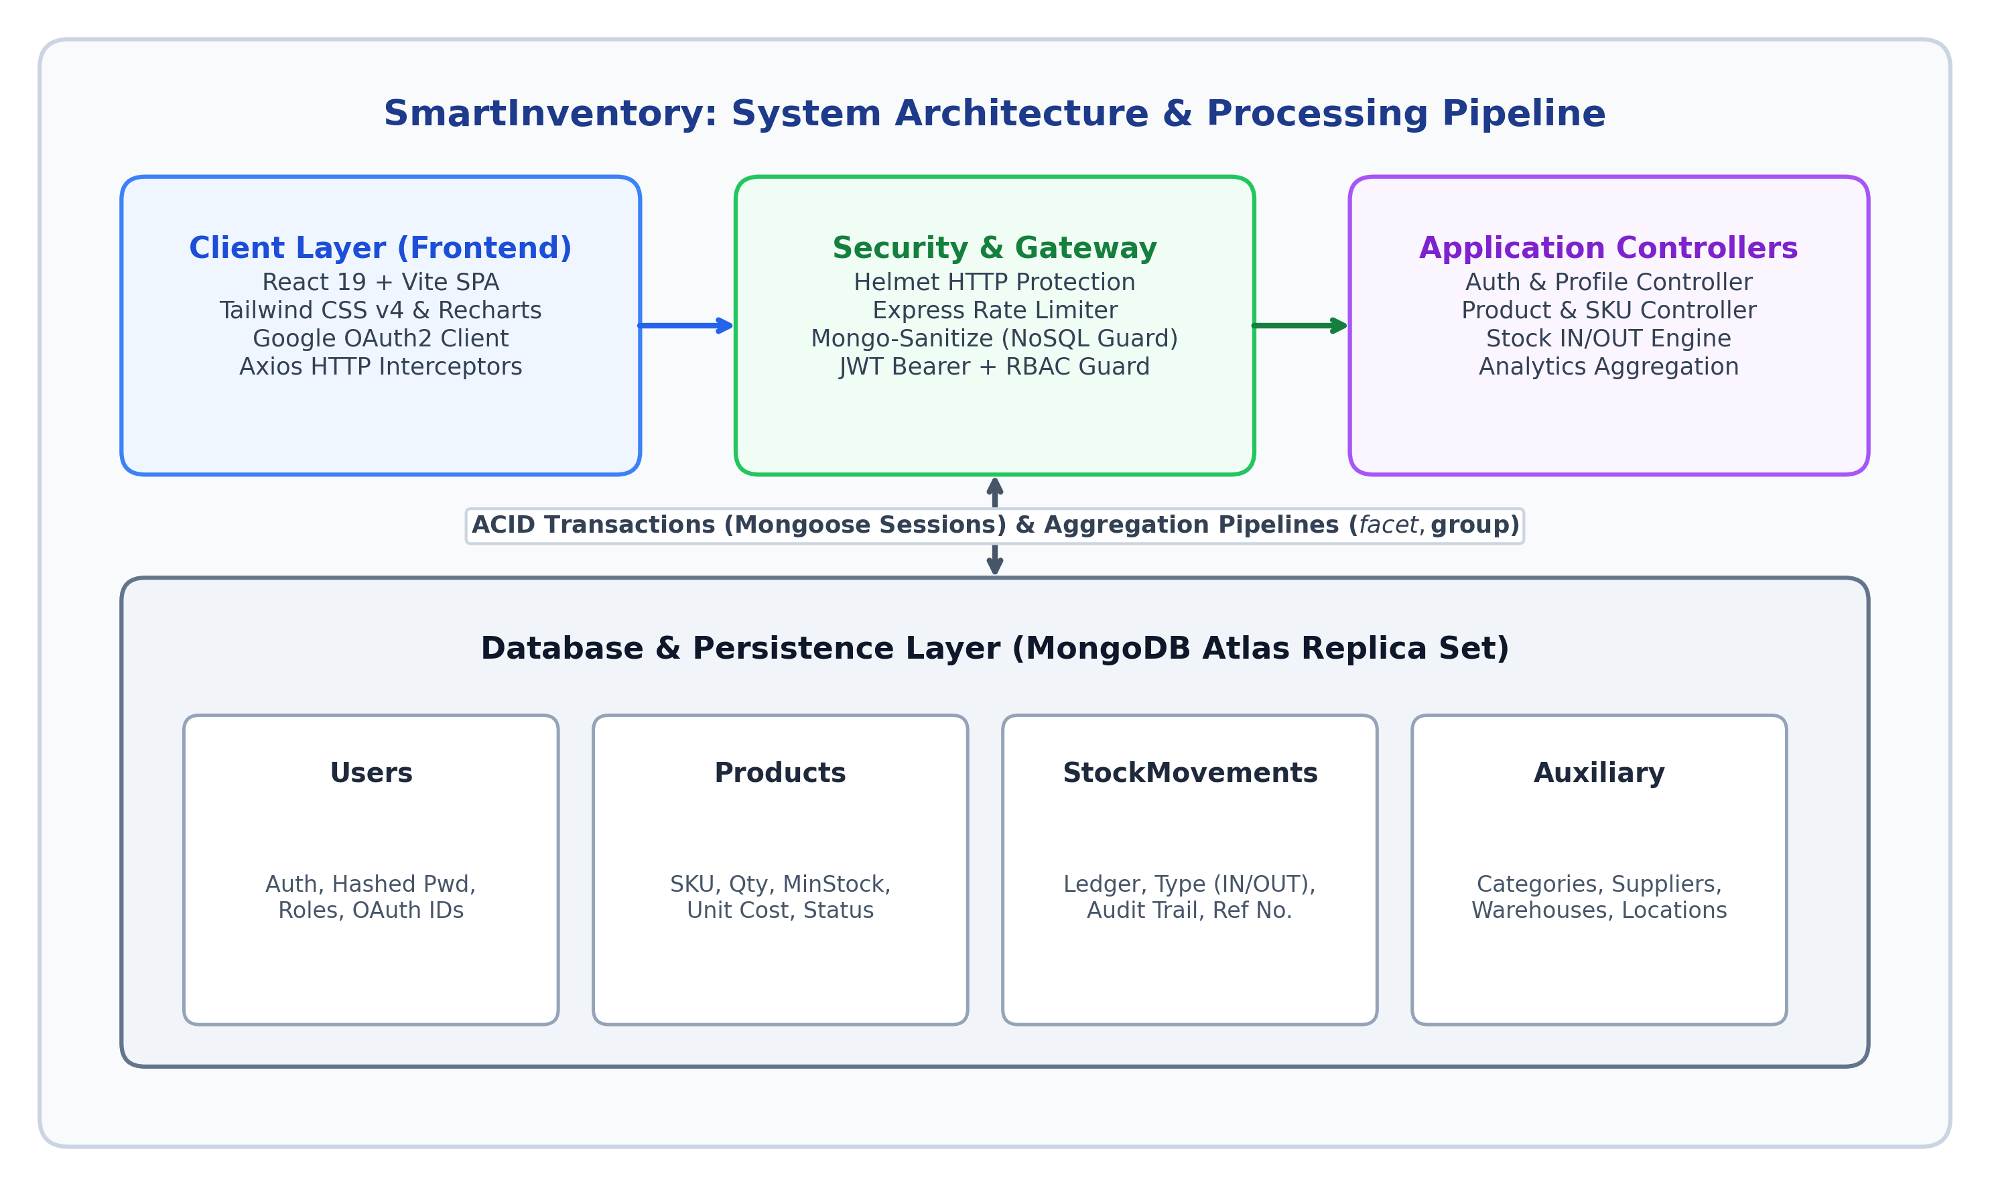
TECHNICAL DESIGN • DECOUPLED FULL-STACK ARCHITECTURE
Three-Tier Architecture & Technology Stack
01
Frontend Presentation Tier (React 19 + Vite)
Built with React 19, Tailwind CSS, and Lucide icons. Operates as a fast Single Page Application (SPA). Provides instant client-side input validation and dynamic UI re-rendering without page refreshes.
02
Application & API Tier (Node.js + Express.js)
Handles stateless RESTful endpoints, bcrypt password encryption (10 rounds), and JSON Web Token (JWT) verification. Implements strict Role-Based Access Control (Admin vs. Staff) and business logic.
03
Cloud Database Tier (MongoDB Atlas)
Hosted on a highly-available cloud replica set with automatic failover. Stores schema collections in native JSON/BSON format, utilizing compound indexes for sub-50ms query execution under heavy load.
Decoupled 3-Tier Flow:
Client Browser (React 19) ↔ Secure JWT REST API (Express) ↔ Cloud Cluster (MongoDB Atlas)
TALKING POINT FOR PRESENTATION: "Explain that we chose the MERN stack because JavaScript runs seamlessly from browser to database. Point to the 3 tiers: React gives staff a snappy interface, Express enforces authentication and business rules, and MongoDB Atlas manages data safely in the cloud."
SmartInventory Capstone Project | B.Tech CSE (2025–2026) • Lovely Professional University

Slide 6
DATABASE ENGINEERING • DOCUMENT MODEL & REFERENCING STRATEGY
MongoDB Schema Architecture & Design Rationale
Key Architectural Decision: Referencing vs. Embedding
In MongoDB, embedding transaction logs inside a product document would cause the document to breach the 16 MB limit within months in an active warehouse. Therefore, we used normalized referencing with ObjectId links for StockMovements. This guarantees infinite historical audit logging while keeping product queries ultra-fast.
Users Collection
Products Collection
Stock Movements
Warehouses & Suppliers
• Stores username, email, hashed password, and role ('admin' vs 'staff').
• Uses bcrypt with 10 salt rounds.
• Enforces role-based permissions so only admins manage warehouses/suppliers.
• Stores SKU, name, category, unit price, quantity, and minStockThreshold.
• Indexed on SKU (unique) for instant lookup.
• Supports soft-delete ('isActive') so past movement histories are never corrupted.
• Immutable audit log for every transaction.
• Records type ('IN', 'OUT', 'TRANSFER'), quantity, previous vs new stock, reference, and date.
• Links to Product and User via ObjectId references.
• Warehouses: Multi-location tracking with physical address, capacity, and supervisor.
• Suppliers: Contact name, lead time, and payment terms.
• Keeps supplier-product supply chains organized.
TALKING POINT FOR PRESENTATION: "Highlight our Referencing design decision. Evaluators love database schema justification! Explain that referencing prevents hitting MongoDB's 16 MB document size ceiling and allows unlimited historical audit logging without slowing down daily queries."
SmartInventory Capstone Project | B.Tech CSE (2025–2026) • Lovely Professional University

Slide 7
OPERATIONAL WORKFLOW • STEP-BY-STEP LIFECYCLE OF A STOCK MOVEMENT
Core Working Principle: 5-Step Transaction Lifecycle
Step 1
User Action
Step 2
Client Validation
Step 3
API Authentication
Step 4
Atomic Database Update
Step 5
Audit Log & Sync
01
02
03
04
05
Staff initiates a Stock IN or OUT form, selecting the target product, warehouse, quantity, and reference invoice note.
React verifies positive integer inputs and checks requested dispatch quantity against current physical balance before submitting.
Express verifies the user's JWT token, validates role permissions, and starts an atomic controller transaction.
MongoDB executes a conditional update ($inc) ensuring stock cannot drop below zero. If condition fails, transaction aborts.
An unalterable StockMovement record is written, and dashboard KPI cards update in real time without refreshing.
TALKING POINT FOR PRESENTATION: "This is your best demonstration slide! Walk the evaluators step-by-step from Step 1 to Step 5. Point out that a stock change is never just an edit—it is validated twice, updated atomically in MongoDB, and logged permanently in the movement journal."
SmartInventory Capstone Project | B.Tech CSE (2025–2026) • Lovely Professional University

Slide 8
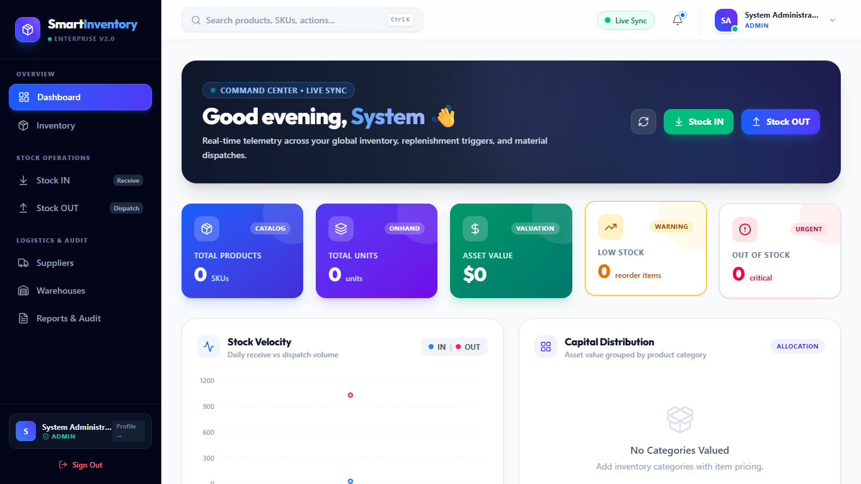
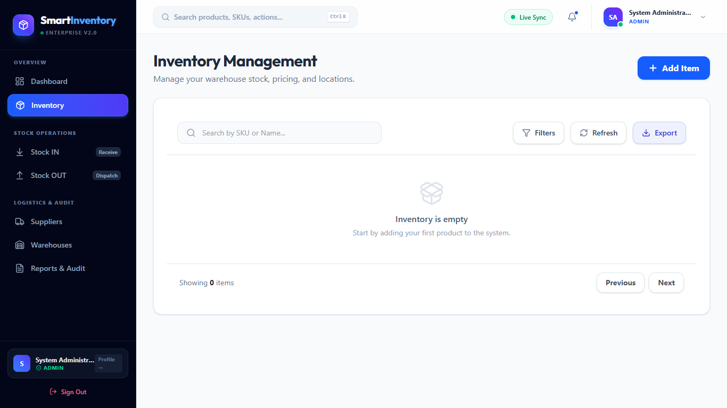
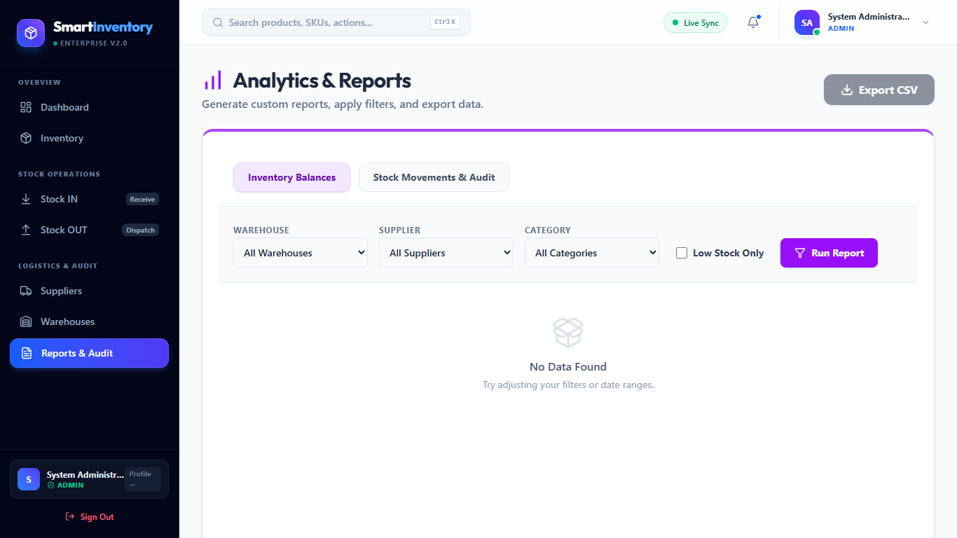
IMPLEMENTATION SHOWCASE • OPERATIONAL EXPERIENCE ON DESKTOP & MOBILE
Live System Walkthrough: Production Interfaces
Operational Dashboard
Real-Time Inventory Catalog
Comprehensive Movement Reports
• Top-level KPI summary cards: Total Items, Inventory Valuation, Low-Stock Alerts, and Out-of-Stock warnings.
• Quick-action buttons allow staff to log Stock IN / OUT in under 5 seconds.
• Gives warehouse supervisors a real-time operational pulse upon login.
• Filterable and searchable catalog with live SKU search, category pills, and warehouse location badges.
• Dynamic color indicators instantly show items nearing depletion.
• Supports inline edit, restocking, and soft-delete archive.
• Complete chronological transaction audit log with filter by date, warehouse, and movement type.
• Displays exact quantities, timestamp, and authenticated user identity.
• Eliminates disputes by providing proof of every dispatch.
TALKING POINT FOR PRESENTATION: "Point to the 3 actual screens of our running application: The Dashboard gives managers the big picture, the Inventory Catalog lets clerks find and restock items quickly, and the Reports tab provides an undeniable audit history."
SmartInventory Capstone Project | B.Tech CSE (2025–2026) • Lovely Professional University

Slide 9
PROBLEM SOLVING • OVERCOMING REAL-WORLD DEVELOPMENT HURDLES
Key Engineering Challenges & Technical Solutions
01
Preventing Race Conditions & Negative Stock
The Hurdle: In high-traffic warehouses, two clerks dispatching the last 5 items at the exact same moment could result in a negative balance of -5, breaking accounting integrity. How We Solved It: We implemented atomic conditional updates at the database level using Mongoose query conditions: { _id: id, quantity: { $gte: reqQty } }, combined with schema-level validation min: 0. If stock is insufficient, the operation is blocked atomically.
02
Node.js 24 Cloud DNS Resolution on Atlas
The Hurdle: Node.js v24 introduced strict RFC-compliant DNS SRV lookups, causing intermittent connection timeouts when resolving mongodb+srv:// Atlas URIs on certain ISP routers. How We Solved It: We configured explicit public DNS resolvers in server.js using dns.setServers(['8.8.8.8', '8.8.4.4']), ensuring instantaneous, reliable database connection in all local and cloud deployment environments.
03
Real-Time UI Synchronization Without Reloads
The Hurdle: Staff shouldn't have to hit browser refresh (F5) to see updated quantities or low-stock banners after completing a dispatch or receipt. How We Solved It: We engineered optimistic UI updates and reactive state hooks in React. The moment the backend confirms the stock change, local state updates seamlessly and triggers an async metric re-fetch in the background.
TALKING POINT FOR PRESENTATION: "Evaluators love seeing technical problem-solving! Explain that we didn't just write a simple CRUD app—we solved real concurrency race conditions, resolved Node 24 DNS lookups on MongoDB Atlas, and built reactive state sync."
SmartInventory Capstone Project | B.Tech CSE (2025–2026) • Lovely Professional University

Slide 10
IMPACT ASSESSMENT • MEASURABLE OPERATIONAL TRANSFORMATION
Comparative Analysis: Traditional vs. SmartInventory
✕
Traditional Spreadsheets & Paper
✓
SmartInventory Web Platform
• Prone to human typo errors and accidental formula overwrites.
• Zero concurrency protection when multiple staff members log dispatches.
• No audit trail; impossible to prove who removed stock or when.
• Reordering is purely reactive after products run out completely.
• Requires tedious manual stock counts that take hours each week.
• 1-Click stock adjustments with automated mathematical precision.
• Atomic database writes guarantee consistent inventory counts.
• 100% immutable transaction journal with user ID and timestamps.
• Proactive low-stock warnings alert managers before stockouts occur.
• Real-time cloud dashboard eliminates manual stock reconciliations.
TALKING POINT FOR PRESENTATION: "Directly contrast the two sides for the committee. On the left is the messy, error-prone spreadsheet reality that causes warehouse losses. On the right is SmartInventory: instant, atomic, fully auditable, and proactive."
SmartInventory Capstone Project | B.Tech CSE (2025–2026) • Lovely Professional University

Slide 11
LONG-TERM VISION • SCALING FROM CAPSTONE TO COMMERCIAL DEPLOYMENT
Future Roadmap & Scalability Enhancements
PLANNED ENGINEERING ROADMAP: 4 STRATEGIC PHASES
Phase 1
Phase 2
Phase 3
Phase 4
Barcode & QR Scanning
AI Demand Forecasting
Automated Supplier POs
Offline PWA Sync
Direct mobile camera barcode scanning integrated into the browser, enabling storekeepers to scan boxes for instant Stock IN / OUT without typing SKUs manually.
Machine learning regression models analyzing seasonal purchase trends to recommend automated reorder quantities and prevent over-stocking dead capital.
Automated purchase order email generation dispatched directly to registered suppliers the second an item drops below safety threshold.
Progressive Web App with local IndexedDB storage, enabling warehouse workers in zero-connectivity basement racks to log movements and sync automatically once online.
TALKING POINT FOR PRESENTATION: "Show the committee that you have a clear vision for real-world scaling. Highlight barcode scanning for speed, AI forecasting to reduce dead stock, automated supplier emails, and offline PWA mode for basement warehouses."
SmartInventory Capstone Project | B.Tech CSE (2025–2026) • Lovely Professional University

Slide 12
Project Summary
✓ 100% Pass Rate
Verified across 8 formal functional test cases (TC-01 through TC-08).
✓ Zero Negative Stock
Enforced via dual client-side and backend atomic guards.
✓ Sub-50ms Queries
Optimized with MongoDB compound indexes and referencing schema.
✓ Complete Audit Trail
Every transaction logged permanently with user attribution.
Thank You!
Questions & Technical Discussion
SmartInventory demonstrates how modern full-stack web technologies and cloud document databases can transform manual warehouse operations into a fast, accurate, and completely transparent workflow.
• Live Application & Source Code: https://github.com/ShubhamKumar284/Inventory-Management-System
• Technical Project Report: Complete 15-page academic documentation available for review.
TALKING POINT FOR PRESENTATION: "Conclude by thanking the faculty guide and evaluation committee. State that you are prepared to demonstrate any live feature or dive deeper into the MongoDB queries and backend code."

