Slide 1
Proximity-Aware Cache Coherence in CMPs
Shubham Kumar

Slide 2
Introduction
Modern chip multiprocessors (CMPs) suffer from memory access bottlenecks.
Cache coherence is crucial for consistency but incurs latency overhead.
We explore proximity-aware coherence to minimize data transfer latency.

Slide 3
Background and Prior Work
Traditional MESI and MOESI protocols enforce coherence via directory or bus snooping.
MOESI improves reuse with Owned state, reducing memory traffic.
Prior research introduces locality-aware forwarding in mesh-based CMPs.
This work builds on proximity-aware coherence design.

Slide 4
Project Overview
Implemented three coherence protocols in a custom C++ simulator:
1. Baseline MESI (Directory-based)
2. MOESI (adds Owned state for reuse)
3. Proximity-Aware MESI (forwards from nearest sharer)
Used a 4x4 2D mesh of 16 cores with private L2 caches

Slide 5
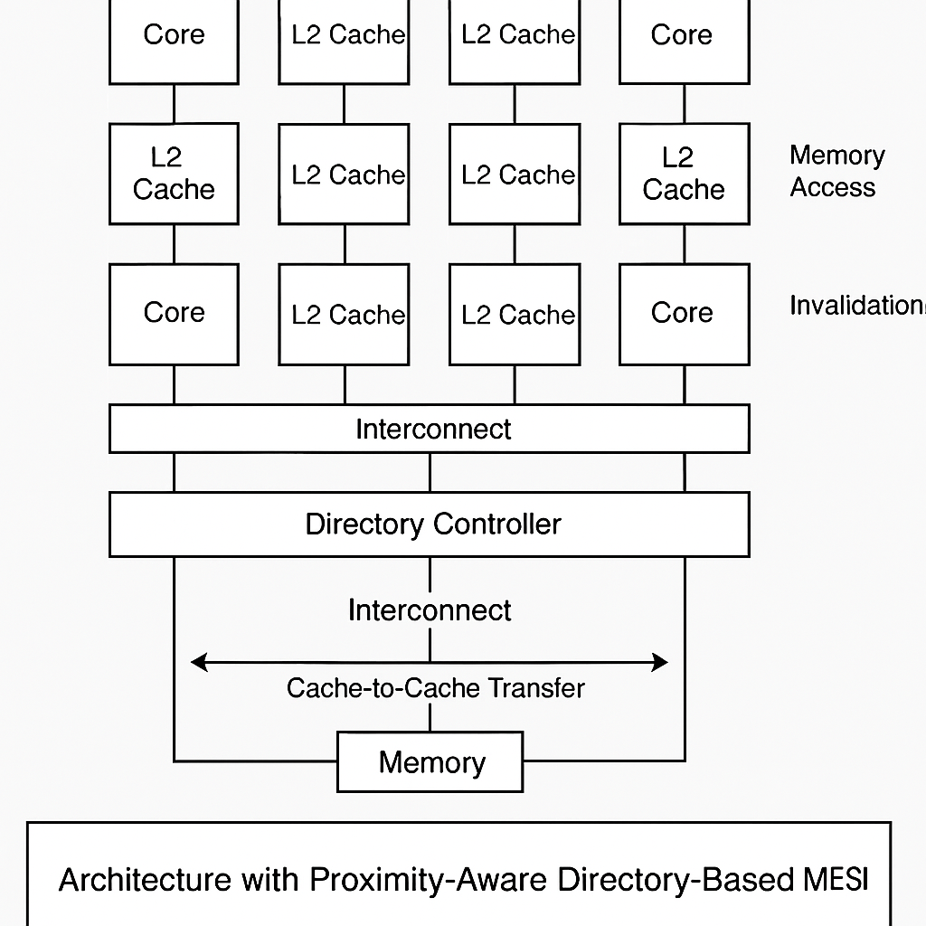
System Architecture

Slide 6
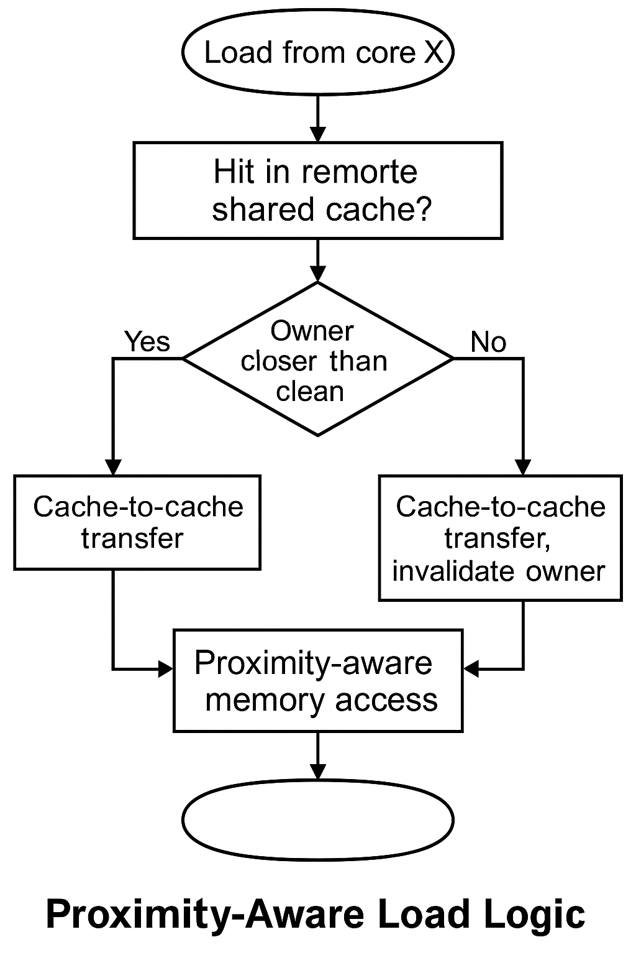
Proximity-Aware Read Handling

Slide 7
Evaluation Methodology
Benchmarks: private, shared read, write-sharing, hybrid, ping-pong, distance-aware, etc.
Metrics: Memory Accesses, Cache-to-Cache Transfers, Latency, Effective Hit Rate
Simulator logs detailed statistics for each benchmark and protocol

Slide 8
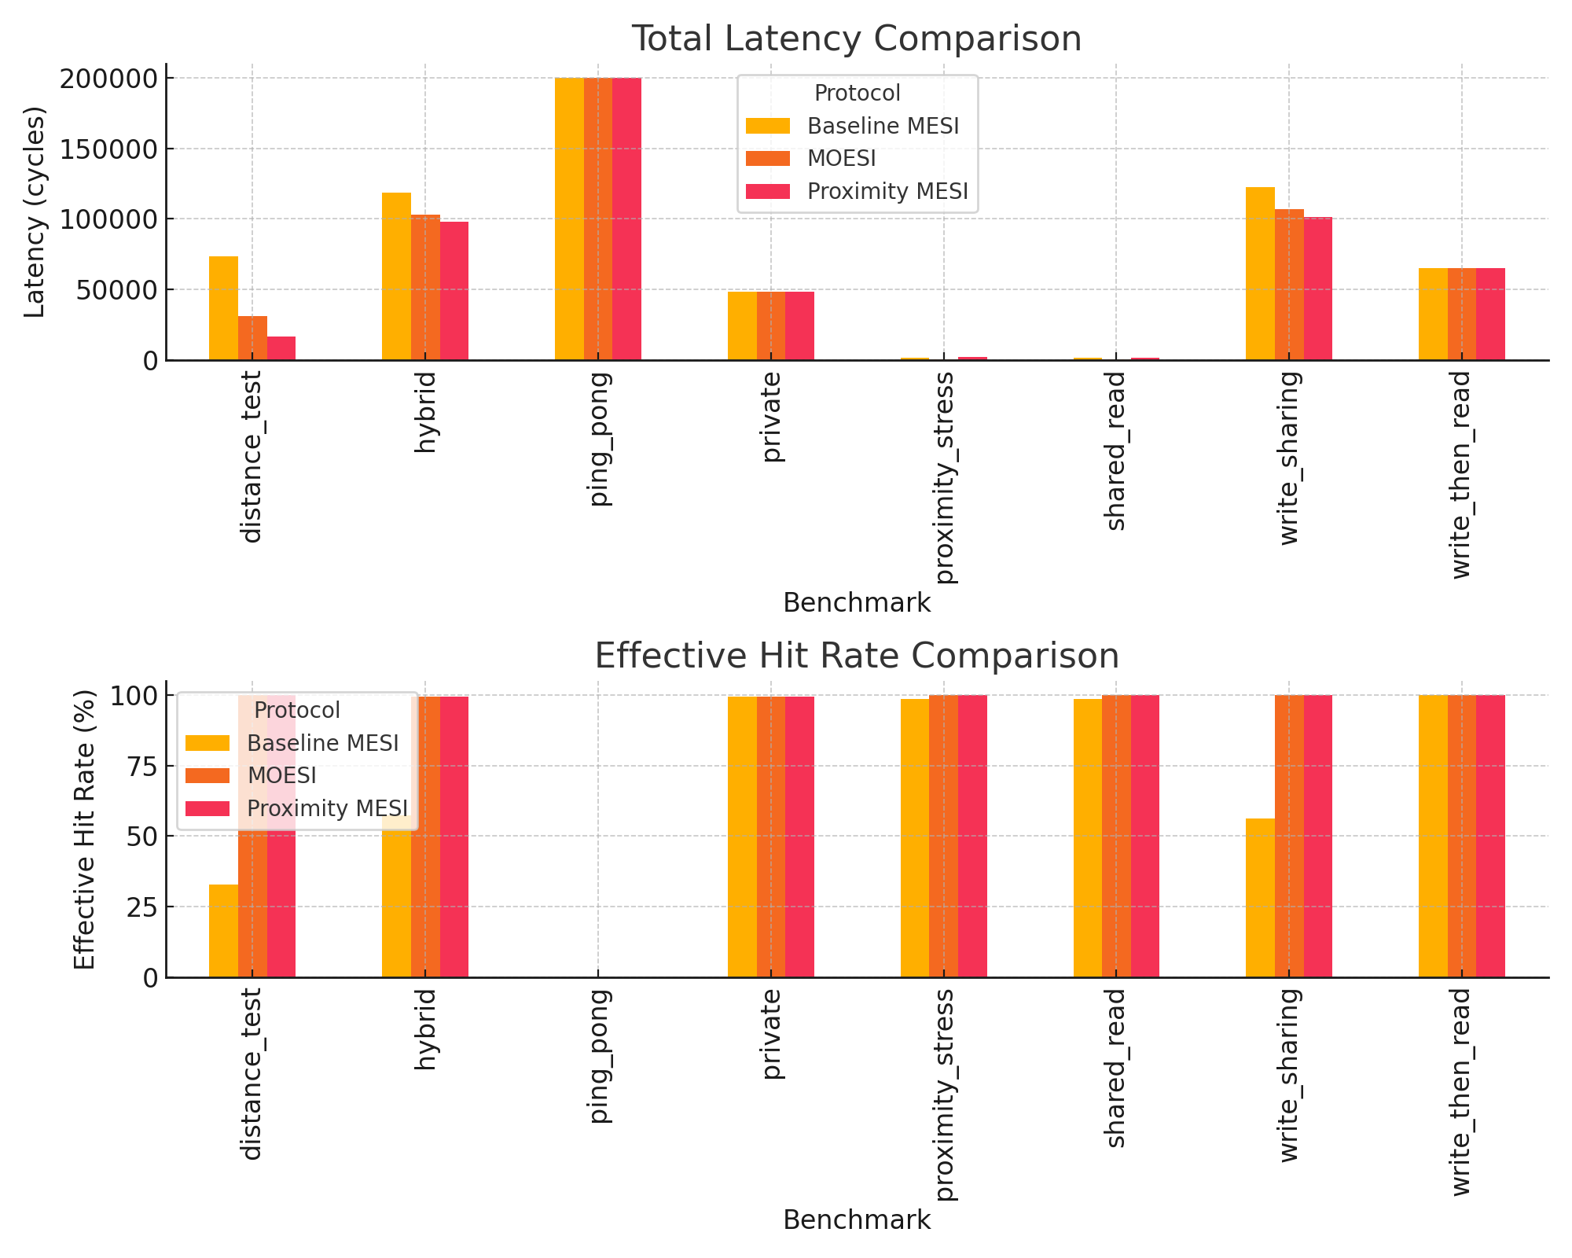
Performance Comparison

Slide 9
Evaluation Summary
Proximity MESI reduces latency up to 50% compared to MOESI in some cases.
MOESI and Proximity MESI both outperform Baseline MESI in hit rate.
Proximity-aware logic excels in read-dominant and distance-sensitive workloads.
Latency improves due to closer sharer selection, not just reuse logic.

Slide 10
Conclusions
Proximity-aware MESI enhances reuse and minimizes latency in CMPs.
Preserves MESI simplicity while achieving performance similar to MOESI.
Scales better in spatially structured workloads (e.g., mesh networks).
Future work: dynamic topology mapping, energy-aware coherence policies.

