Slide 1
Project Presentation
P611 - Book Recommendation System
Presented By Group - 6

Slide 2
Problem statement
To build a book recommendation system that suggests books to users based on similarities in book popularity, user behaviour, and rating patterns.

Slide 3
Objectives
Explore Books, rating and Users datasets and extract meaningful features.
EDA and Feature Engineering
Model Selection, Model Building
Deployment
Summary
To recommend relevant books to users based on their reading preferences
To leverage user ratings and book popularity to generate personalised recommendations
To improve user experience by suggesting books similar to those users have read or liked

Slide 4
Dataset Description
Books Dataset
Users Dataset
Rating dataset
The Dataset Contains information such as :
User-ID, Location, Age, ISBN, Book Title, Book Author, Publisher, Year of Publication, Book Rating, Image-URL-M

Slide 5
Exploratory Data Analysis (EDA)
Merged Users, Books, and Ratings datasets, resulting in 1,031,136 rows and 12 columns
Performed data quality checks, including duplicate detection and missing value analysis
Handled missing values by filling Age with the median and replacing missing authors/publishers with “Unknown”
Detected age outliers using boxplots and restricted the age range to 5–90 years for realistic user profiles
Visualised data using bar plots and box plots to analyse rating distribution, popular books, active users, and age vs ratings, most rated book & authors

Slide 6
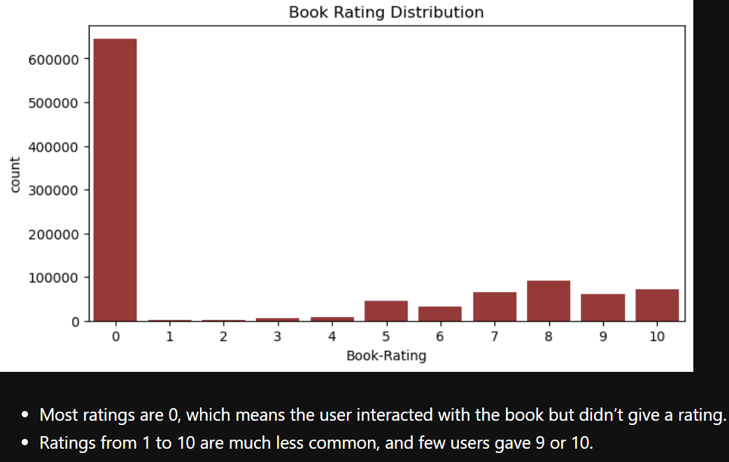
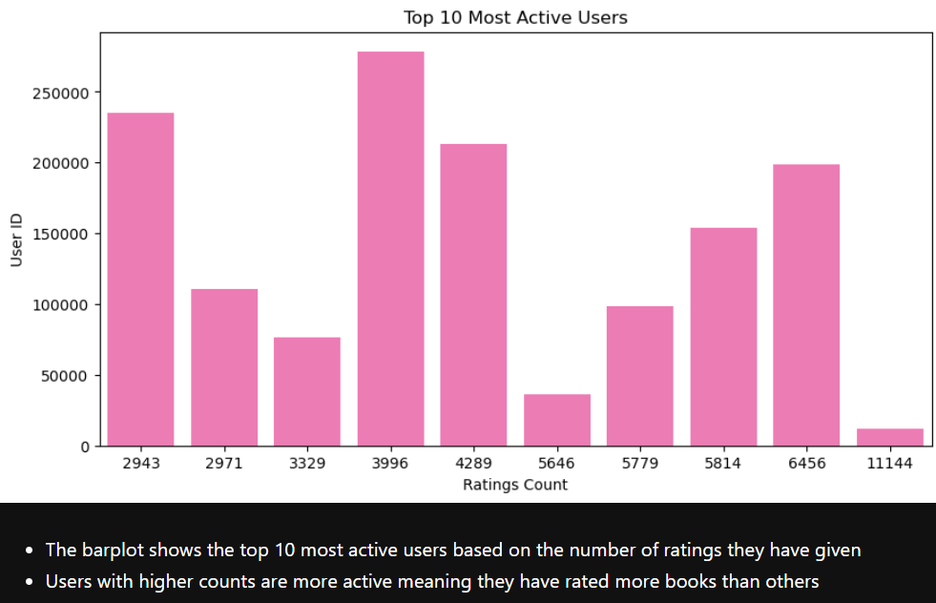
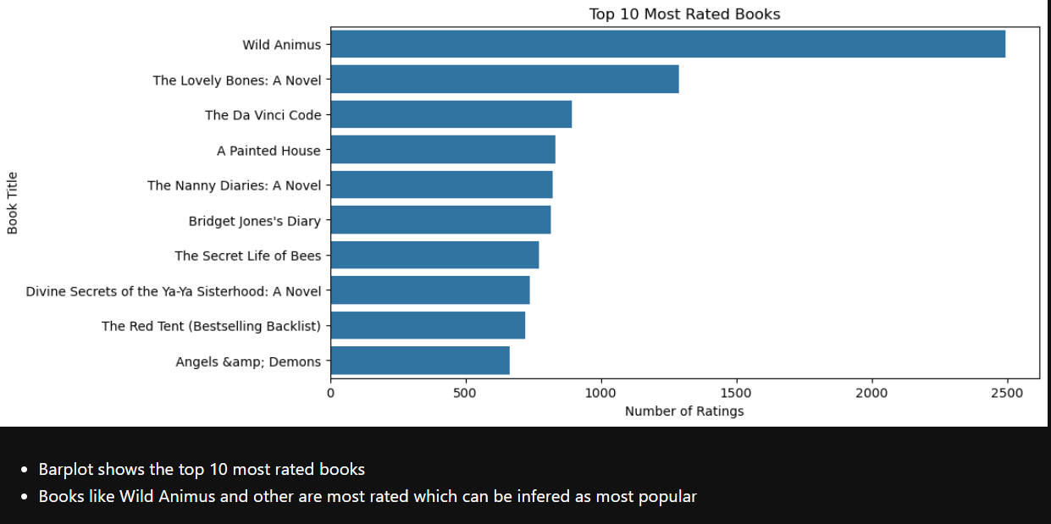
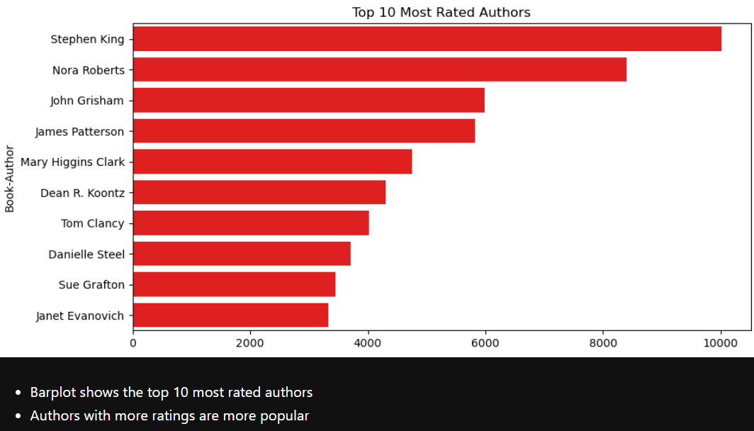

Slide 7
Feature Engineering
Selected important features required for recommendation, such as User-ID, ISBN, Book details, Age, and Location
Converted Year-Of-Publication to numeric format and handled missing values using median
Extracted City, State, and Country from Location to enhance user demographic information
Encoded categorical variables using Label Encoding to make the data model-ready
Filtered sparse users and books by keeping only those with a minimum number of
interactions to reduce noise and improve recommendation reliability
Created a User–Item Matrix (Pivot Table) and converted it into a sparse matrix
to efficiently store user-book interactions and optimise memory usage

Slide 8
Model Selection
Chose an Unsupervised Learning approach since no labeled output is available
Implemented a Popularity-Based Recommendation Model to suggest trending books
Built a Collaborative Filtering model using user–item interactions
Applied Cosine Similarity to measure similarity between books based on user ratings
Selected this approach due to its effectiveness in handling sparse data and scalability

Slide 9
Model Building
Built a Cosine Similarity between books to identify similar items
Generated Popularity-Based Model to recommend the most frequently rated books
Constructed a User–Item Matrix using pivot tables to represent user-book interactions
Converted the matrix into a Sparse Matrix to handle large and sparse data efficiently
Computed book recommendations by selecting top similar books for a given input

Slide 10
Popularity Based Recommender System
Calculated total number of ratings and average rating for each book
Filtered books having minimum 50 ratings to ensure reliability
Ranked books based on high average rating + rating count
Recommended top N most popular books to users
Used this model to handle cold-start users (no user history)

Slide 11
Collaborative Filtering Recommender System (Item-Based & User-Based)
Collaborative Filtering Recommender System (Item-Based & User-Based)
Built a User–Item Matrix using a pivot table to represent user–book ratings
Handled sparse data by filling missing ratings with 0 and converting it into a CSR sparse matrix for memory efficiency
Item-Based Model: calculated book-to-book similarity using cosine similarity
Recommended books that are most similar to the selected book based on user rating patterns
User-Based Model: computed user-to-user similarity using cosine similarity on the transposed matrix
Recommended books liked by similar users, with a popularity fallback for users having very few ratings

Slide 12
Cosine Similarity
Used cosine similarity to measure pattern similarity between users/books
Compared vectors based on rating behaviour, not rating values
Handled sparse data efficiently
Generated similarity scores between 0 and 1
Used similarity scores for both user-based and item-based models

Slide 13
Hybrid Recommendation System
Combined item similarity scores with book popularity
Assigned higher weight to similarity and lower weight to rating
Filtered books with sufficient ratings for better accuracy
Ranked books using a final weighted score
Provided more stable and accurate recommendations

Slide 14
Model Evaluation
Evaluated the model using qualitative analysis due to the unsupervised nature of the problem
Verified recommendations based on relevance, similarity, and popularity of books
Checked consistency of recommendations for different input books
Ensured the model produces diverse yet relevant suggestions
Confirmed scalability and performance on large datasets

Slide 15
Deployment
Deployed the recommendation system using Streamlit for interactive user experience
Serialized trained models and data objects using Pickle for reuse
Loaded pickled files (popular.pkl, pt.pkl, books.pkl, similarity_scores.pkl) in the app
Built a simple UI to accept book input and display recommendations
Enabled real-time book recommendations through a web interfa

Slide 16
Summary

