Slide 1
DTC Real Time Route Data Analysis
Shubham Sharma (MT20324)

Slide 2
Introduction
DTC operates one of the largest bus network in the world which provides connectivity within the Delhi-NCR region.
This Project aims to provide analysis on the various routes, trips, stops, timings amongst other things on which DTC operates.
The main emphasis of this project will be on real time GPS data which can help in tracking and predicting the bus arrival times at a particular location.

Slide 3
Features
Users will be able to find routes between stops.
The portal will allow users to check timings of the buses on a particular route.
Apart from the above user can also check buses operating from a particular stop and its direct connectivity.
The Portal will provide real time tracking of the buses on a particular route and their expected arrival time.

Slide 4
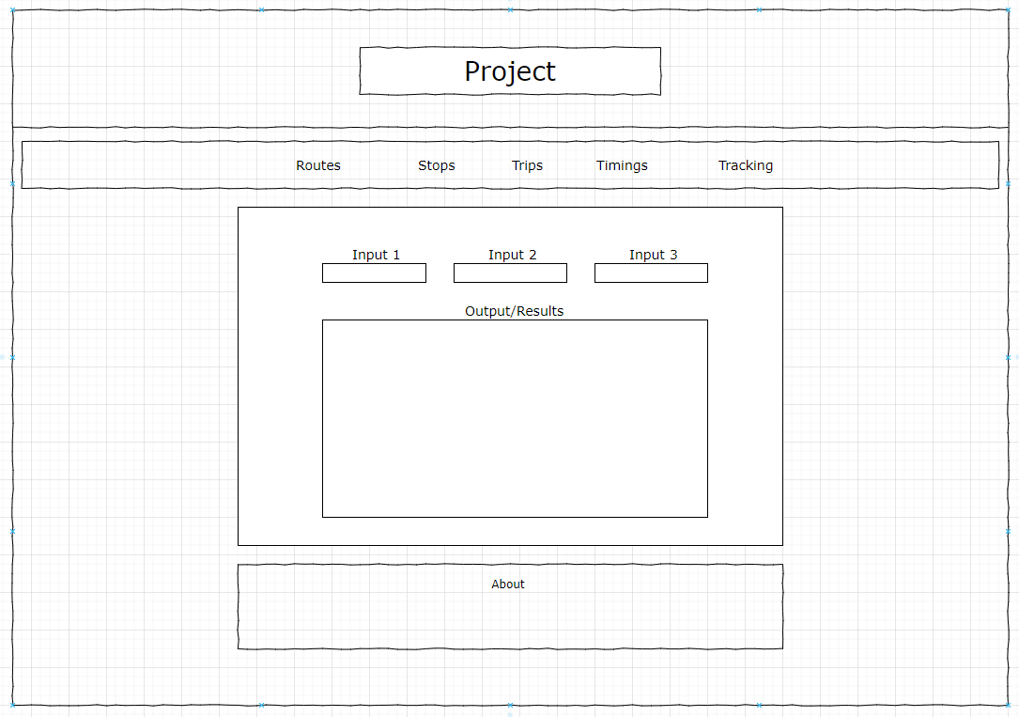
Wire Frame

Slide 5
Weekly Coverage
Data Exploration and Analysis.
Data Preprocessing and Storage.
Backend code for obtaining results.
Step 3 + Frontend development and verification of results.
Deployment and Fine Tuning/Optimizing.

