Slide 1
DTC Real Time Route Data Analysis
Shubham Sharma (MT20324)

Slide 2
Introduction
DTC operates one of the largest bus network in the world which provides connectivity within the Delhi-NCR region.
This Project aims to create a dashboard which will show real time status of the buses on the routes on which DTC operates.

Slide 3
Features
The Dashboard will show the starting, next and destination stop of the bus,timings and its current running status.
User will get the option to select the route of which the status will be fetched and presented.

Slide 4
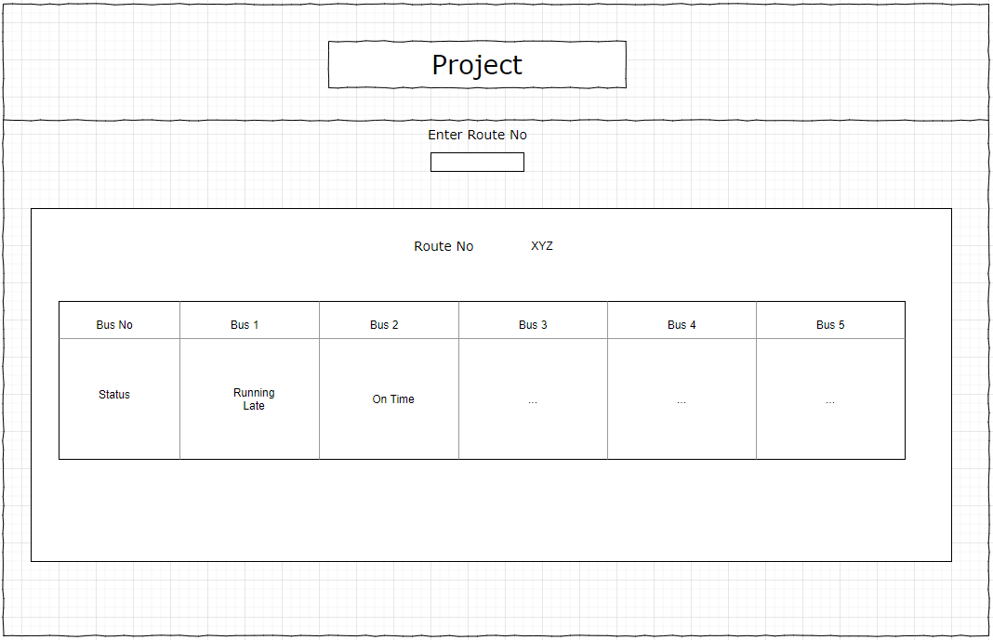
Wire Frame

Slide 5
Weekly Coverage
Data Exploration and Analysis.
Frontend + Backend code for obtaining results.
Step 3 + Reiterations and verification of results.
Deployment and Fine Tuning/Optimizing.

