Slide 1

Sprocket Central Pty Ltd
Data analytics approach
Shubham Malunjkar

Slide 2
Agenda
Introduction
Data Exploration
Model Development
Interpretation

Slide 3
Introduction
Identify and Recommend the Top 1000 Customers to target from the Dataset
Outline
Sprocket Central is a company that specializes in high-quality bikes and cycling accessories.
The marketing team of the company is looking to boost sales.
Using 3 datasets, the aim is to analyze and recommend the top 1000 customers for the company to target.
Contents for data analysis
“New” and “old” age customers distributions
Bike-related purchases over the last 3 years by gender.
Job industry distribution.
Wealth segmentation by age category.
RFM analysis and customer classification.

Slide 4
Data Exploration
“New” and “Old” Customer age distribution
Most customers are aged between 40-49 in the old customers’ list as well as the new customer list.
The lowest group is 20 and 80+ for both lists.
Both graphs suggest that the 20-49 age group is the most populated.

Slide 5
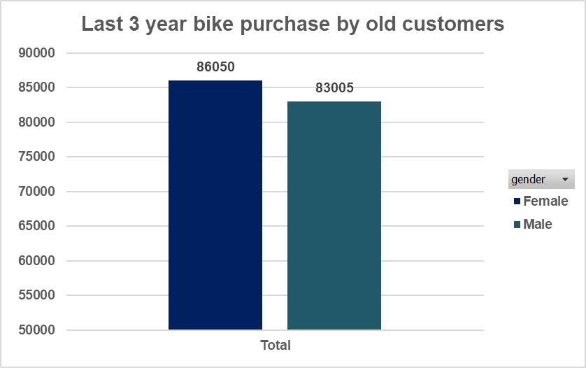
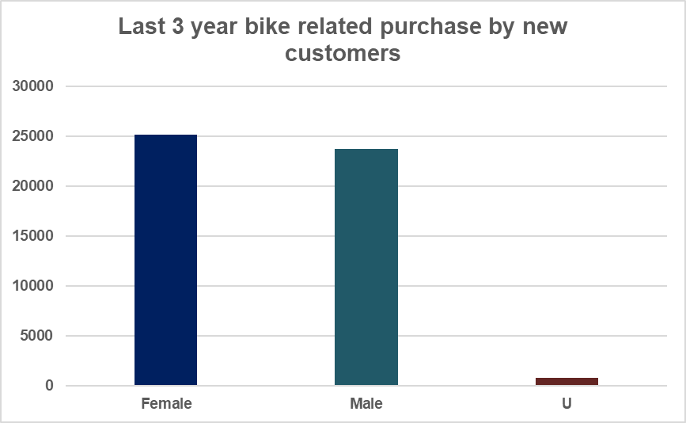
Data Exploration
Bike-related purchases in last 3 years by gender.
Over the last 3 years almost 50% of bike-related purchases are done by females 48% of purchases are made by men and almost 2% are done by unknown gender.

Slide 6
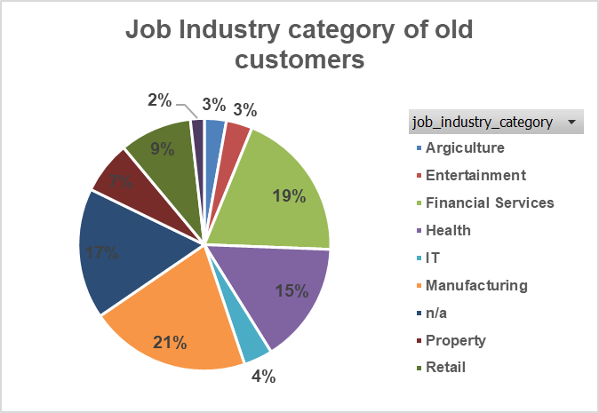
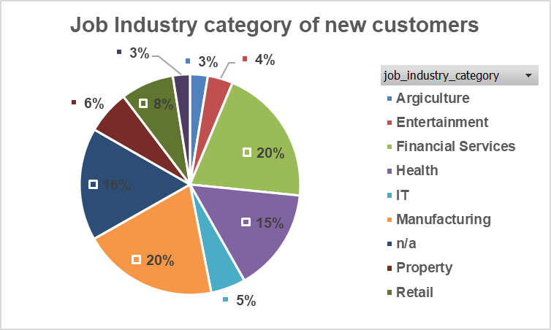
Data Exploration
Job industry distribution.
The Smallest number of customers are from Agriculture and Telecommunications.
Similar pattern is seen in both lists.

Slide 7
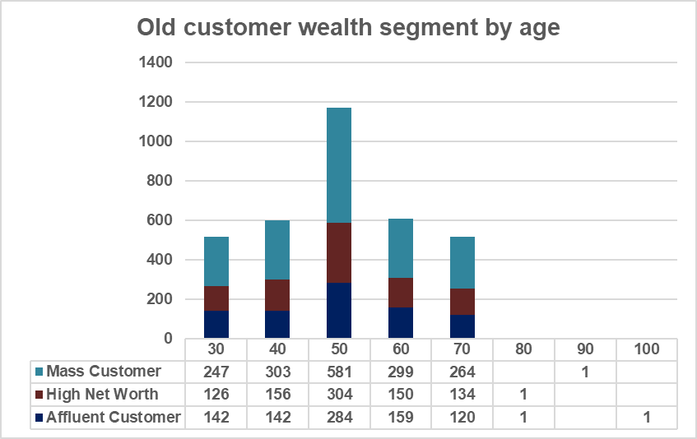
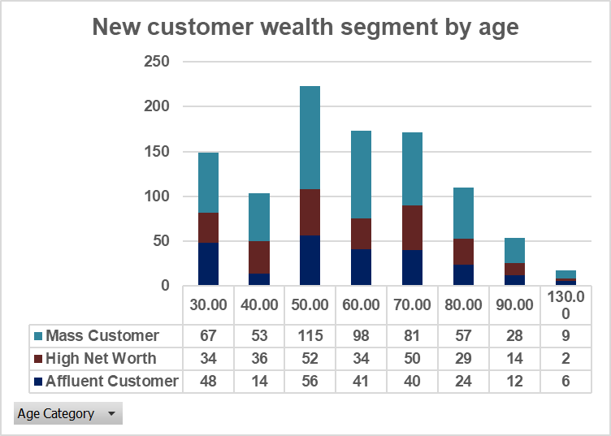
Data Exploration
Wealth Segmentation by age category
In both lists the largest number of customers are classified under the mass customer category.
The next category is high net worth.
Affluent customers outperform the high net worth category in the 40-49 age group.

Slide 8
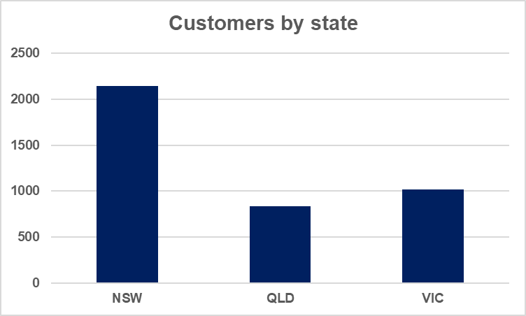
Data Exploration
Customer by state
Clearly, most customers of the company are from New South Wales (NSW).
Company’s target state for its marketing strategy should be in NSW.

Slide 9
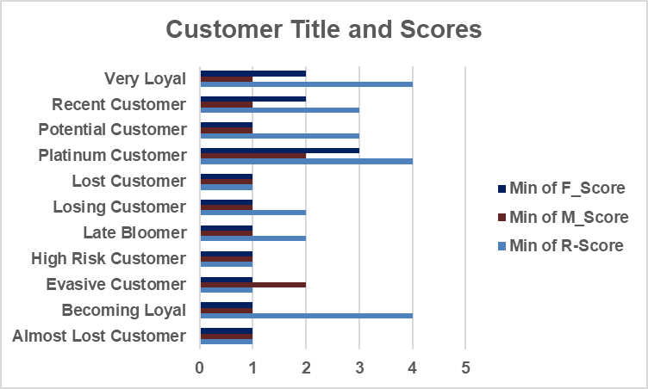
Data Exploration
RFM analysis and customer classification
RFM analysis is used to determine which customers a business should target to increase its revenue and value.
The RFM ( Recency, Frequency, Monetary) model shows customers that have displayed high levels of engagement with the business in the three categories mentioned.

Slide 10
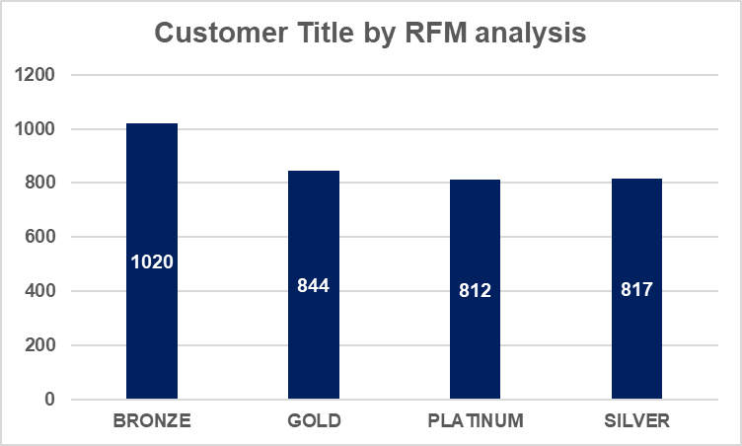
Data Exploration
Customer Distribution by RFM
Customers are categorized according to RFM score into four categories. (Bronze, Silver, Gold, Platinum)

Slide 11
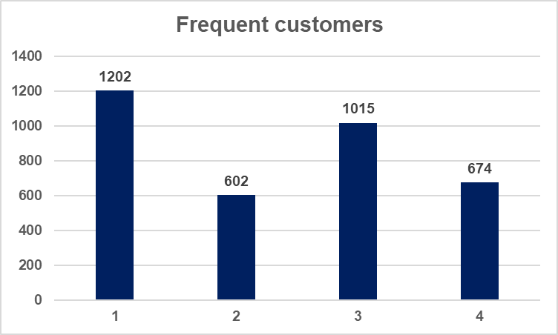
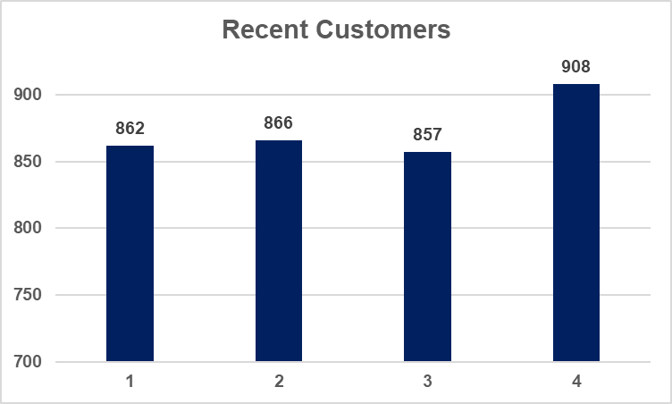
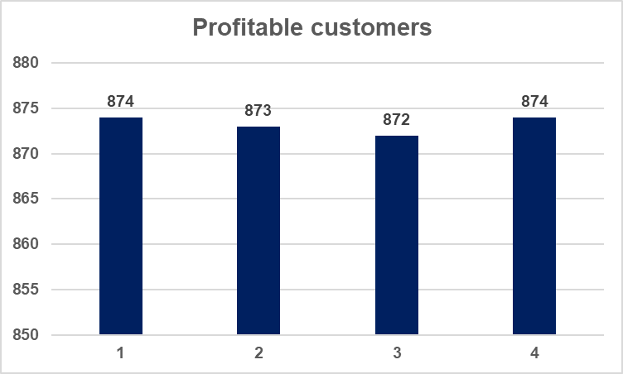
Data Exploration
RFM Scores by numbers.

Slide 12
Model Development
Customer title definition list with RFM values assigned.

Slide 13
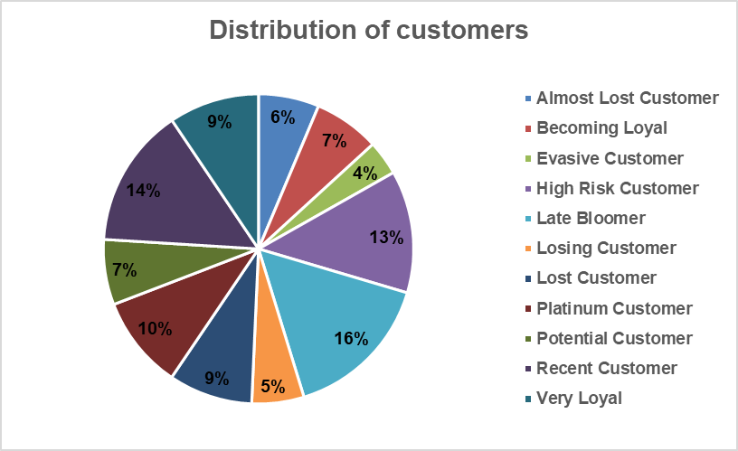
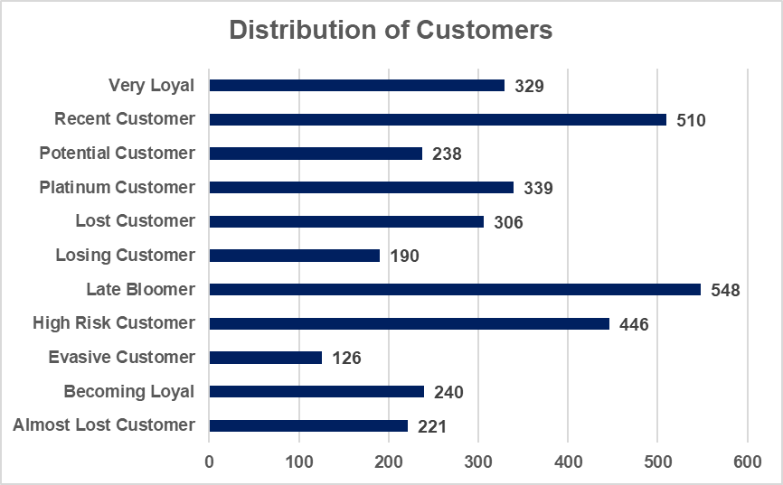
Model Development
Customer Title Distribution in Dataset

Slide 14
Model Development
Summary table of top 1000 customers to target

Slide 15
Interpretation
Customer Target and Methodology
Filter through the top 1000 customers by assigning the conditions discussed in the table above.
The 1000 customers selected would have bought recently, frequently in the past, and tend to spend more than other customers.

Slide 16
Thank You For Reading.

