Slide 1

Basic Details of the Team and Problem Statement
Ministry/Organization Name/Student Innovation: Ministry of
Jal Shakti
PS Code: SIH1293
Problem Statement Title: Automatic regulation of valves for release of water based upon soil moisture availability in the root zone of the crop, using artificial intelligence, in a piped and micro irrigation network of irrigation system.
Team Name: ByteBenders
Team Leader Name: Shubham Nayak
Institute Code (AISHE):
Institute Name: Veermata Jijabai Technological Institute.
Theme Name: Agriculture, FoodTech & Rural Development

Slide 2
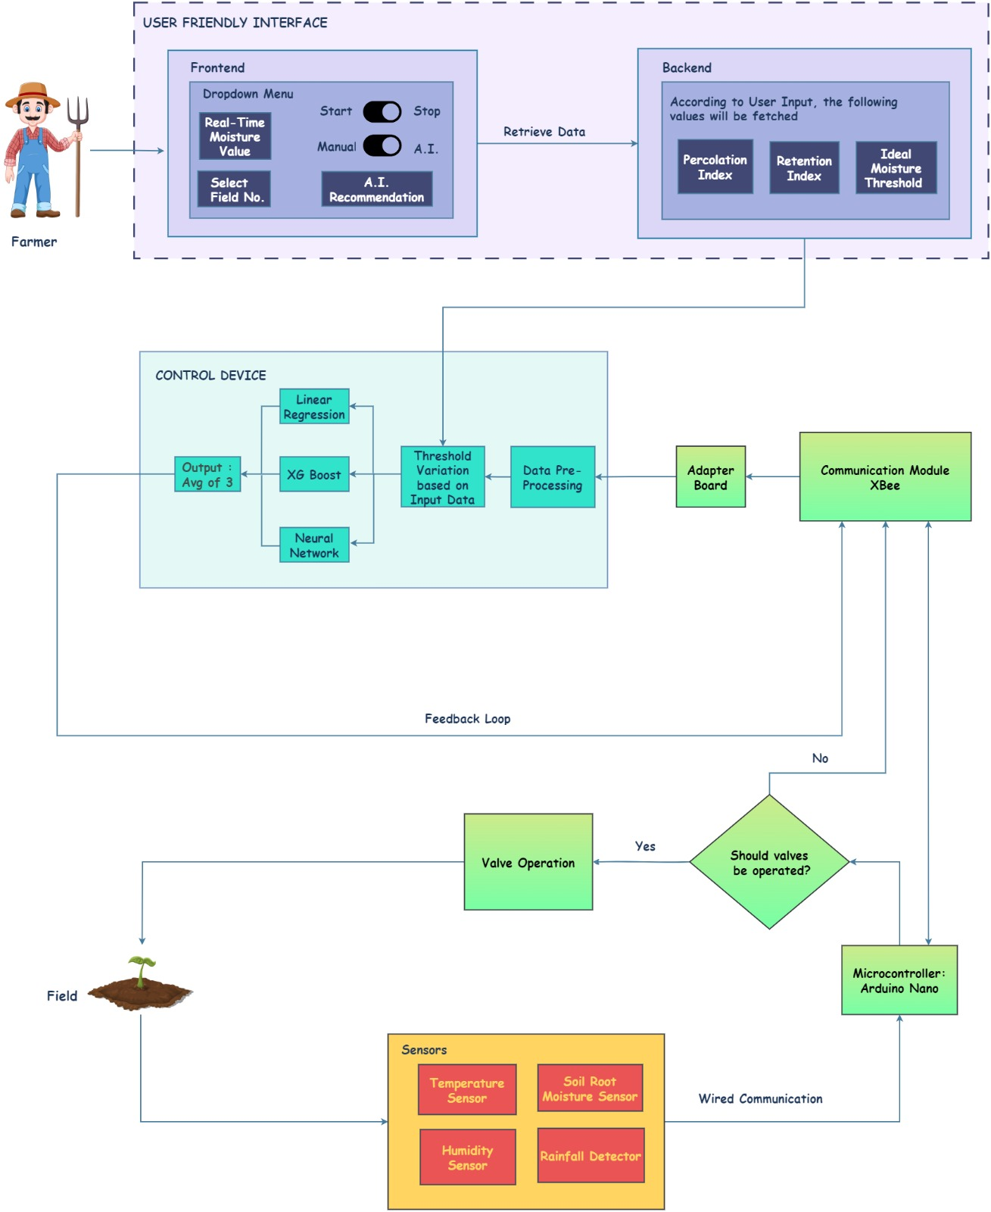
Idea/Approach Details
A dashboard is made available to the farmer to select the field number, the backend data for ideal moisture value, and the percolation and retention index .
Sensors, such as, temperature, air humidity, rainfall and soil moisture are deployed.
XCTU (XBee) , Arduino, IDEVSCode (compiler) , kicad
Sensor data is sampled every 30 s to generate the database.
This data is sent to the Arduino Nano, which forwards it to the Laptop via XBee. The data is stored in the form of csv.
Data is sent to the ML model after being preprocessed.
A prediction model is integrated with the ML model.
If irrigation is required due to lack of enough moisture in the soil, the valve opens, and the sampling rate is changed to 30s. Lastly a scoring system employing three models is used.

Slide 3
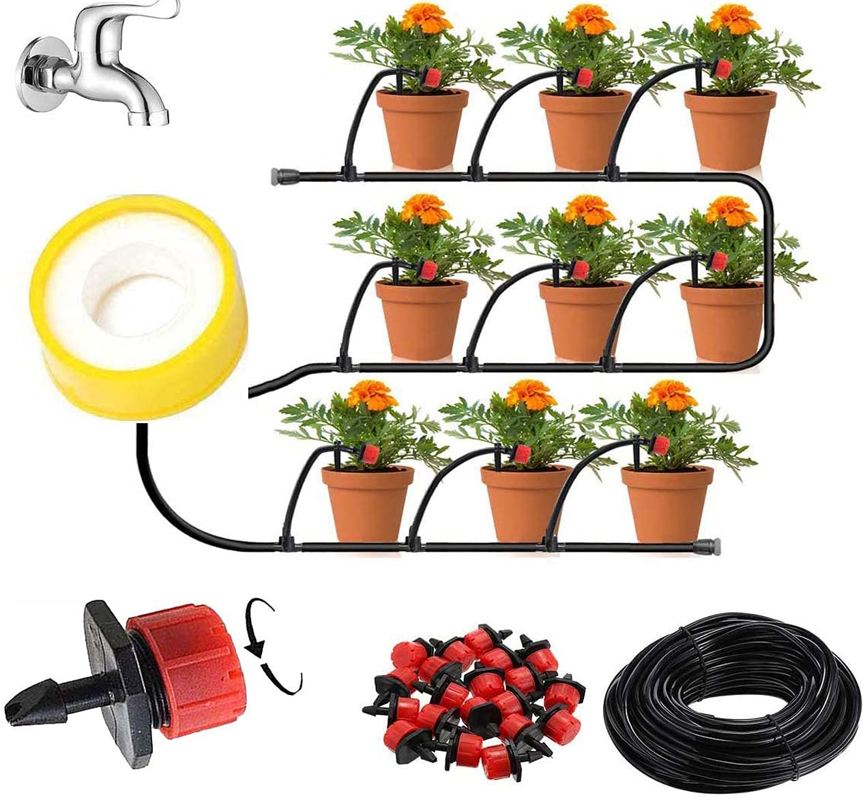
Idea/Approach Details
Libraries used in ML and dashboard:
streamlit
pandas
PIL
scikit-learn
numpy

Slide 4
Team Member Details
Team Leader Name: Shubham Nayak
Branch (Btech-EXTC) Stream (ECE) Year(IV):
Team Member 1 Name: Kartika Sharma
Branch (Btech-Electrical) Stream (ECE) Year (IV):
Team Member 2 Name: Kimaya Mutha
Branch (Btech-Electrical) Stream (ECE) Year (IV):
Team Member 3 Name: Saniya Deshmukh
Branch (Btech-EXTC) Stream (ECE) Year (IV):
Team Member 4 Name: Ojas Taskar
Branch (Btech-EXTC) Stream (ECE) Year (IV):
Team Member 5 Name: Parth Pawar
Branch (Btech-EXTC) Stream (ECE) Year (IV):

