Slide 1
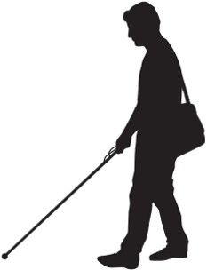
SMART NAVIGATION FOR THE VISUALLY CHALLENGED
MAYANK RAMNANI – B150234350
SAKSHI TIWARI – B150234393
SHUBHAM NAGARKAR – B150234315
SIKANDER SINGH – B150234384
GUIDE : T. P. VAIDYA

Slide 2
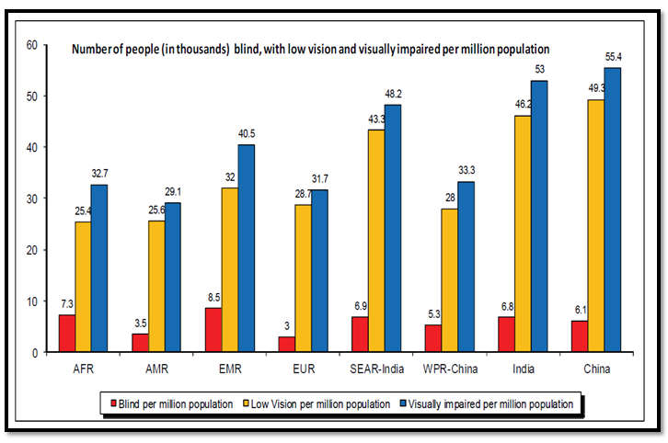
Need of System :
Facts:
According to WHO, 2% of the population is suffering from Visual Impairments.
In the year 2000 there were 82 million people with moderate visual impairment in the population of India. This number is likely to be 139 million by the year 2020 if the current trend continues.

Slide 3
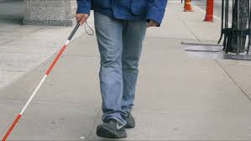
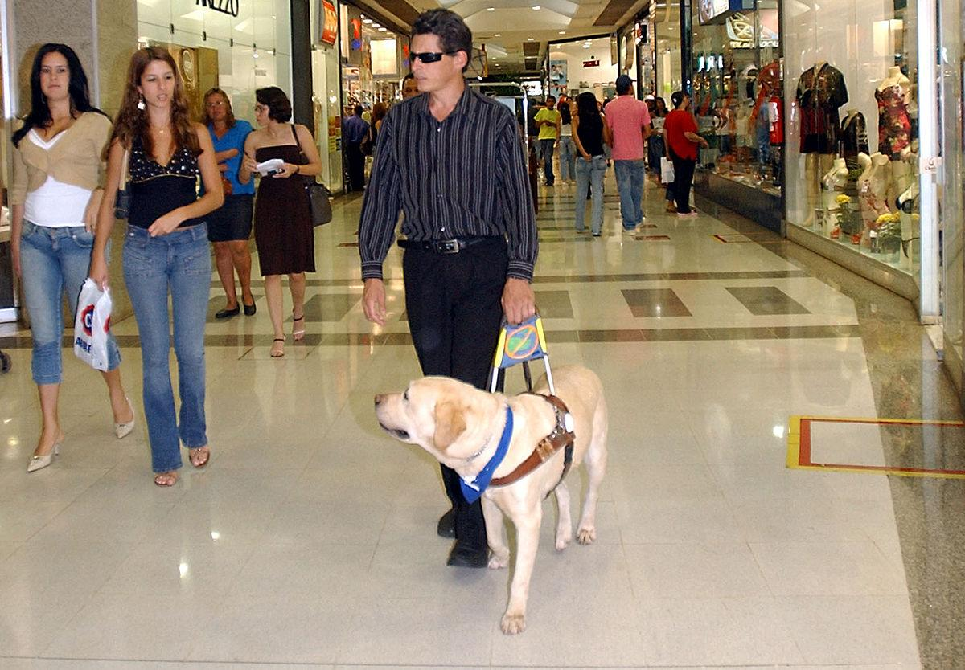
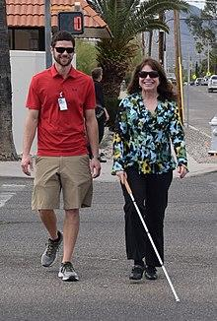
Traditional Methods :
Cane
Dogs
Person

Slide 4
Proposed System :
In this system, an assistive method that coagulates computer vision techniques and machine learning concepts in order to detect, navigate and avoid collision with objects encountered in the vicinity, is proposed.
The major approaches used to tackle the problem are:
TF Lite
Triangle Similarity
Cognition System
2

Slide 5
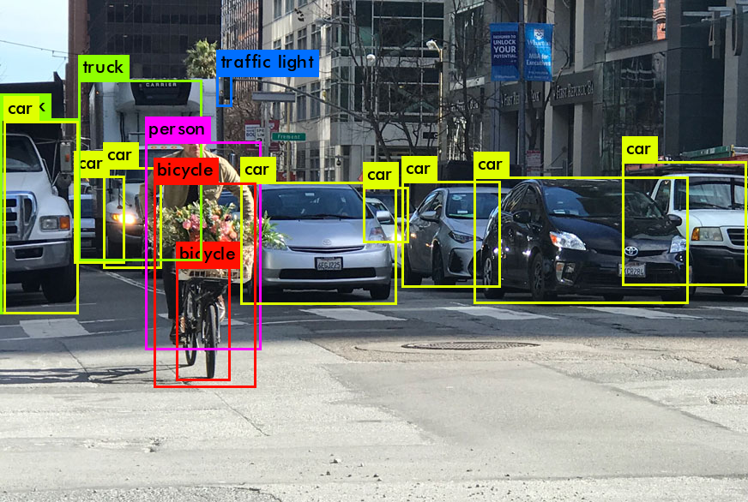
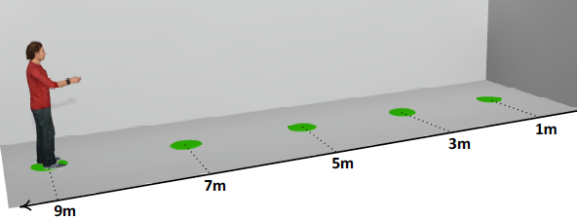

Detected objects sent for Distance estimation.
Alerts about the objects closest to the user.

Slide 6
Limitations of already developed systems :
System 1 [1] :
  Strong server requirement.
  Needs a special 3D camera like Kinect or GoPro for distance calculation.
  A special streaming device like cable is required which limits its portable usage.
  Delay of 8-10 seconds is expected.
System 2 [2] :
  Expensive device like bone conduction earphones are required.
  No module for distance estimation.

Slide 7
Why our system ?
Server independency
Approximate distance alert in terms of steps
Portability
No Network requirement
No extra hardware required
Quick response time
Cost effective

Slide 8
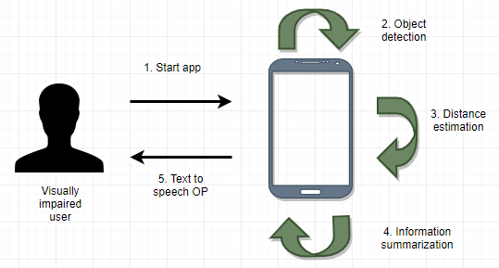
System Overview Diagram :

Slide 9
Object Detection via TensorFlow Lite :
The TFLite model is used which is trained on the COCO dataset with SSD algorithm for object detection.
COCO(Common Objects in Context) is a large-scale object detection, segmentation, and captioning dataset sponsored by Microsoft.
Single Shot Detector(SSD) algorithm achieves a good balance between speed and accuracy, and it is a good choice for detection of objects on a low computation device such as mobile phones.

Slide 10
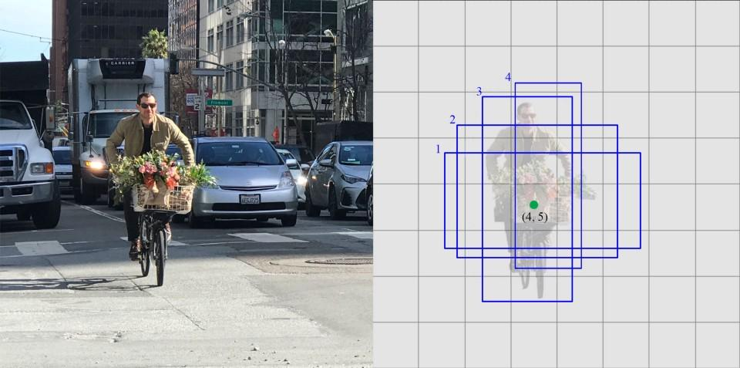
Working of SSD (Single Shot Detector) :
The SSD object detection composes of 2 parts:
Extract feature maps, and
Apply convolution filters to detect objects.

Slide 11
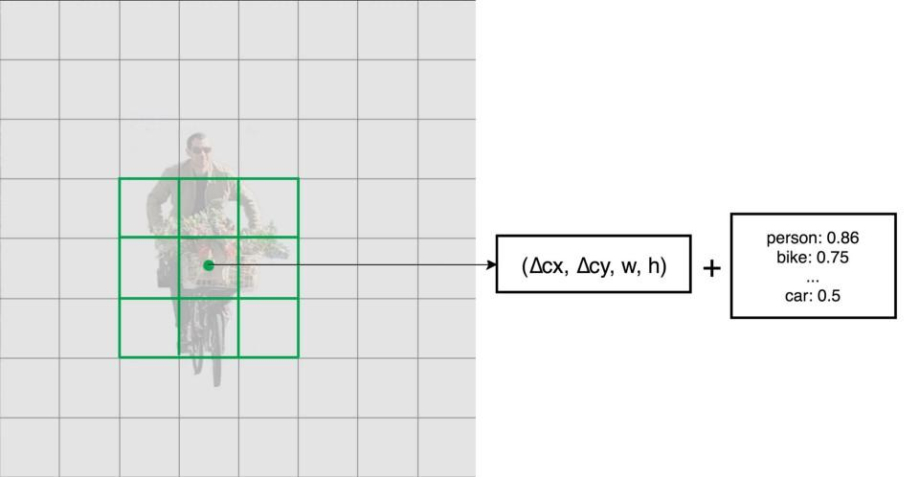
Feature extraction is carried out using VGG16 which defines the various features in the image.
After extracting the feature maps, SSD applies 3 × 3 convolution filters for each cell of the feature to make predictions.
It computes both the location and class scores using these 3 × 3 filters.

Slide 12
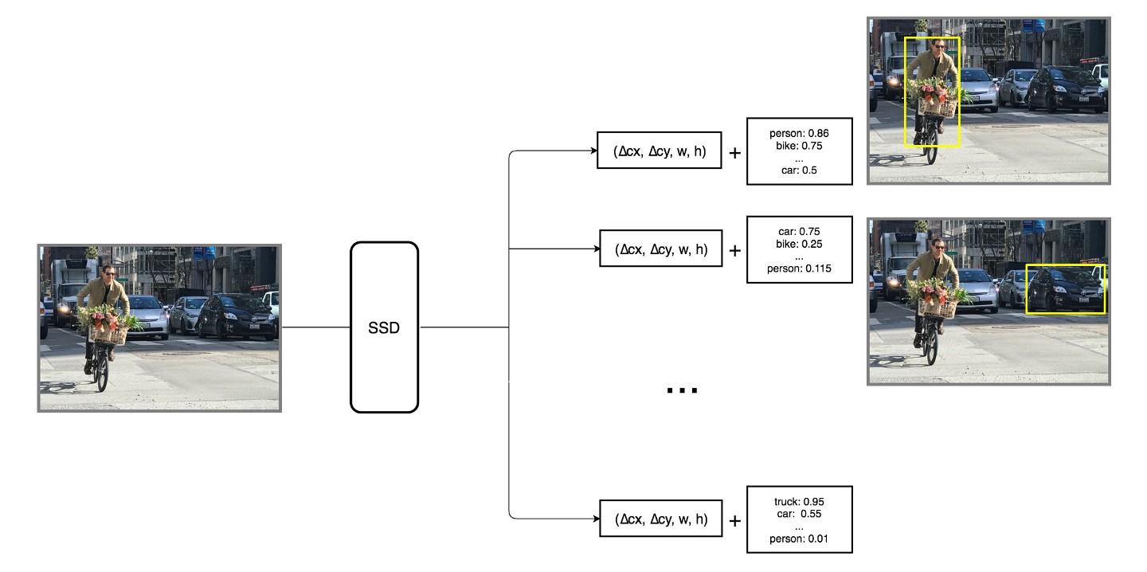
Same process of computation of class scores and location is repeated for each feature.
The class with the highest score for each feature is selected and output given along with the location and boundary box.

Slide 13
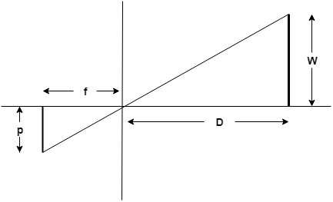
Formulation for Distance Estimation :
By triangle similarity:
D = (f x W ) / p
where,
D – Distance of object from camera
f – Pixel focal length of camera
W – Actual object height
p – Pixel height of object in image
Camera lens side
Real world side

Slide 14
Calculation of pixel focal length:
f = (F/ S) * w [3]
where,
f – pixel focal length
F – focal length of lens in mm (property of camera)
S – sensor width in mm (property of camera)
w – image width in pixels

Slide 15
Performance Statistics :
Object detection accuracy is 50 - 90% depending upon the orientation of the object and the ambient light.
Alerts are generated after every 2 seconds
Distance estimation accuracy is approximately 80% which depends upon the camera position

Slide 16
Limitations :
Approximate distance of the objects from the user
Accuracy depends upon angle of camera
Object detection accuracy up to 80% depending upon ambient light
Dataset of object height are average values and not the actual ones

Slide 17
Useful Links :
Final Report – Project Report.pdf
Class Diagram – images\class diagram.jpg
Sequence Diagram – images\sequence diagram.jpg
Use Case Diagram – images\use case diagram.jpg
Deployment Diagram – images\deployment diagram.jpg

Slide 18
Conclusion :
Thus our proposed systems solves the problems faced by visually challenged people of identification and navigation around the objects in their surroundings in a very accessible and independent way.
22

Slide 19
Future Scope :
Stereo camera enabled phones would give maximum accuracy in distance estimation as it would remove the dependency of dataset
With better training data, the accuracy of object detection can be increased
The number of classes of objects that can be detected, currently 80, can be increased to cover a bigger variety of objects

Slide 20
References :
Let the blind people see : Real time visual recognition with results converted to 3D audio.
Seeing without sight : An automatic cognition system dedicated to blind and visually impaired people.
https://answers.opencv.org/question/17076/conversion-focal-distance-from-mm-to-pixels/
https://www.who.int/en/news-room/fact-sheets/detail/blindness-and-visual- impairment
Jiang, Rui & Lin, Qian & Qu, Shuhui. (2016). Let Blind People See: Real-Time Visual Recognition with Results Converted to 3D Audio.
Delahoz, Yueng & Labrador, Miguel. (2017). A Deep-Learning-Based Floor Detection System for the Visually Impaired. 883-888. 10.1109/DASC-PICom-DataCom-CyberSciTec.2017.148.
B. Mocanu, R. Tapu and T. Zaharia, "Seeing Without Sight — An Automatic Cognition System Dedicated to Blind and Visually Impaired People," 2017 IEEE International Conference on Computer Vision Workshops (ICCVW), Venice, 2017, pp. 1452-1459.
23

