Slide 1
IPL AUCTION

Slide 2
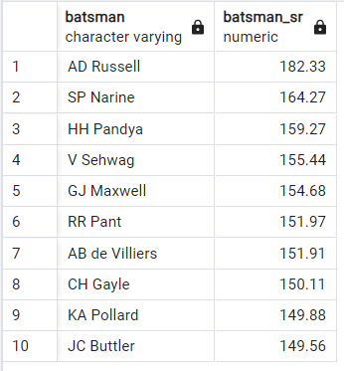
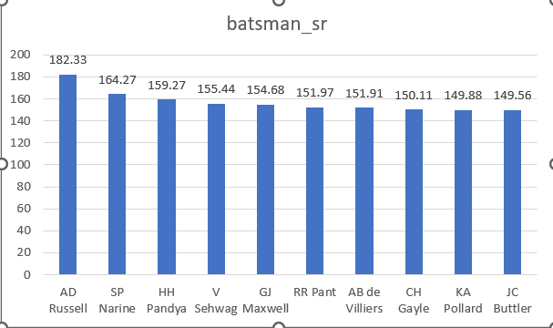
List of 10 batsman with tall batting strike rate who have confronted at slightest 500 balls
SELECT batsman,
ROUND((SUM(batsman_runs)*1.0 / COUNT(ball)) * 100,2) AS batsman_sr
FROM ipl_ball WHERE extras_type not in ('wides') Bunch BY batsman HAVING COUNT(ball) > 500 ORDER BY batsman_sr DESC LIMIT 10;

Slide 3
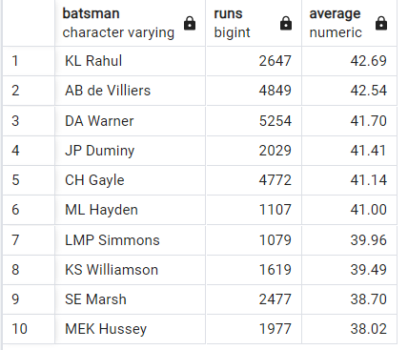
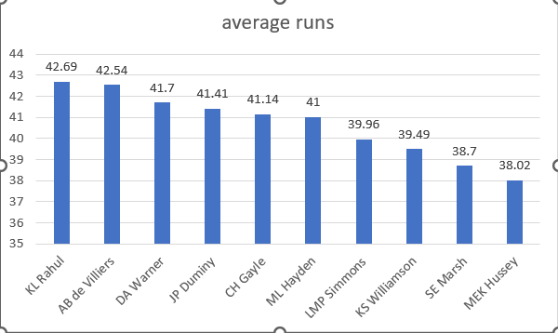
List of 10 players with best normal who have played more than 2 IPL seasons (or 28 matches)
SELECT batsman, SUM(batsman_runs) AS runs, ROUND(SUM(batsman_runs)*1.0/SUM(is_wicket),2) AS average FROM ipl_ball Gather BY batsman HAVING SUM(is_wicket) > 0 AND COUNT(DISTINCT id) > 28 ORDER BY average DESC LIMIT 10;

Slide 4
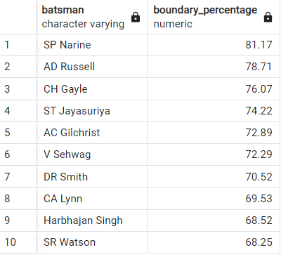
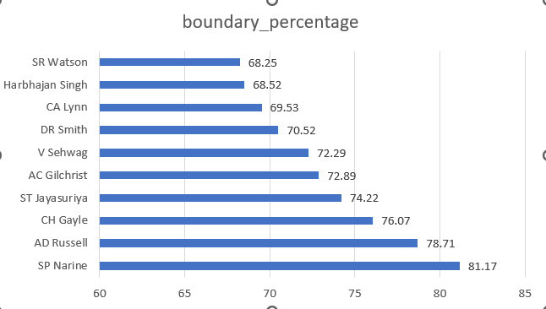
List of 10 players who have scored most runs in boundaries and have played more than 2 IPL seasons(more than 28 matches).
SELECT batsman, ROUND(SUM(CASE WHEN batsman_runs in(4,6) At that point batsman_runs else 0 END)*1.0 / SUM(batsman_runs)*100,2) AS boundary_percentage FROM ipl_ball WHERE extras_type NOT IN ('wides’) GROUP BY batsman HAVING COUNT(DISTINCT id) > 28 ORDER BY boundary_percentage DESC LIMIT 10;

Slide 5
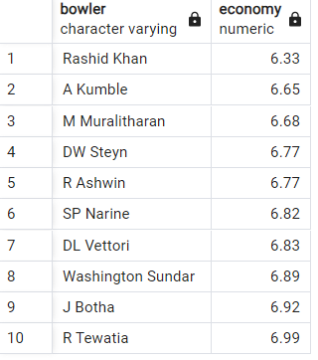
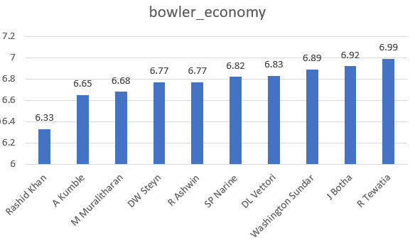
List of 10 bowlers with best economy who have bowled at slightest 500 balls in IPL
SELECT bowler, ROUND(SUM(total_runs)/(COUNT(bowler)/6. 0), 2) as economy FROM ipl_ball Bunch BY bowler HAVING COUNT(bowler) > 500 ORDER BY economy LIMIT 10;

Slide 6
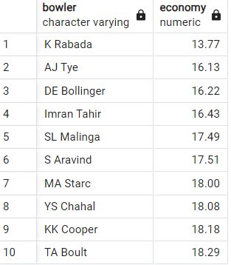
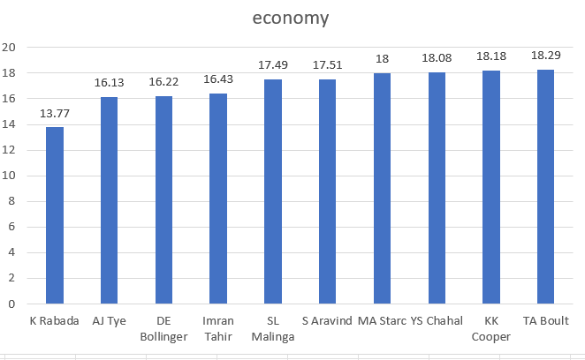
List of 10 bowlers who have the most excellent rate and who gave bowled at slightest 500 balls
WITH ValidDismissals AS (SELECT bowler,is_wicket, CASE WHEN dismissal_kind IN ('bowled', 'caught', 'caught and bowled', 'hit wicket', 'lbw', 'stumped') At that point 1 ELSE 0 Conclusion AS is_valid_dismissal FROM ipl_ball) SELECT bowler, ROUND(COUNT(bowler) * 1.0 / SUM(is_valid_dismissal),2) AS economy FROM ValidDismissals Bunch BY bowler HAVING COUNT(bowler) > 500 ORDER BY economy LIMIT 10;

Slide 7
The vital criteria for selecting WICKETKEEPERS within the IPL
• Wicket-keeping Aptitudes: This incorporates variables like glovework, befuddling, nimbleness, and amusement awareness.
• Batting Capacity: A wicketkeeper's batting capacity is pivotal within the IPL, as they regularly bat within the center or lower arrange and ought to score quickly.
• Captaincy Aptitudes: A few groups prefer wicketkeepers who can moreover captain the side, as they have a great see of the whole field and can make strategic decisions.
• Involvement: Experienced wicketkeepers are valuable resources, as they can handle weight circumstances and guide more youthful players.
• Cost: In an auction-based framework just like the cost gets to be a noteworthy figure. Groups have to be aptitude with budget constraints.
• Handling: Prioritize wicketkeepers with fabulous handling abilities, competent of making run-out opportunities.

Slide 8

Extra Questions.
1.Get the number of cities that have facilitated an IPL match.
SELECT COUNT(DISTINCT city) AS total_cities_hosted_ipl FROM ipl_matches;

Slide 9
Extra Questions.
2.Make table deliveries_v02 with all the columns of the table ‘deliveries’ and an extra column ball_result containing values boundary, DOT or other depending on the total_run (boundary for >= 4, DOT for 0 and other for any other number) Make TABLE deliveries_v02
create table deliveries_v02
as select *, case when (total_runs = 4 or total_runs = 6) then 'boundary'
when total_runs = 0 then 'dot' else 'other' end as ball_result from ipl_ball;
Note:- as output is a big table so I have not included it in the ppt

Slide 10
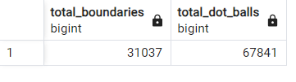
Extra Questions..
3.Compose a query to bring the full number of boundaries and dab balls from the deliveries_v02 table
SELECT
count(*) filter (WHERE total_runs = 4 or total_runs = 6) AS total_boundaries,
count(*) filter (WHERE total_runs = 0) AS total_dot_balls FROM deliveries_v02;

Slide 11
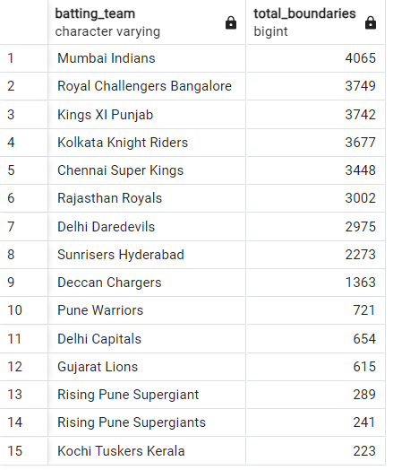
Extra Questions..
4.Type in a query to bring the overall number of boundaries scored by each group from the deliveries_v02 table and arrange it in descending order arrange of the number of boundaries scored.
SELECT batting_team, count(*) FILTER (WHERE total_runs = 4 OR total_runs = 6) AS total_boundaries FROM deliveries_v02 group BY batting_team order BY total_boundaries DESC;

Slide 12
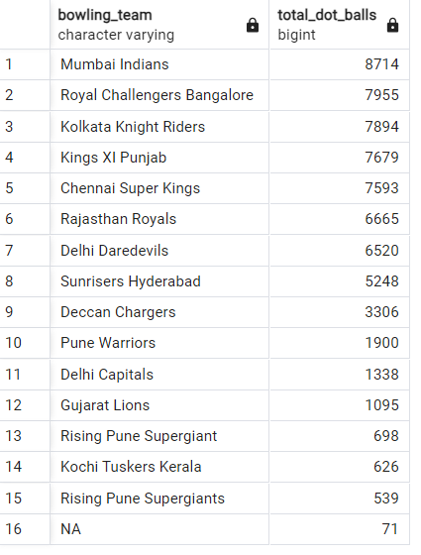
Extra Questions..
5.Type in a query to get the whole number of dot balls bowled by each group and arrange it in descending order arrange of the entire number of dot balls bowled.
SELECT bowling_team, count(*) filter (WHERE total_runs = 0) AS total_dot_balls from deliveries_v02 group by bowling_team order by total_dot_balls desc;

Slide 13
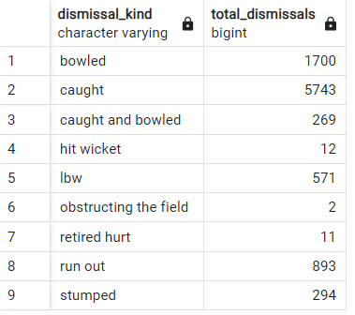
Extra Questions..
6.Type in a query to get the entire number of dismissal by dismissal sorts where dismissal kind isn't NA
SELECT dismissal_kind, count(*) AS total_dismissals FROM deliveries_v02 WHERE dismissal_kind is not null AND dismissal_kind ='NA’
group BY dismissal_kind;

Slide 14
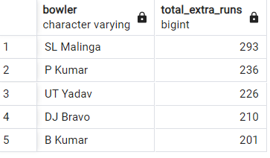
Extra Questions..
7.Type in a query to urge the best 5 bowlers who conceded most extreme additional runs from the deliveries table.
SELECT bowler, SUM(extra_runs) AS total_extra_runs FROM deliveries_v02 group BY bowler order BY total_extra_runs DESC LIMIT 5;

Slide 15
Extra Questions..
8.Type in a query to make a table named deliveries_v03 with all the columns of deliveries_v02 table and two extra column (named setting and match_date) of setting and date from table matches.
CREATE TABLE deliveries_v03 AS SELECT dv02.*, a.venue, a.date FROM deliveries_v02 as dv02 JOIN ipl_matches as a ON dv02.id = a.id;
Note:- as output is a big table so I have not included it in the ppt

Slide 16
Extra Questions..
9.Type in a query to bring the entire runs scored for each scene and arrange it within the descending order of total run scored
SELECT venue, SUM(total_runs) AS total_runs_scored FROM deliveries_v03 group by venue order BY total_runs_scored DESC;

Slide 17
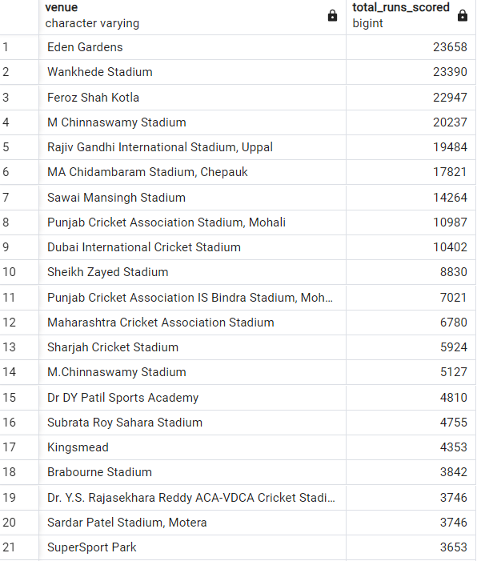
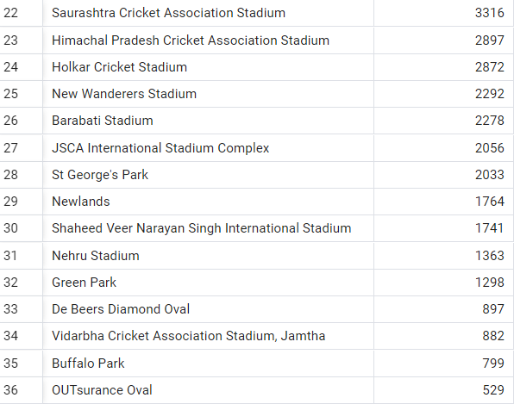

Slide 18
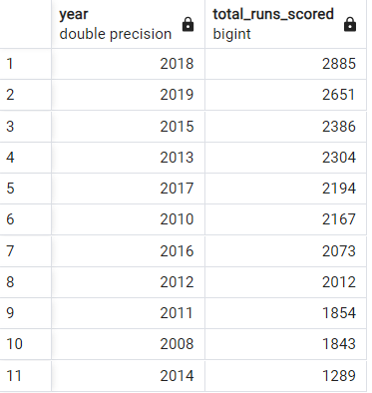
Extra Questions..
10.Compose a query to get the year-wise totals runs scored at Eden Gardens and arrange it within the descending order arrange of total runs scored.
SELECT EXTRACT(YEAR FROM date) AS year, SUM(total_runs) AS total_runs_scored FROM deliveries_v03 WHERE scene = Gardens' GROUP BY year ORDER BY total_runs_scored DESC;

Slide 19
Thanks!

