Slide 1
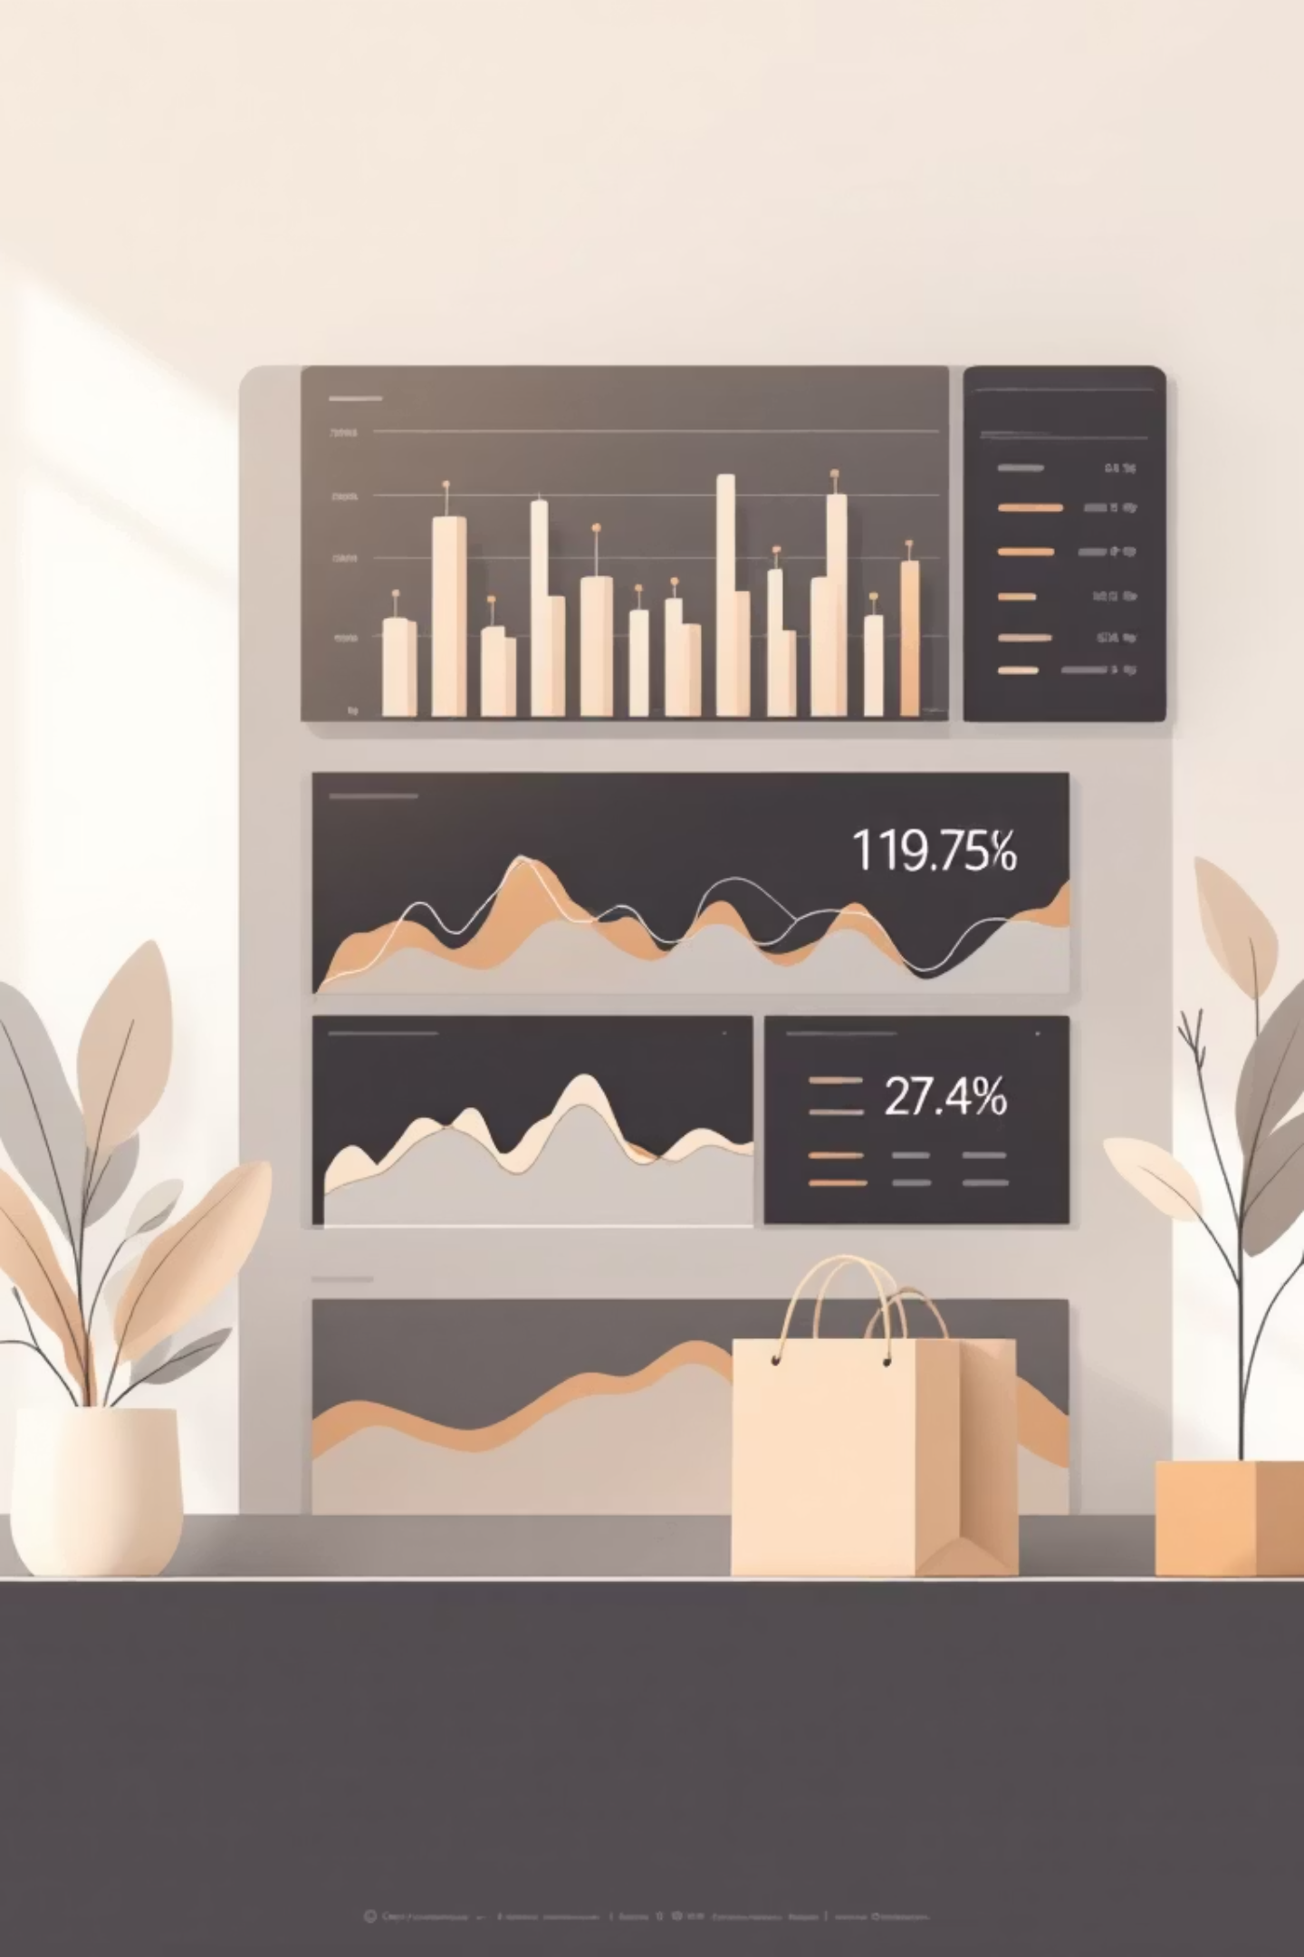
Customer Shopping Behavior Analysis
Uncovering insights from 3,900 purchases to guide strategic business decisions

Slide 2
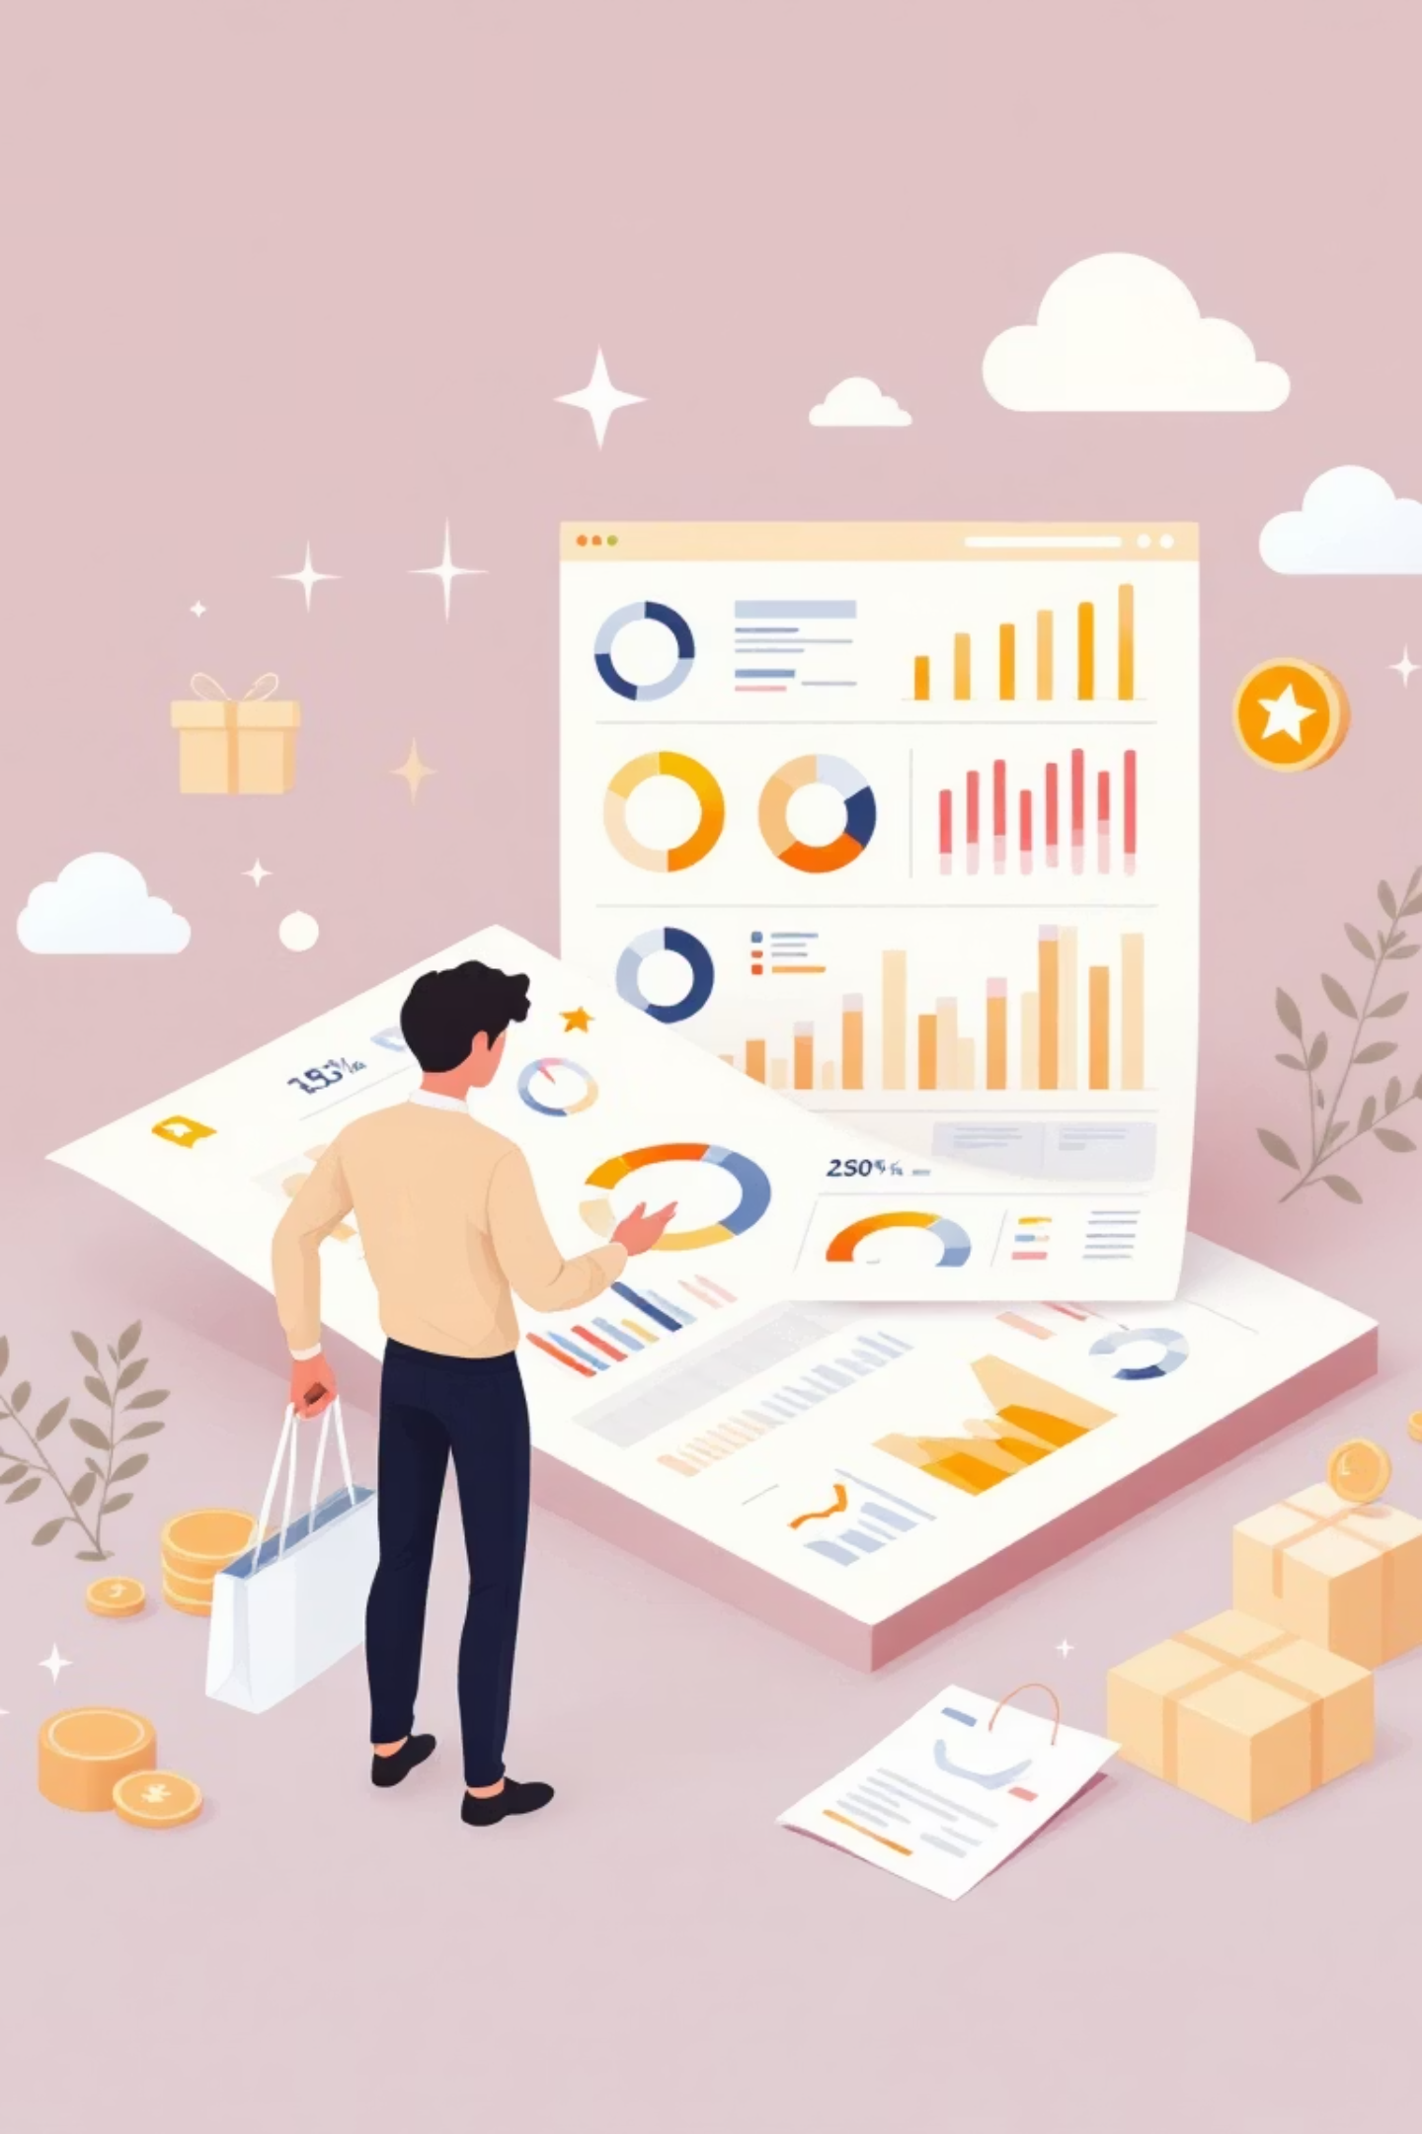
Dataset Overview
3,900
18
50
Total Purchases
Data Points
Locations
Transactions analyzed across all categories
Features covering demographics, purchases, and behavior
Geographic diversity in customer base
25
Products
Items tracked across four categories

Slide 3

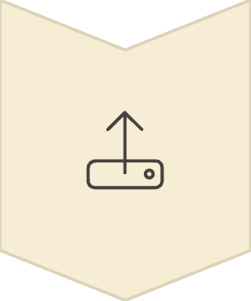



Data Preparation Journey
Data Loading
Imported dataset using pandas
Exploration
Analyzed structure and summary statistics
Cleaning
Handled missing values, standardized columns
Integration
Connected to PostgreSQL for analysis

Slide 4
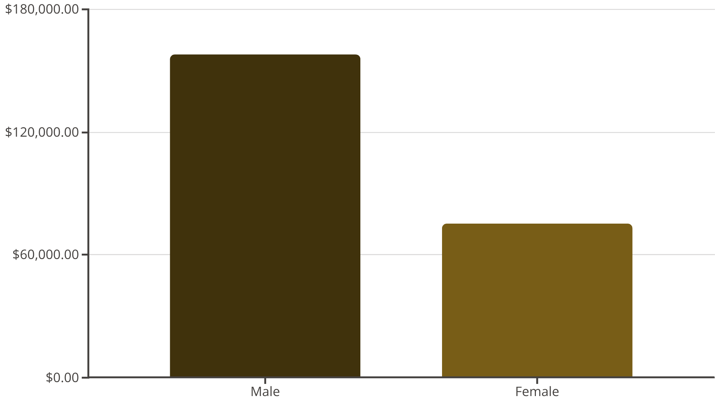
Revenue Insights
Gender Distribution
Male customers generate 68% of total revenue
Female segment represents significant growth opportunity

Slide 5
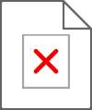
Top-Rated Products
Gloves
Sandals
Boots
3.86 rating
3.84 rating
3.82 rating
Hat
Skirt
3.80 rating
3.78 rating
Highest average review ratings across all categories

Slide 6
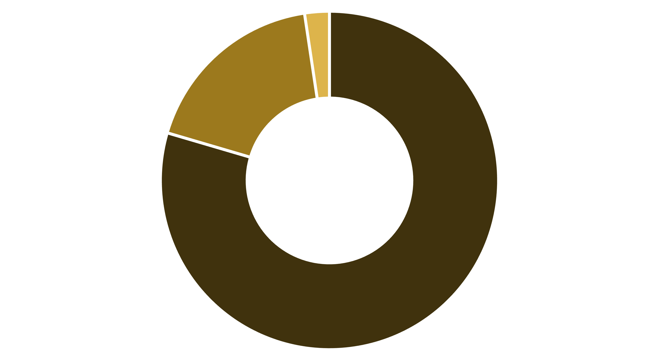
Customer Segmentation
Loyal
Returning
New
Loyal Customers
Growth Opportunity
80% of customer base shows strong retention
Convert returning buyers into loyal segment

Slide 7
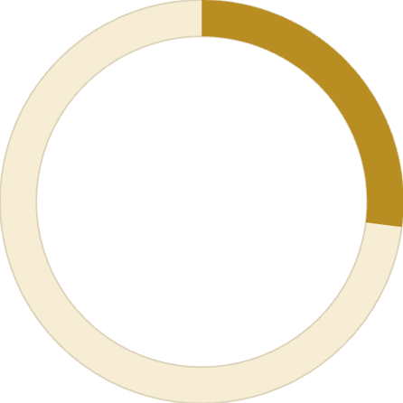


Subscription Analysis
27%
73%
Subscription Rate
Non-Subscribers
1,053 customers subscribed
2,847 customers without subscription
Spending Patterns
Subscribers: $59.49 average spend
Non-subscribers: $59.87 average spend
Minimal difference suggests untapped potential

Slide 8

Discount Strategy Insights
1
2
3
Hat
Sneakers
Coat
50% discount rate
49.66% discount rate
49.07% discount rate
4
5
Sweater
Pants
48.17% discount rate
47.37% discount rate
Key Finding: 839 customers used discounts but spent above average—balance promotions with margin control

Slide 9
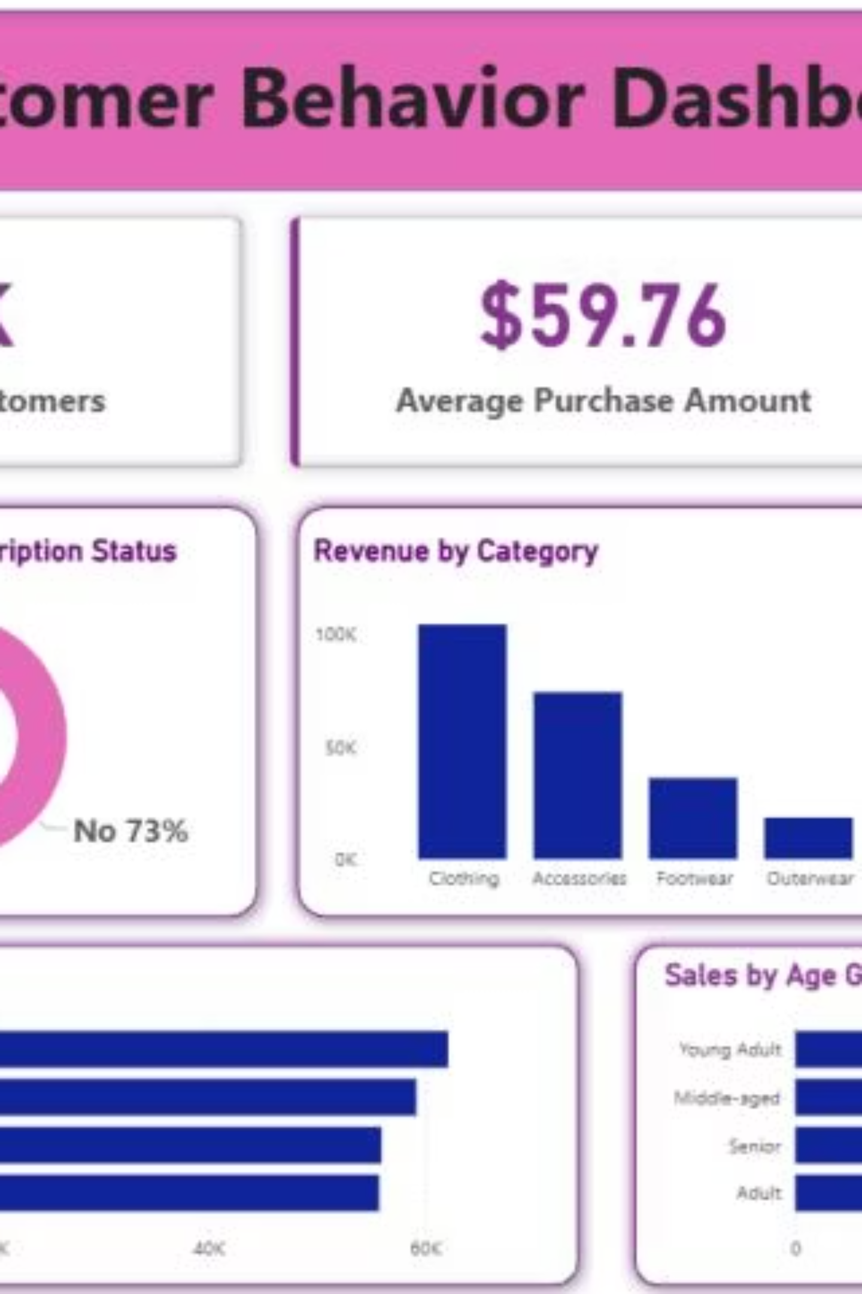
Interactive Dashboard
Power BI dashboard visualizing key metrics and trends for strategic decision-making

Slide 10
Strategic Recommendations
Boost Subscriptions
Loyalty Programs
Optimize Discounts
Promote exclusive benefits to increase 27% subscription rate
Reward repeat buyers to grow loyal segment beyond 80%
Balance sales boosts with margin control on high-discount items
Product Positioning
Targeted Marketing
Highlight top-rated products in marketing campaigns
Focus on high-revenue segments and express shipping users

