Slide 1
Video Conferencing Web App
Author Mr. Shubham Oulkar
2023-08-14

Slide 2
Objectives:
Design an intuitive and user-centric video conferencing web application that provides seamless,
high-quality virtual communication experiences, fosters collaboration, and ensures accessibility
across devices and platforms. The objective is to create a user-friendly interface, optimize audio
and video performance, integrate essential features such as screen sharing , prioritize
data security and privacy, and deliver a reliable tool that enhances remote communication for
both personal and professional users.

Slide 3
Functional Requirements :
The system must support 1-to-1 calls
Calls can be audio or video or screen sharing
User signup
Responsive Web Page design
Note: Screen share will be an extension of video call itself, only in case of video call the source of the video is the camera, whereas in screen share source of the video will be the screen.

Slide 4
Non Functional Requirements:
Should be super fast - low latency is not enough
High availability
Data loss is OK for video/audio/screen sharing
works the same in every environment

Slide 5
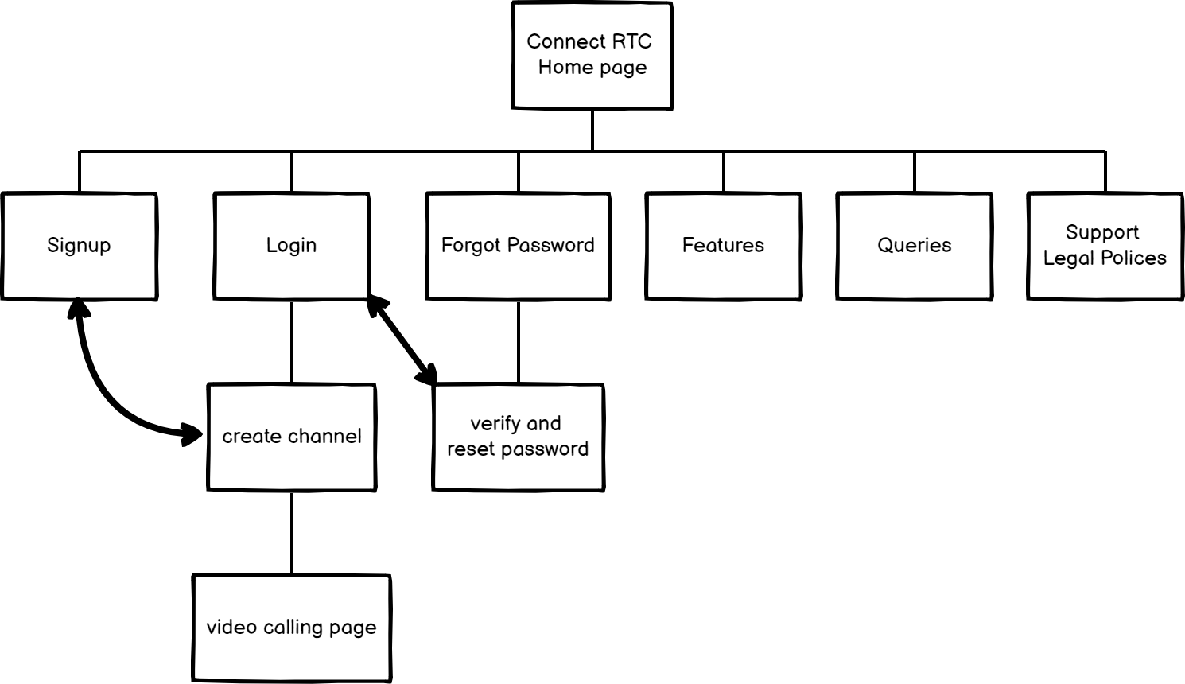
Site map: following are list of pages for a website

Slide 6
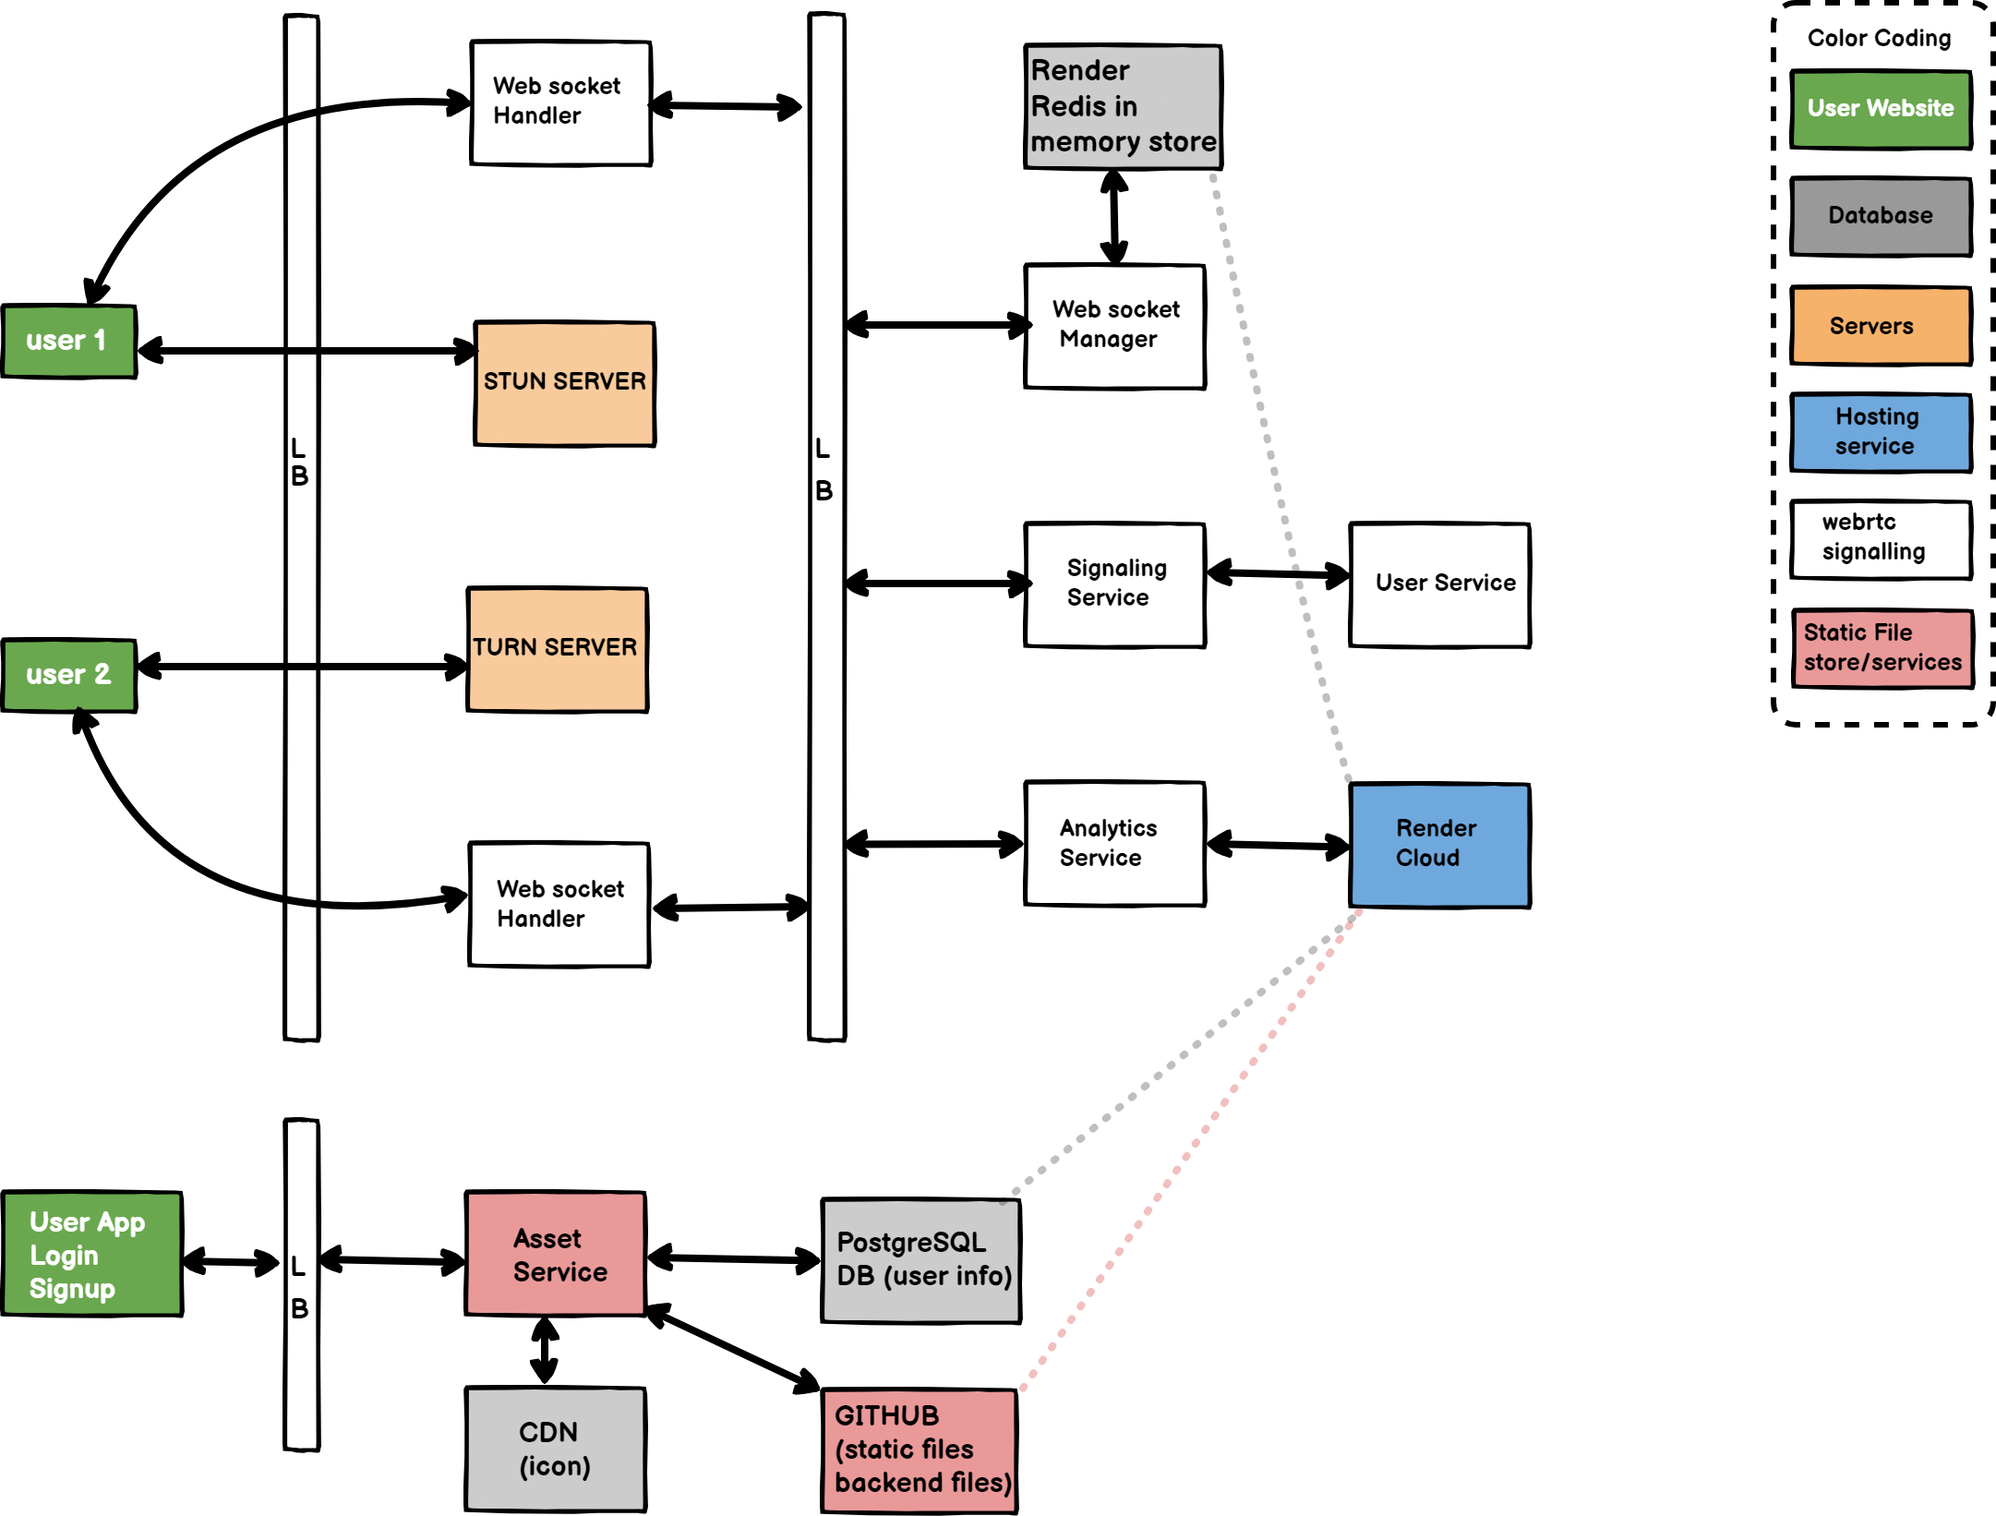
Architecture:

Slide 7
How Webrtc works

Slide 11












Reference:
https://developer.mozilla.org/en-US/docs/Web/API/WebRTC_API
https://webrtcforthecurious.com/docs/01-what-why-and-how
Technology Used:
UI design tools used:

