Slide 1

AIZEN
Agentic AI: Intelligent Task Execution System
"Type one command. Get a workspace that feels alive."
MAJOR PROJECT REPORT — VIVA PRESENTATION
Shubham Paithane [2303051051245] • Adarsh Singh Rajput [2303051051092]
Guided by Mr. Meet Kumar Patel, Assistant Professor, CSE
Parul Institute of Technology, Parul University, Vadodara | Session AY 2026-2027

Slide 2



THE PROBLEM
Every project still starts the same way
Open a folder, pick a stack, wire up configuration
The same boilerplate gets rebuilt before the part that was actually the point even begins.
AI autocomplete gets you a suggestion, not a project
The developer still owns the project structure, the stack choice, and actually running what was written.
That overhead repeats on every build
Hackathons, prototypes, and personal projects all lose the same setup time — every single time.
02

Slide 3


OBJECTIVES
What Aizen set out to prove
Six concrete objectives guided the build, moving the minor project from a diagram-level idea to a system that is directly testable: a build request either produces a running project, or a clear, logged error explaining why not.
Classify intent reliably
Route each instruction to a conversational reply, a new build, or a refinement.
Generate real, multi-stack projects
React, Flask, Node/Express, Python, Java, C++, PHP and plain HTML — not one hard-coded template.
Let the agent correct its own output
A bounded tool-use loop lists, reads, rewrites and runs files instead of generating once and stopping.
03

Slide 4
MINOR PROJECT → MAJOR PROJECT
From a diagram to a working system
MINOR PROJECT
MAJOR PROJECT — AIZEN
Implementation
Implementation
Diagram-level design only; nothing was built or demonstrated.
A complete working web app, built and used with real prompts.
Technology stack
Technology stack
Proposed only — no backend, frontend, or database.
Flask + Groq backend, React + Vite frontend, JWT auth, SQLite.
Agent behaviour
Agent behaviour
Single-pass planning, described conceptually.
A bounded tool-use loop that inspects and corrects its own output.
Feature set
Feature set
Limited to the single task-execution loop in the proposal.
Extended with a dedicated SQL Assistant — English to SQL.
04

Slide 5








TECHNOLOGY STACK
Built on a modern, practical stack
React
Vite
Flask
SQLite
Frontend UI
Build tooling
Backend REST / SSE API
Users & chat history
Tailwind CSS
Groq LLM API
JWT + bcrypt
Monaco Editor
Design-token styling
Model-backed generation
Authentication
In-browser code editor
05

Slide 6
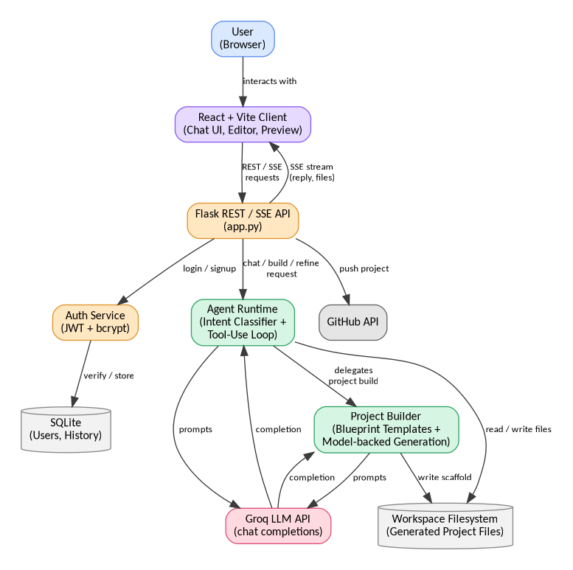
SYSTEM DESIGN
System architecture
One instruction flows from the React client through the Flask API to the Agent Runtime, which delegates to the Project Builder and the Groq LLM API, then streams files back as a live artifact.
06

Slide 7





IMPLEMENTATION
Twelve modules, one workspace
Authentication
Intent Classification
Project Builder
Sign-up/login, JWT issuance, bcrypt hashing, per-user history.
Routes each instruction to chat, create, or refine.
Model-backed generation across ten blueprint stacks.
NEW
Agent Tool-Execution Loop
Live Preview & Code Editor
SQL Assistant
Bounded list / read / write / run loop that polishes output.
Monaco-based editor with save support and instant preview.
English question → runnable SQL query + explanation.
07

Slide 8

NEW THIS MAJOR PROJECT
SQL Assistant
A dedicated panel that turns a plain-English question — with an optional table schema and target dialect — into a ready-to-run SQL query and a plain-English explanation.
→
→
Ask in plain English
Groq model, narrowed by prompt
SQL + explanation out
"Show total orders per customer in the last 30 days"
One dedicated system prompt + a strict JSON output contract
Syntax-highlighted query, ready to run
Prompt-based specialization, not fine-tuning. The same Groq-hosted model used for chat is narrowed to this one job through a dedicated system prompt and a strict output contract — the practical substitute for training a separate model, used throughout this project.
08

Slide 9

WORKFLOW
One instruction, start to finish
1
2
3
4
5
→
→
→
→
Type one instruction
Intent is classified
Model-backed generation
Agent loop refines it
Streamed to chat
A single natural-language request.
Routed to chat, build, or refine.
Structured project across blueprints.
List / read / rewrite / run, bounded.
Files land as a live, editable artifact.
09

Slide 10
OUTCOMES
What shipped
10
12
10s
1-click
Blueprint stacks supported
Modules shipped
Sandboxed execution limit
GitHub deployment
"Success is directly testable: a build request either produces a running project, or a clear, logged error explaining why not."
10

Slide 11


WRAPPING UP
Where Aizen stands, and what’s next
Conclusion
Future Scope
All six objectives met: classification, multi-stack generation with fallback, an iterative agent loop, and an integrated browser workspace.
Smarter fallback & self-healing Retry with an alternate model or narrower prompt on failure.
Multi-agent collaboration A writer agent and an adversarial checker agent, paired.
A real silent-failure bug — a missed intent phrasing plus a swallowed model-call error — taught more about dependable agent design than the original design phase did.
Stronger execution sandboxing Run code in an isolated container, not the host process.
Answers the minor project’s open question: an agentic, tool-using approach holds up under real use when failure paths are treated as first-class.
Team sharing & mobile client Real-time collaboration and a responsive mobile UI.
11

Slide 12
Thank You
Questions & Discussion
Shubham Paithane [2303051051245] • Adarsh Singh Rajput [2303051051092]
Guided by Mr. Meet Kumar Patel, Assistant Professor, CSE
Department of Computer Science & Engineering, Parul Institute of Technology

