Slide 1
Multivariate Methods
Slides from Machine Learning by Ethem Alpaydin
Expanded by some slides from Gutierrez-Osuna

Slide 2
Overview
We learned how to use the Bayesian approach for classification if we had the probability distribution of the underlying classes (p(x|C_{i})).
We have seen ML estimation for simpler distributions
Now we will see ML estimation for multivariate Gaussian and the corresponding Bayes classifier

Slide 3
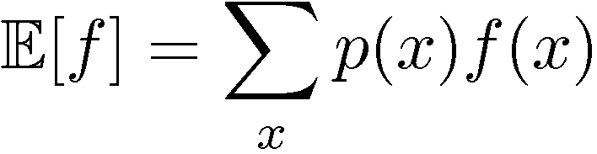
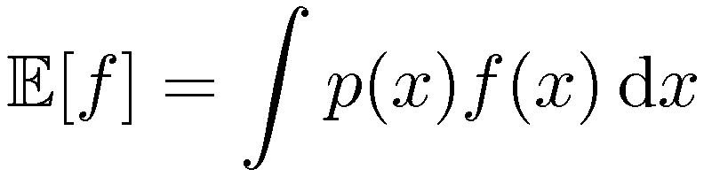
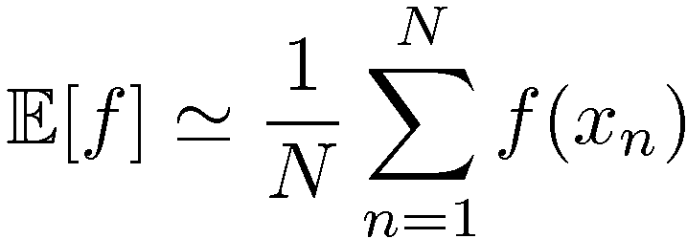
Expectations
The average value of a function f(x) under a probability distribution p(x) is called the expectation of f(x).
Average is weighted by the relative probabilities of different values of x.
Approximate expectation:
(discrete and continuous)
In other words, if we have some samples x from a given distribution along with f(x) values, we can estimate the expected value of f(x) by computing its average over the samples obtained from this distribution. Note that there will be more samples in the data set where p(x) is larger and fewer samples where p(x) is smaller; hence we do not need p(x) anymore.
Now we are going to look at concepts: variance and co-variance, of one or more random variables, using the concept of expectation.

Slide 4
Variance and Covariance
The variance of f(x) provides a measure for how much f(x) varies around its mean E[f(x)].
Given a set of N points {x_{i}} in the1D-space, the variance of the corresponding random variable x is var[x] = E[(x-μ)²] where μ=E[x].
You can estimate the expected value as
var(x) = E[(x-μ)²] ≈ 1/N Σ (x_{i}-μ)²
^{x}_{i}
Remember the definition of expectation:

Slide 5
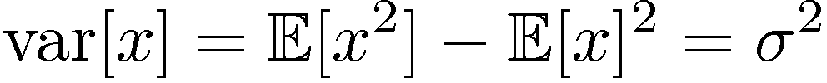
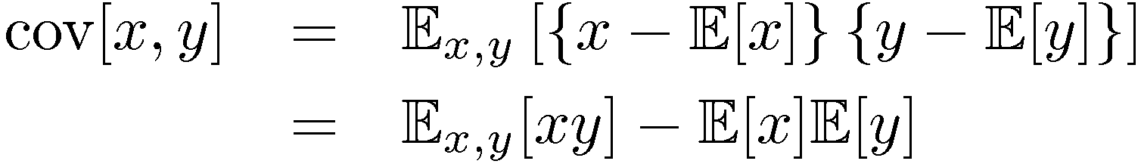
Variance and Covariance
The variance of x provides a measure for how much x varies around its mean μ=E[x].
var(x) = E[(x-μ)²]
Co-variance of two random variables x and y measures
the extent to which they vary together.

Slide 6
Multivariate Normal Distribution

Slide 7
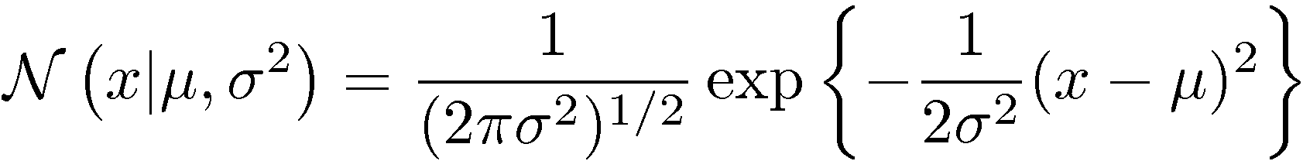
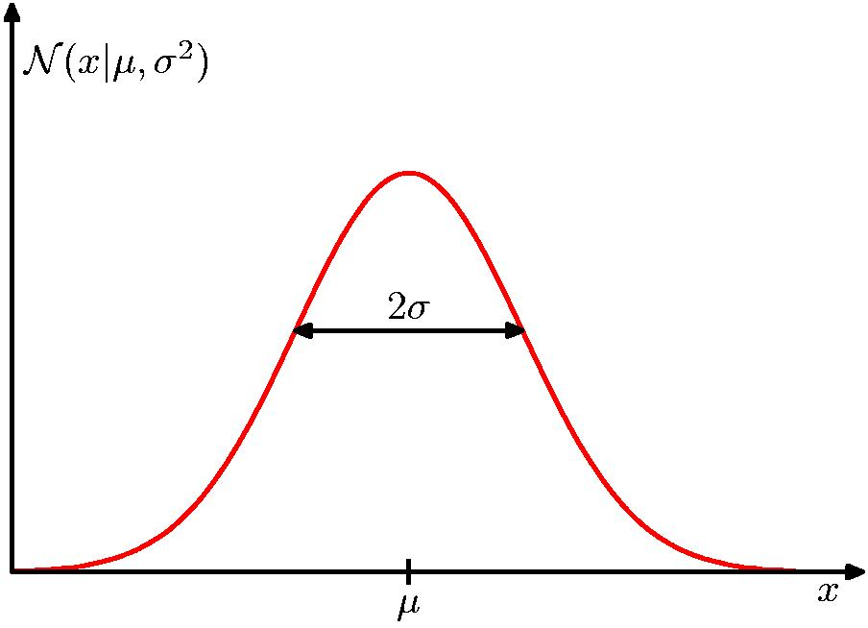
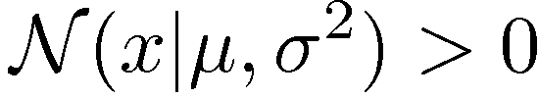
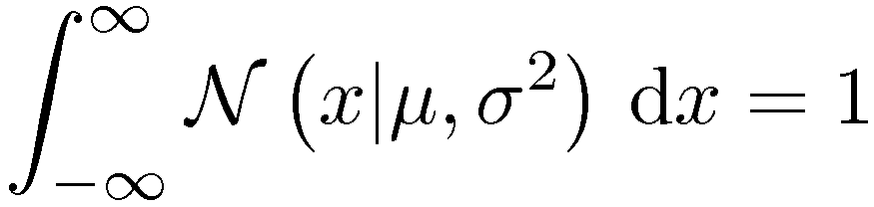
The Gaussian Distribution

Slide 8
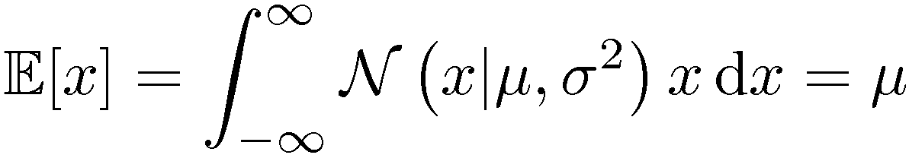
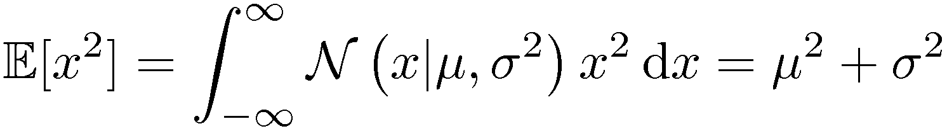
Expectations
For normally distributed x:

Slide 9
Assume we have a d-dimensional input (e.g. 2D), x.
We will see how can we characterize p(x), assuming x is normally distributed.
  For 1-dimension it was the mean (μ) and variance (σ²)
    Mean=E[x]
    Variance=E[(x - μ)²]
  For d-dimensions, we need
    the d-dimensional mean vector
    dxd dimensional covariance matrix
  If x ~ N_{d}(μ,Σ) then each dimension of x is univariate normal
    Converse is not true

Slide 10


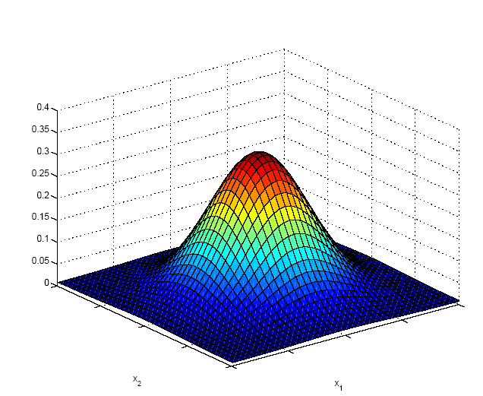

Normal Distribution &
Multivariate Normal Distribution
For a single variable, the normal density function is:
For variables in higher dimensions, this generalizes to:
where the mean μ is now a d-dimensional vector,
  Σ is a d x d covariance matrix
  |Σ| is the determinant of Σ:

Slide 11
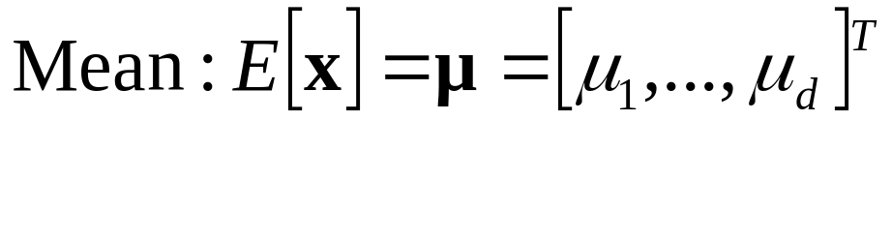
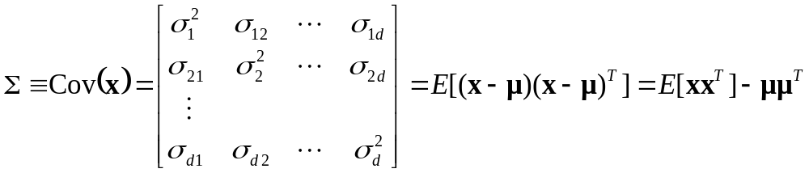
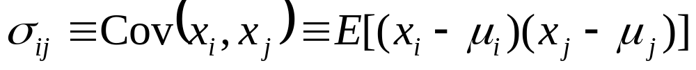
Multivariate Parameters: Mean, Covariance

Slide 12
Matlab code
close all;
rand('twister', 1987) % seed
%Define the parameters of two 2d-Normal distribution
mu1 = [5 -5];
mu2 = [0 0];
sigma1 = [2 0; 0 2];
sigma2 = [5 5; 5 5];
N=500; %Number of samples we want to generate from this distribution
samp1 = mvnrnd(mu1,sigma1, N);
samp2 = mvnrnd(mu2, sigma2, N);
figure; clf;
plot(samp1(:,1), samp1(:,2),'.', 'MarkerEdgeColor', 'b');
hold on;
plot(samp2(:,1), samp2(:,2),'*', 'MarkerEdgeColor', 'r');
axis([-20 20 -20 20]); legend('d1', 'd2');

Slide 13
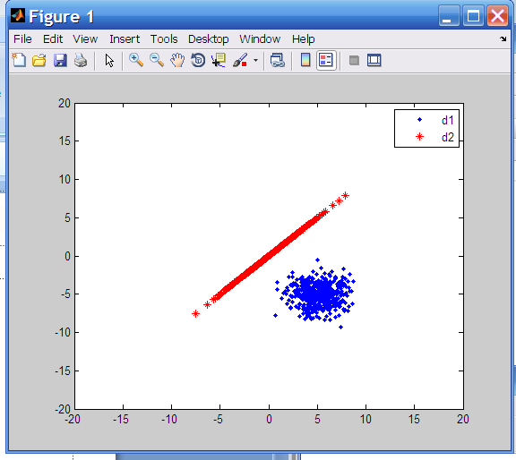
mu1 = [5 -5];
mu2 = [0 0];
sigma1 = [2 0; 0 2];
sigma2 = [5 5; 5 5];

Slide 14
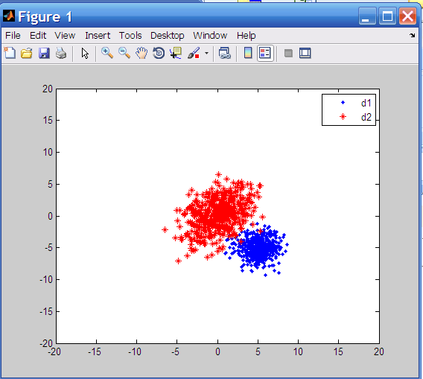
mu1 = [5 -5];
mu2 = [0 0];
sigma1 = [2 0; 0 2];
sigma2 = [5 2; 2 5];

Slide 15
Matlab sample cont.
% Lets compute the mean and covariance as if we are given this data
sampmu1 = sum(samp1)/N;
sampmu2 = sum(samp2)/N;
sampcov1 = zeros(2,2);
sampcov2 = zeros(2,2);
for i =1:N
sampcov1 = sampcov1 + (samp1(i,:)-sampmu1)' * (samp1(i,:)-sampmu1);
sampcov2 = sampcov2 + (samp2(i,:)-sampmu2)' * (samp2(i,:)-sampmu2);
End
sampcov1 = sampcov1 /N;
sampcov2 = sampcov2 /N;
%%%%%%%%%%%%%%%%%%%%%%%%%%%%%%%%%%%%%%%%%%%%%%%%%%%%%%%%
% Lets compute the mean and covariance as if we are given this data USING MATRIX OPERATIONS
% Notice that in samp1, samples are given in ROWS – but for this multiplication, columns * rows is req.
sampcov1 = (samp1'*samp1)/N - sampmu1'*sampmu1;
%Or simply
mu=mean(samp1);
cov=cov(samp1);

Slide 16
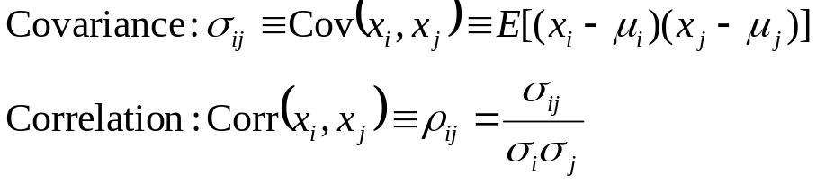
Variance: How much X varies around the expected value
Covariance is the measure the strength of the linear relationship between two random variables
  covariance becomes more positive for each pair of values which differ from their mean in the same direction
  covariance becomes more negative with each pair of values which differ from their mean in opposite directions.
  if two variables are independent, then their covariance/correlation is zero (converse is not true).
Correlation is a dimensionless measure of linear dependence.
  range between –1 and +1

Slide 17
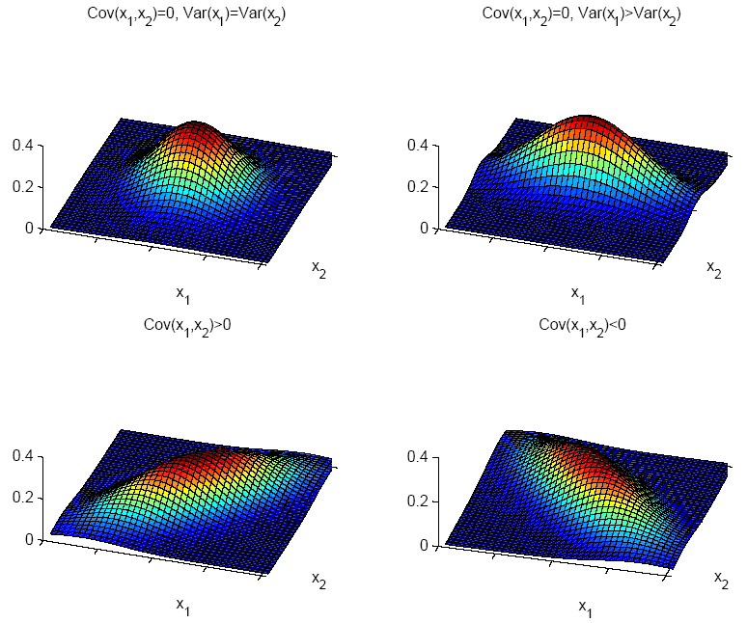
How to characterize differences between these distributions

Slide 18
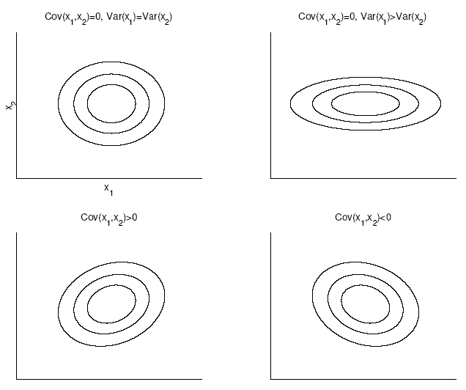
Covariance Matrices

Slide 19
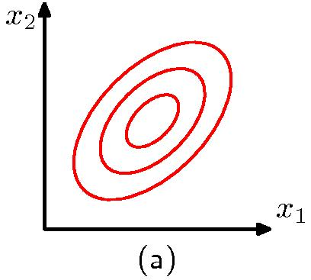
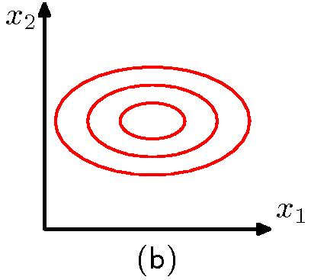
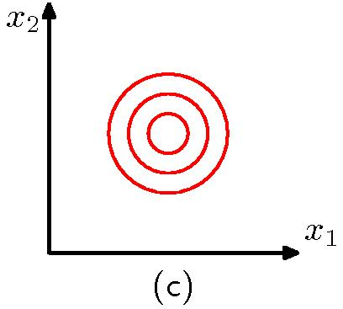
Contours of constant probability density for a 2D Gaussian distributions with
a) general covariance matrix
b) diagonal covariance matrix (covariance of x1,x2 is 0)
c) Σ proportional to the identity matrix (covariances are 0, variances of each dimension are the same)

Slide 20
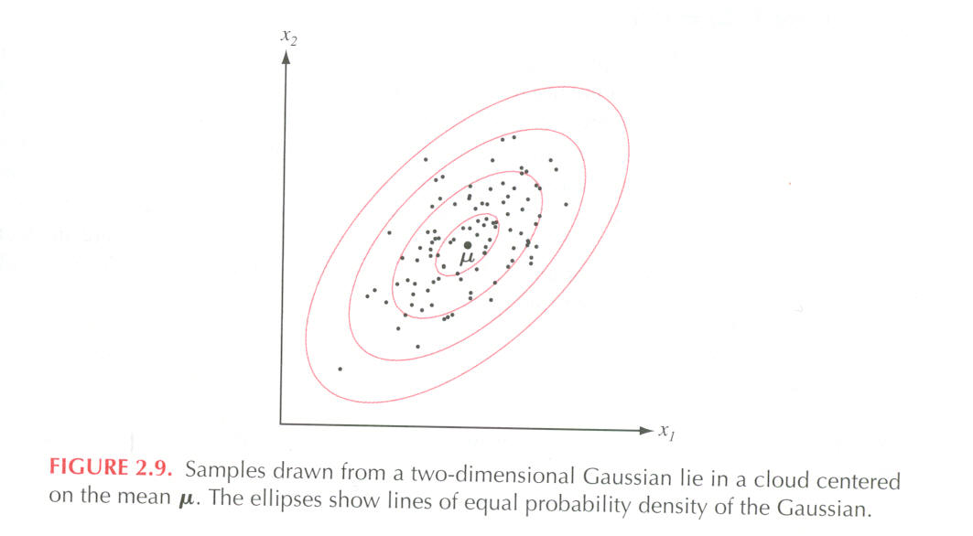
Shape and orientation of the hyper-ellipsoid centered at μ is defined by Σ
v₂
v₁

Slide 21
Properties of Σ
A small value of |Σ| (determinant of the covariance matrix) indicates that samples are close to μ
Small |Σ| may also indicate that there is a high correlation between variables
If some of the variables are linearly dependent, or
if the variance of one variable is 0, then Σ is singular and |Σ| is 0.
    Dimensionality should be reduced to get a positive definite matrix
    Advanced:
      The covariance matrix of a multivariate probability distribution is always positive semi-definite unless one variable is an exact linear combination of the others.
      Conversely, every positive semi-definite matrix is the covariance matrix of some multivariate distribution.

Slide 22

Positive Semi-Definite-Advanced
The covariance matrix Σ is symmetric and positive semi-definite
An n × n real symmetric matrix M is positive definite
if z^{T}Mz > 0 for all non-zero vectors z with real entries.
An n × n real symmetric matrix M is positive semi-definite
if z^{T}Mz >= 0 for all non-zero vectors z with real entries.
Comes from the requirement that the variance of each dimension is >= 0 and that the matrix is symmetric.
When you randomly generate a covariance matrix, it may violate this rule
  Test to see if all the eigenvalues are >= 0
  Higham 2002 – how to find nearest valid covariance matrix
  Set negative eigenvalues to small positive values

Slide 23
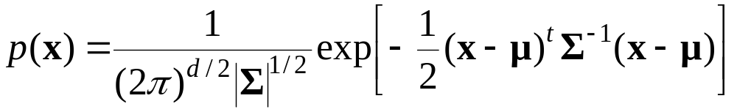
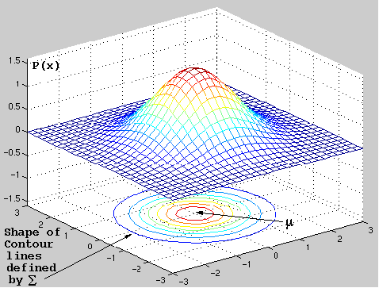


Mahalanobis Distance
From the equation for the normal density, it is apparent that points
which have the same density must have the same constant term:
Mahalanobis distance measures the distance from x to μ in terms of ∑

Slide 24
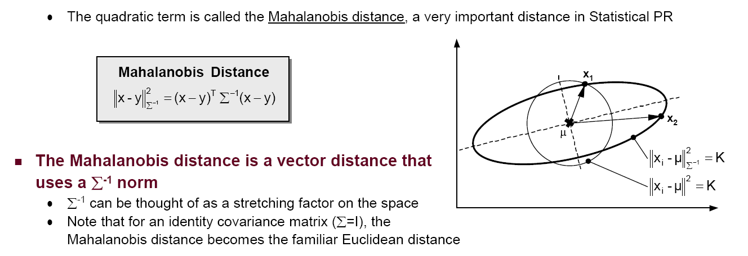
Points that are the same distance from μ
The
The ellipse consists of points that are equi-distant to the center w.r.t. Mahalanobis distance.
The circle consists of points that are equi-distant to the center w.r.t. The Euclidian distance.

Slide 25
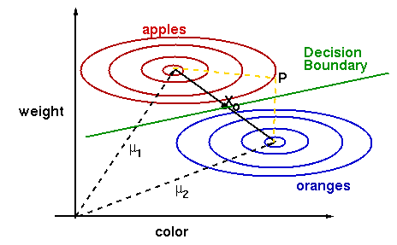
Why Mahalanobis Distance
It takes into account the covariance of the data.
Point P is at closer to the mean for the orange class when considering the Euclidean distance, but using the Mahalanobis distance, it is found to be closer to 'apple‘ class.

Slide 26
Parameter Estimation for Multivariate Gaussian

Slide 27
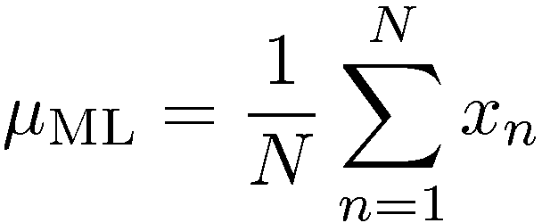
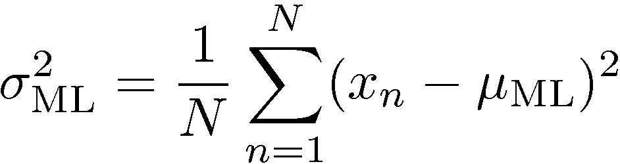
Maximum (Log) Likelihood for a 1D-Gaussian
In other words, maximum likelihood estimates of mean and variance are the same as sample mean and variance.

Slide 28
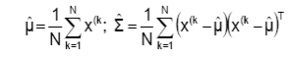
Maximum (Log) Likelihood for Multivarate Case
Similarly, it can be shown that the ML estimates for the multivariate Gaussian are also the sample mean vector and the sample covariance matrix:

Slide 29
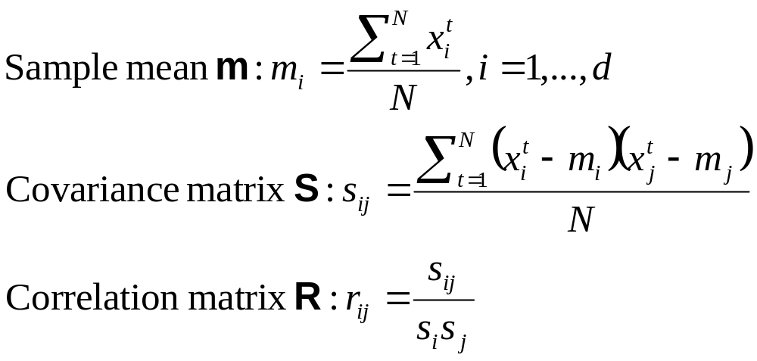
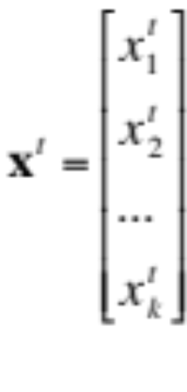
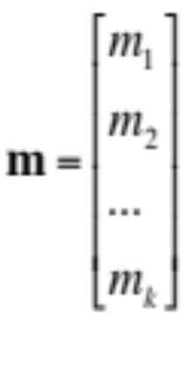
Sample Mean and Variance for Multivariate Case
Where N is the number of data points x^{t}:

Slide 30
Parametric Classification
We will use the Bayesian decision criteria applied to normally distributed classes, whose parameters are either known or estimated from the sample.

Slide 31
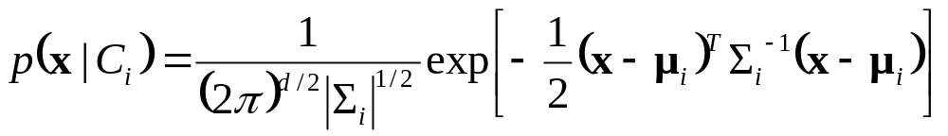
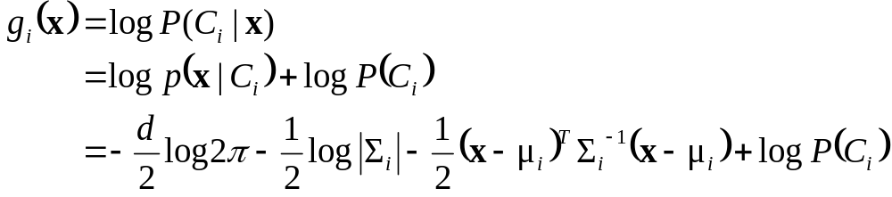
Parametric Classification
If p (x | C_{i} ) ~ N ( μ_{i} , ∑_{i} )
Discriminant functions are:

Slide 32
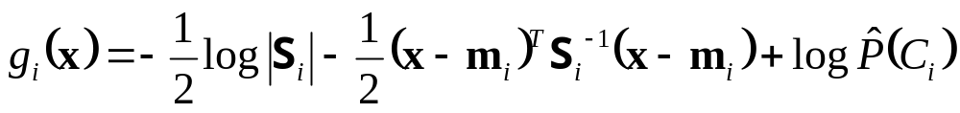
Estimation of Parameters
If we estimate the unknown parameters from the sample,
the discriminant function becomes:

Slide 33
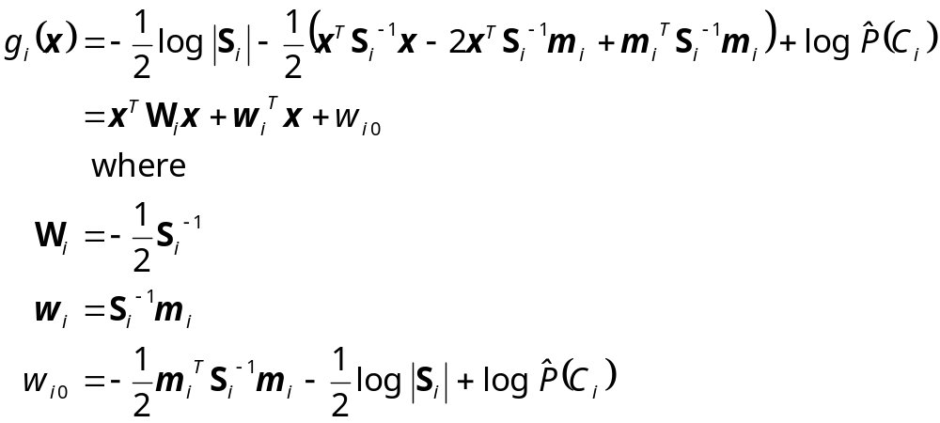
Case 1) Different S_{i} (each class has a separate variance)
ADVANCED
if we group the terms, we see that there are
second order terms,
which means the discriminant is quadratic.

Slide 34
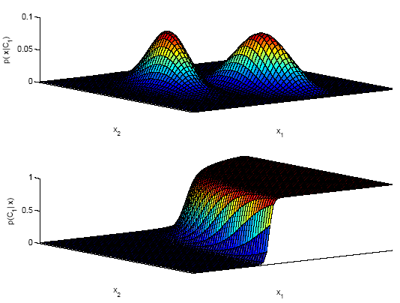
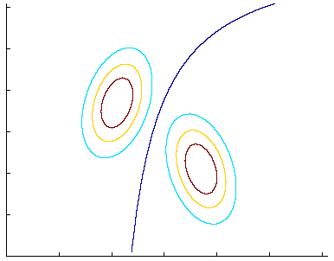
discriminant:
P (C₁|x ) = 0.5
likelihoods
posterior for C₁

Slide 35
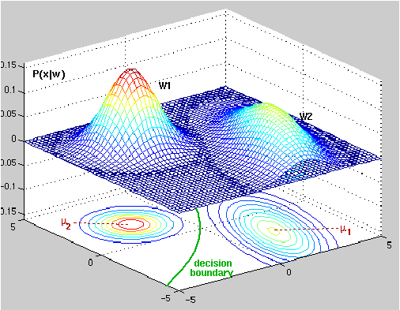
Two bi-variate normals, with completely different covariance matrix,
showing a hyper-quadratic decision boundary.

Slide 36
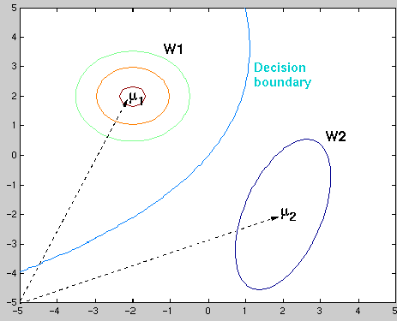

Slide 37
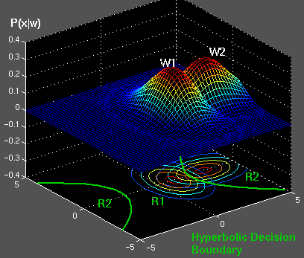
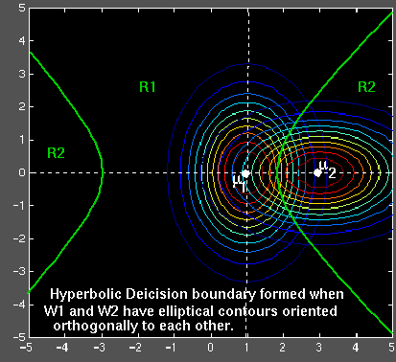
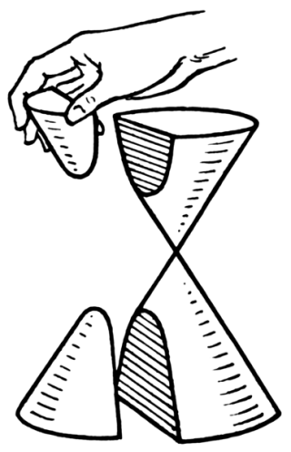
Hyperbola: A hyperbola is an open curve with two branches, the intersection of a plane with both halves of a double cone. The plane may or may not be parallel to the axis of the cone (from Wikipedia).

Slide 38
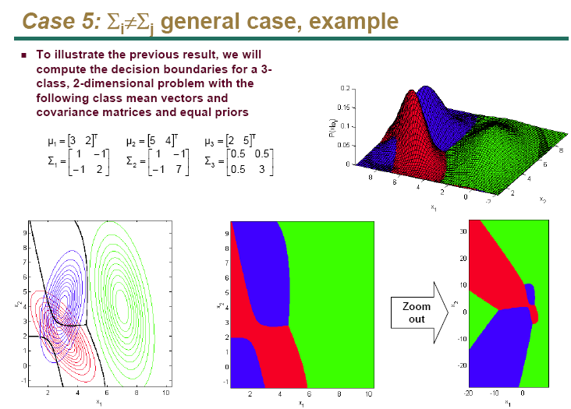

Slide 39
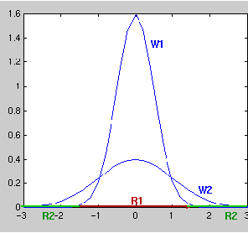
Typical single-variable normal distributions showing a disconnected
decision region R₂

Slide 40
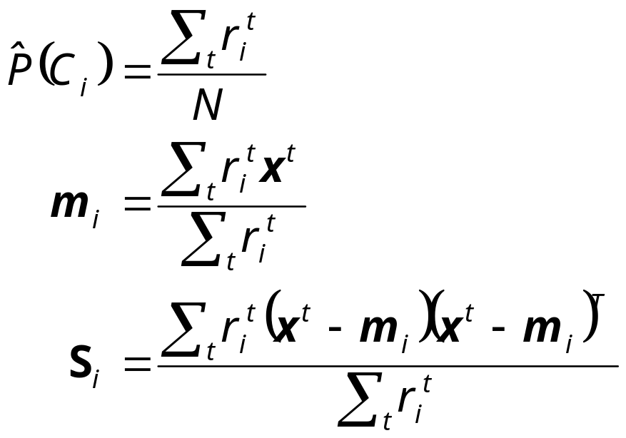

Notation: Ethem book
Using the notation in Ethem book, the sample mean and sample covariance… can be estimated as follows:
where is 1 if the tth sample belongs to class i

Slide 41
If d (dimension) is large with respect to N (number of samples), we may have a problem with this approach:
  | Σ | may be zero, thus Σ will be singular (inverse does not exist)
  | Σ | may be non-zero, but very small, instability would result
    Small changes in Σ would cause large changes in Σ⁻¹
Solutions:
  Reduce the dimensionality
    Feature selection
    Feature extraction: PCA
  Pool the data and estimate a common covariance matrix for all classes
Σ = Σ_{i} P(C_{i}) * Σ_{i}

Slide 42
Now we make an assumption that the covariance matrix is the same for all classes
to simplify things and with the hope of estimating Σ more reliably.

Slide 43
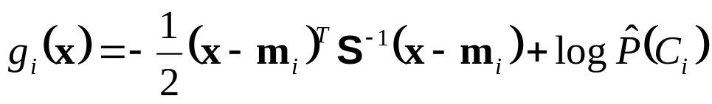
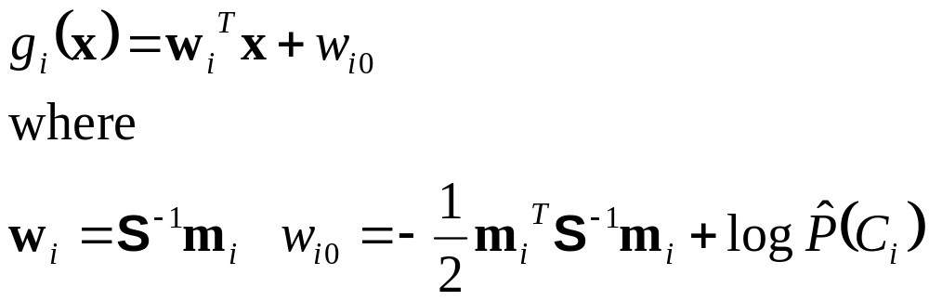
Case 2) Common Covariance Matrix S=S_{i}
Shared common sample covariance S
  An arbitrary covariance matrix – but shared between the classes
We had this full discriminant function:
which now reduces to “no subscript i for S“:
  which is a linear discriminant

Slide 44
Linear discriminant:
  Decision boundaries are hyper-planes
  Convex decision regions:
    All points between two arbitrary points chosen from one decision region belongs to the same decision region
If we further assume equal class priors, the classifier becomes a minimum Mahalanobis classifier

Slide 45

Case 2) Common Covariance Matrix S
Linear discriminant

Slide 46


Slide 47



Slide 48

Unequal priors shift the decision boundary towards the less likely class, as before.

Slide 49


Slide 50
Now we make a further assumption:
S is shared between classes AND
S is diagonal

Slide 51


Case 3) Common Covariance Matrix S which is Diagonal
In the previous case, we had a common, general covariance matrix, resulting in these discriminant functions:
When x_{j} (j = 1,..d) are independent, ∑ is diagonal
Classification is done based on weighted Euclidean distance (in s_{j} units) to the nearest mean.
Naive Bayes classifier where p(x_{j}|C_{i}) are univariate Gaussian
p (x|C_{i}) = ∏_{j} p (x_{j} |C_{i}) (Naive Bayes’ assumption)

Slide 52

Case 3) Common Covariance Matrix S which is Diagonal
variances may be
different

Slide 53


Slide 54

Case 4) Common Covariance Matrix S which is Diagonal + equal variances
We had this before (S which is diagonal):
If the priors are also equal, we have the Nearest Mean classifier: Classify based on Euclidean distance to the nearest mean!
Each mean can be considered a prototype or template and this is template matching

Slide 55

Case 4) Common Covariance Matrix S which is Diagonal + equal variances
*
?

Slide 56

Case 4) Common Covariance Matrix S which is Diagonal + equal variances

Slide 57

A second example where the priors have been changed:
The decision boundary has shifted away from the more likely class,
although it is still orthogonal to the line joining the 2 means.

Slide 58


Slide 59

Case 5: S_{i}=σ_{i}²I

Slide 60
Model Selection
As we increase complexity (less restricted S), bias decreases and variance increases
Assume simple models (allow some bias) to control variance (regularization)
Assumption | Covariance matrix | No of parameters
Shared, Hyperspheric | S_{i}=S=s²I | 1
Shared, Axis-aligned | S_{i}=S, with s_{ij}=0 | d
Shared, Hyperellipsoidal | S_{i}=S | d(d+1)/2
Different, Hyperellipsoidal | S_{i} | K d(d+1)/2

Slide 61
Estimation of Missing Values
What to do if certain instances have missing attributes?
  Ignore those instances: not a good idea if the sample is small
  Use ‘missing’ as an attribute: may give information
  Imputation: Fill in the missing value
    Mean imputation: Use the most likely value (e.g., mean)
    Imputation by regression: Predict based on other attributes
Another important problem is sensitivity due to outliers

Slide 62
Tuning Complexity
When we use Euclidian distance to measure similarity, we are assuming that all variables have the same variance and that they are independent
  E.g. Two variables age and yearly income
When these assumptions don’t hold,
  Normalization may be used (use PCA, whitening, make each dimension zero mean and unit variance…) to use Euclidian distance
  We may still want to use simpler models in order to estimate the related parameters more accurately

Slide 63
Conclusions
The Bayes classifier for normally distributed classes is a quadratic classifier
The Bayes classifier for normally distributed classes with equal covariance matrices is a linear classifier
The minimum Mahalanobis distance is Bayes-optimal for
  Normally distributed classes, having
  Equal covariance matrices and
  Equal priors
The minimum Euclidian distance is Bayes-optimal for
  Normally distributed classes -and-
  Equal covariance matrices proportional to the identity matrix–and-
  Equal priors
Both Euclidian and Mahalanobis distance classifiers are linear classifiers

Slide 64


PRTOOLS
load nutsbolts; //an existing Prtools dataset with 4 classes
w1=ldc(z); //linear Bayes Normal classifier
w2=qdc(z); //quadratic Bayes Normal classifier
figure(1); scatterd(z); hold on; plotc(w1);
figure(2); scatterd(z); hold on; plotc(w2);

Slide 65


Slide 66


>> A = gendath([50 50]); //Generate data with 2 classes x 50 samples each
>> [C,D] = gendat(A,[20 20]); //Split 20 as C=train; rest becomes D=test
>> W1 = ldc(C); //linear
>> W2 = qdc(C); //quadratic
>> figure(5); scatterd(C); hold on; plotm(W2);

Slide 67

scatterd(A); //scatter plot
plotc({W1,W2});

Slide 68


Slide 69


Slide 70

error on test: 9.5%

Slide 71

error on test: 11.5%

Slide 72

with N=20 points

Slide 73


Slide 74


Slide 75


Slide 76


Slide 77


Slide 78


Slide 79
Eigenvalue Decomposition of the Covariance Matrix
Will not be covered

Slide 80
Eigenvector and Eigenvalue
Given a linear transformation A, a non-zero vector x is defined to be an eigenvector of the transformation if it satisfies the eigenvalue equation
  Ax = λ x for some scalar λ.
In this situation, the scalar λ is called an eigenvalue of A corresponding to the eigenvector x.
(A- λI)x=0 => det(A- λI) must be 0.
  Gives the characteristic polynomial whore roots are the eigenvalues of A

Slide 81


Eigenvalues of the covariance matrix
The covariance matrix is symmetrical and it can always be
diagonalized as:
where
is the column matrix consisting of the eigenvectors of Σ,
Φ^{T}=Φ⁻¹ and
Λ is the diagonal matrix whose elements are the eigenvalues of Σ.

Slide 82




Contours of equal Mahalanobis distance:
Define x’= Φ^{T}x. The coordinates of x’ are equal to ν_{k}^{T}x, k=1,2,…,l
that is, the projections of x onto the eigenvectors.
Thus all points having the same Mahalabonis distance from a specific point are located on an ellipse with center of mass at μ_{i},
and the principle axes are aligned with the corresponding eigenvectors and have lengths

Slide 83


Slide 84
Eigenvalue decomposition of the covariance matrix is very useful:
  PCA
  Decorrelate data (Whitening transform)
  …

Slide 85


Matrix Transpose
Given the matrix A, the transpose of A is the , denoted A^{T}, whose columns are formed from the corresponding rows of A.
Some properties of transpose
  (A^{T})^{T} = A
  (A + B)^{T} = A^{T} + B^{T}
  (rA)^{T} = rA^{T} where r is any scalar.
  (AB)^{T} = B^{T}A^{T}
  A^{T}B=B^{T}A where A and B are vectors
  …

Slide 86
Matrix Derivation
If y = x^{T}Ax where A is a square matrix
  ∂y/∂x = Ax + A^{T} x
If y = x^{T}Ax and A is symmetric
  ∂y/∂x = 2Ax.
If y = x^{T}x
  ∂y/∂x = 2x.

Slide 87
If x ~ N_{d}(μ,Σ) then each dimension of x is univariate normal
  Converse is not true – counterexample?
The projection of a d-dimensional normal distribution onto the vector w is univariate normal
  w^{T}x ~ N (w^{T}μ, w^{T}Σw)
More generally, when W is a dxk matrix with k < d,
then the k-dimensional Wx is k-variate normal with:
  W^{T}x ~ N_{k}(W^{T}μ, W^{T}ΣW)

Slide 88
Univariate normal – transformed x
E[w^{T}x] = w^{T} E[x] = w^{T} μ
Var[w^{T}x] = E[ (w^{T}x - w^{T} μ) (w^{T}x - w^{T} μ)^{Τ}]
= E[ (w^{T}x - w^{T} μ)²] since (w^{T}x - w^{T} μ) is a scalar
    = E[ (w^{T}x - w^{T} μ) (w^{T}x - w^{T} μ) ]
    = Ε[ w^{T}(x−μ) (x−μ)^{Τ} w ] based on slide 27.rule 5
    = w^{T}Σ w move out and use defin. of Σ

Slide 89


Slide 90
Whitening Transform
We can decorrelate variables and obtain Σ=I by using a whitening transform A_{w}=Λ^{−1/2}Φ^{T} where
  Λ is the diagonal matrix of the eigenvalues of the original distribution and
  Φ is the matrix composed of eigenvectors as its columns

