Slide 1

MOTION-BASED SMART LED LIGHTING SYSTEM

Slide 2
INTRODUCTION
Rapid growth in energy consumption demands efficient utilization of electrical power
Conventional lighting systems result in significant energy wastage due to manual control
Automation using sensor-based systems provides an effective solution
The proposed system uses a PIR sensor to detect human motion based on infrared radiation
A microcontroller processes the sensor signal and controls the LED accordingly
The system automatically switches ON the light upon motion detection and OFF after a predefined delay
Provides an energy-efficient, cost-effective, and reliable lighting solution for modern applications

Slide 3
Motivation
Need for energy-efficient lighting using motion detection and ambient light sensing
Requirement of multi-level brightness control (100%, reduced, background)
Overcome issues like false triggering and inefficient energy usage
Demand for user-configurable automated lighting systems
Applications
Smart lighting with motion + lux-based control
Street and industrial lighting with adaptive brightness levels
Security systems using motion-triggered illumination
Social Relevance
Reduces energy consumption using PWM-based dimming and lux control
Supports sustainable and smart infrastructure
Enhances user convenience and automation

Slide 4
Aim And Objective
To study motion detection using PIR sensor and ambient light sensing using lux sensor for adaptive lighting control
To design a system with multi-level brightness operation (Full, Reduced, Background) based on motion and timing logic
To implement LED dimming using PWM and microcontroller-based control logic
To develop a system with user-configurable parameters (brightness levels, lux threshold, delay timings T1 & T2)
To test and evaluate system performance based on state-based operation (OFF, FULL, REDUCED, BACKGROUND) and energy efficiency
To design and implement a motion-based LED lighting system with ambient light sensing, multi-level brightness control, and user-configurable operation

Slide 5
Literature Survey
[1] IEEE Xplore, Smart Motion-Based Lighting Systems for Energy Efficiency, 2020
[2] Passive Infrared (PIR) Sensor Datasheet, HC-SR501 Module
[3] Ambient Light Sensor Datasheet (LDR / BH1750 Lux Sensor)
[4] Texas Instruments, LED Driver Design and PWM Dimming Techniques
[5] Arduino Documentation, Microcontroller Programming and PWM Control
[6] IEEE Xplore, Adaptive Lighting Control Using Motion and Ambient Light Sensors, 2021
[7] Espressif Systems, ESP32 Technical Reference Manual
[8] ON Semiconductor, Constant Current LED Driver Design Guide
[9] PIR Motion Sensor Datasheet (Detailed)
https://www.handsontec.com/dataspecs/SR501%20Motion%20Sensor.pdf
[10] HC-SR501 Complete Datasheet (Alt Source)
https://electronilab.co/wp-content/uploads/2013/12/HC-SR501.pdf

Slide 6
Time Period Control Using Bluetooth
Purpose
To allow wireless adjustment of T1 and T2 time periods
To provide remote and user-friendly control
To achieve higher precision compared to manual knobs
To enable real-time parameter tuning without hardware changes
Working
Bluetooth functionality is implemented using the ESP32.
A mobile application sends digital time values for T1 and T2.
The ESP32 receives these values wirelessly via Bluetooth.
The received values are processed and mapped to internal timers.
When Bluetooth is active, the digital values override rotor knob settings.
Updated time periods are applied instantly during operation.
Screen reader content is loading

Slide 7
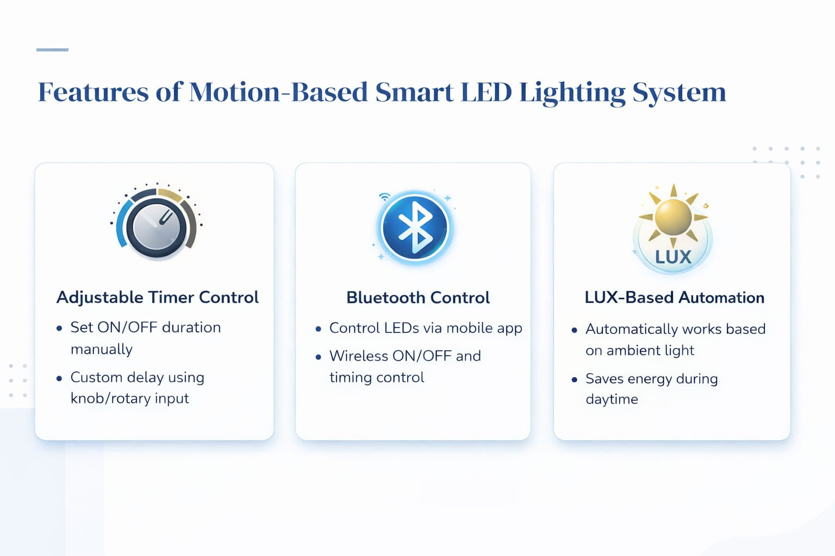

Slide 8
Time Period Control Using ROTOR
Purpose
Used for manual adjustment of T1 and T2 time periods
Provides user control without Bluetooth
Allows quick and smooth tuning of delay values
Time Period Control Using ROTOR
Working
The rotor knob is a rotary potentiometer with three terminals: VCC, GND, and output.
Rotating the knob changes the internal resistance.
This causes a change in the output analog voltage.
The ESP32 reads this voltage using its ADC.
The ADC value is mapped to time delay values for T1 or T2.
As the knob is rotated, the ON and OFF delay times increase or decrease accordingly.

Slide 9
Time Period Control Using Bluetooth
Purpose
To allow wireless adjustment of T1 and T2 time periods
To provide remote and user-friendly control
To achieve higher precision compared to manual knobs
To enable real-time parameter tuning without hardware changes
Working
Bluetooth functionality is implemented using the ESP32.
A mobile application sends digital time values for T1 and T2.
The ESP32 receives these values wirelessly via Bluetooth.
The received values are processed and mapped to internal timers.
When Bluetooth is active, the digital values override rotor knob settings.
Updated time periods are applied instantly during operation.
Screen reader content is loading

Slide 10
LUX Control
Purpose
To detect ambient light intensity in the surroundings
To ensure LED operation only in low-light conditions
To reduce unnecessary power consumption
To improve energy efficiency and LED lifespan
Working
A lux sensor (LDR or digital light sensor) is used to measure ambient light.
The sensor output varies according to surrounding light intensity.
The ESP32 reads the sensor value using an ADC (or digital interface).
The measured lux value is compared with a preset threshold.
If ambient light is below the threshold, the LED is allowed to turn ON.
If ambient light is above the threshold, the LED remains OFF even if motion is detected.

Slide 11
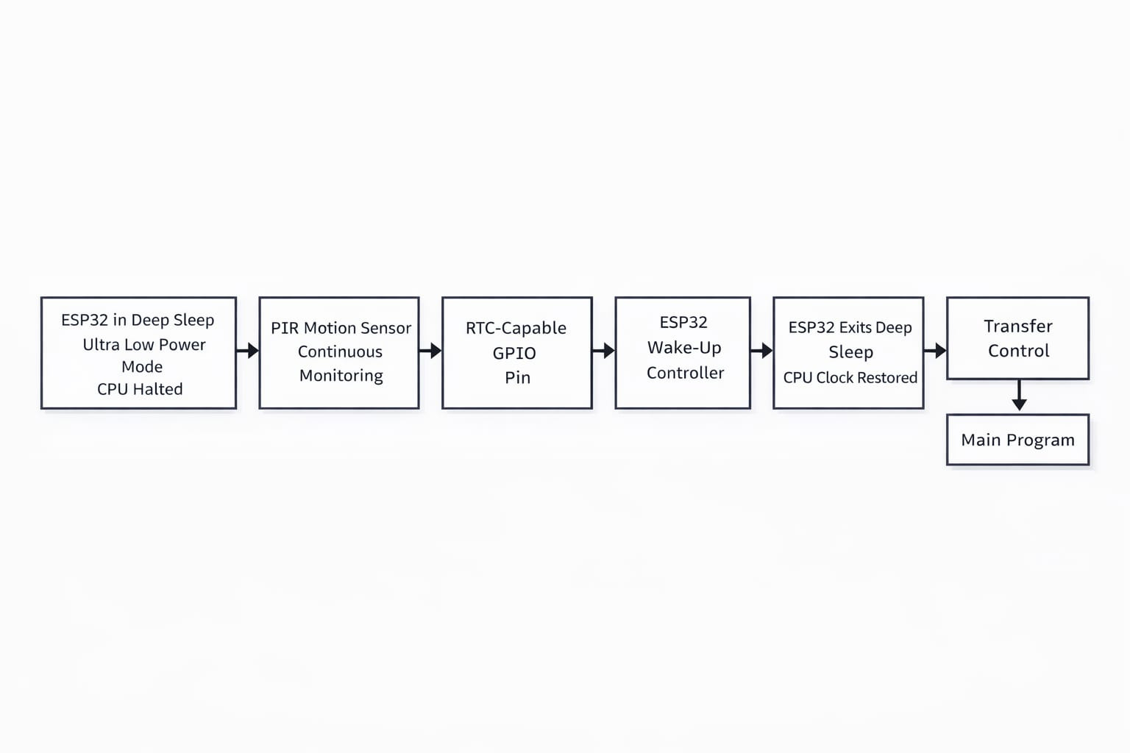
The ESP32 stays in deep sleep mode to save power.
The PIR sensor continuously monitors motion.
When motion is detected, it sends a signal to the RTC GPIO pin.
This triggers an external interrupt, waking up the ESP32.
The ESP32 restores operation and runs the main program.

Slide 12
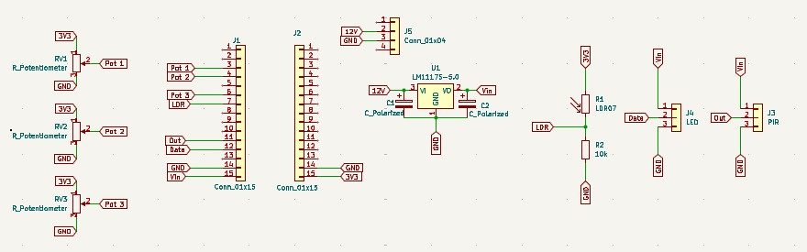
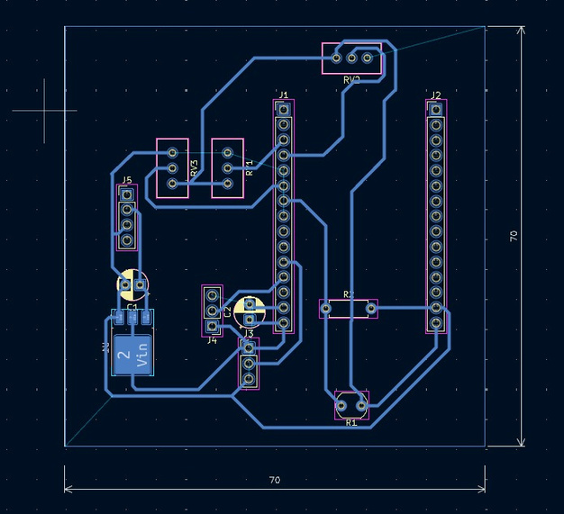
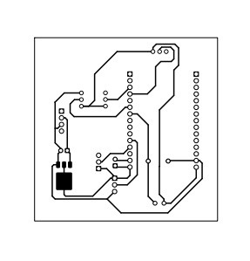
Schematic Diagram

Slide 13
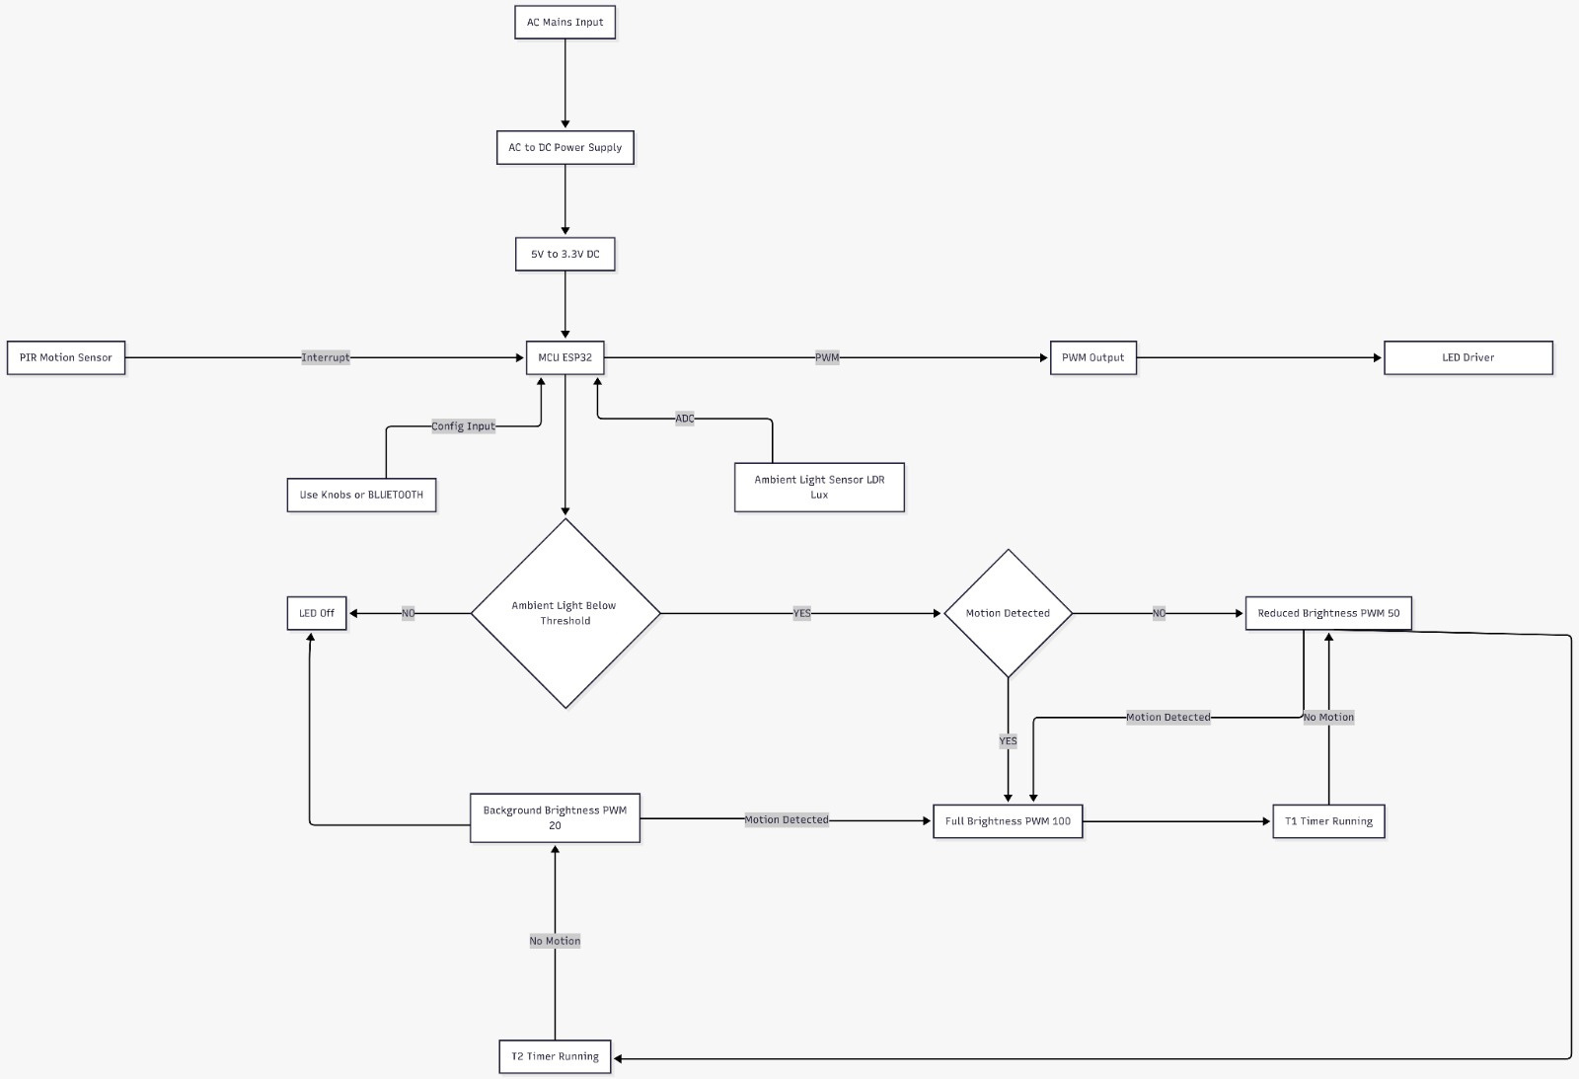
Block Diagram

Slide 14
Outcome of Literature Review
Identified need for combined motion + lux-based control system [1][3]
Existing systems showed false triggering and inefficient brightness control [1]
Lack of multi-level brightness and user configurability in basic systems [1]
Limitations Overcome
Implemented multi-level brightness (Full, Reduced, Background) for better efficiency [1]
Reduced false triggering using proper sensor interfacing and signal filtering [2]
Improved system using PWM-based smooth dimming control [4]
Added user-configurable parameters (T1, T2, brightness, lux threshold) [1]

Slide 15
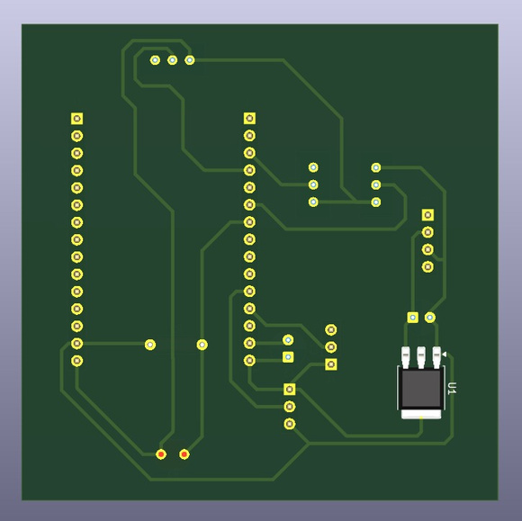
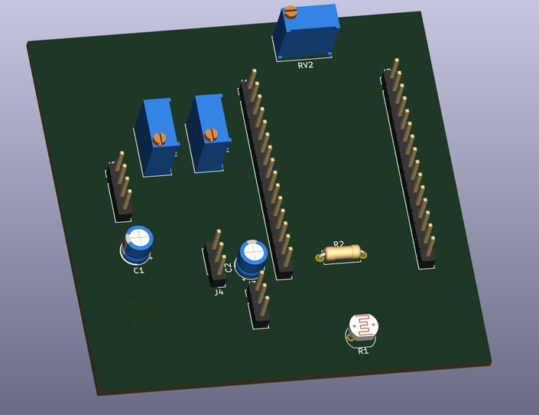
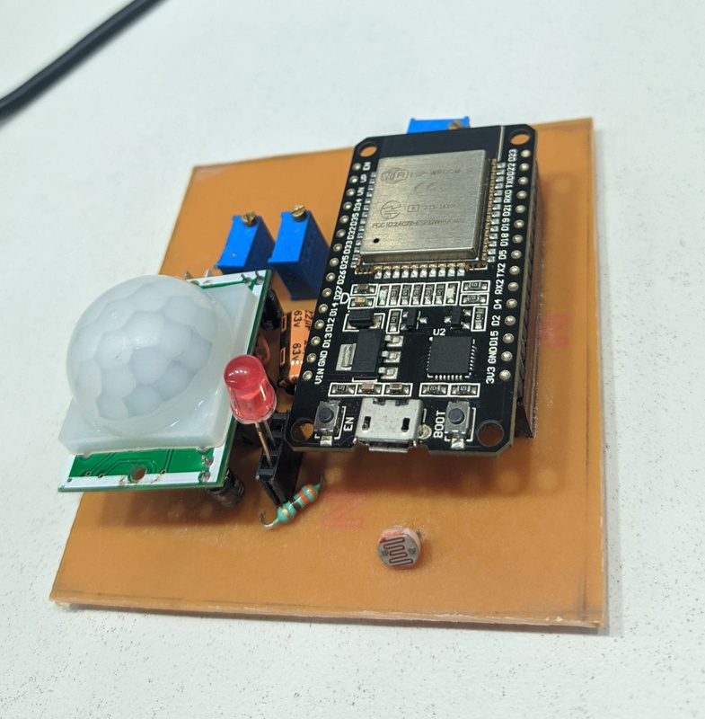
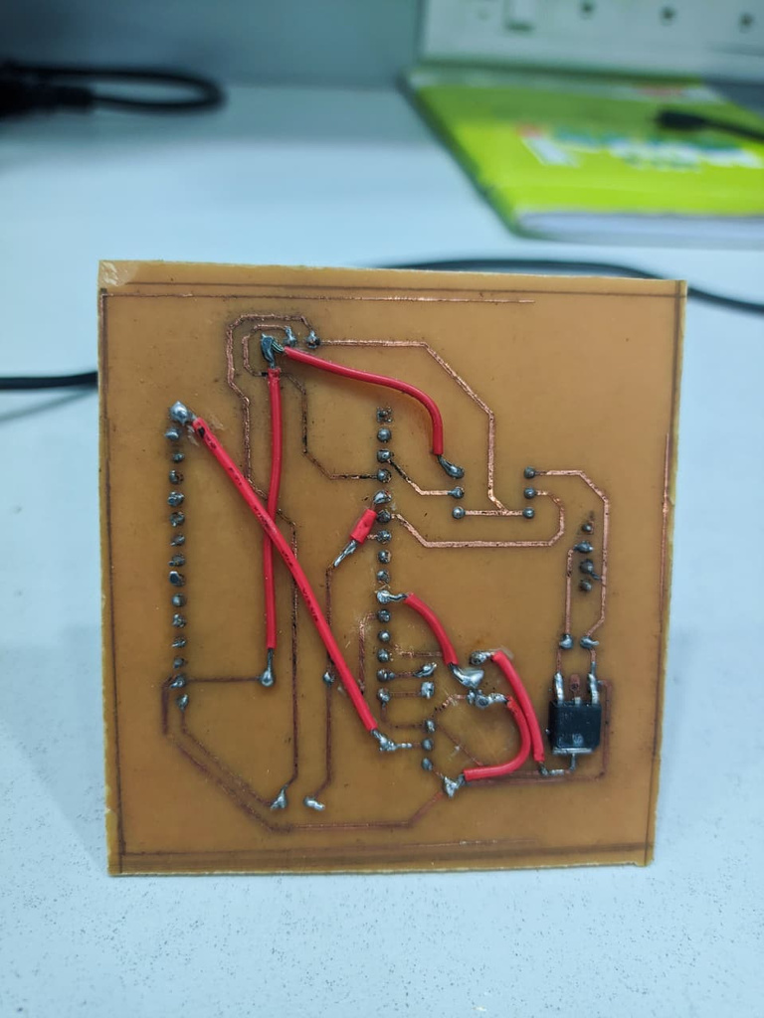
PCB Designs

Slide 16
Testing & Debugging
Observed issues during testing:
False triggering due to environmental noise [2]
Incorrect brightness transitions [4]
Delay mismatch in timing (T1, T2) [1]
Corrections Implemented:
Adjusted PIR sensitivity and delay settings [2]
Optimized PWM signal for smooth dimming [4]
Calibrated lux threshold for accurate ambient sensing [3]
Verified state transitions (FULL → REDUCED → BACKGROUND) [1]

Slide 17
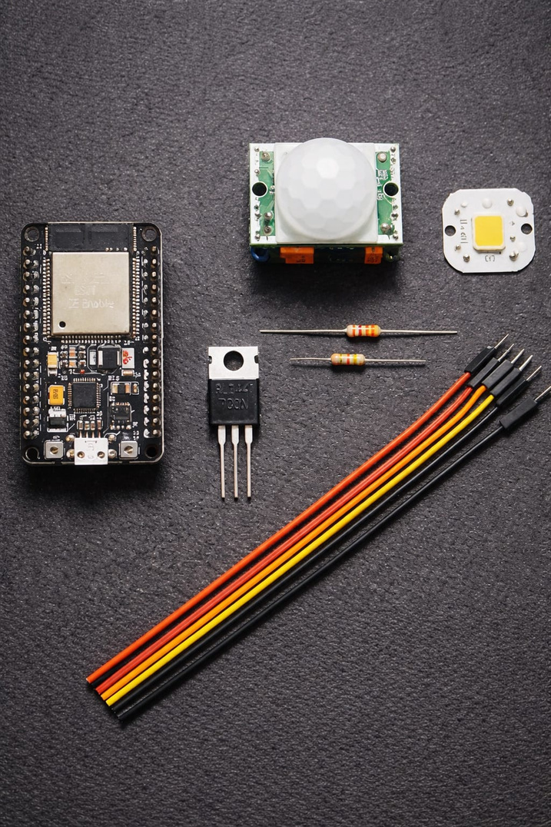
Resources
PIR Motion Sensor (HC-SR501) [2]
Ambient Light Sensor (LDR / Lux Sensor) [3]
Microcontroller (Arduino / ESP32) [5]
LED with constant current driver [4]
Resistors, power supply, connecting wires
IR receiver module (for user control – optional) [1]
Optional: LDR(Ambient light control)
Microcontroller (ESP32)
LED & Driver Electronics
High Power LED (9W)
LED Constant Current Driver(300mA–700mA)
PWM Dimming Interface (MCU → Driver)
Resistors, capacitors, connectors, headers

Slide 18
Future Scope
Integration with IoT for remote monitoring and real-time control of lighting parameters [5]
Implementation of AI/ML algorithms for adaptive brightness based on usage patterns
Use of advanced motion sensors (microwave/mmWave) for higher accuracy and reduced false triggering [1]
Development of self-learning systems to automatically adjust lux threshold and delay timings (T1, T2) [1]
Integration with smart home systems (centralized automation platforms)
Use of solar-powered LED systems for energy-efficient standalone operation
Enhancement with wireless communication (Wi-Fi/Bluetooth) for user control [5]
Expansion for smart street lighting with network-based centralized control [1]

Slide 19
Conclusion
The literature shows that conventional PIR lighting systems lack dimming, suffer
from flicker, and are less efficient. Using an efficient SMPS-based LED driver with
smooth, low-flicker dimming and intelligent control can significantly improve energy
efficiency and lighting quality.
Literature is that abrupt ON/OFF switching in conventional systems causes sudden
changes in illumination, which can be uncomfortable for users. Gradual dimming and
soft-start techniques are recommended to improve visual comfort. Intelligent
control also helps reduce unnecessary power consumption during idle periods. This
approach supports longer LED life and better overall system reliability

Slide 20
THANK YOU

