Slide 1


Capstone Project
Company Bankruptcy Prediction
Shubham Purkar
1

Slide 2

Catching the Doom, Before it Happens
Problem Statement
Feature Selection
Exploratory Data Analysis
Applying the Models
Model Selection and validation

Slide 3
Problem Statement
Prediction of bankruptcy is a phenomenon of increasing interest to ﬁrms who stand to lose money because of unpaid debts. Since computers can store huge dataset pertaining to bankruptcy, making accurate predictions from them beforehand is becoming important.
A highly unbalanced dataset, to predict the ﬁnancial state of the companies in Taiwan, was presented. Company bankruptcy was deﬁned based on the business regulations of the Taiwan Stock Exchange.
For this project, we have aimed to curate a model that captures the bankruptcy patterns among companies in the industry. This model will work to provide early signs of ﬁnancial downturn in the corporations

Slide 4
Data Pipeline
Cleaning the Data: The data was checked for null values, categorical values and primary inspection was performed.
Feature Selection: Techniques such as VIF, p-value, L-1 Regularization and Information Gain were performed to select important features.
EDA: Exploratory analysis was performed to review the skewness in the data, outliers and correlation patterns.
Model Testing: Combination of different models and feature selection techniques were used to determine optimal results

Slide 5
Data Pipeline
The data were collected from the Taiwan Economic Journal for the years 1999 to 2009. Company bankruptcy was deﬁned based on the business regulations of the Taiwan Stock Exchange.
The dataset consisted of 96 columns with mainly of continuous features in 6819 rows

Slide 6
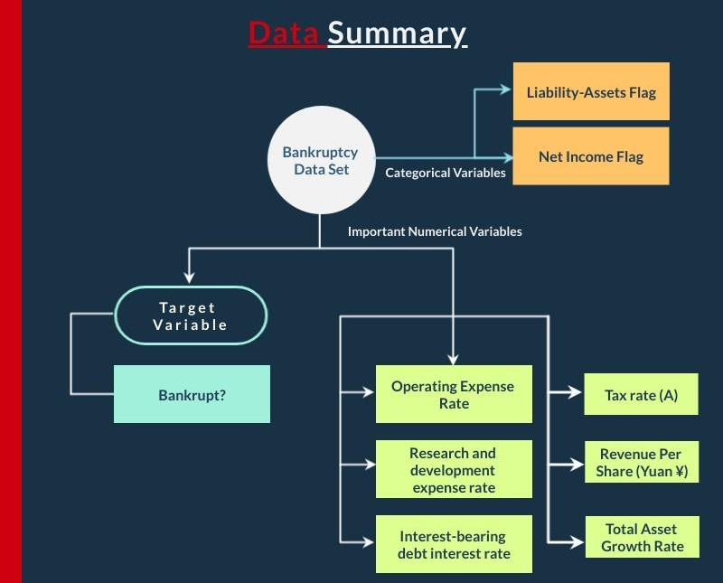

Slide 7
Data Summary
Operating Expense Rate: The operating expense rate shows the efﬁciency of a company's management by comparing the total operating expense (OPEX) of a company to net sales.
Research and Development Expense Rate: Research and development (R&D) expenses are associated directly with the research and development of a company's goods or services and any intellectual property generated in the process.
Interest Bearing Debt Interest Rate: The interest-bearing debt ratio is
signiﬁcant because it gives a window into the ﬁnancial health of a
company. The interest-bearing debt ratio, or debt to equity ratio, is
calculated by dividing the total long-term, interest-bearing debt of the
company by the equity value.

Slide 8
Data Summary
Tax Rate: A tax rate is the percentage at which an individual or corporation is taxed.
Revenue per share: Amount of revenue over common shares outstanding. Answers the question, what's the ownership of sales to each share? Increasing revenue per share (RPS) over time is a good sign, because it means each share now has claim to more revenues.
Total Asset Growth Rate: Total Asset Growth Rate deﬁned as year-over-year percentage change in total assets

Slide 9

Important Feature Selection Techniques

Slide 10
Important Feature Selection Techn.
Quasi Method: Quasi-constant features are those that show the same value for the great majority of the observations of the dataset. In general, these features provide little if any information that allows a machine learning model to discriminate or predict a target.
Using Quasi Constant Method: 31 columns were selected
Lasso Regression: In linear model regularization, the penalty is applied over the coefﬁcients that multiply each of the predictors. Lasso or l1 has the property that is able to shrink some coefﬁcients to zero. Therefore, that feature can be removed from the model.
Using Lasso Regression Method and VIF scores: 19 columns were selected

Slide 11
Important Feature Selection Techn.
Information Gain: Information gain or mutual information measures how much information the presence/absence of a feature contributes to making the correct prediction on the target.
Using Information Gain Method: 30columns were selected
Random Forest: Random forests consist of 4-12 hundred decision trees, each of them built over a random extraction of the observations from the dataset and a random extraction of the features. Features that are selected at the top of the trees are in general more important than features that are selected at the end nodes of the trees, as generally the top splits lead to bigger information gains.
Using Random Forest: 30 columns were selected

Slide 12
Other Feature Selection Techn.
Using VIF- 71 columns were selected.
Using VIF and p_values(logit) 14 were selected.
Using p_values- OLS 32 were selected.
Using just Lasso -24.

Slide 13

Exploratory Data Analysis

Slide 14
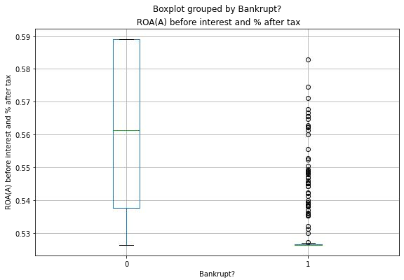
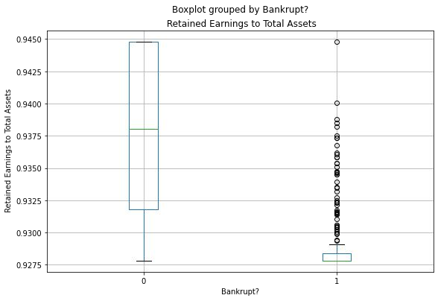
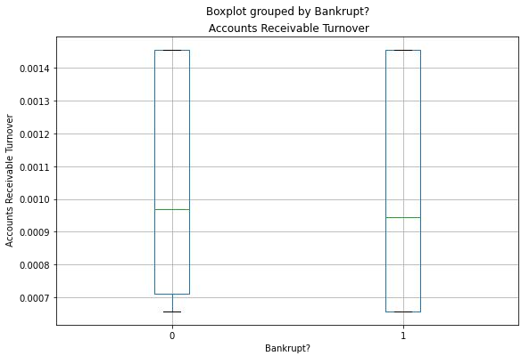
Primary EDA: Understanding the effect of the value of a feature on the decision
Insights
Bankruptcy is more likely, if the value of features such as ROA(A) value is low.
Value of features such as Accounts Receivable Turnover is less likely to cause bankruptcy.
For higher values of features like Retained Earnings to Total Assets, a company is likely to stay aﬂoat.
14

Slide 15

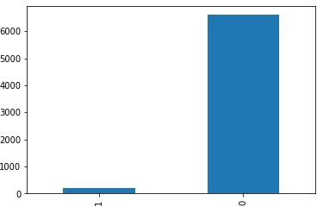
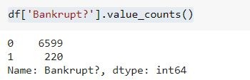
Primary EDA: Checking the Imbalance
Insights
The target variable is highly imbalanced. Less than 3.5% instances for bankrupt companies exist in the data set.

Slide 16
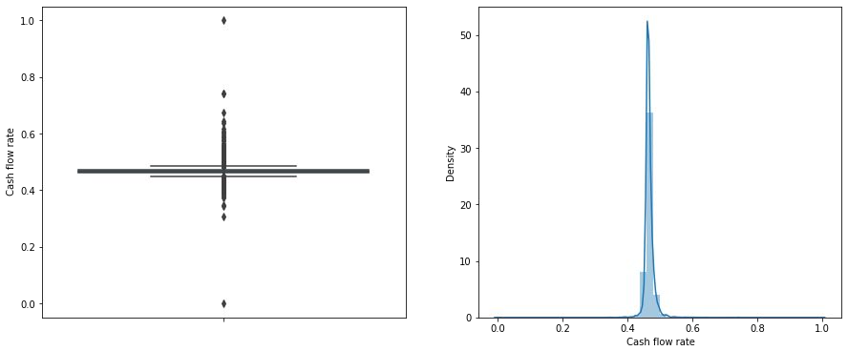
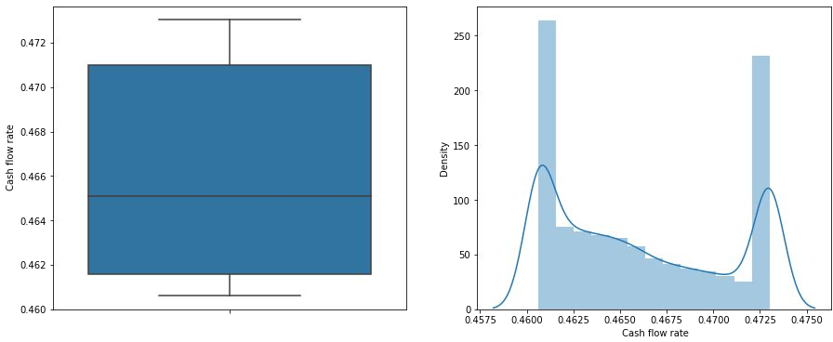
Primary EDA: Detecting and Capping outliers
Before
After
Outliers were capped at 80 percentile value on the upper side and at 20 percentile value at the bottom side

Slide 17
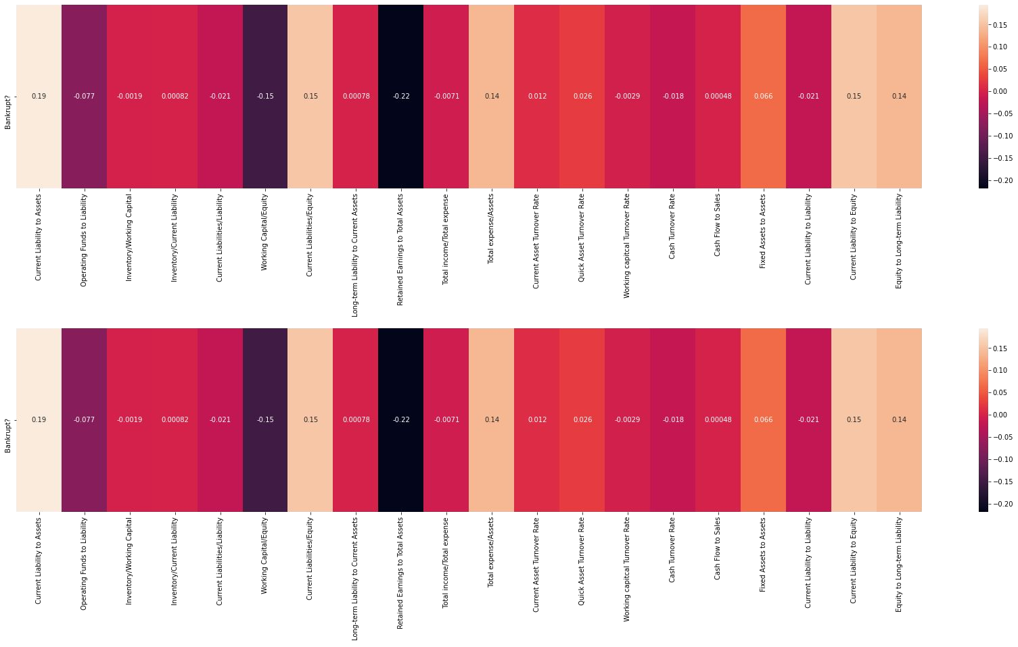
Primary EDA: Understanding the correlation between features and target variable

Slide 18
Primary EDA: Understanding the correlation between features and target variable. (Contd.)
Insights
After going through all the columns, we found that none of the features displayed any high correlation(> 0.5) with the target variable, bankruptcy.
The most negatively correlated feature was ' Net-Income to Total Assets' i.e -0.32
The most positively correlated feature was ' Debt Ratio' i.e +0.25.
Conclusion: Our dataset doesn't provide any modelling power with respect to linear algorithms. Since there is a high imbalance in the classes, this looks like an anomaly detection problem. So, let us try anomaly detection algorithm.

Slide 19
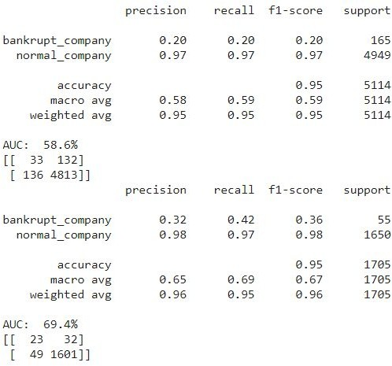
EDA: Using Anomaly Detection Algorithm to further explore the data.
Insights
Isolation Forest was used to detect anomalies in the dataset. Since results, were not up to the mark, let us visualize the dataset to investigate the problem
19

Slide 20
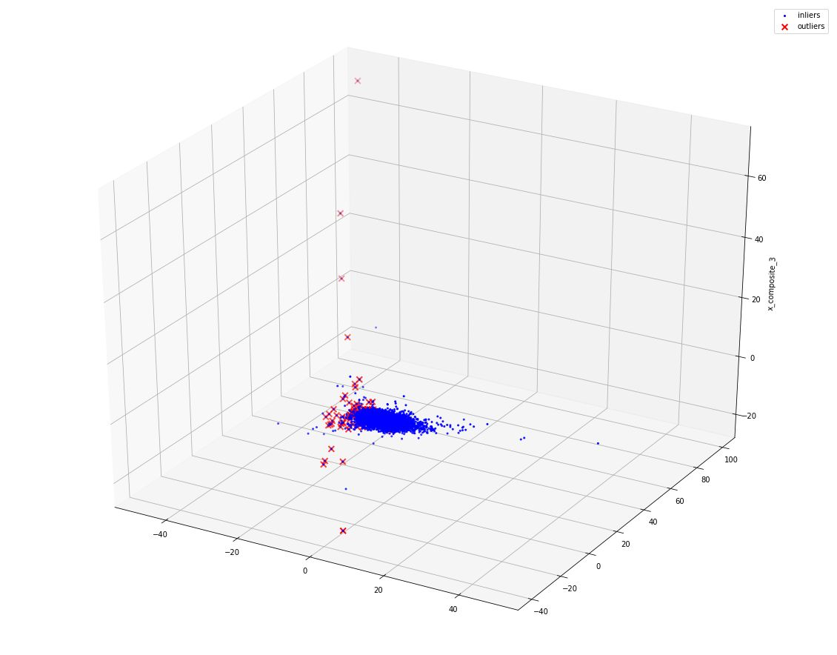
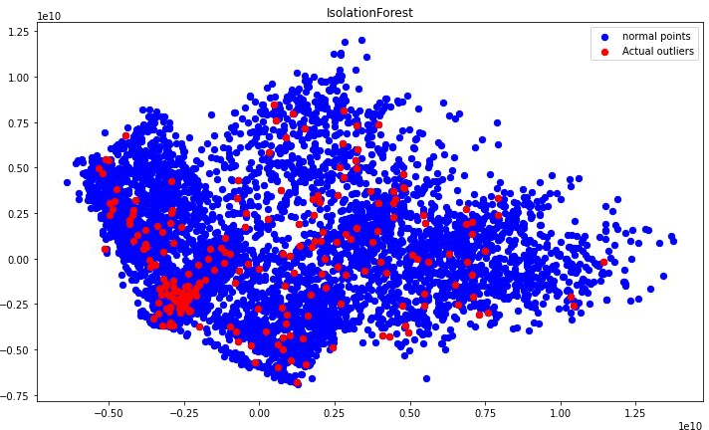
EDA: Data Visualization in 2 and 3 - Dimensions using PCA
Classes are intertwined & overlapping. Thus, bankruptcy isn’t an anomaly. Bankrupt instances, simply, happen to be sparse in the date set.
20

Slide 21
Conclusion
The Problem at hand is not an anomaly detection problem. It is a classiﬁcation
problem with a highly imbalanced dataset.
We will use different combinations of feature selection techniques, classiﬁcation models and resampling techniques to reach a solution

Slide 22

Applying Models

Slide 23
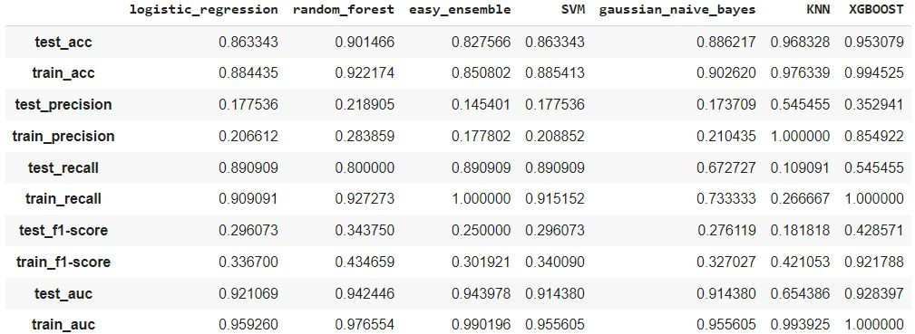
Applying Model: 1. Features Selected Using VIF.
Highest Recall on the test set is obtained from Logistic Regression, Easy
Ensemble and SVM.
Highest test precision is obtained with KNN
XGBoost has best F1-score at 43%, on the test set.
23

Slide 24
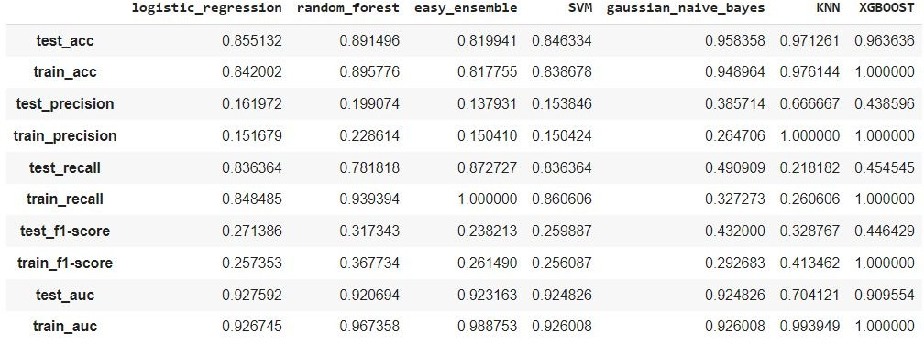
Applying Model: 2. Features Selected Using VIF & p-values(logit-function)
Highest Recall on the test set is obtained from Easy Ensemble at 87.2%
Highest test precision is obtained with KNN at 66%
XGBoost has best F1-score at 44%, on the test set.
24

Slide 25
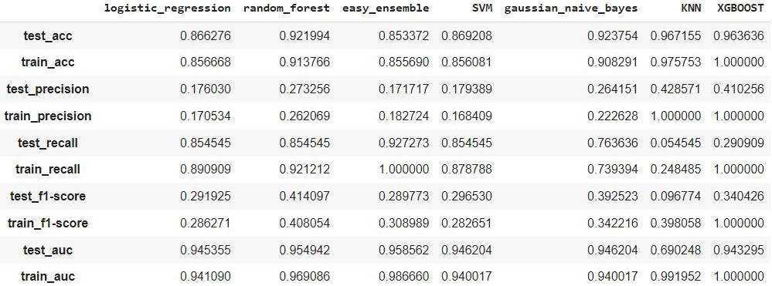
Applying Model: 3. Features Selected Using VIF & l1 Regularization
Highest Recall on the test set is obtained from Easy Ensemble at 92%
Highest test precision is obtained from KNN att 42%
Random Forest has best F1-score at 41%, on the test set.
25

Slide 26
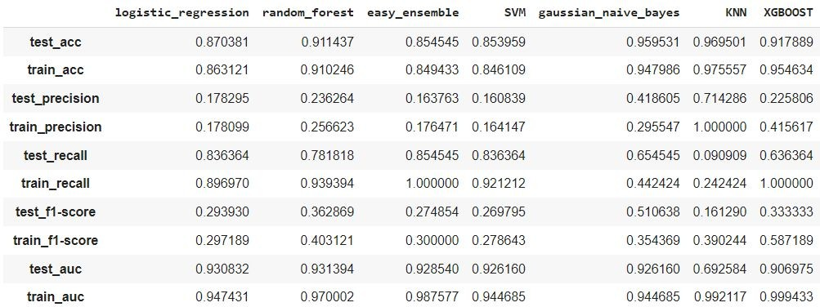
Applying Model: 4. Features Selected Using p_values with OLS model.
Highest Recall on the test set is obtained from Easy Ensemble at 85.4%
Highest test precision is obtained from KNN att 71.4%
● Gaussian Naive Bayes has best F1-score at 51%, on the test set.
26

Slide 27
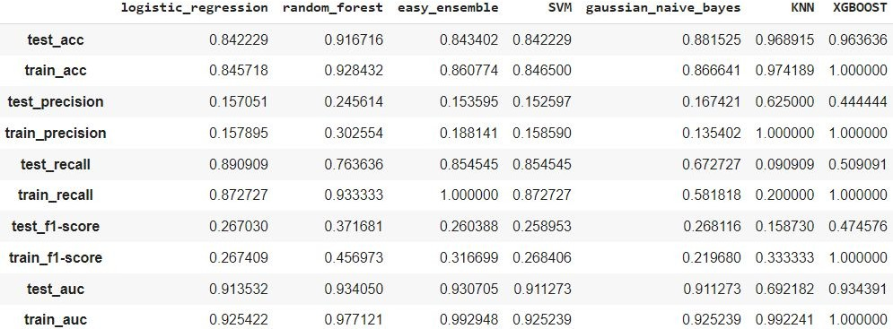
Applying Model: 5. Using Quasi Constant Method
Highest Recall on the test set is obtained from Logistic Regression at 89%
Highest test precision is obtained from KNN at 62.5%
● XGBoost has best F1-score at 47.4%, on the test set.
27

Slide 28
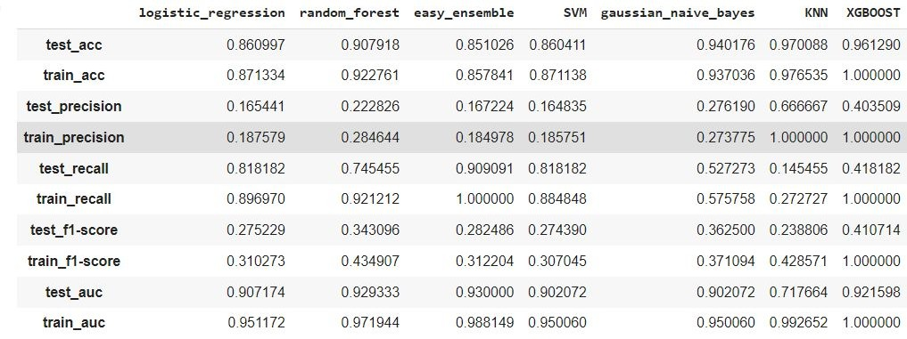
Applying Model: 6. Using Information Gain
Highest Recall on the test set is obtained from Easy Ensemble at 90%
Highest test precision is obtained from KNN at 66.5%
● XGBoost has best F1-score at 41%, on the test set.
28

Slide 29
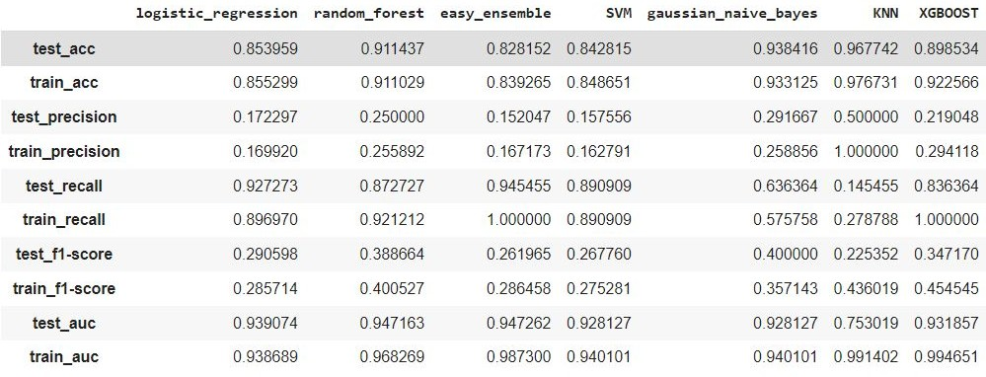
Applying Model: 7. Using Random Forest Method
Highest Recall on the test set is obtained from Easy Ensemble at 94%
Highest test precision is obtained from KNN at 50.5%
● Gaussian Naive Bias has best F1-score at 40%, on the test set.
29

Slide 30
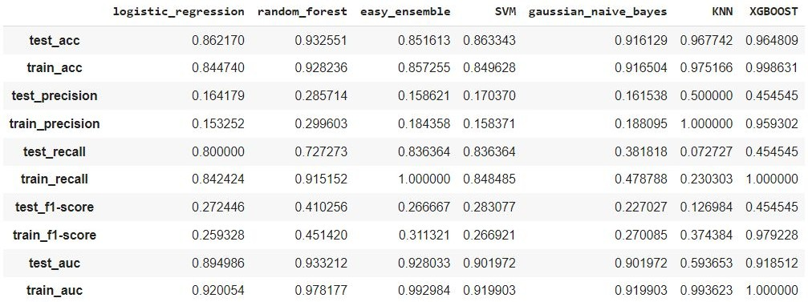
Applying Model: 8. Lasso Regularization Method
Highest Recall on the test set is obtained from Easy Ensemble at 83%
Highest test precision is obtained from KNN at 50%
● XGBoost has best F1-score at 45%, on the test set.
30

Slide 31
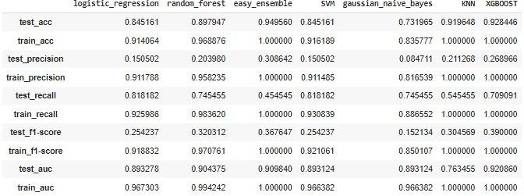
Applying Model: 9. Using SMOTE with Quasi Selection
Highest Recall on the test set is obtained from Logistic Regression & SVM at
82%
Highest test precision is obtained from Easy Ensemble at 31%
XGBoost has best F1-score at 39%, on the test set.
31

Slide 32
Conclusion
If Recall is critical to the use case, then Easy Ensemble model should be used with Random Forest feature selection, to obtain a 94% Recall value.
If Precision is critical to the use case, then KKN model should be used with, p_values-OLS feature selection method to obtain a Precision of 71.4%
If over-all performance is critical to the use case, then Gaussian Naive Bayes Model with, p_values-OLS feature selection method can be used to obtain F1 score of 51%.
We can use combination of high recall models and high precision models to cross validate and obtain ideal solution.
32

Slide 33
Challenges
Balancing the trade-off between recall and precision was a challenge.
Feature selection and choosing a right technique.
Exploring literature and resources to understand the problem and to ﬁnd the solution was a little exhaustive.
Deadlines felt a little strained. But it all worked out for the best.

