Slide 1


Project
Customer Churn Prediction
Shubham Purkar
1

Slide 2


Catching the Doom, Before it Happens
Problem Statement
Feature Selection
Exploratory Data Analysis
Applying the Models
Model Selection and validation

Slide 3
Problem Statement
The objective of this assignment is to build a predictive model that can predict customer churn for a given company. The intern will use machine learning techniques to build the model and document the process, including feature selection, model evaluation, and performance metrics.

Slide 4
Data Pipeline
Cleaning the Data: The data was checked for null values, categorical values and primary inspection was performed.
Feature Selection: Techniques such as VIF, p-value, L-1 Regularization and Information Gain were performed to select important features.
EDA: Exploratory analysis was performed to review the skewness in the data, outliers and correlation patterns.
Model Testing: Combination of different models and feature selection techniques were used to determine optimal results

Slide 5
Data Pipeline
The data is related with direct marketing campaigns of a Portuguese banking institution. The marketing campaigns were based on phone calls. Often, more than one contact to the same client was required, in order to access if the product (bank term deposit) would be (or not) subscribed.
The dataset consisted of 17 columns with mainly of continuous features in 4520 rows

Slide 6
Data Summary
Balance: average yearly balance, in euros (numeric)
Housing: has housing loan? (binary: "yes","no")
Loan: has personal loan? (binary: "yes","no")
Contact: contact communication type (categorical: "unknown","telephone","cellular")
Day: last contact day of the month (numeric)
Month: last contact month of year
duration: last contact duration, in second

Slide 7
Data Summary
Campaign: number of contacts performed during this campaign and for this client
Pdays: number of days that passed by after the client was last contacted from a previous campaign
previous: number of contacts performed before this campaign and for this client
poutcome: outcome of the previous marketing campaign
Y : has the client subscribed a term deposit?

Slide 8

Important Feature Selection Techniques

Slide 9
Important Feature Selection Techn.
Quasi Method: Quasi-constant features are those that show the same value for the great majority of the observations of the dataset. In general, these features provide little if any information that allows a machine learning model to discriminate or predict a target.
Using Quasi Constant Method: 40 columns were selected
Lasso Regression: In linear model regularization, the penalty is applied over the coefﬁcients that multiply each of the predictors. Lasso or l1 has the property that is able to shrink some coefﬁcients to zero. Therefore, that feature can be removed from the model.
Using Lasso Regression Method and VIF scores: 12 columns were selected

Slide 10
Important Feature Selection Techn.
Information Gain: Information gain or mutual information measures how much information the presence/absence of a feature contributes to making the correct prediction on the target.
Using Information Gain Method: 30columns were selected
Random Forest: Random forests consist of 4-12 hundred decision trees, each of them built over a random extraction of the observations from the dataset and a random extraction of the features. Features that are selected at the top of the trees are in general more important than features that are selected at the end nodes of the trees, as generally the top splits lead to bigger information gains.
Using Random Forest: 42 columns were selected

Slide 11

Exploratory Data Analysis

Slide 12
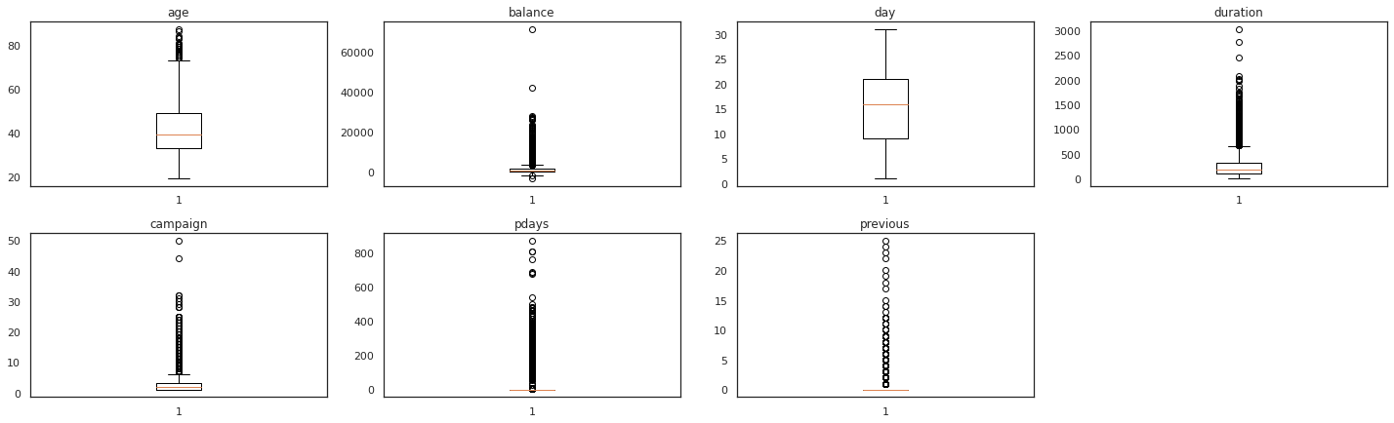
Primary EDA: Understanding the effect of the value of a feature on the decision
Insights
Most of features are skewed
14

Slide 13

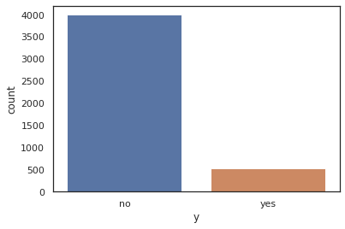
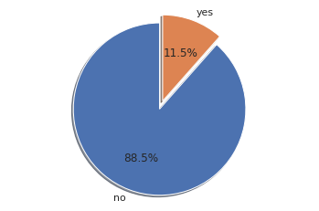
Primary EDA: Checking the Imbalance
Insights
The target variable is highly imbalanced. Less than 12% instances for churn exist in the data set.

Slide 14

Applying Models

Slide 15
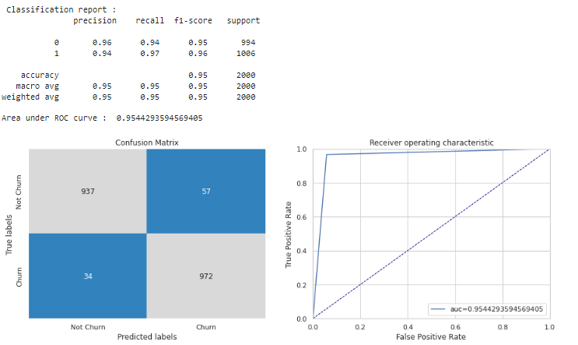
Applying Model: 1. Features Selected Using VIF.
Highest Recall on the test set is obtained Adaboost .
Highest test precision is obtained with adaboost
Adaboost Boost has best F1-score at 43%, on the test set.
23

Slide 16
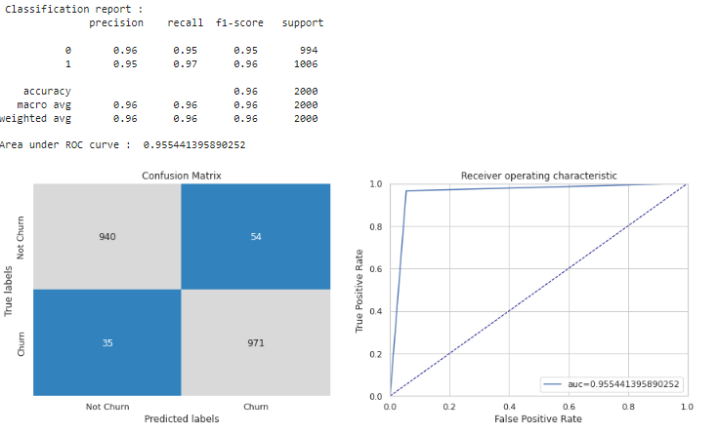
Applying Model: 8. Lasso Regularization Method
Highest Recall on the test set is obtained from Ada at 95%
Highest test precision is obtained from ada at 96%
● ada has best F1-score at 95%, on the test set.
16

Slide 17
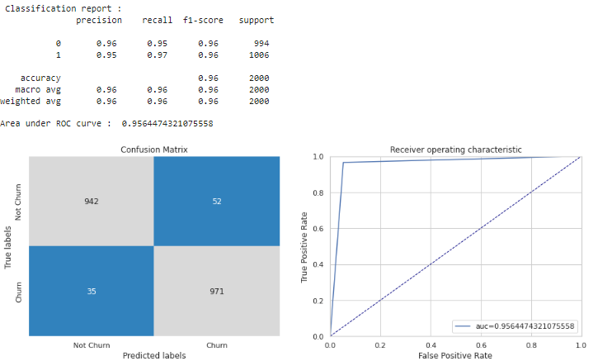
Applying Model: 7. Using Random Forest Method
Highest Recall on the test set is obtained from adaboost at 96%
Adaboost test precision is obtained from 96%
● Adaboost has best F1-score at 96%, on the test set.
17

Slide 18
Conclusion
Choosing Adaboost with random forest feature selection
1) It Performing best it classify perfectly churn with 96% accuracy
2) base on confustion matrics false positive and false negative is less compare to other model
3) it obtained 96% f1 score with highly inbalace test
32

Slide 19
Challenges
Balancing the trade-off between recall and precision was a challenge.
Feature selection and choosing a right technique.
Exploring literature and resources to understand the problem and to ﬁnd the solution was a little exhaustive.
Deadlines felt a little strained. But it all worked out for the best.

