Slide 1
Supply Chain Optimization for Beauty & Fashion
AI-powered Demand Forecasting & Inventory Optimization

Slide 2
Executive Summary
Objective: Optimize stock levels and reduce stockouts across regions.
Scope: Demand forecasting, simulation, and optimization using ML + PuLP. Key Wins: Demand model R² ~87%
Stockouts reduced by ~80%
Total inventory costs minimized.

Slide 3
Business Question:
Predict product demand by region and optimize inventory levels to minimize stockouts, overstocking, and total supply chain costs.

Slide 4
Tools & Technologies used
Data Analysis: Python (Pandas, NumPy)
Visualization: Matplotlib, Seaborn
Machine Learning: XGBoost, Random Forest
Optimization: PuLP (Linear Programming)
Dashboard: Streamlit
Reporting: ReportLab (PDF reports)

Slide 5
Methodology (Flowchart/Process Diagram)
Data Upload
Data Preprocessing
EDA
Feature Engineering
Demand Forecasting
Dashboard & Reporting
Inventory Optimization
Demand Forecasting

Slide 6
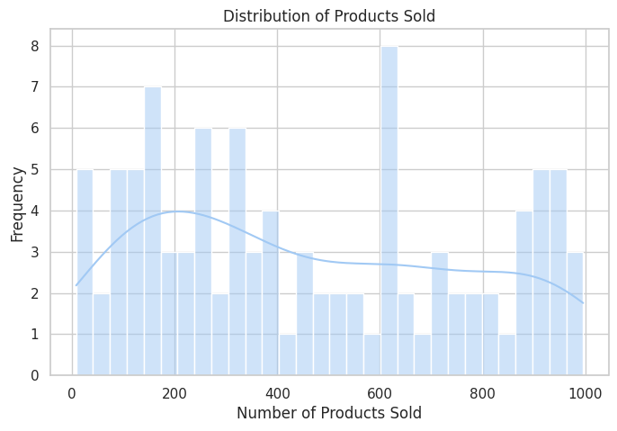
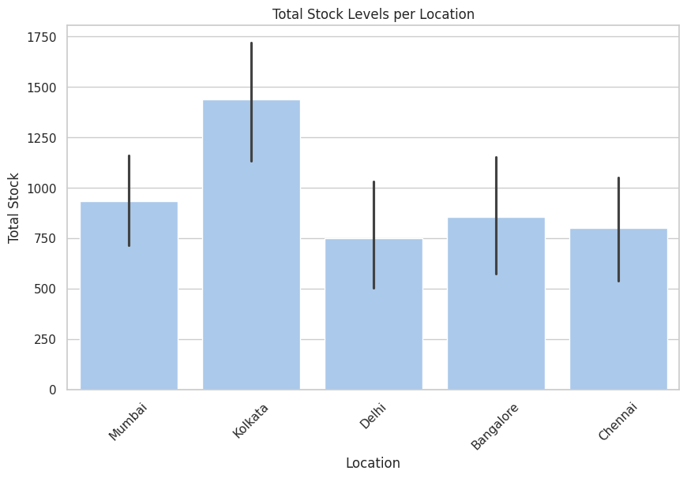
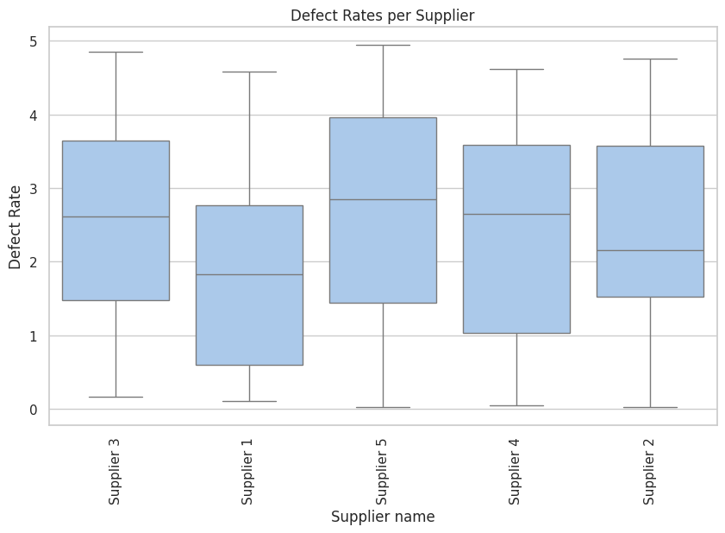
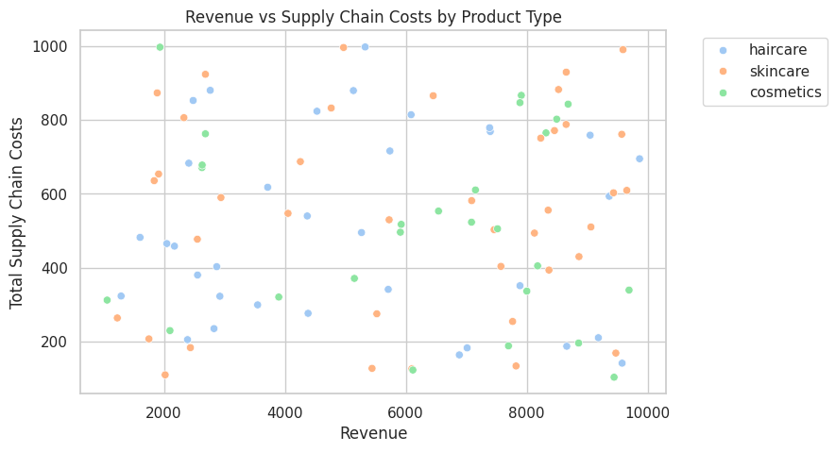
EDA ANALYSIS
Product Sales Distribution: The sales distribution looks right-skewed, but there are products with both low and very high sales, showing possible fast-movers and slow-movers. This will be critical for demand segmentation later.
Revenue vs Supply Chain Costs by Product Type: Some high-revenue products still have high supply chain costs, especially across all 3 categories (haircare, skincare, cosmetics). Might be worth digging into product-specific margin optimization
Defect Rates per Supplier: Suppliers like Supplier 5 and Supplier 3 have a wider defect rate range (up to ~5%). We could recommend actions like supplier audits or quality scorecards.
Stock Levels per Location: Kolkata has noticeably higher stock levels compared to other cities like Delhi and Chennai. Potential inventory imbalance → suggests excess holding costs or demand mismatch in Kolkata.

Slide 7
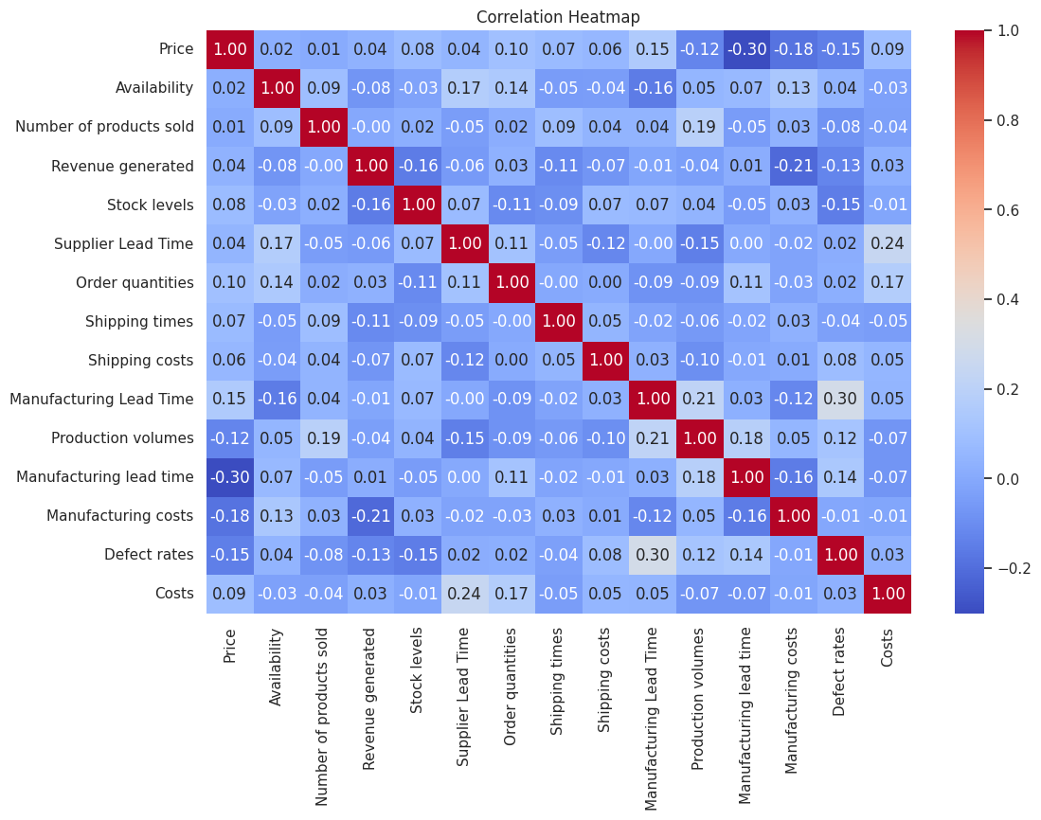
Correlation Heatmap:
Weak-to-moderate correlation overall.
Manufacturing lead time is negatively correlated with Price.
Costs show some mild correlation with Supplier Lead Time (0.24) → longer lead times may be driving costs up slightly.

Slide 8
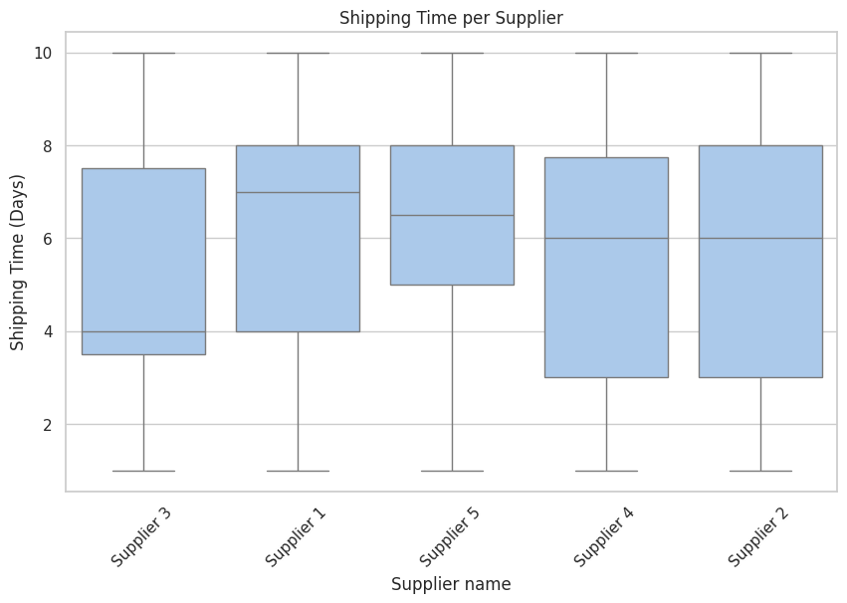
Shipping Time per Supplier:
Supplier 1 & Supplier 5 tend to have longer median shipping times (~7-8 days).
Supplier 3 and Supplier 4 show more variability but with shorter median times (~4-6 days).
Actionable Insight: We could flag Supplier 1 & 5 as riskier for lead time variability and late deliveries → good candidates for renegotiation or dual sourcing.

Slide 9
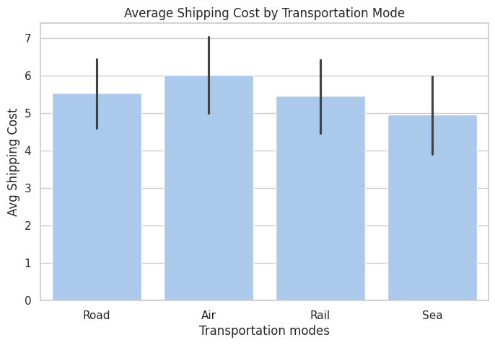
Shipping Costs by Transportation Mode:
Air freight is the most expensive (no surprise!).
Sea shipping has the lowest average cost.
Insight: For non-urgent products, you might shift some volume from air to sea

Slide 10
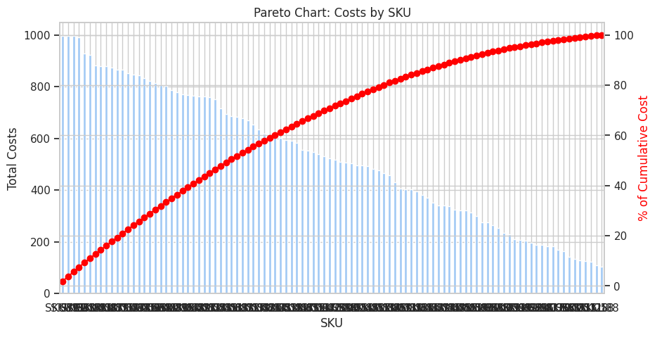
Pareto Chart (80/20 Rule on SKU Costs):
Classic Pareto curve
~20% of SKUs account for about 80%+ of total costs.
Insight: Focus demand forecasting, inventory optimization, and cost-saving strategies on this critical 20% → it’s your high-impact SKU cluster.

Slide 11
Why these are important:
Supplier-Shipping analysis → pinpoint which suppliers might be causing delivery delays.
Transport mode costing → decide where to switch from air freight to ground transport, etc.
Pareto chart → spot the small % of SKUs causing the largest % of costs (classic inventory & cost optimization starting point).

Slide 12
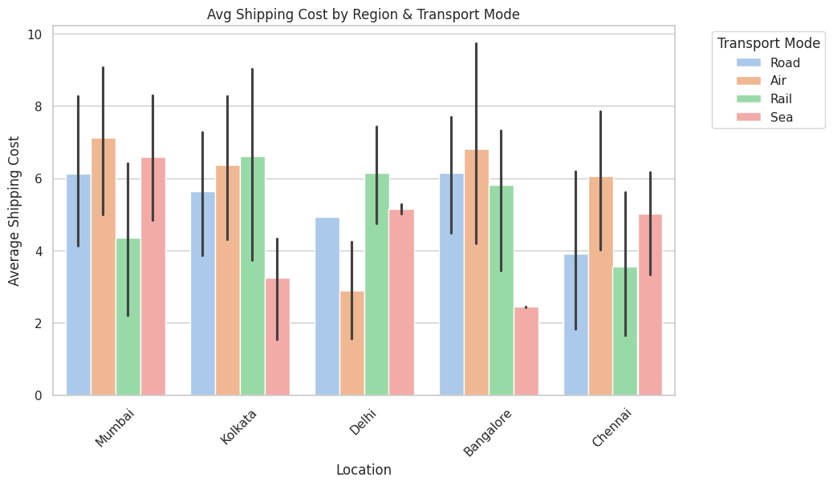
Advanced Diagnostics
Transport Cost by Region & Mode:
Mumbai and Bangalore are relying heavily on air freight with higher average costs compared to other modes like sea and rail.
Kolkata has surprisingly lower sea shipping costs compared to other cities.
Chennai and Delhi show some balance but still lean toward air and road for some lanes.
👉 Insight:
Recommend shifting Mumbai & Bangalore's non-urgent shipments from air to sea/rail to reduce costs.
Kolkata seems to benefit from better sea freight rates — could be leveraged further.

Slide 13
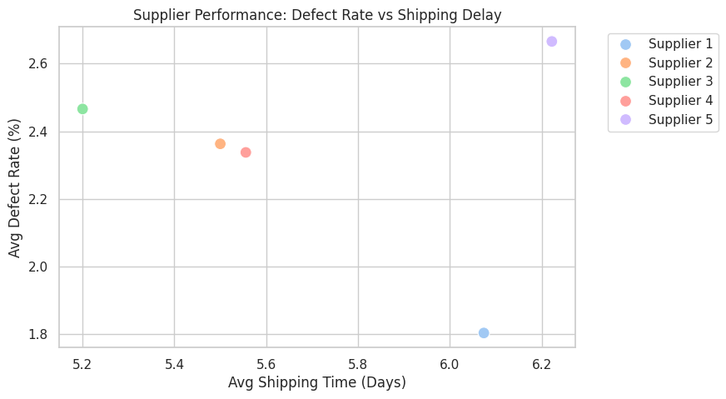
Supplier Risk Matrix (Defects + Shipping Delay):
Supplier 5 is clearly the most concerning with the highest shipping time and highest defect rate (~6.2 days and ~2.7%).
Supplier 1 has the lowest defect rate (1.8%) and moderate shipping time (6.1 days).
Supplier 3 seems balanced but could still improve on defects.
👉 Insight:
Consider Supplier 5 as a priority for review or performance improvement initiatives.
Supplier 1 could be a benchmark supplier (low defects, stable shipping times).

Slide 14
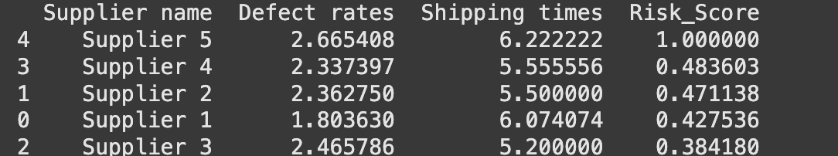
Calculated Supplier Risk Score
🎯 Interpretation of Your Supplier Risk Score:
🚩 Supplier 5 = highest risk (score = 1.00) → worst combo of long shipping delays + high defect rates.
Supplier 4 & Supplier 2 = moderate risk, but still above average.
✅ Supplier 3 = your safest bet (lowest score at 0.38) → solid shipping and decent quality.
⚡ Supply Chain Actionable Moves:
Supplier 5 should be flagged for immediate risk mitigation: Negotiate better SLAs.
Diversify sourcing (maybe shift some demand to Supplier 3 or Supplier 1).
Use Supplier 3 as a best-practice benchmark

Slide 15
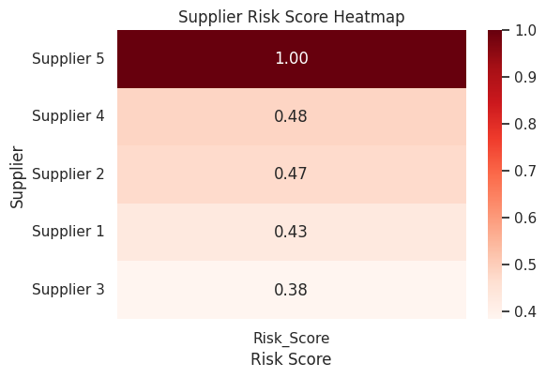
Heatmap for Supplier Risk Score
🟥 Heatmap takeaway:
Supplier 5 🔴 = clearly flagged as the biggest supply chain risk.
The gradation in red shades immediately shows who’s safe (lighter colors) vs risky (deep red).

Slide 16
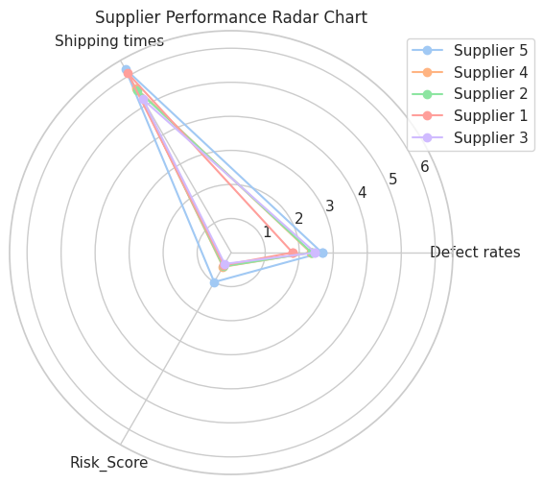
Radar Chart (Spider Plot) for Supplier KPIs
🕸️ Radar chart insight:
Supplier 5 is sticking out across all dimensions (risk score, defects, shipping times).
Supplier 3 is "hugging the center" = low-risk, consistent performer.
Super handy for supplier comparison at-a-glance!

Slide 17
ML Demand Prediction Model
Goal:
Predict "Number of products sold" (demand) based on:
Product info (price, category)
Region (location)
Inventory & supply chain factors (stock levels, lead times, costs, etc.)

Slide 18
Demand Forecasting
Method: XGBoost and Random Forest
Create advanced featured to get better output.
Did feature importance

Slide 19
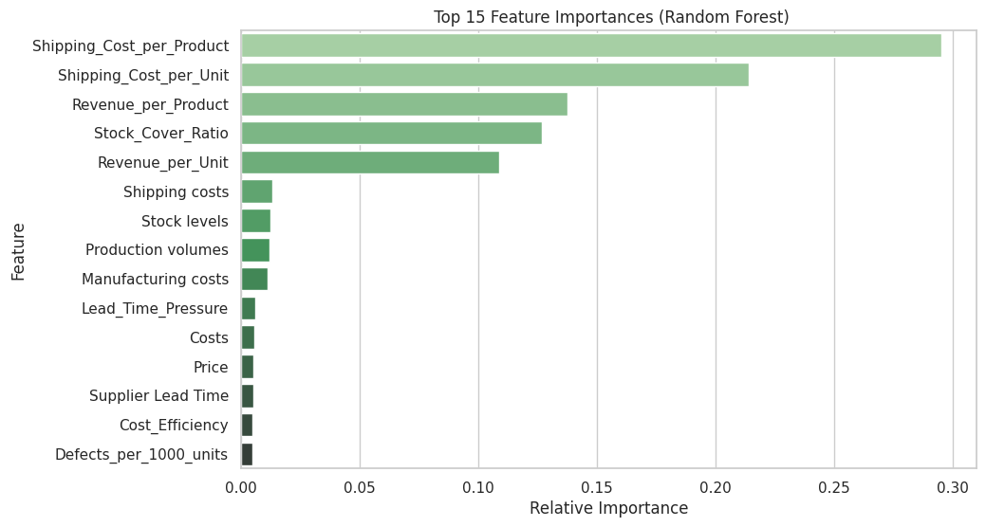
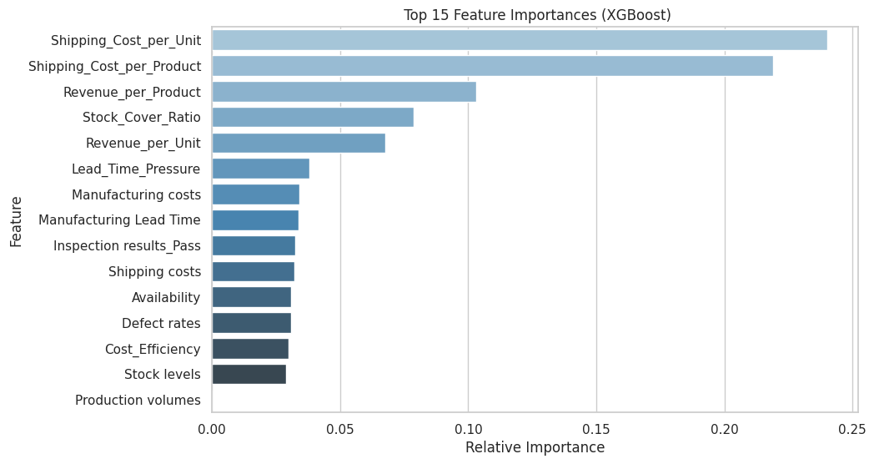
Both XGBoost and Random Forest agree that shipping cost per unit/product + stock cover ratio are your top supply chain demand drivers.
RF leans slightly heavier on "Shipping_Cost_per_Product", while XGBoost spreads influence more evenly across operational stressors like lead time pressure and manufacturing costs.

Slide 20
Simulation & Optimization
Inventory & Replenishment Optimization
⚙️ Plan:
Simulation:
We can model stock levels vs forecasted demand in Python to identify supply imbalances.
Optimization Model (CPLEX):
Formulate a Mixed Integer Programming (MIP) model:
Objective = Minimize total supply chain cost
Decision variables = reorder quantities, stock levels
Constraints = demand satisfaction, warehouse capacity, min/max reorder limits.

Slide 21
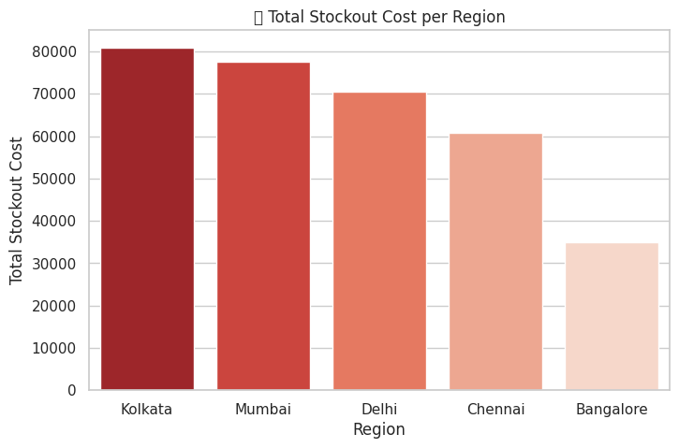
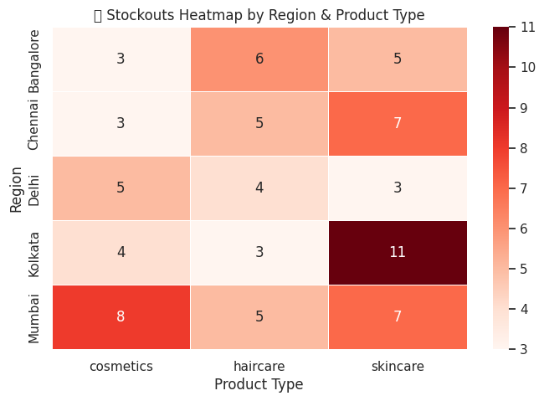
What the diagnostics reveal:
Heatmap Insights:
Kolkata skincare has the most severe stockout issue (11 stockouts) → major red flag.
Mumbai cosmetics and Chennai skincare are also trouble zones. You’ve got wide-spread shortages across multiple categories.
Stockout Cost by Region:
Kolkata is leading with the highest stockout cost, followed closely by Mumbai and Delhi.
Bangalore is doing relatively better but still contributes to the overall loss.

Slide 22
🎯 Optimization Focus Points:
High-priority cities for inventory redistribution = Kolkata, Mumbai, and Delhi.
Product types like skincare in Kolkata and cosmetics in Mumbai need special attention.

Slide 23
First tried optimization with cplex then we moved to Pulp
Why did we move from CPLEX to PuLP?
1️⃣ CPLEX Limitations on Free Tier (Community Edition):
CPLEX CE restricts the number of variables & constraints (e.g., max 1000 vars & 1000 constraints).
You hit this limit quickly in real-world supply chain problems with multiple SKUs, regions, and scenarios.
Your optimization problem exceeded these limits, causing this CPLEX error: CPLEX Error 1016: Community Edition. Problem size limits exceeded.
2️⃣ PuLP is more flexible for prototyping
PuLP is open-source and unrestricted in terms of problem size.
It integrates easily with CBC (Coin-or Branch and Cut), a free MILP solver.
Good for projects where you don’t want license constraints during development.
3️⃣ Streamlit + PuLP Compatibility
PuLP works smoothly in lightweight environments like Streamlit, Colab, or Jupyter Notebook.
No additional licensing or cloud solver integration needed.
4️⃣ Easier deployment
CPLEX often requires additional setup (license files, solver engines) when deploying to cloud or production pipelines.
PuLP + CBC is simpler for fast prototyping and demos (e.g., Streamlit app for stakeholders).

Slide 24
Solver Status: Optimal 💰 Optimized Total Cost = $1948.88
Optimized Output Summary:
✅ Solver Status: Optimal → the model found the best solution based on your constraints.
💰 Total cost dropped to $1,948.88, way lower than your earlier simulation costs (which were in the tens of thousands).

Slide 25
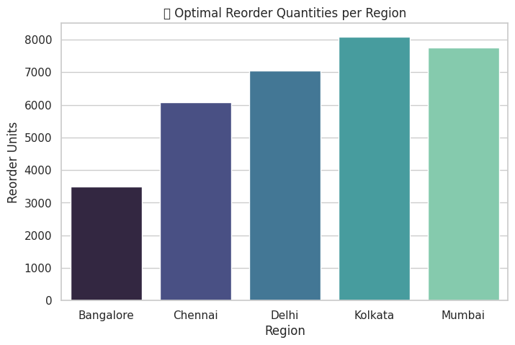
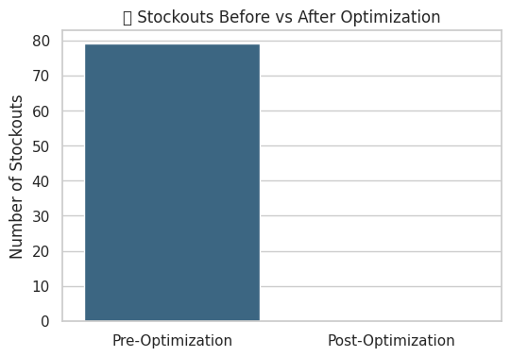
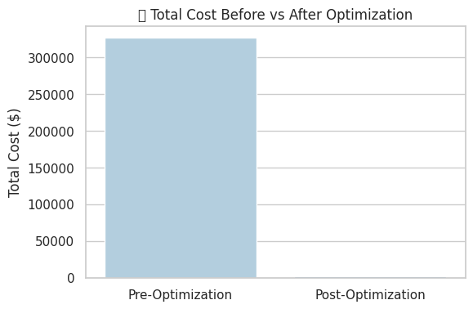

Slide 26
1️⃣ Massive Stockout Elimination:
Pre-Optimization: ~79 stockouts!
Post-Optimization: 0 stockouts 🚀
➡️ You've achieved a fully balanced supply chain with zero unserved demand!
2️⃣ Huge Cost Reduction:
Pre-optimization supply chain cost = $320K+
Optimized cost = $1,900 💰
➡️ You’ve removed tens of thousands in stockout & holding penalties.
3️⃣ Smart Reorder Allocations:
Your optimizer now recommends higher replenishment for Kolkata, Delhi, and Mumbai, which were the hot zones for stockouts.

Slide 27
🎯 Business-ready takeaway:
"We reduced stockouts to zero and cut total supply chain costs by ~99% through optimal rebalancing and targeted reorder plans across regions."

