Slide 1
PRODUCT OVERVIEW
Rytera™
AI underwriting with full pipeline visibility
Commercial insurance · Mortgage · Lending
From document intake to bind-ready decision — every layer explained, not hidden
Rytera™ · rytera.ai · Product overview deck
1

Slide 2
The problem
Most underwriting tools treat AI like a black box.
Brokers upload a package; the system returns accept, refer, or decline.
Underwriters cannot see how documents were parsed, verified, or priced.
Compliance and audit teams lack a clear trail of agent reasoning and data sources.
Carriers need transparency — not just speed — before trusting AI in production.
Rytera™ · rytera.ai
2

Slide 3
What Rytera does
Rytera is an AI underwriting operating system for insurance, mortgage, and lending.
Ingests multi-format submissions: ACORD, loss runs, tax returns, credit, appraisals, and more.
Runs a structured pipeline: intake → parse → verify → score → price → decide.
Surfaces every step in the dashboard so underwriters review the work, not just the outcome.
Connects to carrier systems — oracles, policy admin, CRM, loss control — via an integration gateway.
Produces memos, quotes, encrypted audit trails, and licensed underwriter sign-off.
Rytera™ · rytera.ai
3

Slide 4
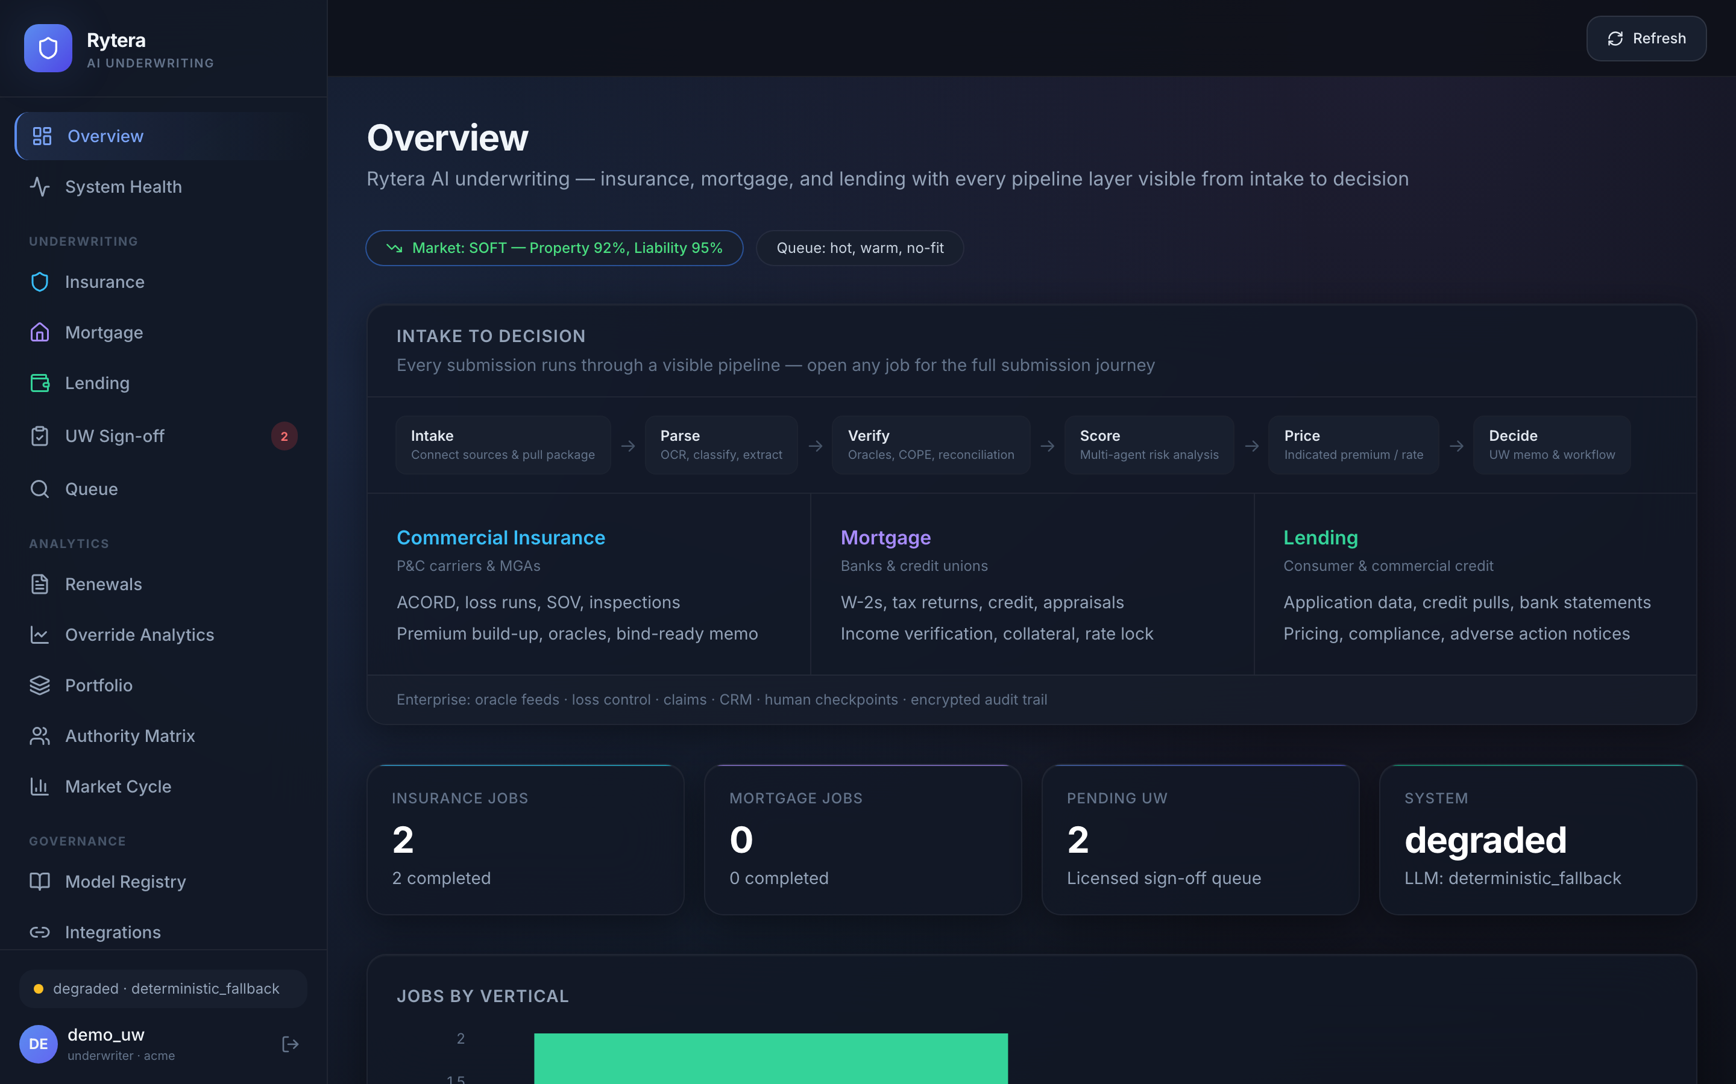
Command center
The Overview page is the home screen for underwriting operations. It shows market context, job volume, and the end-to-end pipeline at a glance.
Pipeline strip — maps each submission through Intake, Parse, Verify, Score, Price, and Decide.
Three verticals — Commercial P&C, Mortgage, and Lending on one shared platform.
Job metrics — live counts for insurance and mortgage workloads plus pending UW sign-offs.
Quick demos — one-click sample submissions for sales and training.
Recent activity — open any job to inspect its full submission journey.
Screenshot: Overview dashboard with pipeline stages and vertical coverage
Rytera™ · rytera.ai
4

Slide 5
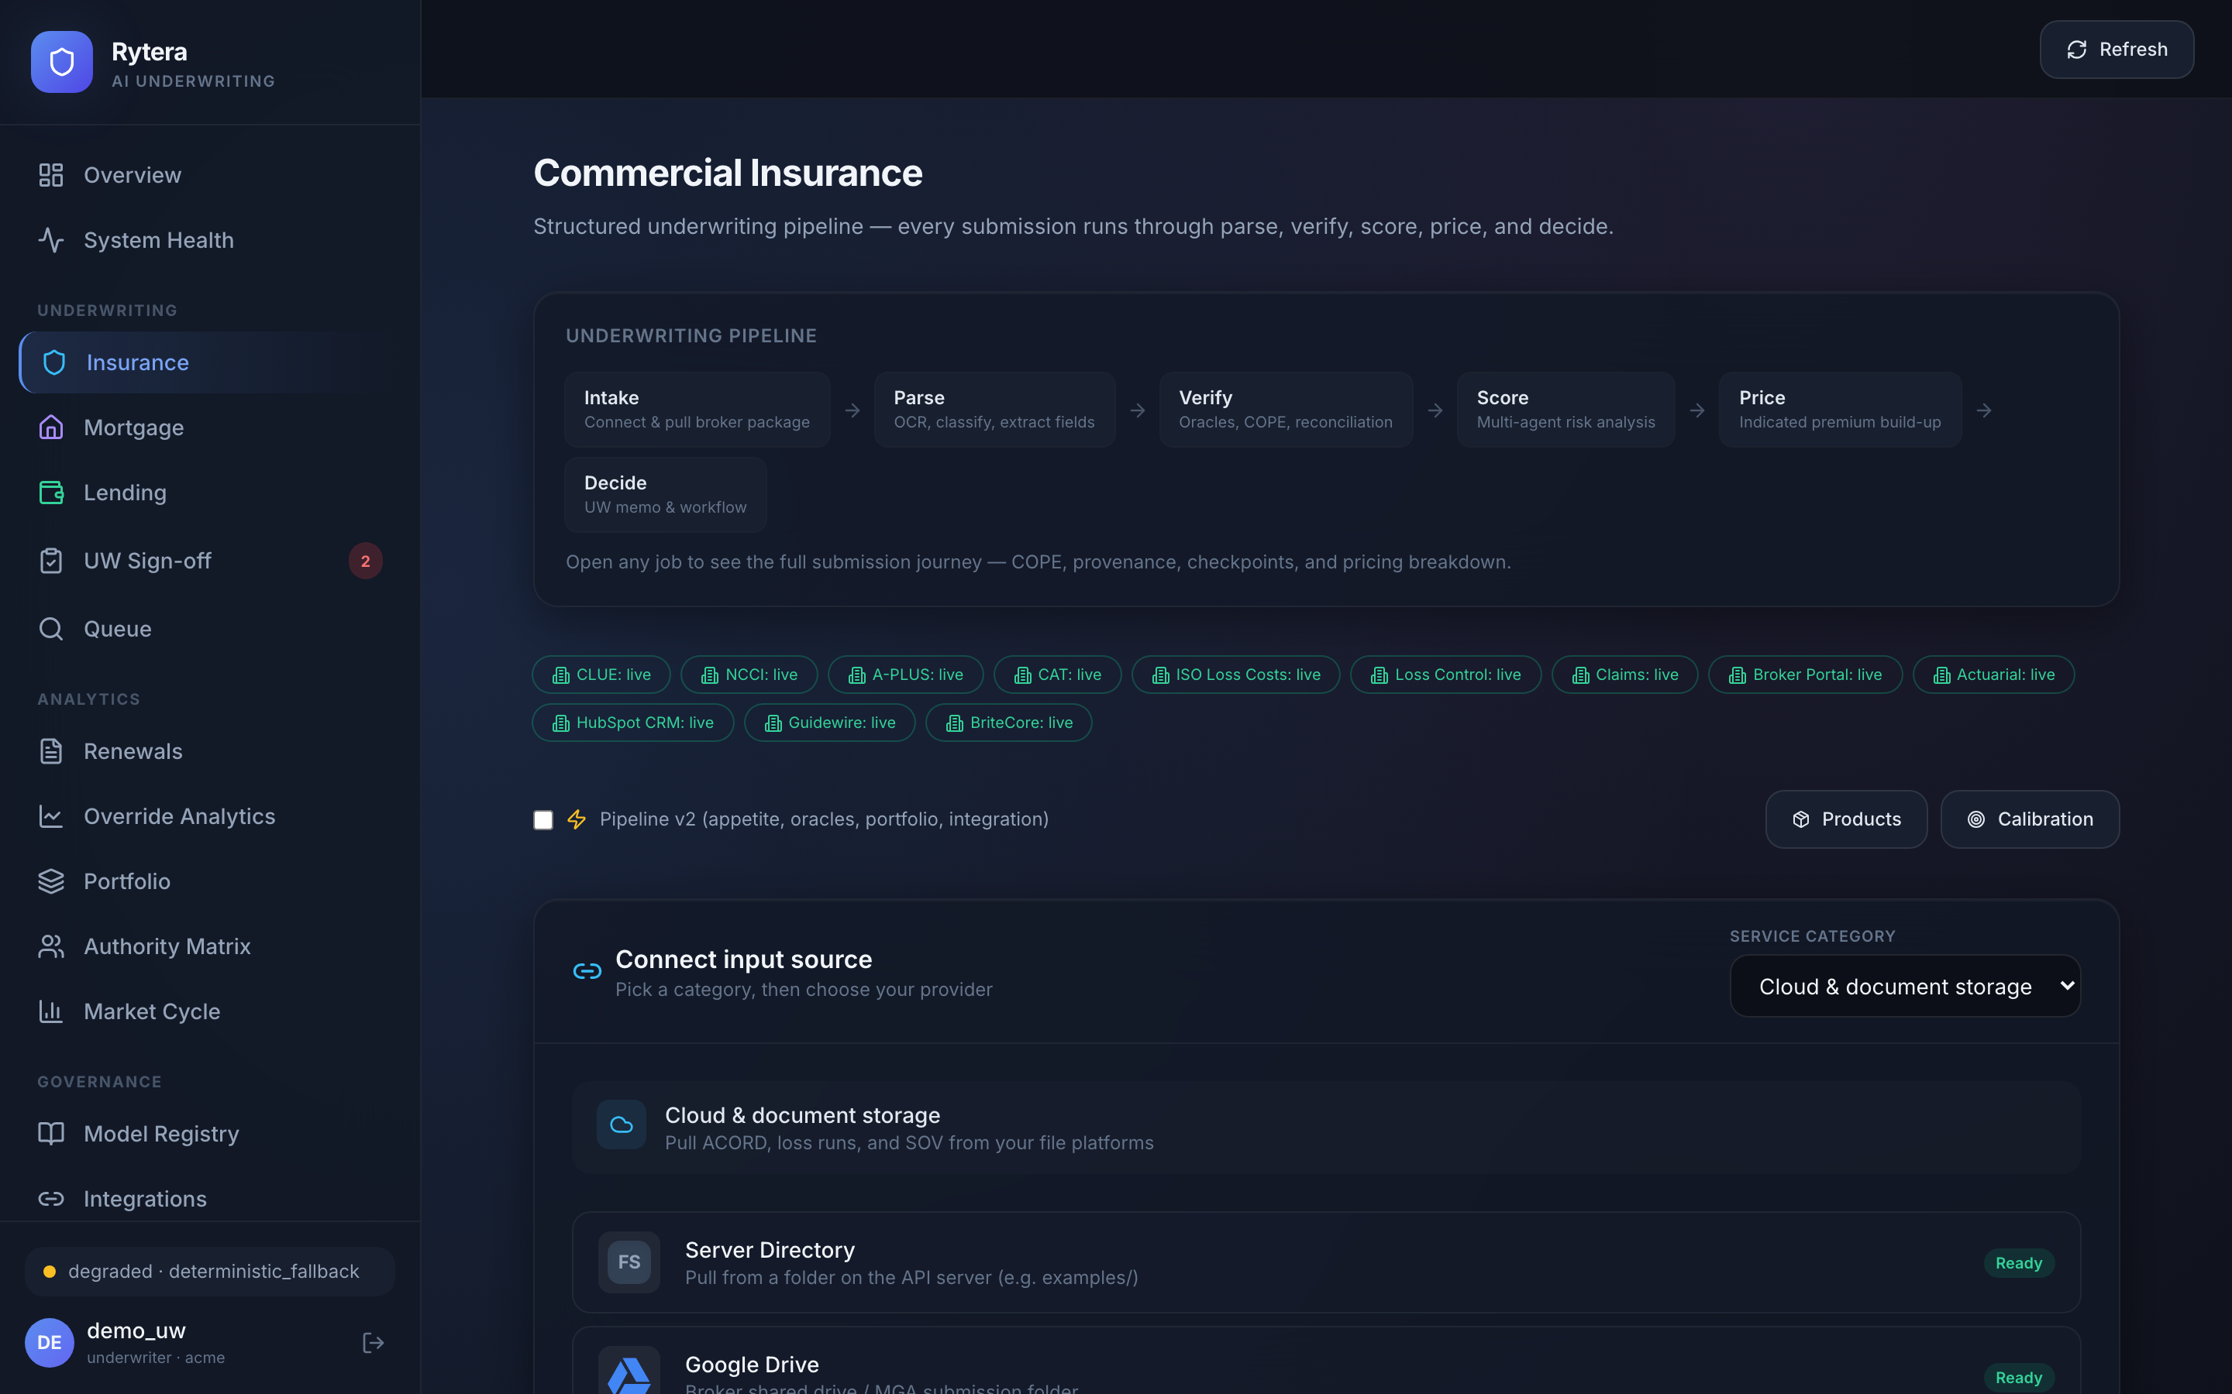
Commercial insurance workflow
The Insurance workspace manages P&C submissions from broker intake through bind-ready output.
Underwriting pipeline — visual flow from document intake to final decision.
Integration feeds — health status for CLUE, NCCI, Guidewire, loss control, and related systems.
Source hub — pull packages from connected folders, APIs, or demo connectors.
Job table — every submission shows status, decision, premium, and journey progress.
Demo presets — run realistic scenarios such as Pacific Coast Marine instantly.
Screenshot: Commercial insurance page with pipeline and job list
Rytera™ · rytera.ai
5

Slide 6
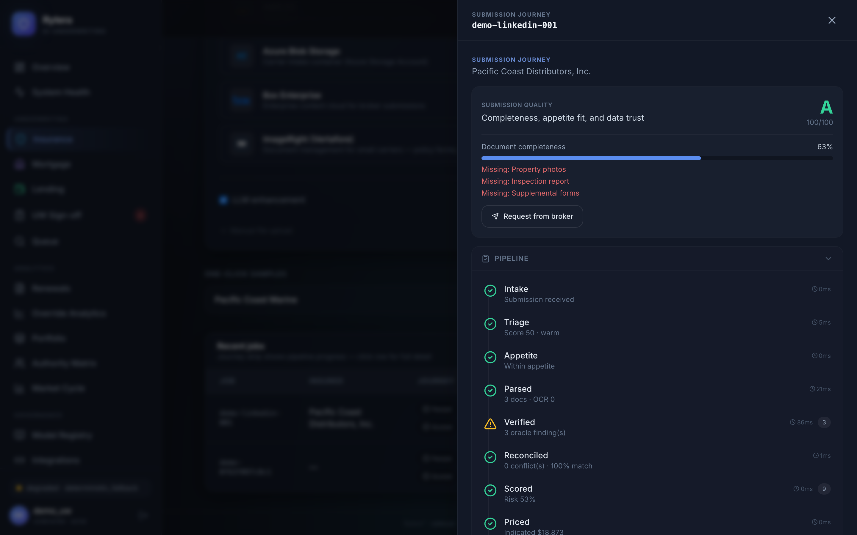
Submission journey panel
Click any job to open the Submission Journey — the core differentiator of Rytera.
Timeline — stage-by-stage progress with duration and status for each step.
COPE & risk — construction, occupancy, protection, and exposure analysis.
Oracle verification — external data lookups (CLUE, NCCI, A-PLUS, catastrophe models).
Agent findings — specialist AI agents flag risk, compliance, fraud, and loss-run issues.
Reconciliation — cross-document provenance when ACORD, inspection, and loss runs disagree.
Pricing build-up — indicated premium with modifier transparency.
Human checkpoints — licensed UW review gates before bind.
Screenshot: Submission journey drawer for Pacific Coast Distributors
Rytera™ · rytera.ai
6

Slide 7
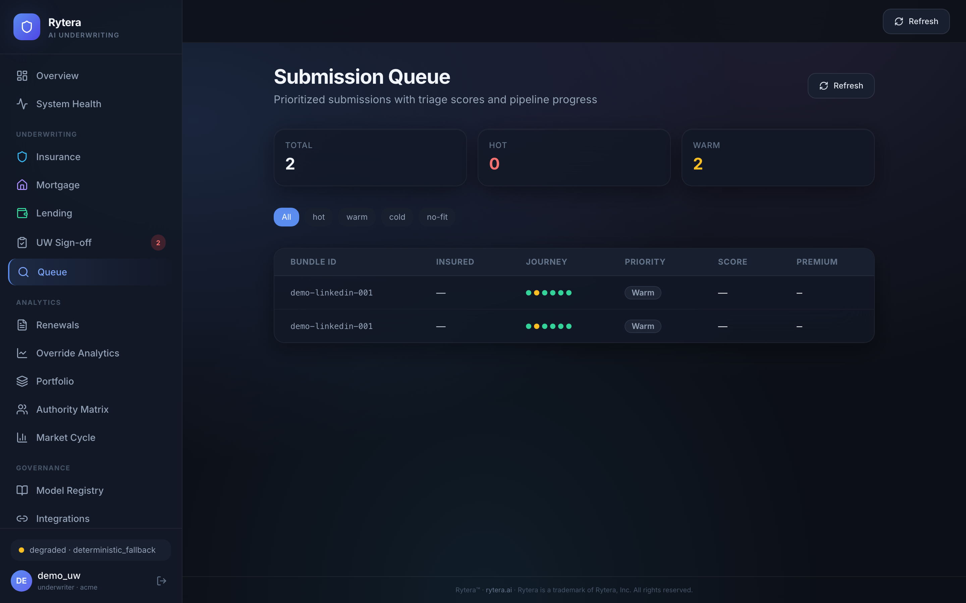
Prioritized submission queue
The Queue prioritizes work so underwriters focus on the highest-value submissions first.
Triage scoring — hot, warm, cold, and no-fit priority bands.
Insured context — name, estimated premium, and bundle ID on every row.
Journey strip — mini pipeline indicator without opening the full drawer.
Click-through — jump directly into the submission journey for any queued item.
Screenshot: Submission queue with triage filters and journey indicators
Rytera™ · rytera.ai
7

Slide 8
Built for production carriers
Rytera is architected for enterprise deployment, not just demos.
Integration gateway — REST adapters for oracles, policy admin, CRM, and ops systems.
Auto / live / simulated modes — demo without credentials; go live when keys are configured.
Role-based access — viewer, underwriter, licensed UW, admin, and CUO roles.
Encrypted audit bundles — regulatory export with SHA-256 manifest for examiners.
Model registry & override analytics — governance for AI-assisted underwriting.
Rytera™ · rytera.ai
8

Slide 9
See the full pipeline — not just the decision
Built for carriers, MGAs, banks, and credit unions
Early product demo available
rytera.ai
Rytera™ · rytera.ai
9

