Slide 1
Nexus — Production Deep Dive
Omnichannel AI agent platform (Chat · Copilot · Voice) with auth, observability, and operations.

Slide 2
Problem & Outcome
CX teams lose speed and accuracy when chat, voice, and internal tools are siloed.
Nexus provides one orchestrator and one console for customer + agent workflows across channels.
Outcomes: faster resolutions, consistent quality, and full operational visibility.
Production baseline: HTTPS, JWT auth, rate limiting, audit logging, backups, systemd operation.
Notes:
Frame the problem in contact-center language (AHT, CSAT, escalations, handoffs).

Slide 3
What We Do (Agentic CX)
AI Agents for Customers: resolve chat/voice inquiries end-to-end (intake → execute → follow-up)
AI Agents for Frontline Teams: copilot assistance with context + next-best actions + drafts
AI Agents for Operations: evaluation, insights, and continuous improvement loops
Shared knowledge layer: RAG retrieval with persistence (Chroma), citations, and guardrails

Slide 4
Architecture (Conceptual)
Browser UI (static) → FastAPI `/api/v1/*`
JWT auth (multi-tenant) gates all production endpoints
Orchestrator routes requests to tools + KB retrieval
Persistence: SQLite + Chroma on free tier (upgrade path: Postgres + Redis)

Slide 5
Production Hardening
APP_ENV=production (docs disabled, demo reset disabled)
AUTH_REQUIRED=true (JWT required for APIs + WS)
Registration closed after bootstrap (ALLOW_REGISTRATION=false)
Admin-only integrations + audit logging
Rate limiting middleware per endpoint group

Slide 6
Operations
systemd: `nexus.service` for reboot-safe uptime
Daily backups: SQLite + Chroma + config (`nexus-backup.timer`)
Edge hardening: Caddy TLS + security headers + CSP
Monitoring: health endpoint + optional Sentry

Slide 7
Integrations (62 native connectors)
Public catalog at /integrations — searchable by category (CRM, ticketing, CCaaS, BI, HRIS, …)
Each connector: encrypted vault credentials, status API, and proxy routes
Examples: HubSpot, Salesforce, Zendesk, Freshdesk, PagerDuty, Snowflake, Epic, Workday
iPaaS webhooks (n8n/Zapier) alongside native adapters for lifecycle events

Slide 8
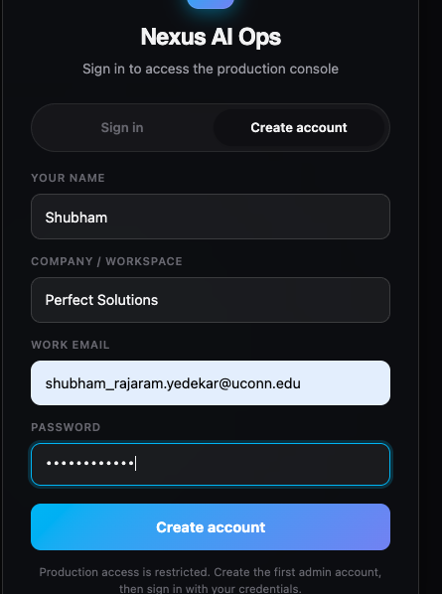
Product UI — Example 1
Auth gate: sign-in / create account
Notes:
Screenshot: image-2b57a9b6-9666-4e93-9ab4-fc5db0f6141b.png
Explain what the viewer is seeing, what problem this UI solves, and how it connects to the backend APIs.

Slide 9
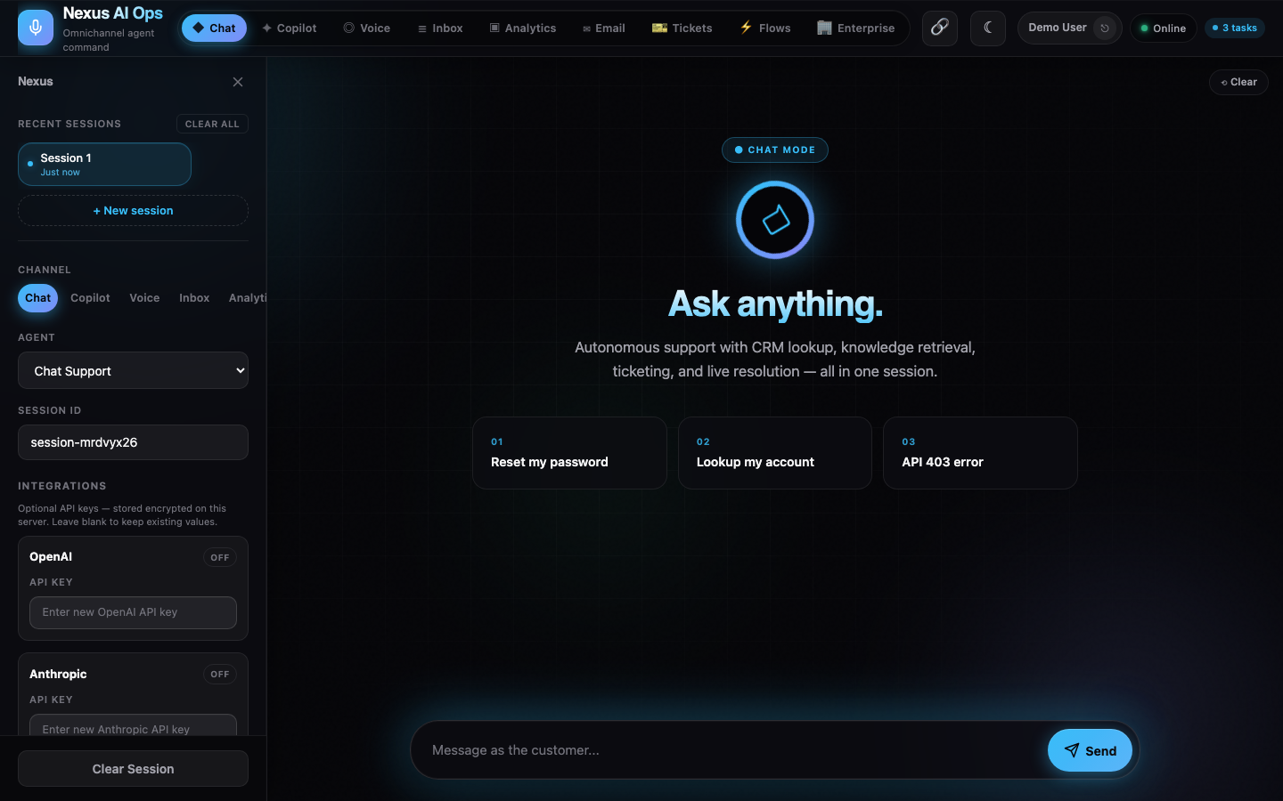
Product UI — Example 2
Nexus console UI (chat / copilot / voice)
Notes:
Screenshot: 01-chat.png
Explain what the viewer is seeing, what problem this UI solves, and how it connects to the backend APIs.

Slide 10
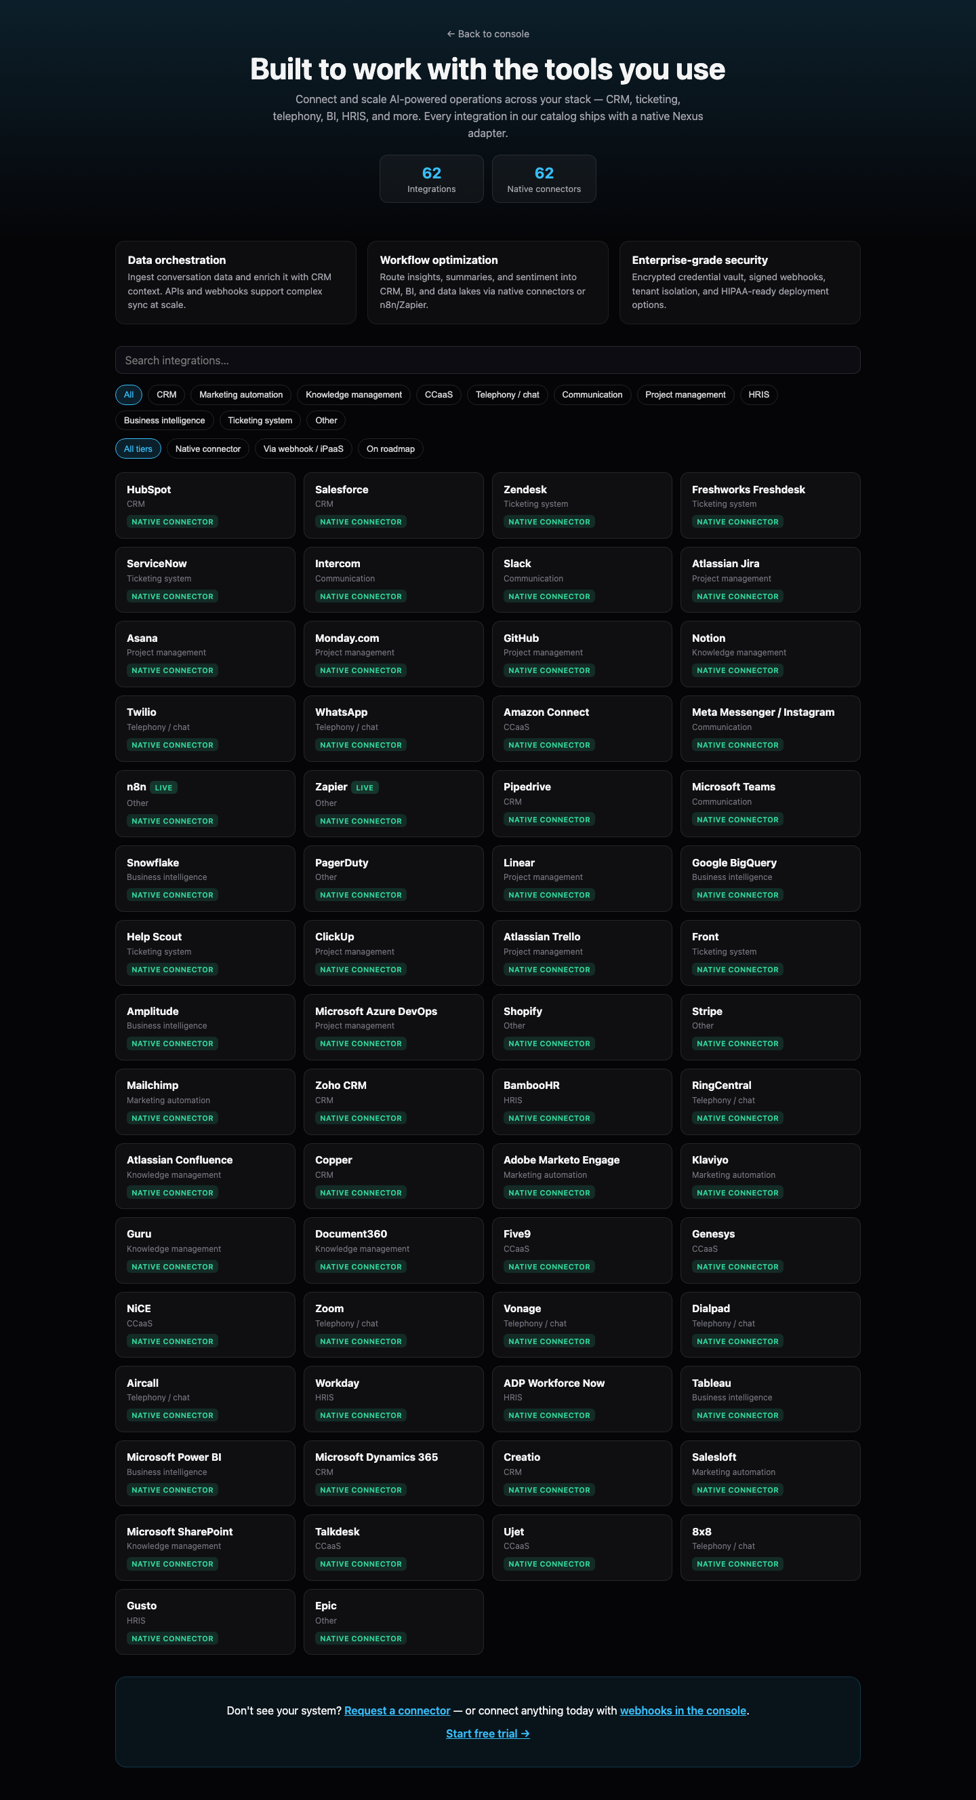
Product UI — Example 3
Integrations catalog — 62 native connectors (CRM, CCaaS, BI, HRIS, and more)
Notes:
Screenshot: 04-integrations.png
Explain what the viewer is seeing, what problem this UI solves, and how it connects to the backend APIs.

Slide 11
Why This Helps Industry
62 native integrations — CRM, ticketing, telephony, BI, and HRIS out of the box
Composable platform: swap LLMs, connectors, and automation flows
Clear security posture: auth-first, encrypted vault, audit log
Operational maturity: backups, systemd, health checks, 215+ automated tests

Slide 12
Next Steps
Move to Oracle Always Free Ampere A1 (still $0) for Postgres + Redis
Add admin UI for user provisioning (instead of API-only)
Add WAF/bot protection (Cloudflare) and alerting dashboards

