Slide 1
Predicting Eligibility for Social Welfare Schemes using Machine Learning
CAPSTONE PROJECT
Name- Shubham Srivastava
Faculty Name- Aman Srivastava
College Name-Haridwar University,
Department-CSE (Data Science)

Slide 2
OUTLINE
Problem Statement
Proposed System/Solution
System Development Approach
Algorithm & Deployment
Result
Conclusion
Future Scope
References

Slide 3
Problem Statement
The National Social Assistance Programme (NSAP) is a major social welfare initiative by the Government of India that provides financial assistance to elderly persons, widows, and persons with disabilities belonging to Below Poverty Line (BPL) households.
NSAP consists of multiple sub-schemes such as old-age pension, widow pension, and disability pension, each having different eligibility criteria based on age, gender, marital status, disability status, income level, and other socio-economic factors.
Currently, the process of verifying applications and assigning the correct welfare scheme is largely manual. This manual process is time-consuming, prone to human errors, and may lead to delays or incorrect allocation of benefits. Such issues can prevent deserving beneficiaries from receiving timely financial assistance.
Therefore, there is a need for an automated system that can accurately predict the most appropriate NSAP scheme for an applicant using demographic and socio-economic data.

Slide 4
Proposed Solution
The proposed system aims to automate the eligibility prediction process for NSAP schemes using machine learning techniques. The system will analyze applicant data such as age, gender, marital status, disability status, income category, and district-level information to predict the most suitable NSAP scheme.
Key Highlights
Machine learning–based multi-class classification
Fully deployed on IBM Cloud Lite Services
Secure, scalable, and reliable cloud architecture
Real-time prediction support for large-scale applicants
The system uses applicant demographic and socio-economic data to predict the most appropriate NSAP scheme with high accuracy, ensuring fair, fast, and transparent welfare delivery.
This system will help reduce delays, minimize human errors, and ensure fair and efficient distribution of social welfare benefits.

Slide 5
System Approach
1. Data Ingestion
    NSAP dataset uploaded to IBM Cloud Object Storage
2. Data Preprocessing (IBM Watson Studio)
1. Handling missing values
2. Encoding categorical attributes
3. Feature selection and normalization
3. Model Training
1. Multi-class classification model trained in Watson Studio
2. Hyperparameter tuning for improved accuracy
4. Model Deployment
1. Trained model deployed using IBM Watson Machine Learning
5. Prediction & Output
1. Applicant data sent via API
2. Predicted NSAP scheme returned instantly

Slide 6
Algorithm & Deployment
1. Algorithm Used
  Decision Tree / Random Forest / Logistic Regression
  (Multi-class classification)
2.. Why These Algorithms?
1. Handle categorical and numerical data effectively
2. Interpretable decision-making
3. Suitable for government and policy-based applications
3. Training Process
1. Dataset split into training and testing sets
2. Model trained using historical NSAP records
3. Performance optimized using hyperparameter tuning
4. Evaluated using accuracy and confusion matrix

Slide 7
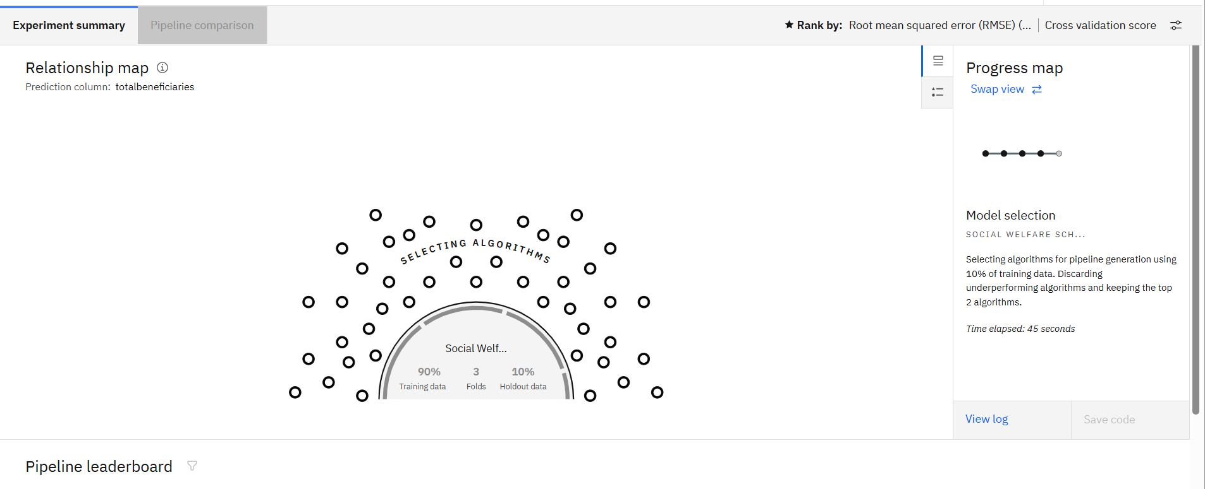
Result

Slide 8
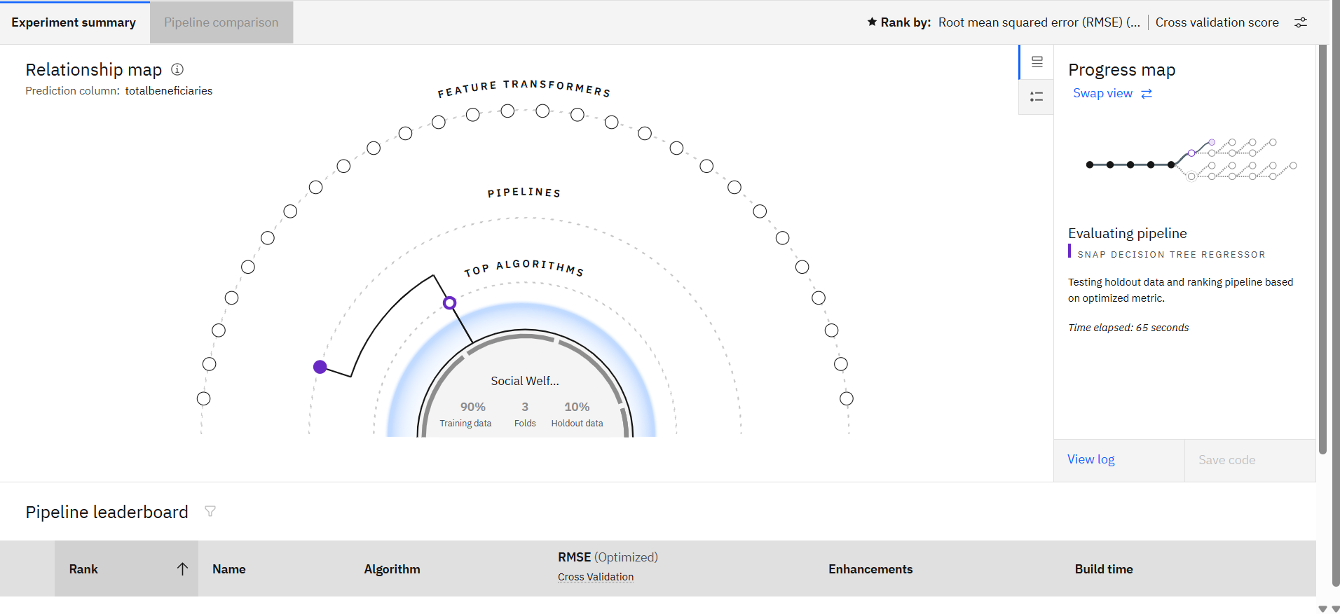

Slide 9
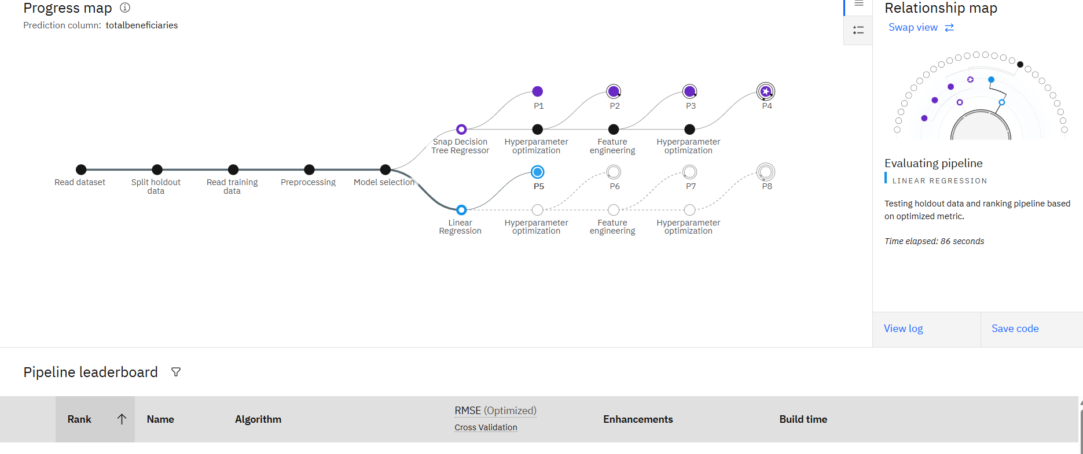

Slide 10
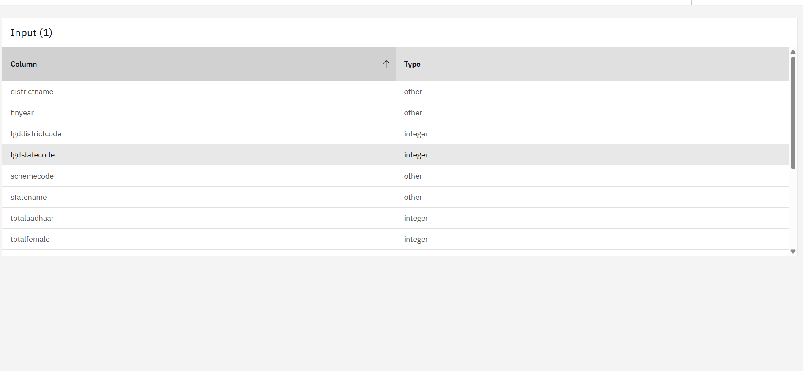

Slide 11
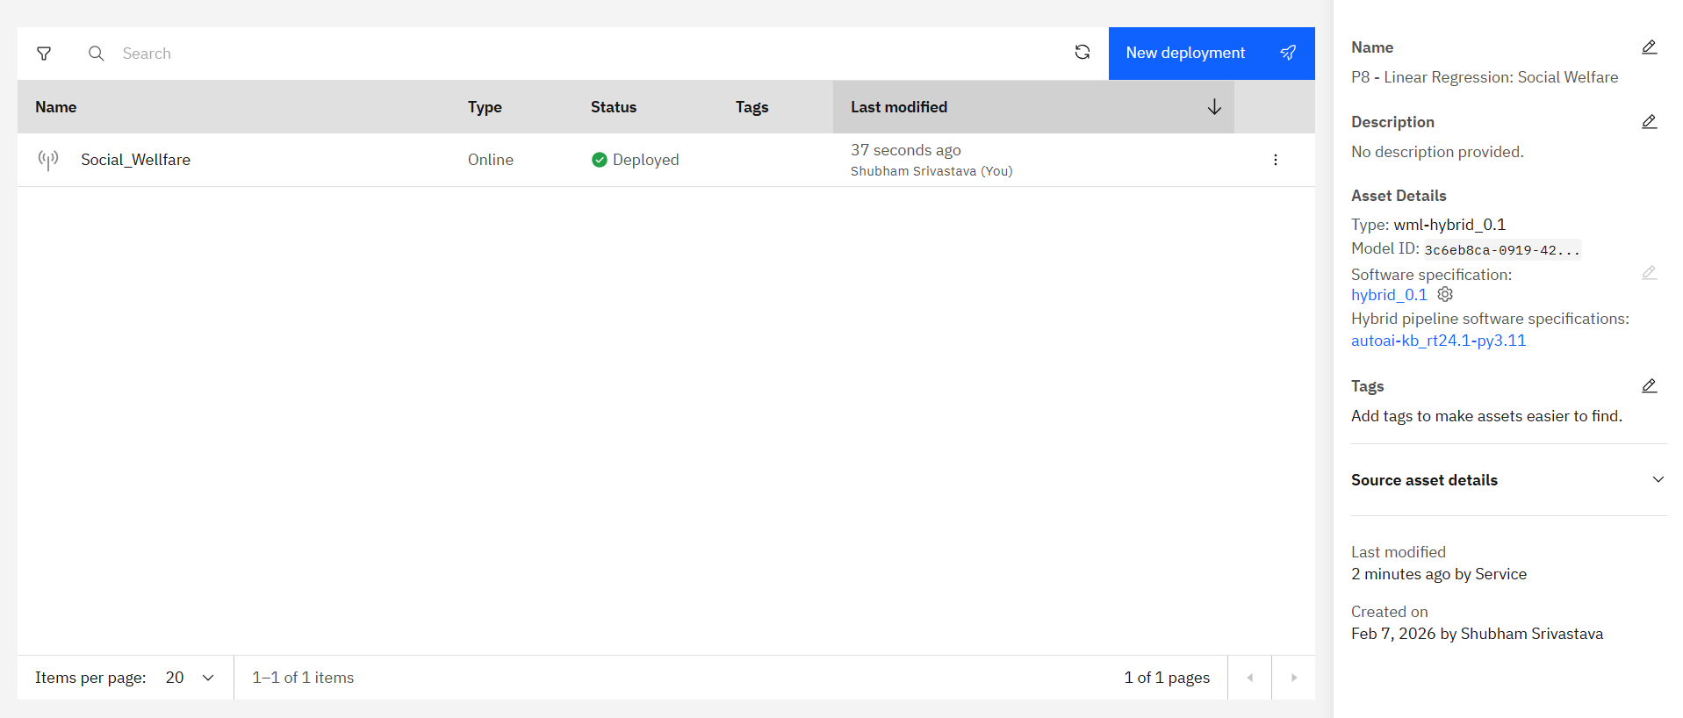

Slide 12
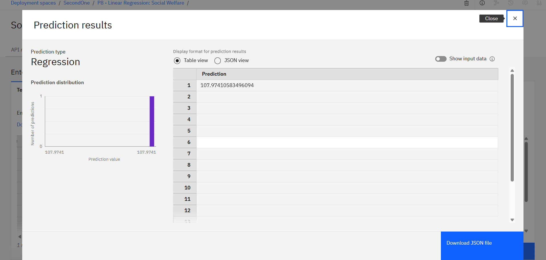

Slide 13
Conclusion
This project successfully demonstrates a cloud-based artificial intelligence solution for social welfare eligibility prediction under the National Social Assistance Programme. By leveraging machine learning techniques, the system automates complex eligibility determination processes that are traditionally handled manually. The integration of IBM Cloud services provides a secure, scalable, and enterprise-grade platform for model training, deployment, and inference. Overall, the system enhances efficiency, accuracy, and transparency in government service delivery. The project highlights the potential of IBM Cloud and AI technologies to create impactful, scalable solutions that address real-world social challenges and improve public welfare outcomes.

Slide 14
Future scope
In the future, the proposed system can be enhanced by integrating it with real-time government databases such as Aadhaar-linked welfare records and state-level pension portals to enable live data validation and instant eligibility assessment. The prediction accuracy and robustness of the system can be further improved by incorporating advanced artificial intelligence techniques such as Gradient Boosting algorithms and Deep Learning models. The solution can be scaled on IBM Cloud to support nationwide deployment and extended to include multiple social welfare schemes beyond NSAP, enabling a unified welfare management platform. Additionally, the development of citizen-facing web and mobile applications can allow applicants and government officials to interact with the system more efficiently. To ensure inclusivity and accessibility, multilingual support can be implemented so that beneficiaries from diverse linguistic backgrounds can easily access and understand the services provided by the system.

Slide 15
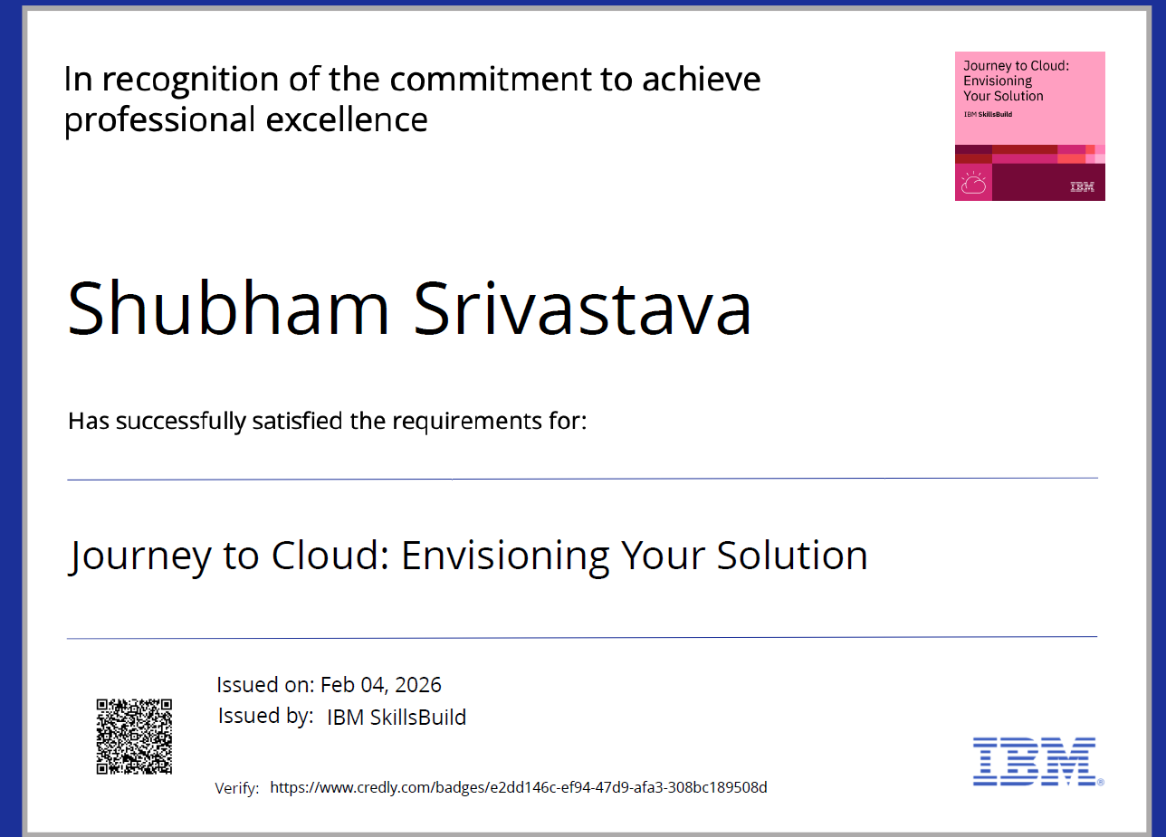
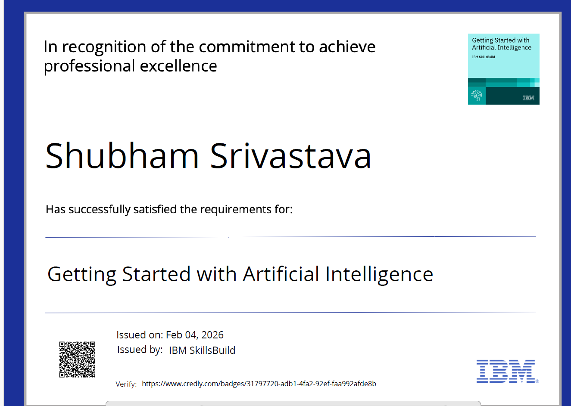
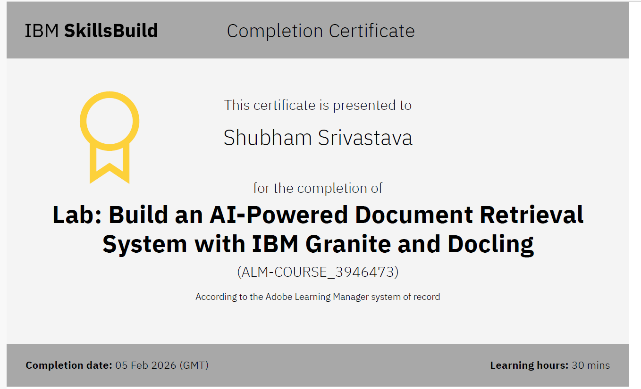
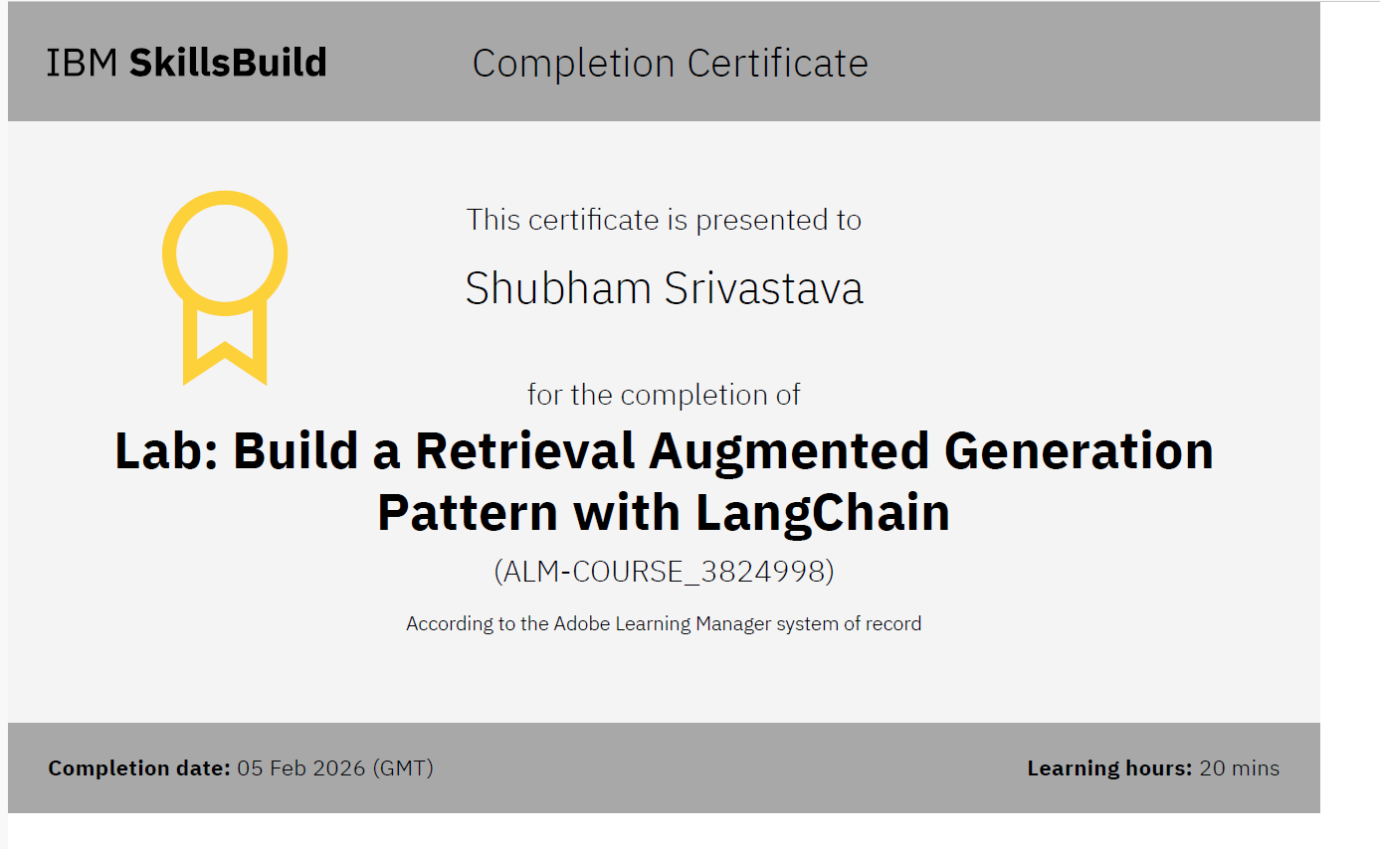
Certificates

Slide 16
Github
https://github.com/ShubhamS2005/IBM_Edunet_Project

Slide 17
THANK YOU

